Slide 1
GANDHINAGAR INSTITUTE OF TECHNOLGY
Information Technology Department
Big Data Analytics (2171607)
Understanding i/o and o/p of MapReduce -Data Serialization
Prepared By:
Patel Maulik Satishkumar (150124116006)
Guided By: Prof. Prakash B. Patel

Slide 2
Content
  Why MapReduce ?
  What is MapReduce ?
  Inputs and Outputs of MapReduce
  MapReduce Example
  What is Data Serialization ?
  Data Serialization in Java & Hadoop

Slide 3





Why MapReduce ?
Traditional Approach of Big Data Processing
Input
Blocks
Results
Big Data
Split Data
Matches
Output
Split Data
Matches
All Matches
Split Data
Matches
Split Data
Matches
High Processing Power is required
Large no. of Computer Systems are required
We have to write code for individual block.
Splitting & Merging is difficult to manage

Slide 4
Why MapReduce ?
Process lots of data.
  Google processed about 24 petabytes of data per day in 2009.
A single machine cannot serve all the data
  You need a distributed system to store and process in parallel.
Parallel programming?
  Threading is hard!
  How do you facilitate communication between nodes?
  How do you scale to more machines?
  How do you handle machine failures?

Slide 5
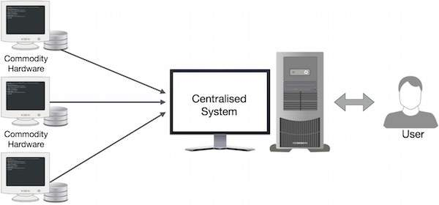
What is MapReduce ?
MapReduce divides a task into small parts and assigns them to many computers. Later, the results are collected at one place and integrated to form the result dataset.

Slide 6
What is MapReduce ?
Hadoop MapReduce is a software framework for easily writing applications which process huge amounts of data in-parallel on large clusters of commodity hardware in a reliable and fault-tolerant manner.
MapReduce = Map + Reduce
(Mapper) (Reducer)
Mappers read in data from the file system, and output (typically) modified data.
Reducers collect all of the mappers output on the keys, and output (typically) reduced data.
The outputted data is written to disk.
All data is in terms of key value pairs.

Slide 7
What is MapReduce ?
The MapReduce algorithm consists two important tasks, namely Map and Reduce.
  Map Task : It takes set of data and convert it into another set of data, where individual elements are broken down into tuples (key-value pairs).
  Reduce Task : It takes the outputs from the Map as an input and combines those data tuples (key-value pairs) into a smaller set of tuples. The reduce task is always performed after the map job.

Slide 8
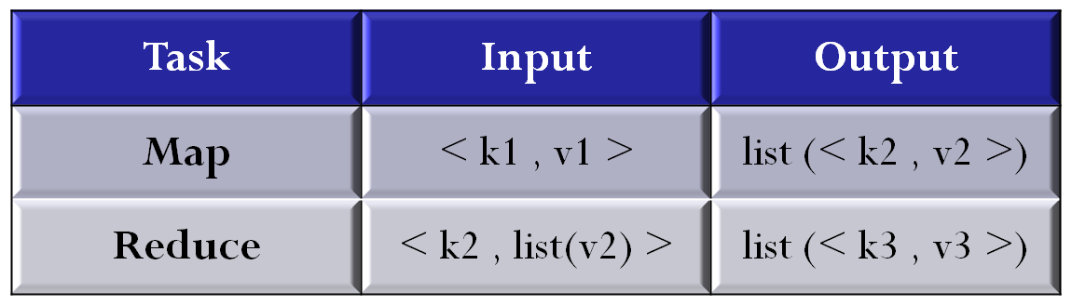
Inputs & Outputs of MapReduce
The MapReduce framework operates on < key, value > pairs , that is , the framework views the input as a set of < key, value > pairs and produces a set of < key, value > pairs as the output.

Slide 9












MapReduce Example
Splitting
Mapping
Shuffling
Reducing
Final
Result
Input
Bear , 1
Bear , 1
Bear , 2
Dear , 1
Bear , 1
River , 1
Dear Bear River
Car , 1
Car , 1
Car , 1
Car , 3
Bear , 2
Car , 3
Deer , 2
River , 2
Dear Bear River
Car Car River
Deer Car Beer
Car , 1
Car , 1
River , 1
Car Car River
Deer , 1
Deer , 1
Deer , 2
Deer , 1
Car , 1
Beer , 1
Deer Car Beer
River , 1
River , 1
River , 2
The overall MapReduce for Word Count Process

Slide 10
What is Data serialization ?
Serialization is the process of translating data structures or objects state into binary or textual form to transport the data over network or to store on some persistent storage.
Once the data is transported over network or retrieved from the persistent storage, it needs to be deserialized again.
Serialization is termed as marshalling and deserialization is termed as unmarshalling.

Slide 11
Data serialization in Java & Hadoop
Java provides mechanism, called object serialization where an object can be represented as a sequence of bytes that includes the object’s data as well as information about the object’s type and the types of data stored in the object.
In Hadoop, the concept of serialization is used for Interprocess communication and Persistence storage.
Persistence storage is a digital storage facility that does not lose its data with the lose of power supply.
Ex:- Magnetic disks and Hard Disk Drives.

Slide 12



