Slide 1
GANDHINAGAR INSTITUTE OF TECHNOLGY
Information Technology Department
.NET Technology (2160711)
Modifiers, Properties and Indexers,
Attributes & Reflection API
Prepared by-
Patel Maulik Satishkumar (150124116006)
Guided By: Prof. Dhaval D. Vaja

Slide 2
Content
  Modifiers
  Property
  Indexers
  Attributes
  Reflection API

Slide 3
Modifiers
Access Modifiers are keywords used to specify the scope (declared accessibility) of a member or a type.
Access Modifiers are an integral part of object-oriented programming.
They support the concept of encapsulation, which promotes the idea of hiding functionality.
Access Modifiers allow you to define, who does or doesn’t have access to certain features.

Slide 4
Modifiers
There are five types of access modifiers are used in C# :
    Private
    Public
    Protected
    Internal
    Protected Internal
Private :
  Private members are accessible only within the body or scope of the class in which they are declared. (by default any member is default)
  We can declare class, method, property, structure and interfaces – as private.

Slide 5
Modifiers
Public :
  Public members are accessible from anywhere in program or application.
  There is no restriction to access public access modifiers.
  We can declare class, method, property, structure and interfaces – as public.
Internal :
  Internal members are accessible only within the same namespace/assembly/project scope in which they are declared.
  We can declare class, method, property, structure and interfaces – as internal.

Slide 6
Modifiers
Protected :
  Protected members are accessible within the body or scope of the class in which they are declared.
  And also accessible within the Derived Class (Child Class) of that Base Class (Parent Class) in same or different namespace/assembly/project .
  We can declare class, method, property, structure and interfaces – as protected.

Slide 7
Modifiers
Protected Internal :
  Protected Internal members of any class are accessible within the same namespace/assembly/project scope in which they are declared.
  And also accessible within the Derived Class (Child Class) of that Base Class (Parent Class) in same or different namespace/assembly/project .
  We can declare class, method, property, structure and interfaces – as protected internal.

Slide 8


Modifiers
 | Same namespace/assembly/project |  |  | Other namespace/assembly/project
 | Same Class | Derived Class | Non-Derived Class | Derived Class | Non-Derived Class
Private
Protected
Internal
Protected Internal
Public
Scope
Access
Modifier

Slide 9
Properties
Properties are named members of classes, structures and interfaces. Member variables or methods in a class or structures are called Fields.
Properties are an extension of fields and are accessed using the same syntax. They use accessors through which the values of the private fields can be read, written or manipulated.
Properties do not name the storage locations. Instead, they have accessors that read, write or compute their values.

Slide 10
Properties
For example, let us have a class named Student, with private field for name. We cannot directly access these field from outside the class scope, but we can have properties for accessing these private fields.
So, to access this private (hidden) field outside the class we will use this concept of Properties.

Slide 11

Properties
using System;
namespace Properties
{
class Student
{
private string name = "not known";
public string Name // Declare a Name property of type string
{
get
{
return name;
}
set
{
name = value ;
}
}

Slide 12


Properties
public override string ToString()
{
return "Name = " + Name;
}
}
class Demo
{
public static void Main()
{
Student S = new Student(); // Create a new Student object
S.Name = “Maulik"; // Setting name of the student
Console.WriteLine("Student Info: {0}", S);
Console.ReadKey();
}
}
}
Student Info: name=Maulik

Slide 13
Indexers
Indexer concept is object act as an array.
Indexer is an object to be indexed in the same way as an array.
Indexer modifier can be private, public, protected or internal.
The return type can be any valid C# types.
Indexers in C# must have at least one parameter. Else the compilation error.

Slide 14
Indexers
using System;
using System.Collections;
namespace Indexers
{
class ParentClass
{
private string[ ] range = new string [5];
public string this [int indexrange]
{
get
{
return range [indexrange];
}
set
{
range [ indexrange] = value;
}

Slide 15


Indexers
//The Above Class just act as array declaration using this pointer
}
}
class Childclass
{
public static void Main()
{
ParentClass obj = new ParentClass();
//The Above Class ParentClass create one object name is obj
obj [0] = "ONE";
obj [1] = "TWO";
obj [2] = "THREE";
Console.WriteLine("{0} ,{1} ,{2}", obj [0], obj [1],obj [2]);
Console.ReadLine();
}
}
}
ONE, TWO, THREE

Slide 16
Attributes
An attribute is a declarative tag that is used to convey information to runtime about the behaviors of various elements like classes, methods, structures, enumerators, assemblies etc.
You can add declarative information to a program by using an attribute. A declarative tag is depicted by square ([ ]) brackets placed above the element it is used for.
Attributes are used for adding metadata, such as compiler instruction and other information such as comments, description, methods and classes to a program.

Slide 17

Attributes
The .NET Framework provides two types of attributes:
    The Pre-defined Attributes
    The Custom built attributes
Syntax for specifying an attribute is as follows:
Name of the attribute and its values are specified within the square brackets, before the element to which the attribute is applied.
Positional parameter specify the essential information and the name parameters specify the optional information.
  [ attribute ( positional_parametres, name_parameter = value,…) ]
  {
  Element ;
  }

Slide 18
Reflection API
Reflection objects are used for obtaining type information at runtime.
.NET Framework's Reflection API allows fetching type (assembly) information at runtime programmatically.
The classes that give access to the metadata of a running program are in the System.Reflection namespace.
The System.Reflection namespace contains classes that allow you to obtain information about the application and to dynamically add types, values, and objects to the application.

Slide 19
Reflection API
Applications of Reflections are as follows:
    It allows view attribute information at runtime.
    It allows examining various types in an assembly and instantiate these types.
    It allows late binding to methods and properties.
    It allows creating new types at runtime and then performs some tasks using those types.

Slide 20
Reflection API
Reflection enables us to use code that is not available at compile time.
.NET Reflection allows an application to collect information about itself and also to manipulate on itself.
With Reflection, we can dynamically create an instance of a type, bind the type to an existing object, or get the type from an existing object and invoke its methods or access its fields and properties.
We can also access attribute information using Reflection.

Slide 21
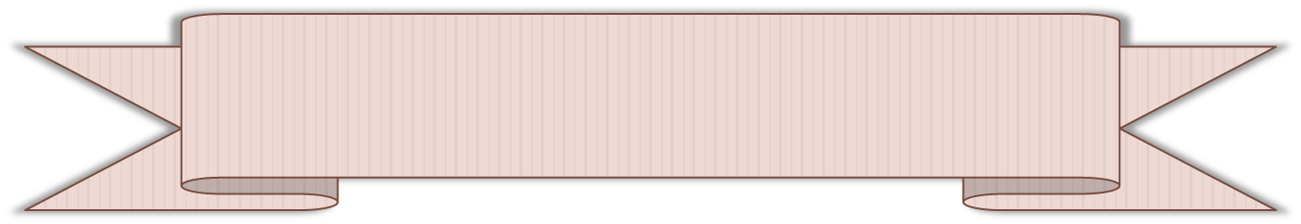
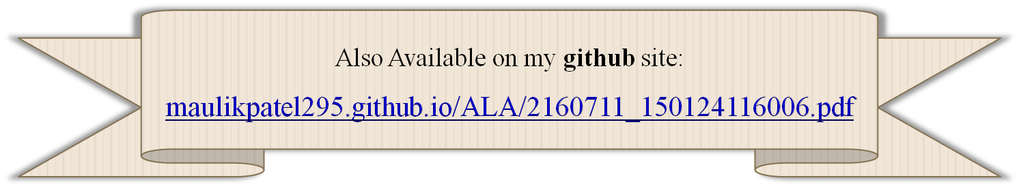
References
Accessed [01/02/2018]. Available :
  https://www.tutorialspoint.com/

Slide 22


