Slide 1
GANDHINAGAR INSTITUTE OF TECHNOLGY
Information Technology Department
Software Engineering (2160701)
Six Sigma for SE and SQA Plan
Prepared by-
Patel Maulik Satishkumar (150124116006)
Guided By: Prof. Bhumi M. Shah

Slide 2


Slide 3
Content
  Definition
  History
  Goals of Six Sigma
  Where can Six Sigma be applied?
  ‘Six Sigma’ companies
  Concept of ‘Six Sigma’
  Roles in ‘Six Sigma’ team
  Methods of ‘Six Sigma’
    DMAIC (Define-Measure-Analyze-Improve-Control)
    DMADV (Define-Measure-Analyze-Design-Verify)

Slide 4
Definition
Six Sigma is management technique developed by Motorola in 1986.
A scientific and practical method to achieve improvements in a company.
It is a set of tools & techniques for process improvement which focuses on quality improvement and waste reduction. Which results in better faster and cost effective products and services.

Slide 5

History
  "Born" at Motorola from Art Sundry's criticism of the company's quality.
  As a result Motorola found out that better quality is cheaper.
  Bill Smith developed the particulars in 1986.

Slide 6
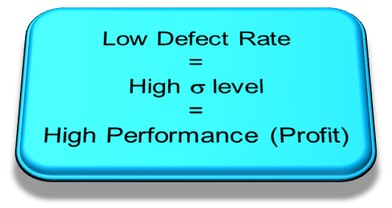
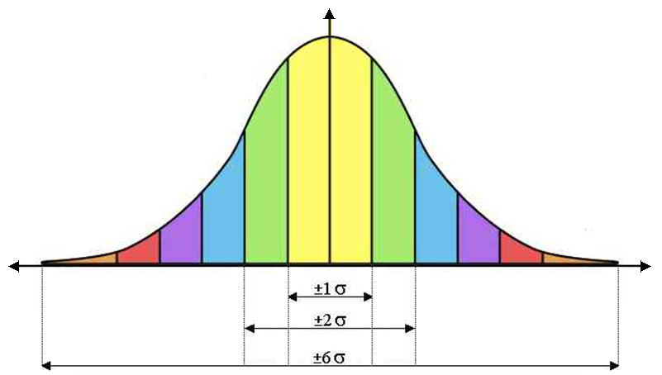
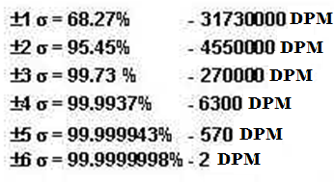
Goals of Six Sigma
To achieve Six Sigma, a process must not produce more than 3.4 defects per million opportunities (99.99966%).
Raise customer satisfaction.
Less customer service costs.
Defect Rate

Slide 7
Where can Six Sigma be applied?
Service
Management
Design
Six Sigma
Methods
Administration
Purchase
IT
Quality
Depart.
Production

Slide 8


‘Six Sigma’ companies
Six Sigma is developed by Bill Smith in 1986.
GE
Microsoft
SONY
Whirlpool
Black & Decker
Ford
Honeywell
Nissan

Slide 9




‘Six Sigma’ companies
Companies who have successfully adopted ‘Six Sigma’ strategies include:

Slide 10
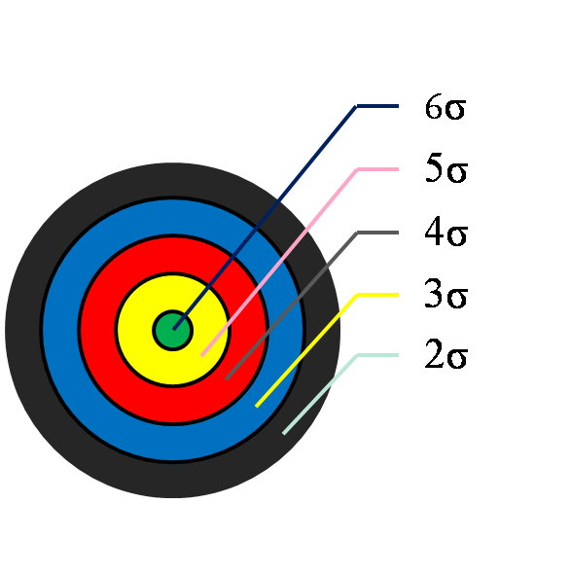





Concept of ‘Six Sigma’
σ-level | Defect rate (ppm) | Costs of poor quality | Status of the company
6 | 3.4 | < 10% of turnover | World class
5 | 233 | 10-15% of turnover
4 | 6210 | 15-20% of turnover | Current standard
3 | 66807 | 20-30% of turnover
2 | 308537 | 30-40% of turnover | Bankruptcy

Slide 11
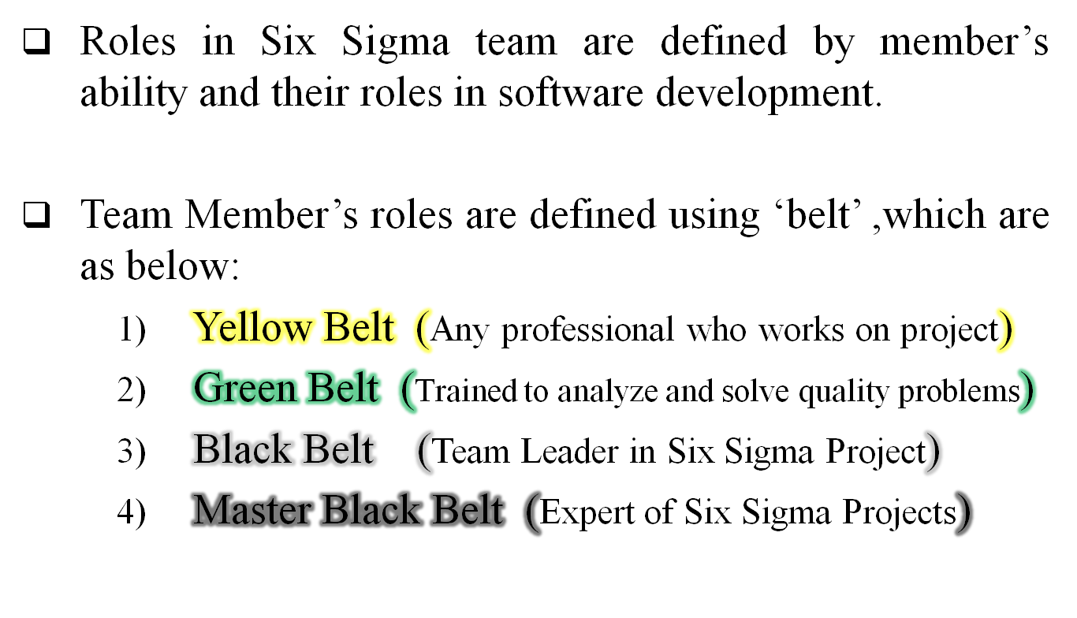
Roles in ‘Six Sigma’ team

Slide 12
Methods of ‘Six Sigma’
There are two methods for achieving Six Sigma in any process: (1). DMAIC
(2). DMADV
DMAIC
  Define-Measure-Analyze-Improve-Control
  Used for improvement of system for existing processes.
  Focus on Execution of Process.
DMADV
  Define-Measure-Analyze-Design-Verify
  Used for improvement of system for developing new processes or products.
  Focus on Design of Process.

Slide 13
DMAIC Method
Design Phase :
  In this phase, First we define– “Who is the customer and what are their needs (requirements)”.
Measure Phase :
  In this phase, we determine– “How is the process defined and how are defects measured”.
Analyze Phase :
  In this phase, we determine– “What are the most important causes of defects”.

Slide 14
DMAIC Method
Improve Phase :
  In this phase, we determine- “How can the causes of the defects be eliminated”.
  Finding the solution to reduce the defects.
Control Phase :
  In this phase, we determine– “What actions are needed to sustain improvement”.
  Determine different techniques for better performance.

Slide 15
DMADV Method
Design Phase :
  In this phase, First we define– “Who is the customer and what are their needs (requirements)”.
Measure Phase :
  In this phase, we determine– “How is the process defined and how are defects measured”.
Analyze Phase :
  In this phase, we determine– “What are the most important causes of defects”.

Slide 16
DMADV Method
Design Phase :
  In this phase, we consider following terms-
    optimize the design and plan for design verification
    Specification Limits
    Simulation Model
    Measurement and Control Plan
Verify Phase :
  In this phase, we consider following terms-
    Implement the production process
    Build testing model (pilot)
    Set up pilot runs (testing)
    Verify the result of testing

Slide 17


Slide 18
Content
  What is SQA ?
  What is SQA Plan ?
  Quality Factors
  Benefits of SQA

Slide 19
What is SQA ?
SQA stands for Software Quality Assurance.
Software Quality Assurance is an activity that is applied throughout the software process and it works parallel with software development.
SQA is simply a way to assure quality in the software.
Software Quality Assurance is also called Software Quality Management technique which defines the qualities of any software.

Slide 20
What is SQA Plan ?
SQA Plan is a plan developed by team members as part of project planning and which is reviewed by all stakeholders.
SQA Plan contain Software Quality Assurance techniques for software.
Quality assurance actions performed by the software engineering team and the SQA group are governed by the plan.

Slide 21
What is SQA Plan ?
SQA Plan provides roadmap for instituting SQA.
SQA Plan works as a template for SQA activities that are instituted for each software project.

Slide 22
Quality Factors
Here is the list of quality factors which affects the quality of software:
  Reliability (Is the software has precision?)
  Efficiency (includes efficiency of resource utilization)
  Portability (Is the software is portable?)
  Usability (Is the software easy in use and operate? )
  Reusability (Is the software can use in other application?)
  Maintainability (Is the software easy to maintain?)
  Correctness (Are requirements & objectives satisfied?)

Slide 23
Benefits of SQA
SQA produce High Quality Software and those are beneficial.
High quality application means short development time.
High quality application saves time and cost.
Better reliability and no maintenance for long time.
High quality commercial software increase market share of company.

Slide 24
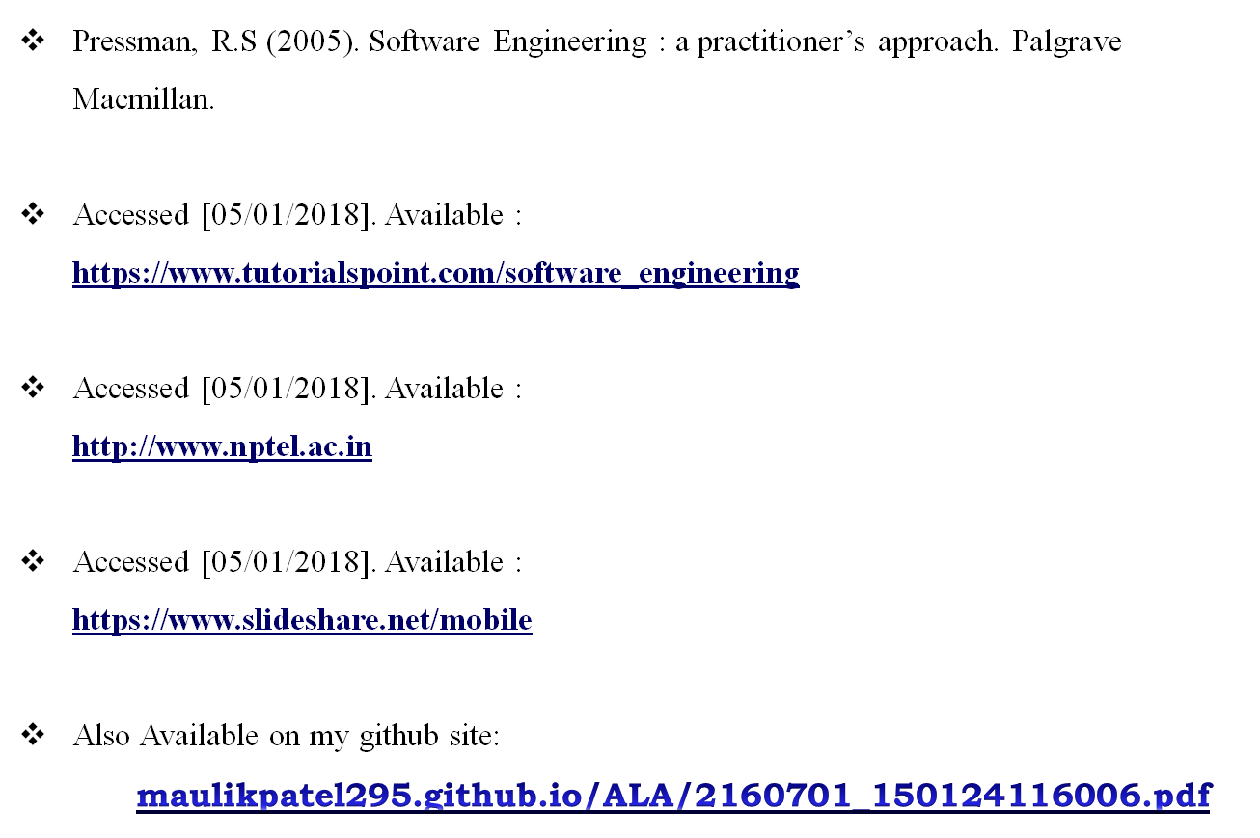
References

Slide 25


