Slide 1
GANDHINAGAR INSTITUTE OF TECHNOLGY
Information Technology Department
Software Engineering (2160701)
Six Sigma for SE and SQA Plan
Prepared by-
Patel Maulik Satishkumar (150124116006)
Guided By: Prof. Bhumi M. Shah

Slide 2
Six Sigma
2

Slide 3
Content
Definition
History
Goals of Six Sigma
Where can Six Sigma be applied?
‘Six Sigma’ companies
Concept of ‘Six Sigma’
Roles in ‘Six Sigma’ team
Methods of ‘Six Sigma’
DMAIC (Define-Measure-Analyze-Improve-Control)
DMADV (Define-Measure-Analyze-Design-Verify)
3

Slide 4
Definition
Six Sigma is management technique developed by Motorola in 1986.
A scientific and practical method to achieve improvements in a company.
It is a set of tools & techniques for process improvement which focuses on quality improvement and waste reduction. Which results in better faster and cost effective products and services.
4

Slide 5
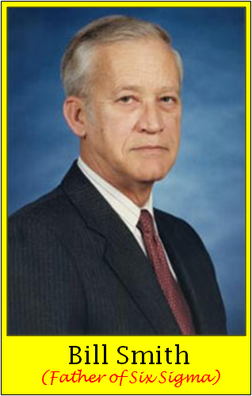
History
"Born" at Motorola from Art Sundry's criticism of the company's quality.
As a result Motorola found out that better quality is cheaper.
Bill Smith developed the particulars in 1986.
5

Slide 6
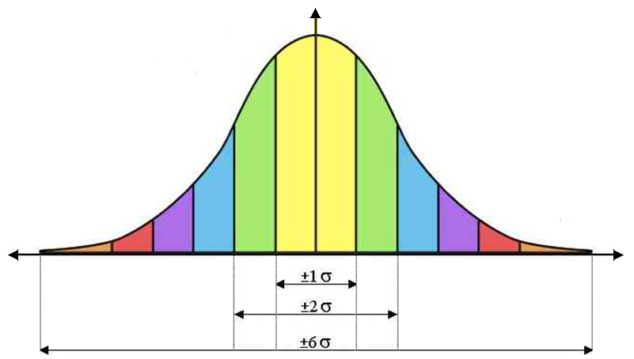
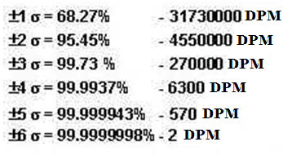
Goals of Six Sigma
To achieve Six Sigma, a process must not produce more than 3.4 defects per million opportunities (99.99966%).
Raise customer satisfaction.
Less customer service costs.
Low Defect Rate
=
High σ level
=
High Performance (Profit)
Defect Rate
6

Slide 7
Where can Six Sigma be applied?
Service
Management
Design
Six Sigma
Methods
Administration
Purchase
IT
Quality
Depart.
Production
7

Slide 8
‘Six Sigma’ companies
Motorola
Six Sigma is developed by Bill Smith in 1986.
Early Adopters of Six Sigma
GE
Microsoft
SONY
Whirlpool
Black & Decker
Ford
Honeywell
Nissan

Slide 9




‘Six Sigma’ companies
Companies who have successfully adopted ‘Six Sigma’ strategies include:
9

Slide 10
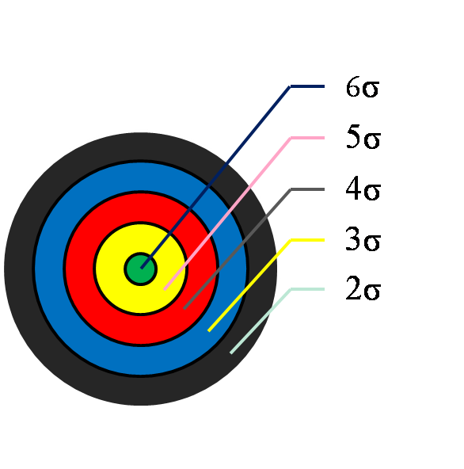
Concept of ‘Six Sigma’
σ-level | Defect rate (ppm) | Costs of poor quality | Status of the company
6 | 3.4 | < 10% of turnover | World class
5 | 233 | 10-15% of turnover
4 | 6210 | 15-20% of turnover | Current standard
3 | 66807 | 20-30% of turnover
2 | 308537 | 30-40% of turnover | Bankruptcy
Profit
Defect
6σ
10

Slide 11
Roles in ‘Six Sigma’ team
Roles in Six Sigma team are defined by member’s ability and their roles in software development.
Team Member’s roles are defined using ‘belt’ ,which are as below:
Yellow Belt (Any professional who works on project)
Green Belt (Trained to analyze and solve quality problems)
Black Belt (Team Leader in Six Sigma Project)
Master Black Belt (Expert of Six Sigma Projects)
11

Slide 12
Methods of ‘Six Sigma’
There are two methods for achieving Six Sigma in any process: (1). DMAIC
(2). DMADV
DMAIC
Define-Measure-Analyze-Improve-Control
Used for improvement of system for existing processes.
Focus on Execution of Process.
DMADV
Define-Measure-Analyze-Design-Verify
Used for improvement of system for developing new processes or products.
Focus on Design of Process.
12

Slide 13
DMAIC Method
Design Phase :
In this phase, First we define– “Who is the customer and what are their needs (requirements)”.
Measure Phase :
In this phase, we determine– “How is the process defined and how are defects measured”.
Analyze Phase :
In this phase, we determine– “What are the most important causes of defects”.
13

Slide 14
DMAIC Method
Improve Phase :
In this phase, we determine- “How can the causes of the defects be eliminated”.
Finding the solution to reduce the defects.
Control Phase :
In this phase, we determine– “What actions are needed to sustain improvement”.
Determine different techniques for better performance.
14

Slide 15
DMADV Method
Design Phase :
In this phase, First we define– “Who is the customer and what are their needs (requirements)”.
Measure Phase :
In this phase, we determine– “How is the process defined and how are defects measured”.
Analyze Phase :
In this phase, we determine– “What are the most important causes of defects”.
15

Slide 16
DMADV Method
Design Phase :
In this phase, we consider following terms-
optimize the design and plan for design verification
Specification Limits
Simulation Model
Measurement and Control Plan
Verify Phase :
In this phase, we consider following terms-
Implement the production process
Build testing model (pilot)
Set up pilot runs (testing)
Verify the result of testing
16

Slide 17
SQA Plan
17

Slide 18
Content
What is SQA ?
What is SQA Plan ?
Quality Factors
Benefits of SQA
18

Slide 19
What is SQA ?
SQA stands for Software Quality Assurance.
Software Quality Assurance is an activity that is applied throughout the software process and it works parallel with software development.
SQA is simply a way to assure quality in the software.
Software Quality Assurance is also called Software Quality Management technique which defines the qualities of any software.
19

Slide 20
What is SQA Plan ?
SQA Plan is a plan developed by team members as part of project planning and which is reviewed by all stakeholders.
SQA Plan contain Software Quality Assurance techniques for software.
Quality assurance actions performed by the software engineering team and the SQA group are governed by the plan.
20

Slide 21
What is SQA Plan ?
SQA Plan provides roadmap for instituting SQA.
SQA Plan works as a template for SQA activities that are instituted for each software project.
21

Slide 22
Quality Factors
Here is the list of quality factors which affects the quality of software:
Reliability (Is the software has precision?)
Efficiency (includes efficiency of resource utilization)
Portability (Is the software is portable?)
Usability (Is the software easy in use and operate? )
Reusability (Is the software can use in other application?)
Maintainability (Is the software easy to maintain?)
Correctness (Are requirements & objectives satisfied?)
22

Slide 23
Benefits of SQA
SQA produce High Quality Software and those are beneficial.
High quality application means short development time.
High quality application saves time and cost.
Better reliability and no maintenance for long time.
High quality commercial software increase market share of company.
23

Slide 24
References
Pressman, R.S (2005). Software Engineering : a practitioner’s approach. Palgrave Macmillan.
Accessed [05/01/2018]. Available : https://www.tutorialspoint.com/software_engineering
Accessed [05/01/2018]. Available :
http://www.nptel.ac.in
Accessed [05/01/2018]. Available : https://www.slideshare.net/mobile06yq7_GdzzkkeGivrfKioj
Also Available on my github site:
maulikpatel295.github.io/ALA/2160701_150124116006.pdf
24

Slide 25
THANK
YOU
25

