Slide 1
GANDHINAGAR INSTITUTE OF TECHNOLGY
Information Technology Department
Advanced JAVA (2160707)
Overview to Servlet and Servlet Life Cycle
Prepared by :
Patel Maulik Satishkumar (150124116006)
Guided By: Prof. Prashant N. Jani

Slide 2
Content
  Overview
  What is Servlet ?
  How to create Servlet ?
  Servlet Life-Cycle
  Servlet Example

Slide 3
Overview
The word servlet is made-up of two word “serv means Server” and “let means Component”.
Servlet is a server component which is responsible to create dynamic content according to client request.
Servlet is used to create dynamic webpage and to fetch the data from database.
Servlet works at back-hand of system.

Slide 4
What is Servlet ?
Servlet is a Java object which resides within a servlet engine. A servlet engine is usually contained within a web server.
Servlets are Java objects which respond to HTTP requests. Servlets may return data of any type but they often return HTML.
Servlets are invoked through a URL which means that a servlet can be invoked from a browser.

Slide 5
How to create Servlet ?
We can create servlet by using these three ways:
  By extending HttpServlet class
  By extending GenericServlet class
  By implementing Servlet interface
  public class Servlet_Name extends HttpServlet
  public class Servlet_Name extends GenericServlet
  public class Servlet_Name implements Servlet

Slide 6


How to create Servlet ?
  Servlets must provide and implementation for doGet, doPost or both.
  All Servlets must import the following packages:
public void doXXX(HttpServletRequest request, HttpServletResponse response) throws ServletException, IOException
  import java.io.*;
  import javax.servlet.*;
  import javax.servlet.http.*;

Slide 7
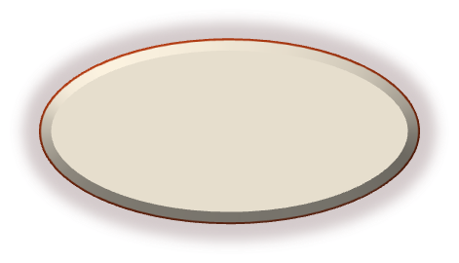
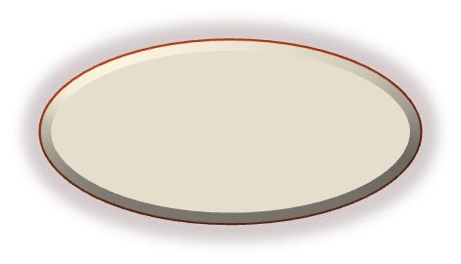
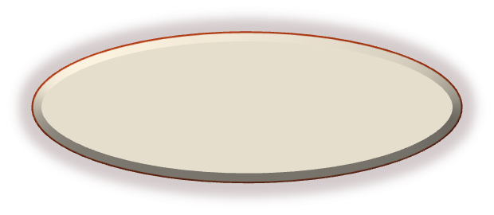





Servlet Life-Cycle
Servlet
.class
Instantiation
new(…)
Garbage Collection
finalize(...)
Client Request
Initialization
init(…)
Destruction
destroy(…)
Ready
service(...)
Form Analysis
doXXX(…)

Slide 8
Servlet Life-Cycle
The client enters the URL in the web browser and makes a request. Then the browser generates the HTTP request and sends it to the Web Server.
Web Server maps this request to the corresponding Servlet using web.xml file (deployment descriptor).
The servlet basically invokes the init( ) method of servlet. This method is called only when the servlet is loaded in the memory for the first time.

Slide 9
Servlet Life-Cycle
Server can invoke the service for particular HTTP request using service( ) method. Then Servlets can read the data provided by the HTTP request with the help of service( ) method.
In the life cycle of servlet there are three important methods.
These methods are: (1). init ( )
(2). service ( )
(3). destroy ( )

Slide 10

Servlet Life-Cycle
init() method :
The init method is called when the servlet is first created and it is used for one-time initializations.
This method invokes only one time.
public void init( ) throws ServletException
{
// Initialization code...
}

Slide 11

Servlet Life-Cycle
service() method :
Each time the server receives a request for a servlet, the server handle that request by calling particular service.
The service method checks the HTTP request type (GET, POST, PUT, DELETE etc.) and calls doGet, doPost, doPut, doDelete etc.
public void service( ) throws ServletException
{
// Service code...
}

Slide 12
Servlet Life-Cycle
destroy() method :
Finally server unloads the servlet from the memory using the destroy( ) method.
This method also invokes only one time.
public void destroy ( )
{
// Destruction code...
}

Slide 13

Servlet Example
import java.io.*;
import javax.servlet.*;
import javax.servlet.http.*;
public class LifeCycle_Demo extends HttpServlet
{
public void init( ) throws ServletException
{
System.out.println("init() Method...");
}
Simple Servlet program with init( ) , service( ) and destroy( ) method.

Slide 14

Servlet Example
public void service( ServletRequest req, ServletResponse res) throws ServletException,IOException
{
System.out.println("service() method...");
System.out.println("Welcome to Servlet.");
System.out.println("This is my First Servlet")
}
public void destroy()
{
System.out.println("destroy() method...");
}
}

Slide 15
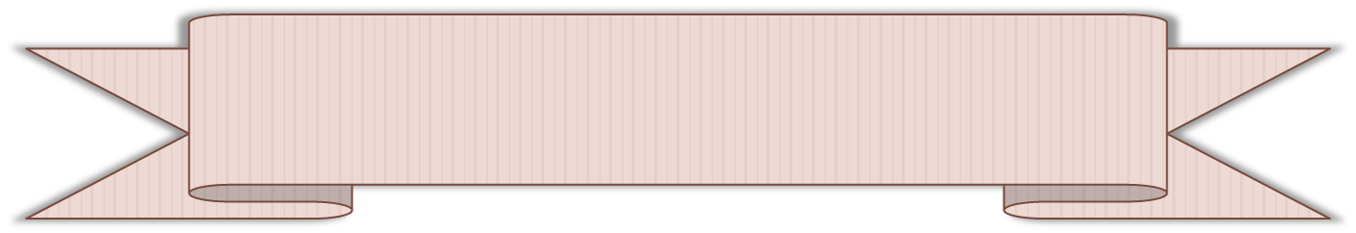
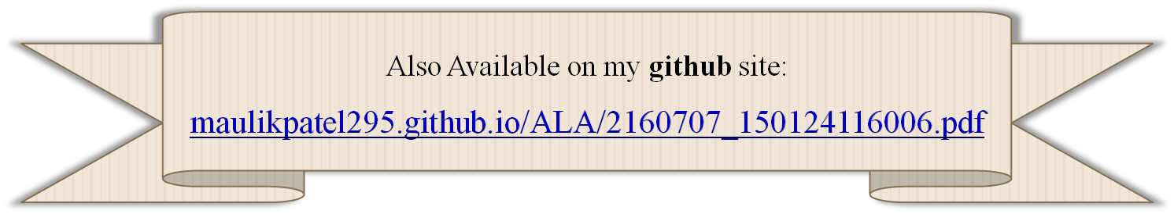
References
Accessed [01/02/2018]. Available :
  https://www.tutorialspoint.com/

Slide 16


