Slide 1

LLM-Powered Distributed
System Simulator
Team 14-LLM Study
Mauli Pandya-035134097
Karthik Kumar Reddy Bobbala-033694360

Slide 2
Problem
How can we simulate real-world distributed systems when they are dynamic and unpredictable?
REAL SYSTEMS
How can we simulate real-world distributed systems?
• Systems are dynamic
• Workloads are bursty
• Failures are complex
• Testing is costly
Need adaptive simulation
Expensive
Risky
Hard to scale
Not realistic enough
Team 14 · LLM Study
2

Slide 3
Motivation
Why are traditional simulators not enough?
Why are traditional simulators not enough?
• Fixed rules
• No adaptability
• No context-awareness
• Fail in real scenarios
Static ≠ real systems
Static rules
Dynamic reality
Need smarter approach
Bursty, adaptive, context-aware behavior
Team 14 · LLM Study
3

Slide 4
Objective
Build a hybrid simulator
• Workload generation
• Failure modeling
• Log analysis
Deterministic engine
(event-driven execution)
LLM reasoning
(bounded layer)
+
How do we improve simulation?
• Hybrid approach
• Deterministic = control
• LLM = reasoning
• Used for workloads, failures
Balance realism + control
Team 14 · LLM Study
4

Slide 5
Key Contributions
Hybrid simulation framework
Combines deterministic execution with LLM-assisted reasoning
Performance trade-off analysis
Latency, throughput, utilization, recovery and LLM overhead
GitHub pipeline
scripts → results → plots
LLM-based modules
Workload generation, failure modeling, semantic log analysis
Reproducible via GitHub
Scripts, results, plots and implementation artifacts
Modular architecture
Agents and bounded reasoning layer improve control
Team 14 · LLM Study
5

Slide 6
Why combine rules with LLM?
Deterministic
LLM
Stable & repeatable
Adaptive & intelligent
Traditional simulators provide control and repeatability, while LLMs introduce adaptability and context-awareness
Hybrid = control + flexibility
Team 14 · LLM Study
6

Slide 7
Architecture
Deterministic simulation core with bounded LLM reasoning
Workload
Generator
Simulation Engine
Deterministic event scheduling
Cluster
Manager
Network
Model
Failure
Injection
LLM Module
Bounded reasoning + validation
Log Analyzer
Anomalies + root cause
Team 14 · LLM Study
7

Slide 8
Workflow
1
2
3
4
5
6
Generate workload
Inject failures
Run simulation
Collect logs
Analyze using LLM
Output metrics
LLM is applied only at key decision points to enhance realism without affecting deterministic execution.
LLM adds reasoning only at high-value points — workloads, failures, and logs
Team 14 · LLM Study
8

Slide 9
Workload Generation
Traditional
LLM
• Static
• Predictable
• Fixed distributions
• Dynamic
• Bursty
• Realistic
LLM-generated workloads better reflect real-world bursty traffic patterns compared to static distributions.
LLM-generated workloads better approximate bursty production traffic
Team 14 · LLM Study
9

Slide 10
Failure Modeling
LLM
• Node failures
• Network partitions
• Cascading failures
• Generates realistic scenarios
• Adapts failures dynamically
• Keeps validation deterministic
Adaptive failure scenarios improve evaluation of system resilience under realistic conditions.
Fault trigger
Impact model
Recovery
Team 14 · LLM Study
10

Slide 11
Log Analysis
Collect logs
Process logs
Detect anomalies
LLM
• Root cause analysis
• Meaningful insights
• Semantic interpretation of patterns
LLM enables semantic understanding of logs, helping identify root causes beyond simple pattern detection.
Team 14 · LLM Study
11

Slide 12
Experimental Setup
Nodes
16–128
GPUs
8 per node
Latency
0.5–10 ms
Bandwidth
10–200 Gbps
Runs: static vs hybrid · seeds 7, 21, 42 · 120 ticks · target 4,200 RPS
Team 14 · LLM Study
12

Slide 13
Metrics
Latency
Responsiveness
Throughput
Work completed
Utilization
Resource efficiency
Recovery time
Fault resilience
These metrics together evaluate system performance, efficiency, and resilience under varying conditions.
Together these measure performance, resilience, and efficiency
Team 14 · LLM Study
13

Slide 14
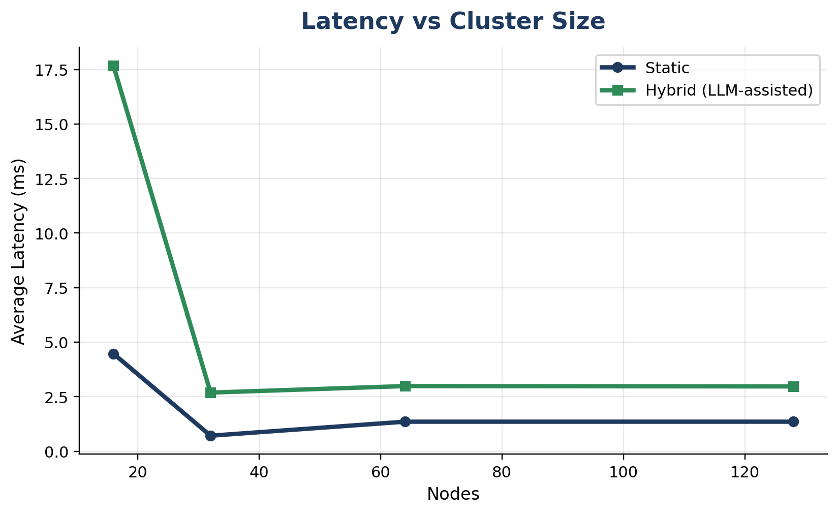
Latency
Key Observations
Hybrid shows higher latency at small scale (~18 ms)
Latency decreases as cluster size increases
Static model maintains consistently low latency
Explanation
LLM inference introduces additional processing delay
At larger scale, workload distribution reduces bottlenecks
Hybrid latency stabilizes near ~3 ms
Trade-off: reasoning adds latency
Data source: benchmark_results.csv generated by scripts/run_experiments.py and scripts/plot_results.py.
Team 14 · LLM Study
14

Slide 15
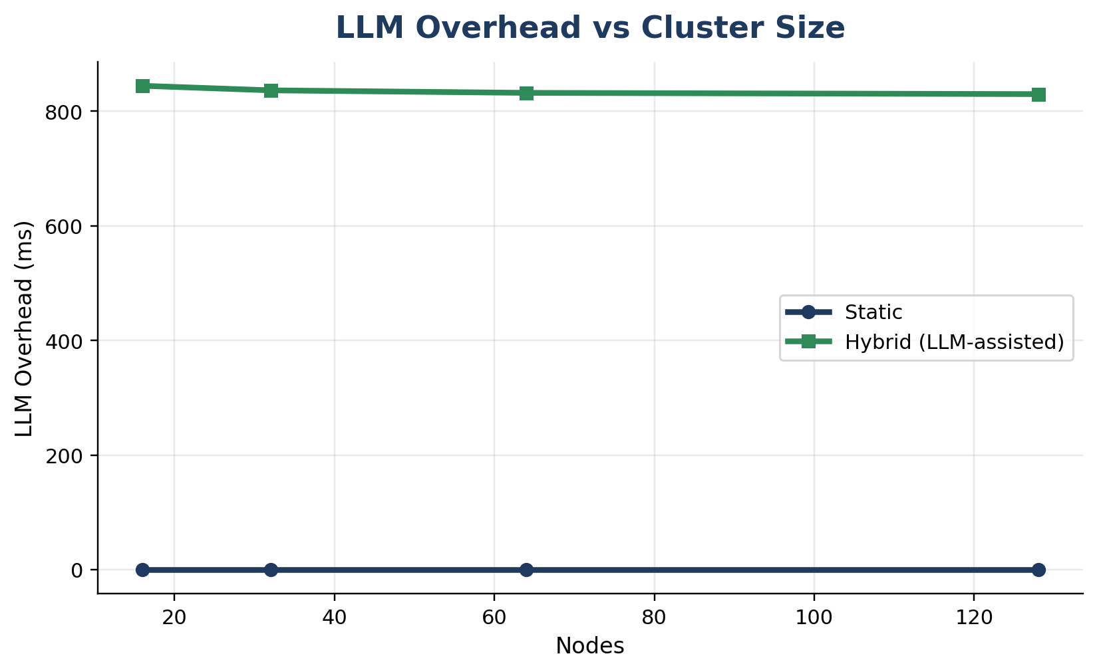
LLM Overhead
Key Observations
LLM overhead ~830–850 ms
Remains constant across all cluster sizes
Explanation
Overhead comes from LLM reasoning steps
Independent of number of nodes
Insight
Bounded reasoning layer ensures predictable cost
LLM used only at critical decision points
Intelligence vs speed
Data source: benchmark_results.csv generated by scripts/run_experiments.py and scripts/plot_results.py.
Team 14 · LLM Study
15

Slide 16
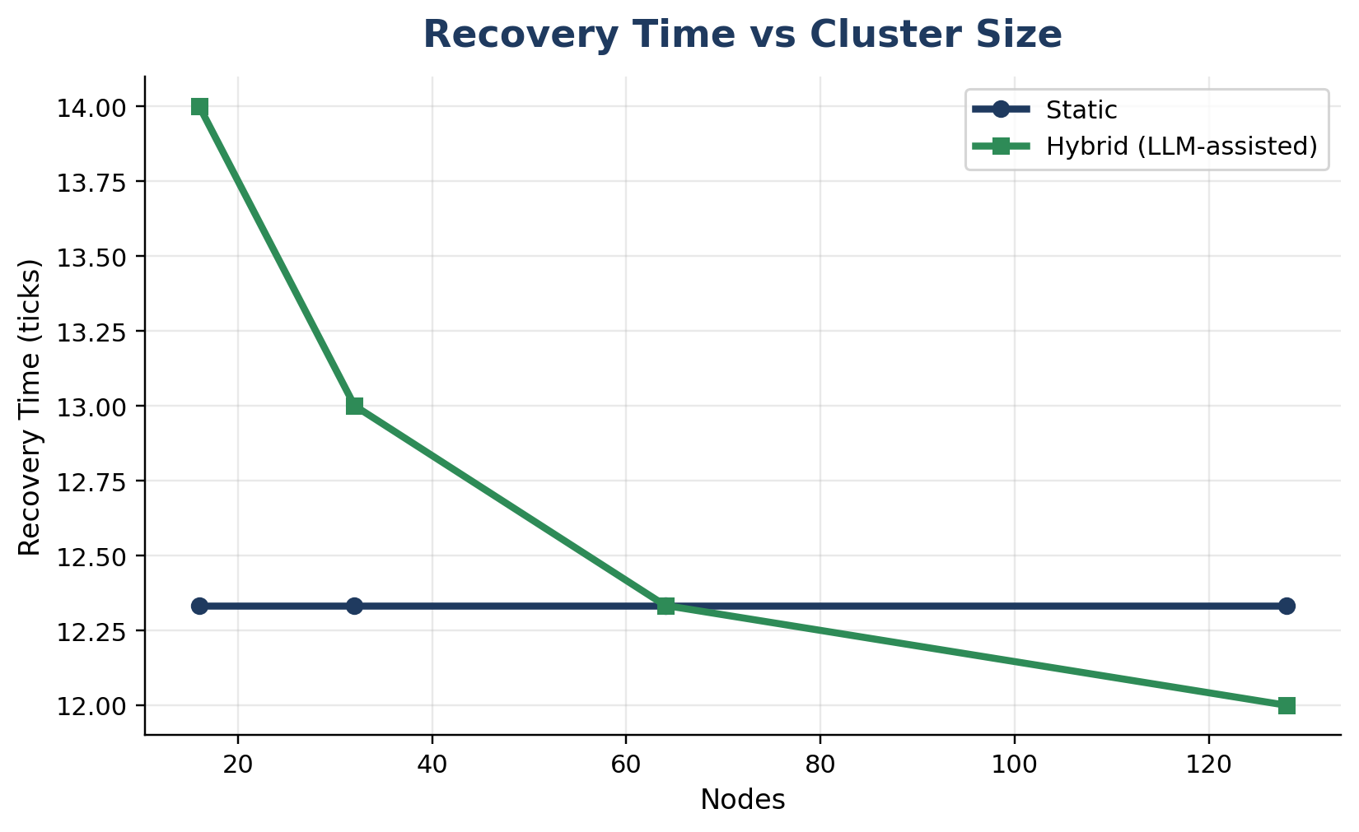
Key Observations
Static recovery remains constant (~12.3 ticks)
Hybrid improves with scale (14 → 12 ticks)
Explanation
LLM enables adaptive failure handling
Better decision-making improves recovery efficiency
Insight
Hybrid system becomes more resilient at scale
Recovery
Resilience improves under adaptive scenarios
Data source: benchmark_results.csv generated by scripts/run_experiments.py and scripts/plot_results.py.
Team 14 · LLM Study
16

Slide 17
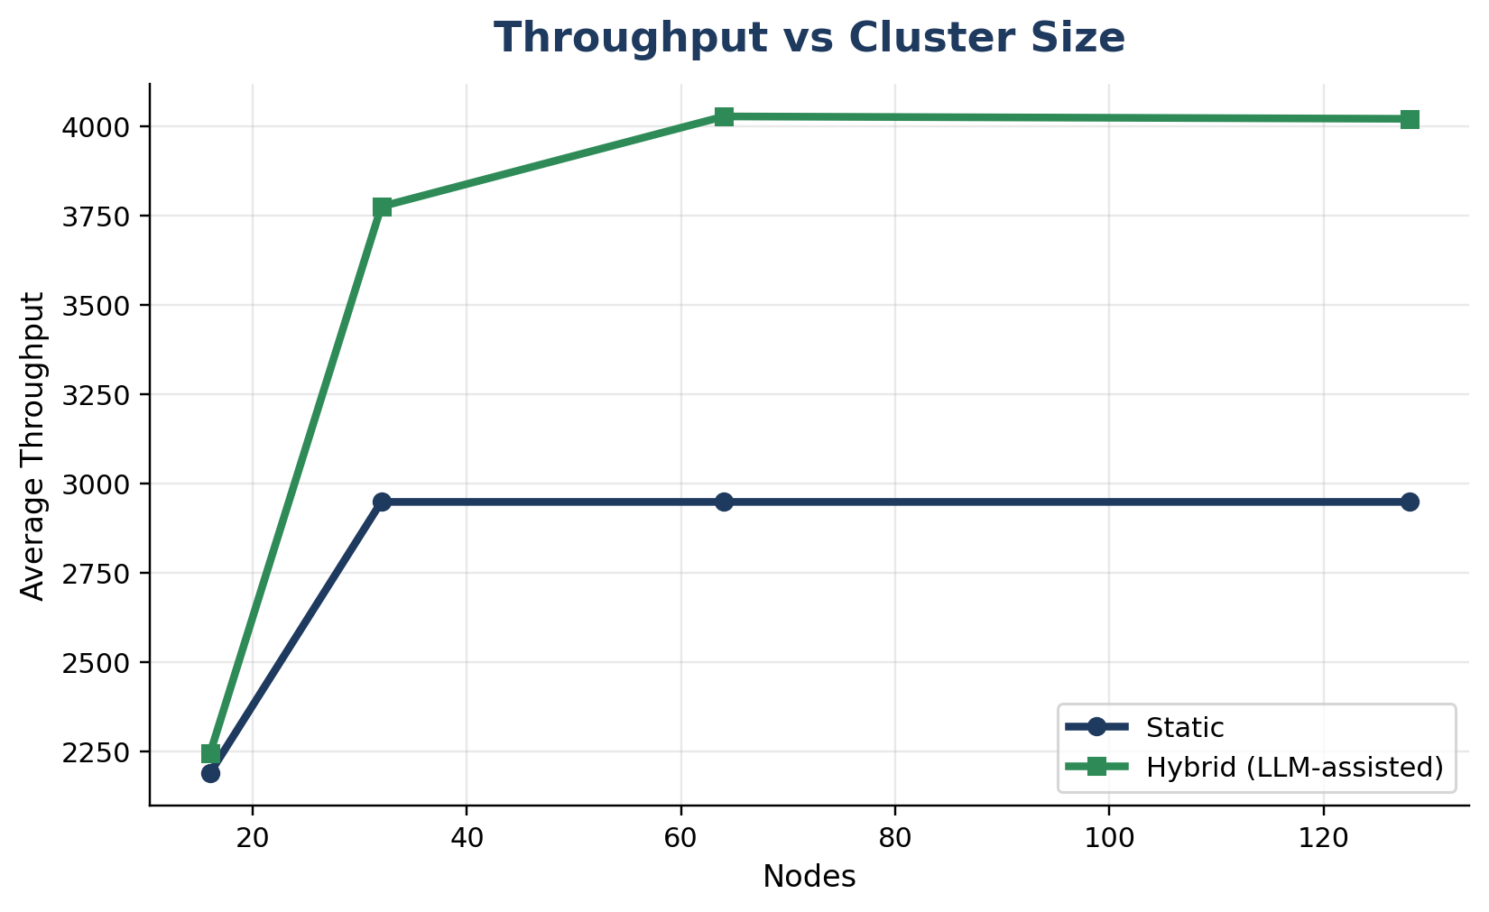
Throughput
Key Observations
Hybrid achieves higher throughput (~4000 RPS)
Static plateaus around ~2950 RPS
Explanation
LLM generates bursty, realistic workloads
Better workload patterns improve system efficiency
Insight
Hybrid approach scales more effectively
LLM-guided workload improves useful work
Data source: benchmark_results.csv generated by scripts/run_experiments.py and scripts/plot_results.py.
Team 14 · LLM Study
17

Slide 18
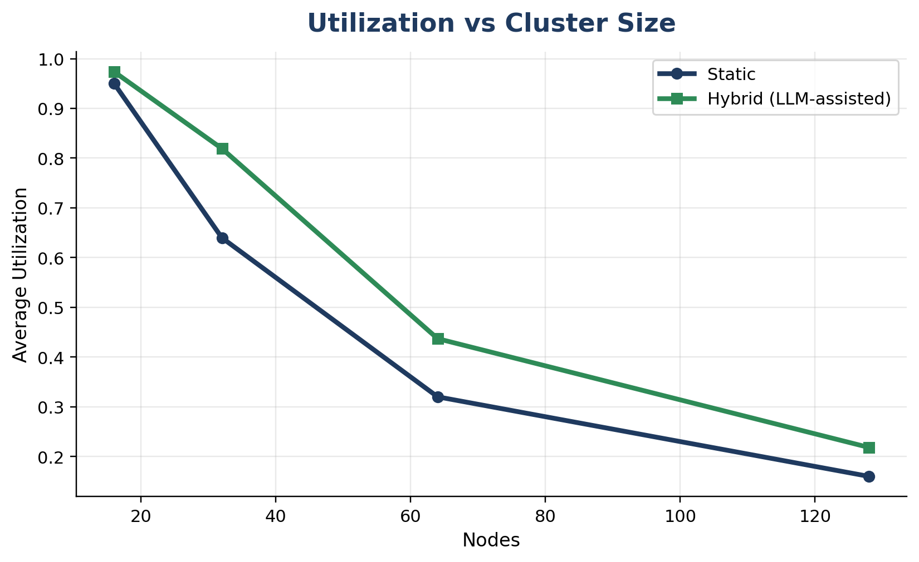
Key Observations
Utilization decreases as cluster size increases
Hybrid consistently higher than static
Explanation
Larger clusters lead to underutilization
LLM workload increases system pressure
Insight
Hybrid improves resource efficiency
Utilization
Hybrid scheduling pressure uses more capacity
Data source: benchmark_results.csv generated by scripts/run_experiments.py and scripts/plot_results.py.
Team 14 · LLM Study
18

Slide 19
Key Findings
• LLM augments simulation
• Modular design improves control
• Context-aware simulation improves realism
• Latency overhead exists
• Best for high-level reasoning
Bounded reasoning layer
Use LLM for planning + interpretation, not low-level numerical execution.
Team 14 · LLM Study
20

Slide 20
Limitations & Future Work
Limitations
Future Work
• LLM latency
• High compute cost
• Validation requirements
• Kubernetes integration
• Real-world workloads
• Multi-agent LLM
• Faster LLM models
Move from simulation-backed evaluation toward production-grade AI-assisted systems
Team 14 · LLM Study
21

Slide 21
Conclusion
What We Built
Hybrid distributed system simulator
Combines deterministic execution + LLM reasoning
Key Results
Better throughput, utilization, and recovery
Trade-off: increased latency
Trade-off: latency
LLM works best as a controlled reasoning layer
LLM-Powered Distributed System Simulator
Team 14 · LLM Study
22

Slide 22


