Slide 1
HOSPITAL MANAGEMENT SYSTEM
GROUP 7
1. Maulshree Verma (Lead)
2. Naga Saiteja Chintakayala
3. Yogesh Nimmagadda
4. Manoj Kumar Thimapuram

Slide 2
PRESENTATION OVERVIEW
PROJECT MOTIVATION
PROJECT DESCRIPTION
PROJECT MODULES
FLOW OF PROJECT
PROJECT FUNCTIONALITY OVERVIEW
PROJECT ENVIRONMENT
PROJECT TEAM ROLES
GANTT CHART
POSSIBLE RISKS
MITIGATION OF RISKS

Slide 3
PROJECT MOTIVATION
There is always a scope to improve when it comes hospital management systems.
This project tends to make the the appointment scheduling process easier.

Slide 4
PROJECT DESCRIPTION
Our Hospital Management System is a web based application which is accessed by the front desk user.
Facilitates the appointment scheduling by checking the doctor availability
Updation of patient’s payment information.
Doctor’s can check his scheduled appointments and can update his availability
Patient’s can check the scheduled appointments and can also provide feedback to the doctor.

Slide 5
PROJECT MODULES
Admin Module
Front Desk User
Doctor
Patient

Slide 6
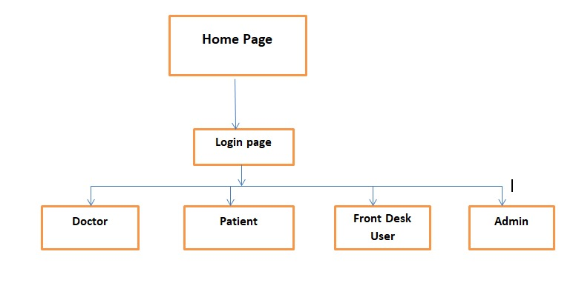
FLOW OF PROJECT

Slide 7
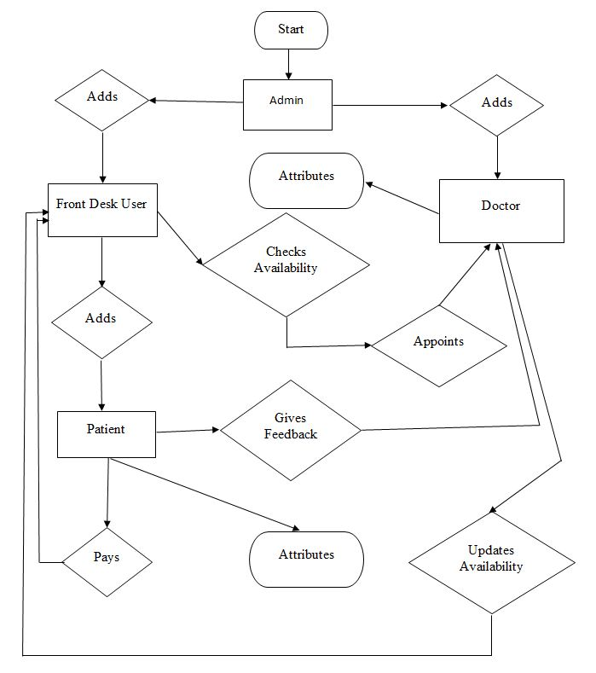
PROJECT FUNCTIONALITY OVERVIEW

Slide 8
PROJECT ENVIRONMENT
Technologies Used:
Asp.Net
C#
MySQL
HTML & CSS

Slide 9
PROJECT ENVIRONMENT
Platform:
Visual Studios 17
SQL Server Management Studio

Slide 10
PROJECT TEAM ROLES:
Front-desk user and Back-end user: Maulshree
Admin module and Documentation: Naga Saiteja
Doctor’s module and Login page: Manoj Kumar
Patient’s module and Home page and Sessions: Yogesh

Slide 11
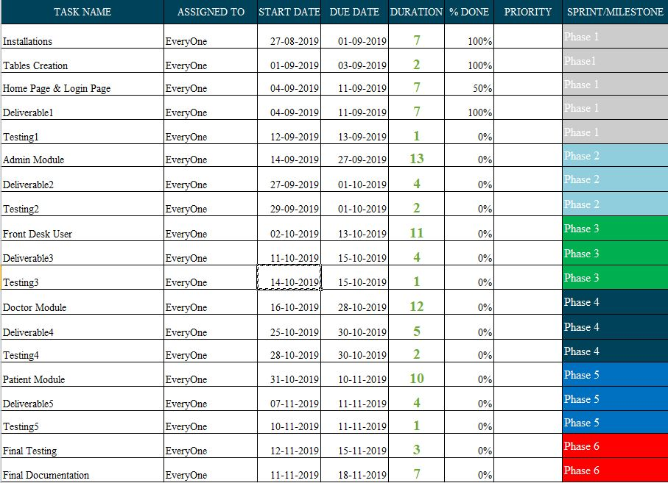
GANTT CHART

Slide 12
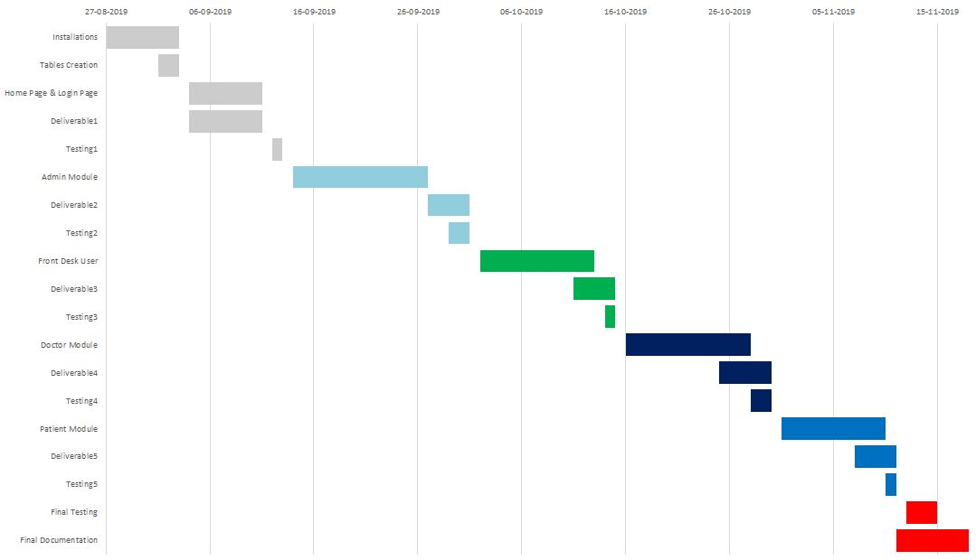
GANTT CHART

Slide 13
POSSIBLE RISKS:
Software Incompatibility
Security risks
Technical feasibility

Slide 14
MITIGATION OF RISKS
Feasibility Analysis
Adding security features
Updation of software in the laptop
Proper planning of the project
Implementing latest coding techniques
Proper Testing

Slide 15
THANK YOU SO MUCH!

