Slide 1
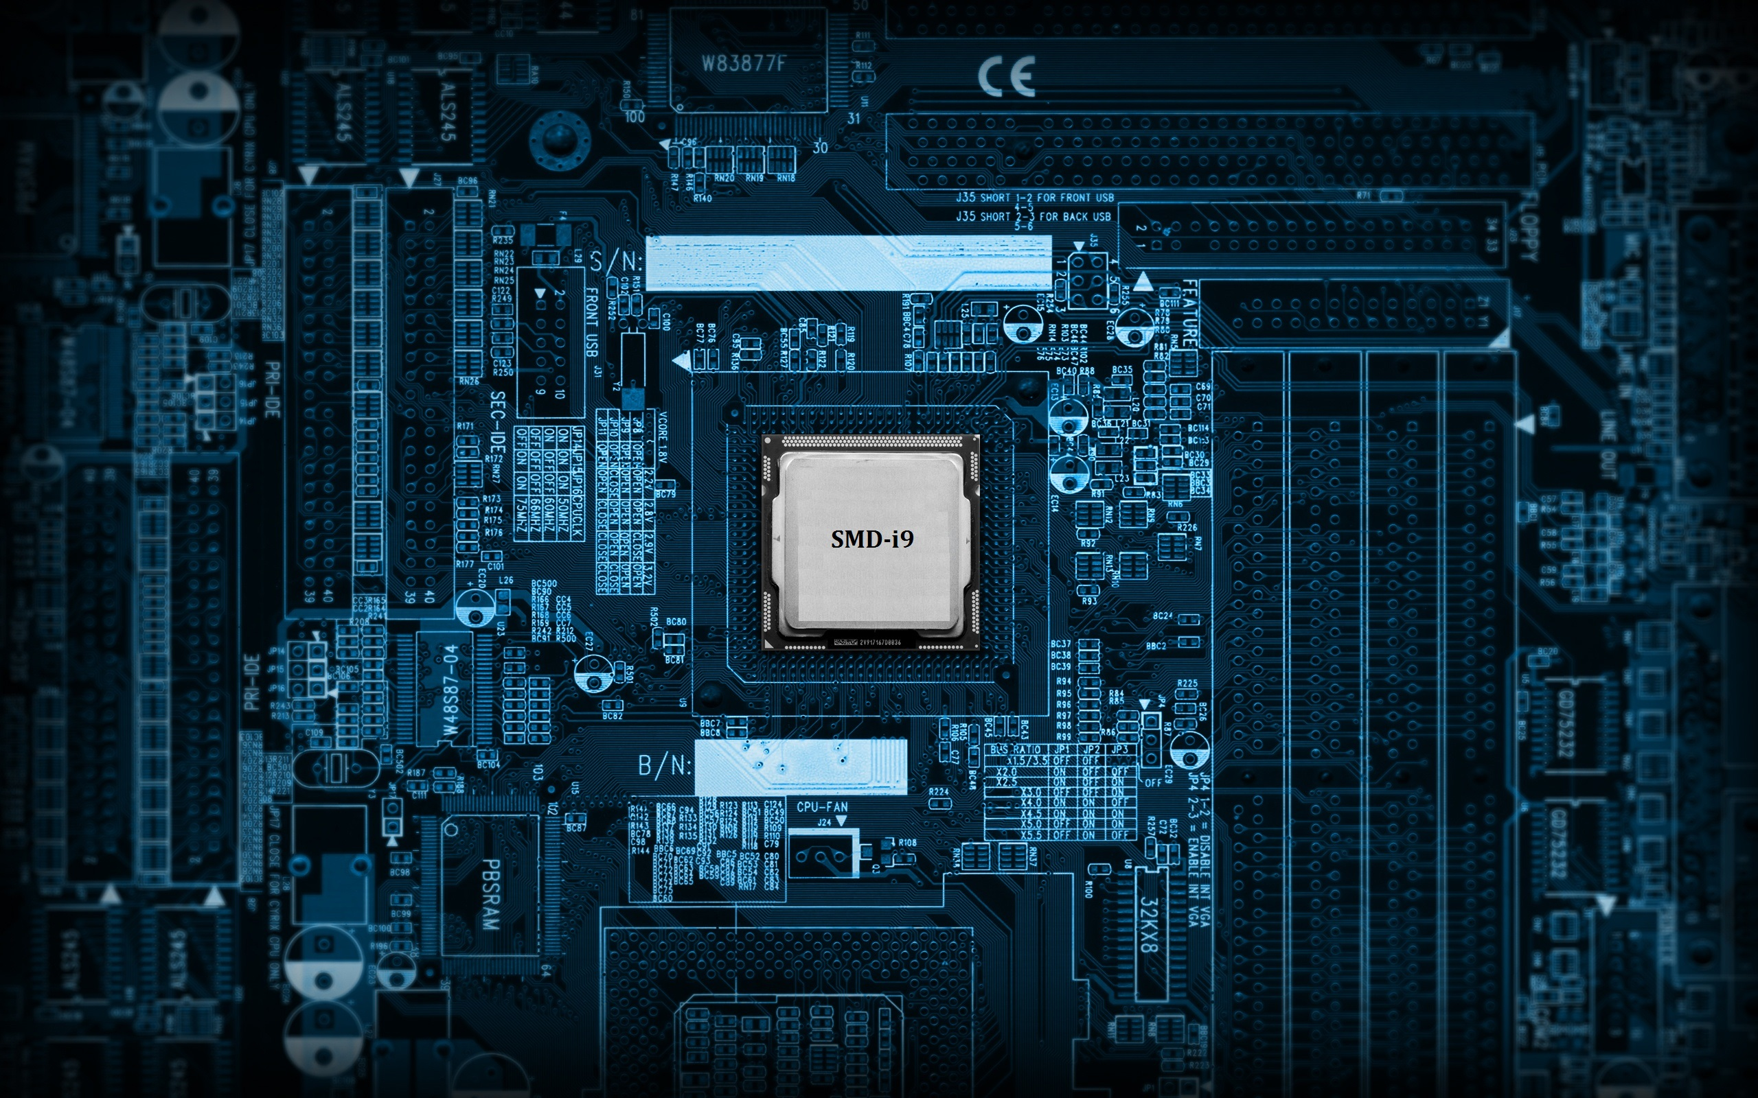
Group 6
Maunil Vyas – 1401007
Deep C. Patel – 1401010
Shreyas Patel – 1401025

Slide 2
Motivation
Inner Curiosity to know working and architecture of a processor motivated us to build this processor.

Slide 3
Specifications
8 Bit Data (I/O)bus
8 bit Address Bus
1 MHZ Operational Speed
RISC Based Architecture
Single Core Processor
256 lines x 8 bit RAM
32 lines x 8 bit Register
Executes 28 different Instructions
Features
Faster process execution, due to process pipelining.
Structural hazard, Data hazard and Control hazard are properly taken care.
R format, I-format and J-Format type instructions are used.

Slide 4
Process
Instruction Memory
Decode &
Register Block
Data Memory
Write back
Register
Register
Execution
Register
Register

Slide 5
Instruction Formats
R _format (Register type)
Opcode [4:0] | Destination Register [4:0] | Register A [4:0] | Register B [4:0]
J_format (Jump or Branch type)
Opcode [4:0] | #10 bit (Don’t care) | Number or address [4:0]
I _format (Immediate type)
Opcode [4:0] | Destination Register[4:0] | Register A [0:4] | Immediate Number

Slide 6
Blocks
The following are Eight Blocks in our Pipelined Processor:-
1)PC Block(Instruction Memory)
2)Decode Block
3)Execution Block
4)Data Memory
5)Write Back Block
6)Jump Control Unit
7)Clock Control Unit
8)Dependency Block

Slide 7
Block Diagram
Data_in
Data_out
Clock control block
Clk4
Clk
Clk1
Clk2
Mem_mux_sel_ex
Clk3
A
ans_Ex
Data Memory
Block
Ans_wb
Program
Counter
And
Instruction Memory
ins
Execution
block
Clk5
Decode Block
B
Mem_rw_ex
Write back block
Mem_rw_Ex
mux_ans_dm
B_bypass
Mux_sel_a
current_Address
Mux_sel_b
pc_mux_Sel
Mem_mux_Sel_dec
jmp_loc
Flag_ex
Mem_en_dec
Mem_rw_dec
Op_ex
Rw_dec
Imm_sel
Jump control Block
Data dependancy Check block
Rw_dm
interrupt

Slide 8
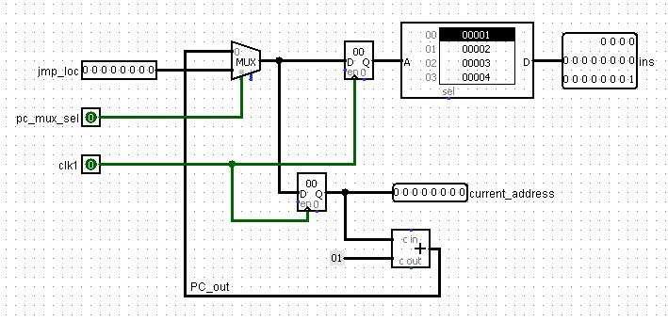
Programme Counter Block/Instruction Fetch
Objective: -To Fetch Instructions one by one from instruction memory and then send to next stage
Signals to PC and IM block | Input variable Name | No. of Bits | Explanation
Inputs | jmp_loc | [7:0] | Address of jump location
 | pc_mux_sel | 1 | Selection bit for jmp_loc or pc_out
 | clk1 | 1 | Input clock signal for PC and IM block
Outputs | ins | [19:0] | Instruction for execution block
 | current_address | [7:0] | Present address value for IM

Slide 9
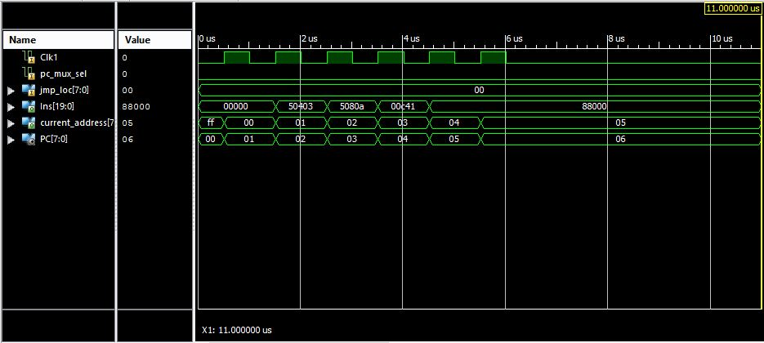
PC Block-Clock Diagram

Slide 10
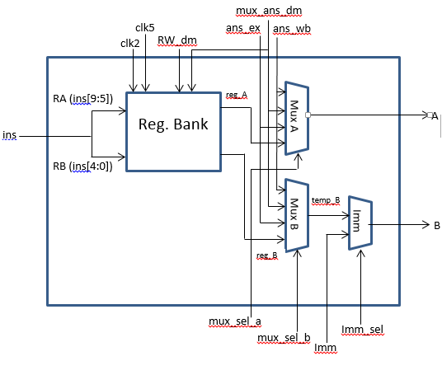
Decode Block
Objective :- Decode instructions and give input A and B to Execution Block, such that no data hazard occur.

Slide 11
Decode Block(contd.)
Signals to Reg Bank | Input variable Name | No. of Bits | Explanation
Inputs | Ins | [19:0] | Instruction for Program Memory
 | RW_dm | [4:0] | Address for RW (write)
 | ans_ex | [7:0] | Answer execute (from ALU)
 | mux_ans_dm | [7:0] | Data to be written at address given by RW
 | ans_wb | [7:0] | Data (answer) for write back
 | Imm | [7:0] | Immediate number
 | mux_sel_a | [1:0] | Mux for selection of A
 | mux_sel_b | [1:0] | Mux for selection of B
 | imm_sel | 1 | Immediate number select
 | clk2 | 1 | Clock for read
 | clk5 | 1 | Clock for write
Outputs | A | [7:0] | Data to be read from the address RA
 | B | [7:0] | Data to be read from the address RB
Control Signals
mux_sel_a | A | mux_sel_b | B | Imm_sel | B
00 | reg_A | 00 | Reg_B | 0 | temp_B
01 | ans_ex | 01 | ans_ex | 1 | Imm
10 | mux_ans_dm | 10 | mux_ans_dm
11 | ans_wb | 11 | ans_wb

Slide 12
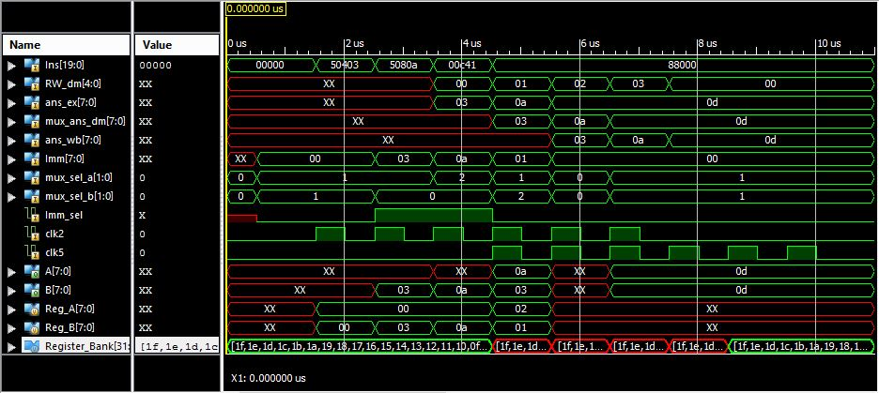
Decode Block-Clock Diagram

Slide 13
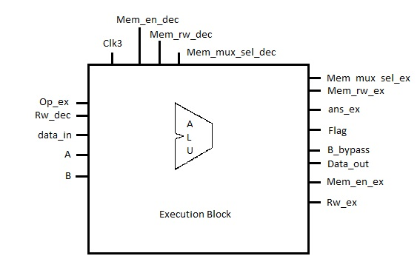
Execution Block
Objective:- Performs all Arithmetical and Logical operations

Slide 14
Execution Block(contd.)
Signals to JC Block | Input variable Name | No. of Bits | Explanation
Inputs | A | [7:0] | Alu Input 1
 | B | [7:0] | Alu input 2
 | data _in | [7:0] | Data From External Port
 | Op_ex | [4:0] | Opcode
 | Clk3 | 1 | Clock
 | Mem_en_dec | 1 | Memory Enable signal form decode block
 | Rw_dec | [4:0] | Write Register address
 | Mem_rw_dec | 1 | Memory Read/Write Signal form decode block
 | Mem_mux_sel_dec | 1 | Memory Mux Selection form Decode Block
Outputs | Flag | [4:0] | Flag Signals
 | Data_Out | [7:0] | Data to External Output port
 | B_bypass
 |  | [7:0] | B_Bypass = B
 | Mem_en_ex
 |  | 1 | Mem_en_ex = Mem_en_dec
 | Mem_rw_ex
 |  | 1 | Mem_rw_ex = Mem_rw_dec
 | Mem_mux_sel_ex
 |  | 1 | Mem_mux_sel_ex=Mem_mux_sel_dec
 |  | [4:0] | Rw_ex=Rw_dec
 | Rw_ex

Slide 15
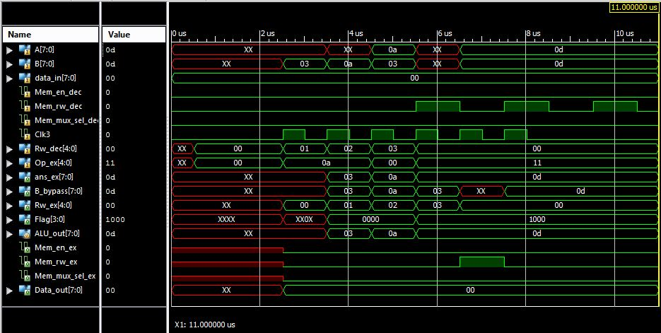
Execution Block-Clock Diagram

Slide 16
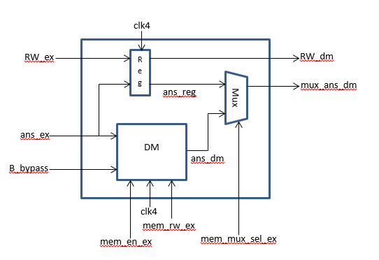
Data Memory Block
Objective:- Store data from Previous Stage in memory or load data from it.

Slide 17
Data Memory Block(contd.)
Signals to DM | Input variable Name | No. of Bits | Explanation
Inputs | ans_ex | [7:0] | Address for memory module (O/P of execution block)
 | B_bypass | [7:0] | Data input for memory module (O/P of execution block)
 | mem_en_ex | 1 | Memory enable signal from execution block
 | mem_rw_ex | 1 | Memory read /write signal from execution block
 | Clk4 | 1 | Clock for the block
 | RW_ex | [4:0] | Write address from execute block
 | mem_mux_sel_ex | 1 | Selection between memory output and execution block output
Outputs | mux_ans_dm | [7:0] | Data out from DM block
 | RW_dm | [4:0] | Write address to DM block

Slide 18
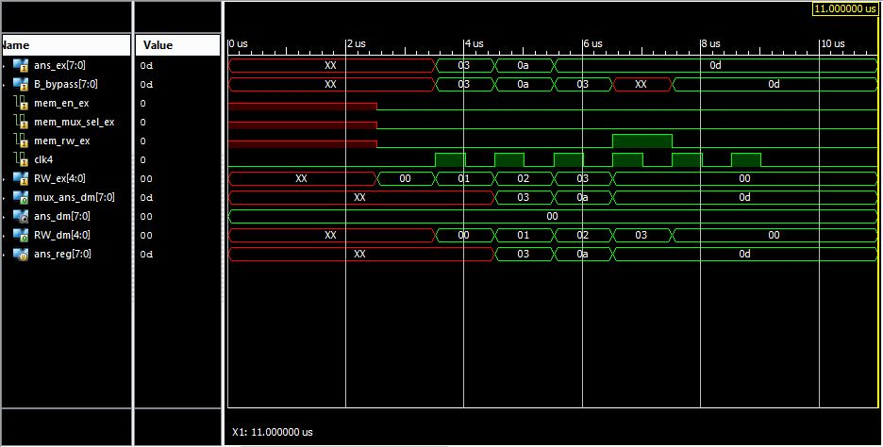
Data Memory-Clock Diagram

Slide 19
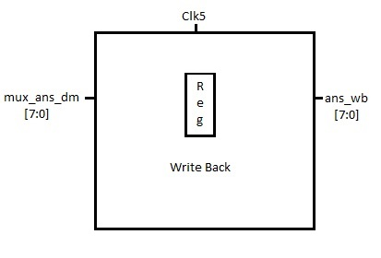
Write-back Block
Objective:-Write Data from Execution or Data memory to Register Bank
Input Variable name | No of Bits | Explaination
mux _ans_dm(input) | [7:0] | Output From data Memory Block
Clk5(input) | 1 | Clock For Write Back
ans_wb(output) | [7:0] | Provide Data to Reg bank for Write

Slide 20
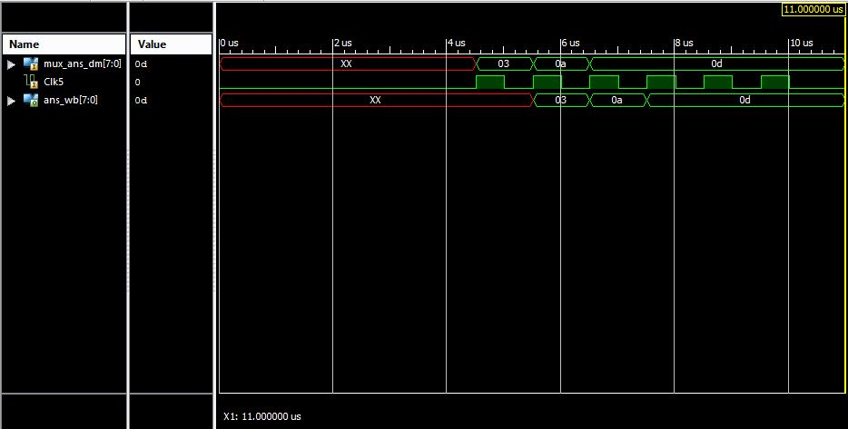
Write-Back Block-Clock Diagram

Slide 21
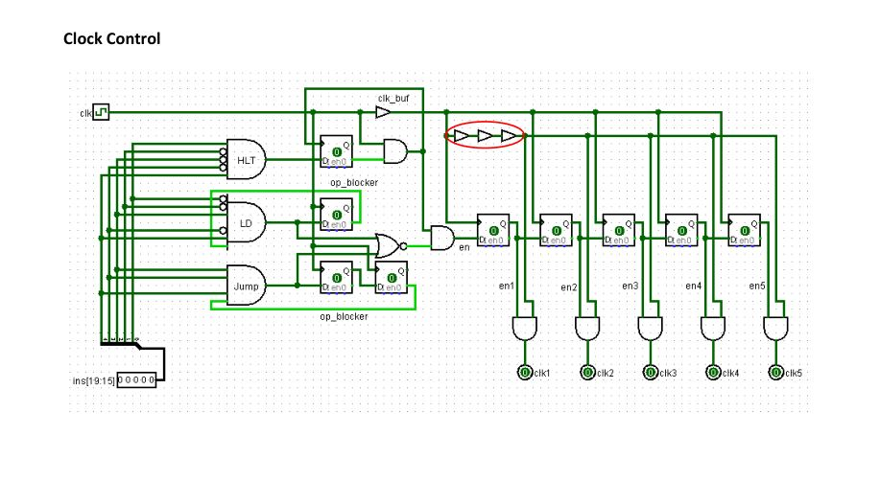
Clock Control Block
Objective:- To generate all clocks signal corresponding to it’s Pipelined Stage.
Signals to Clock Control Block | Input variable Name | No. of Bits | Explanation
Inputs | Ins | [19:0] | Instruction from Program Memory
 | clk | 1 | System Clock (@ 1 MHz)
Outputs | clk1 | 1 | Clock for Program Memory
 | clk2 | 1 | Clock for Reg Bank (Read operation)
 | clk3 | 1 | Clock for Execution Block
 | clk4 | 1 | Clock for Data Memory
 | clk5 | 1 | Clock for Reg Bank Write operation)

Slide 22
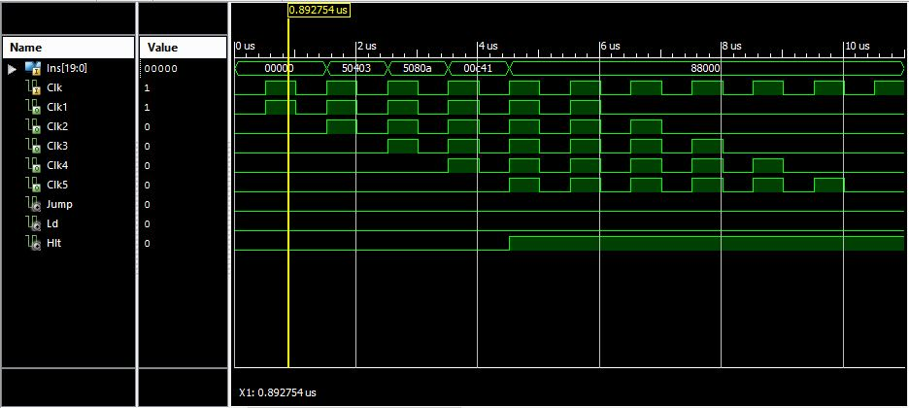
Clock Control-Clock Diagram

Slide 23
Jump Control Block
Objective:- Perform and control different kinds of Jump Operations
Signals to JC Block | Input variable Name | No. of Bits | Explanation
Inputs | ins | [19:0] | Instruction for Program Memory
 | current_address | [7:0] | Present address of Instruction Memory
 | flag_ex | [3:0] | Flag from execute block
 | interrupt | 1 | External interrupt (High level)
Outputs | jmp_loc | [7:0] | Address of jump location
 | pc_mux_sel | 1 | Selection bit for pc_out or jmp_loc
Instruction | Description | Functionality
Interrupt |  | Store current_address and flag_ex in the JC block. jmp_loc = 8’hF0 ,pc_mux_sel = 1’b1
JMP | Unconditional Jump | jmp_loc = ins [7:0] , pc_mux_sel = 1’b1
JZ | Jump if ‘Z’ Flag is set | If condition is true :- jmp_loc = ins [7:0] , pc_mux_sel = 1’b1 If condition is false :- pc_mux_sel = 1’b0
JNZ | Jump if ‘Z’ Flag is reset
JC | Jump if ‘C’ Flag is set
JNC | Jump if ‘C’ Flag is reset
RET | Return from interrupt subroutine | jmp_loc = stored address (During interrupt), pc_mux_sel = 1’b1 Restore the values of flag stored during interrupt.

Slide 24
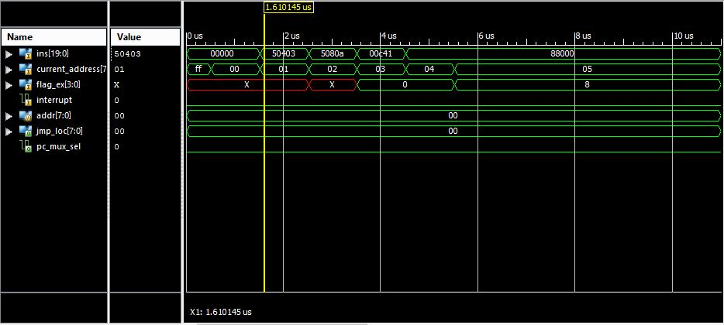
Jump Control-Clock Diagram

Slide 25
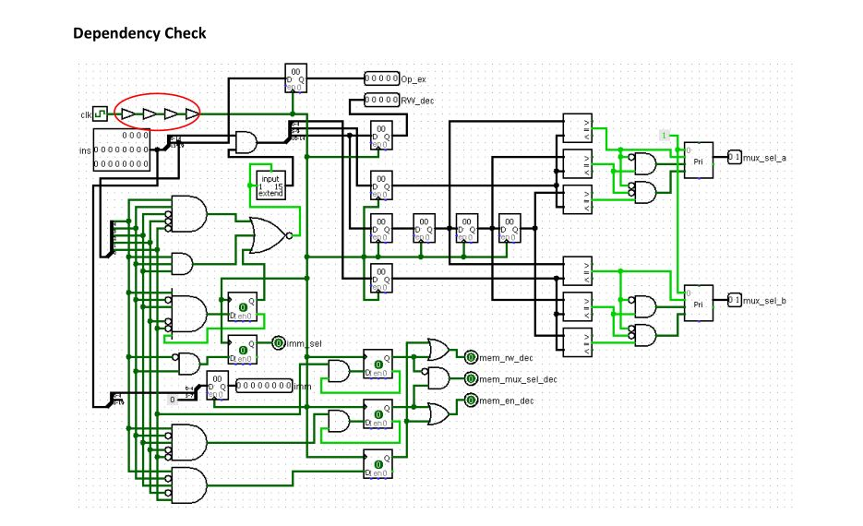
Dependency check Block
Objective:-Resolve the Data Dependency problem in the Processor

Slide 26
Dependency check Block(contd.)
Signals to DC Block | Input variable Name | No. of Bits | Explanation
Inputs | ins | [19:0] | Instruction for Program Memory
 | clk | 1 | System clock of Processor
Outputs | mux_sel_a | [1:0] | Selection bit for Mux A
 | mux_sel_b | [1:0] | Selection bit for Mux B
 | imm_sel | 1 | Immediate number select
 | Imm | [7:0] | Immediate number
 | mem_en_dec | 1 | Memory enable signal
 | mem_rw_dec | 1 | Memory read/write signal
 | mem_mux_sel_dec | 1 | Memory mux select bit
 | RW_dec | [4:0] | Write address
 | Op_ex | [4:0] | Opcode

Slide 27
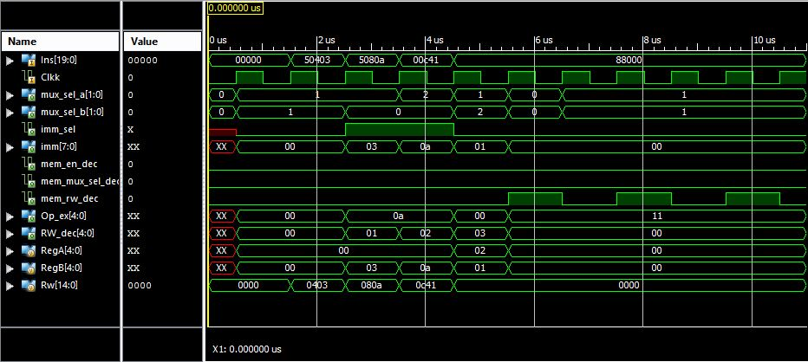
Dependency Check-Clock Diagram

Slide 28
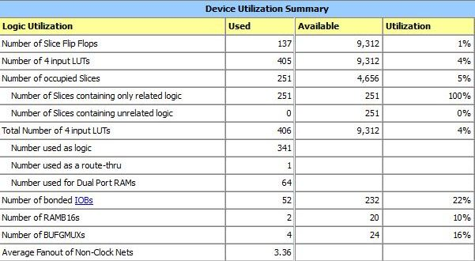
Synthesis Report

Slide 29
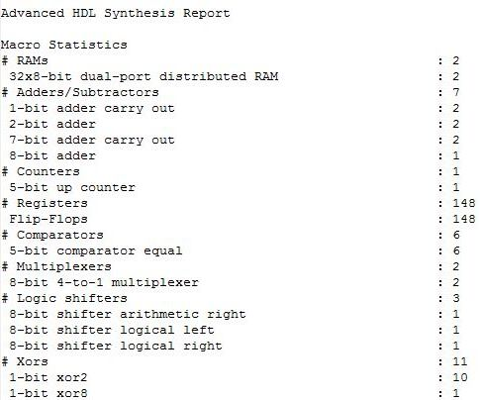
Synthesis Report(contd.)

Slide 30
Comparison
SMD-i9
Pipelined Processor
8 bit Data bus
8 bit Address bus
Single Core
RISC Based Architecture
1 MHz Operational Speed
256 lines x 8 bits RAM
32 lines x 8 bits ROM
Executes 28 different Instructions
8085 Processor
Single Cycled Processor
8 bit Data bus
16 bit Address bus
Single Core
CISC Based Architecture
3 to 6 MHz Operational Speed
Executes 74 different Instructions
6 Registers: B, C, D, E, H, L
8 bit Accumulator

Slide 31
Future Goals
Insertion of Multiplier Circuit.
Addition of Branch Prediction Unit.
Adding more Instruction Support.
Addition of Stack Pointer

Slide 32
Special Thanks
We would like to convey our heart felt thanks to our teacher and guide for this project:-
1).Mr. Pratik Trivedi
We would also like to convey our heart felt thanks to our Lab TAs:-
1).Mr. Manan Mewada
2).Ms. Jaina Mehta
3).Mr. Parth Shah
for their firm support and advice.

Slide 33
Reference
[1] Samir Palnitkar, Verilog HDL: A Guide to Digital Design and Synthesis, SunSoft Press, 1996.
[2] David A. Patterson and John L. Hennessy, Computer Organization and Design, 4th ed, Morgan Kaufmann, 2008.
[3] Xilinx Forums, “multiple drivers error”,[Online]. Available: https://forums.xilinx.com/t5/Synthesis/multiple-drivers-error/td-p/310993, [Accessed: August 15, 2015].

Slide 34
Thank You

