Slide 1


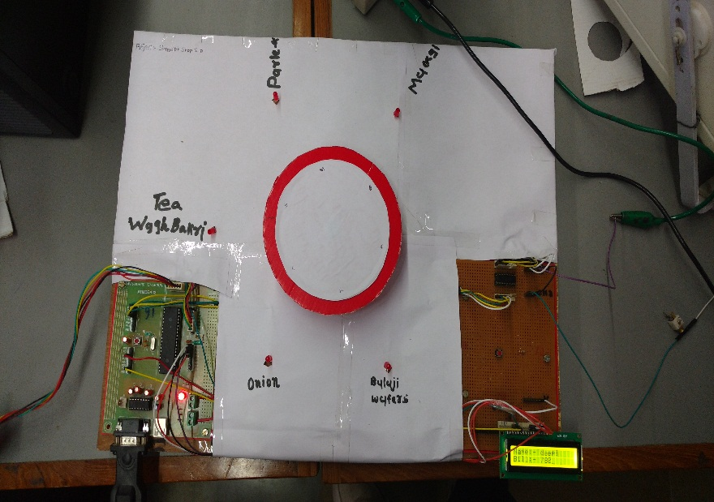
Smart-Shop Maunil Vyas, Deep C. Patel, Shreyas Patel
IET
INSTITUTE OF ENGINEERING & TECHNOLOGY
￼
Application:
To automate the process of shopping
To make human life easier,simpler and fast
Learnings:
Stepper Motor interfacing
LCD interfacing
LED interfacing
USART for serial transmission
Mechanical construction

