Slide 1
Database on Ecommerce Services
“A Relation between Local Service providers and local customers“
Group No-22

Slide 2
Introduction
As we know that in this era, Time is one of the valuable thing for people, due to that there are tremendous change in all kind of services, means they have grabbed the digitization scenario, also people accept this change blindly or we can say happily, with this view one can easily say that there is a huge scope in digitization world for development.
So, by accepting the above facts positively, and also knowing that there is less development in e-commerce sector we are going to make an e-commerce database.

Slide 3
The backwardness of current Scenario
Time Consuming
Not Efficient
One cannot have a 100% trust on the person whom he or she hire or call for solving particular issue like (e.g electrician etc.)means we are not always fortunate to have well certified workers.
Another important thing is that people don’t have the freedom to know what are the prices that they actually have to pay to the person whom they called and due to this most of the time customers trapped in such situations where they had a big loss in terms of money also the local workers demand whatever they want for their work.
Last but not least Sometime people shifted their houses at new area, where they don’t know any one and they have emergencies to solve certain e-commerce problems, this a very difficult task to deal.

Slide 4
Problem definition
How to connect local customers to local service providers in digital platform?
Solution : It would require a virtual platform where local customers can easily connect with their desirable local service providers through third party platform and the backend will be our database.
Database includes the relationship between users and service providers, money models (one is marginal percentages from service providers and second is advertisement), it also includes a virtual platform where user can discuss with his or her acquaintance and come to know who is good for a xyz services, there is a platform where users can recommend service providers and have a right to give stars on the basis of their satisfaction, also provide comments too.There is a separate part for managers(for each city),who manages, this system into their cities.

Slide 5
Diagrams
ER
EER
Relational Model

Slide 6
FDS with Normalization
User_Details
FDs
User_ID → {User_Password, Profile_PIC, Fname, Mname, Lname, Mobilenumber, Category_ID, City_ID,Join_date}
Mobilenumber → {User_Password, Profile_PIC, Fname, Mname, Lname, User_ID, Category_ID, City_ID,Join_date}
User_ID → {City_Name, State_Name}
Mobilenumber → { City_Name, State_Name}
User_ID → {Category_Name}
Mobilenumber → {Category_Name}
Primary Keys: - {User_ID}
Superkeys :-{User_ID,MobileNumber}
Normalization Form: - BCNF

Slide 7
FDS with Normalization
Services
FD
Service_ID → {Service_Name}
Primary Key: - {Service_ID}
Normalization Form: - BCNF
Service_Providers
FD
ServiceProvider_ID → {Qualification, Availability}
Primary Key: - {ServiceProvider_ID}
Normalization Form: - BCNF
Service_Provided
FD
{ServiceProvider_ID , Service_ID , City_ID} → { Basic_Charges , Marginal_Percentage}
Primary Key: - {ServiceProvider_ID , Service_ID ,City_ID}
Normalization Form: - BCNF

Slide 8
FDS with Normalization
Recommend
FD
Recommendation_ID → {Customer_ID, ServiceProvider_ID, Service_ID, Comments, Rating}
Recommendation_ID →{ Customer_Password, Profile_PIC, Fname, Mname, Lname, Mobilenumber, Category_ID, City_ID }
Recommendation_ID → {Qualification, Availability }
Recommendation_ID → {Service_Name}
Primary Key: - {Recommendation_ID}
Normalization Form: - BCNF

Slide 9
FDS with Normalization
Used
FD
Order_ID → {Customer_ID, ServiceProvider_ID, Service_ID, Address, Timing, Amount_paid}
Order_ID →{ Customer_Password, Profile_PIC, Fname, Mname, Lname, Mobilenumber, Category_ID, City_ID }
Order_ID → {Qualification, Working_days} (Transitive from Order_ID → ServiceProvider_ID and ServiceProvider_ID → { Qualification, Working_days })
Order_ID → {Service_Name} (Transitive from Order_ID → Service_ID and Service_ID → Service_Name)
Primary Key: - Order_ID
Normalization Form: - BCNF
General_Status
FDs
{ServiceProvider_ID,Day_online}→ {Online_Offline}
{ServiceProvider_ID,Day_online}→ {Qualification, Availability }
Primary Key: - {ServiceProvider_ID,Day_online}
Normalization Form: - BCNF

Slide 10
FDS with Normalization
City
FD
City_ID → {City_Name, State_Name}
Primary Key: - City_ID
Normalization Form: - BCNF
Friends_and_Relatives
FD
{User_ID,Friend_ID} → {Since_Date}
Primary Key: - {User_ID, Friend_ID}
Normalization Form: - BCNF
FR_ Message
FDS
{User_id,Friend_id,Time_of_interaction} →{Message_in,Message_out}
Primary key:{User_id,Friend_id,Time_of_intercation}
Normalization : BCNF

Slide 11
FDS with Normalization
Manager
FDs
Manager_ID → {M_name, sex, City_ID, Salary}
Manager_ID → {City_Name, State_Name}
Primary Key: - Manager_ID
Normalization Form :- BCNF
Advertisers
FD
Advertiser_ID → {Advertiser_Name}
Primary Key: - Advertiser_ID
Normalization_Form: - BCNF
Advertise
FD
{Adv_Date, Advertiser_ID} → {Advertisement_Cost, number_of _users_intersted}
Primary Key: - {Adv_Date, Advertiser_ID}
Normalization_Form: - BCNF

Slide 12
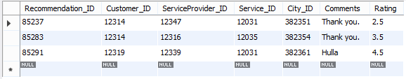
Complex Queries and it’s Output
1).Give information to customers regarding to service providers and their services which are taken by their friends in past like ratings and reviews.
SQL:-
select * from Recommendation where Customer_ID in (select Friend_ID from Friends_And_Relatives where Friends_And_Relatives.User_ID=12310);
Output:-

Slide 13

Complex Queries and it’s Output
2). Get the desired service with nearest area with lowest price and trusted service provider (means it is utilised by customer’s acquaintance.)
SQL:-
select ServiceProvider_ID, Service_ID, Basic_Charges from Service_Provided where City_ID=(select City_ID from User_Details where User_ID=12310) and ServiceProvider_ID in (select ServiceProvider_ID from ((select Friend_ID from Friends_And_Relatives where User_ID=12310) as a) join Recommendation on a.Friend_ID=Recommendation.Customer_ID where Recommendation.Service_ID=12036) and Service_ID=12036 order by Basic_Charges asc;
Output:-

Slide 14

Complex Queries and it’s Output
3). Show the list of service providers which are in the city of the User.
SQL:-
select ServiceProvider_ID, Service_ID, Basic_Charges from Service_Provided where City_ID=(select City_ID from User_Details where User_ID=12310) order by Basic_Charges asc;
Output:-

Slide 15

Complex Queries and it’s Output
4). Show the list of service providers on the basis of their Ratings, Prices
SQL:-
select Service_Provided.ServiceProvider_ID, Service_Provided.Service_ID, Basic_Charges, avgRatings from (Service_Provided natural join averageRating) where Basic_Charges<=300 order by Basic_Charges asc;
Output:-

Slide 16

Complex Queries and it’s Output
5). Get Highest rated service provider with ratings >=3.6
SQL:-
select Service_Provided.ServiceProvider_ID,Service_Provided.Service_ID, Basic_Charges, avgRatings from (Service_Provided natural join averageRating) where avgRatings>=3.6 order by avgRatings desc;
Output:-

Slide 17
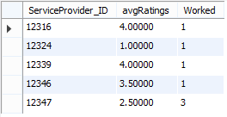
Complex Queries and it’s Output
6). Most experience service providers in one area(The person who has the highest ratings and done almost maximum work in his or her field compare to others).
SQL:-
select a.ServiceProvider_ID, avgRatings, a.Worked from ((select ServiceProvider_ID, count(*) as Worked from Used group by ServiceProvider_ID ) as a join (select Service_Provided.ServiceProvider_ID, avgRatings from(Service_Provided natural join averageRating)) as b on a.ServiceProvider_ID=b.ServiceProvider_ID );
Output:-

Slide 18

Complex Queries and it’s Output
7). Name of cheaper service provider who provide service in rural area means(His or her range for working purpose is not fixed).
SQL:-
select ServiceProvider_ID,tab.cnt,Basic_Charges from (select distinct ServiceProvider_ID, City_ID, Basic_Charges, count(*) as cnt from Service_Provided group by ServiceProvider_ID order by Basic_Charges desc)as tab where tab.cnt>1 order by Basic_Charges asc;
Output:-

Slide 19

Complex Queries and it’s Output
8). Name of the service provider who will done my work on let say not more than xyz rupees.
SQL:-
select ServiceProvider_ID from Used where Customer_ID=12320 and Amount_Paid<500;
Output:-

Slide 20

Complex Queries and it’s Output
9). Which services are commonly utilized by almost every one (Which services has a higher priority)
SQL:-
select Service_ID, count(*) as HighestUsed from Used group by Service_ID limit 1;
Output:-

Slide 21

Complex Queries and it’s Output
10). Who is the worst service provider in xyz services?
SQL:-
select Service_Provided.ServiceProvider_ID, avgRatings from (Service_Provided natural join averageRating) where Service_Provided.Service_ID=12030 order by avgRatings asc limit 1;
Output:-

Slide 22

Complex Queries and it’s Output
11). Who is the most trusted service provider in xyz services?
SQL:-
select Service_Provided.ServiceProvider_ID, avgRatings from (Service_Provided natural join averageRating) where Service_Provided.Service_ID=12031 order by avgRatings desc limit 1;
Output:-

Slide 23

Complex Queries and it’s Output
12). Who earn the most money in current month or year, or less money?
SQL:-
select Service_ID, sum(Amount_paid) as Total_Amount from Used where YEAR(Timing)=2015 group by Service_ID order by Total_Amount desc limit 1;
Output:-

Slide 24

Complex Queries and it’s Output
13). Which are the services that we have to promote (Analysis of service utilization in xyz area).
SQL:-
select Service_ID from(select Service_ID, count(*) as HighestUsed from Used group by Service_ID order by HighestUsed desc) as a where a.HighestUsed<2; #Services that are need to Promote
Output:-

Slide 25

Complex Queries and it’s Output
14). Users signed up since from since fifteen days
SQL:-
select User_ID from User_Details where DATEDIFF(now(),(Join_Date))<=15;
Output:-

Slide 26

Complex Queries and it’s Output
15). Service Providers signed up since from since fifteen days
SQL:-
select User_ID from User_Details join Service_Providers on (User_Details.User_ID=Service_Providers.ServiceProvider_ID) where DATEDIFF(now(),(Join_Date))<=15;
Output:-

Slide 27
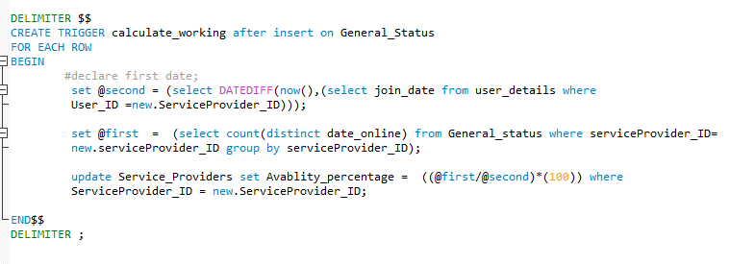
Trigger
We include one trigger in our database which calculates the Availability percentage of Service providers.

Slide 28
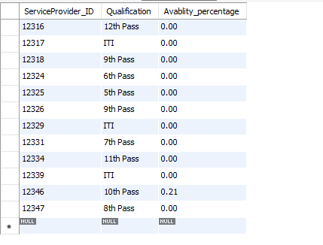
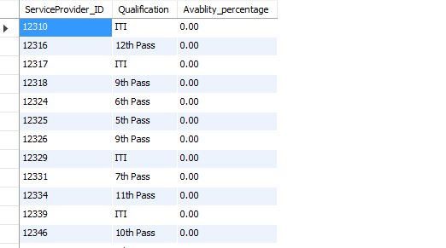
Trigger Output
Before
After
Inserting three entries in ‘general_status’ table, so according to our formula it’s (3/1462)*100 = 0.21

Slide 29
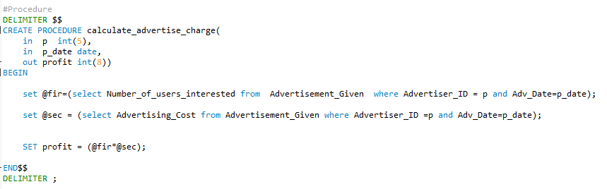
Stored Procedure
We include one stored procedure in our database which calculates the profit generated from an advertisement

Slide 30

Procedure Output
Input:-
Output:-

Slide 31
Done By
Maunil Vyas 1401007
Deep Patel 1401010
Shreyas Patel 1401025
Jay danger 1401043
Rajat Barot 1401045

