Slide 1



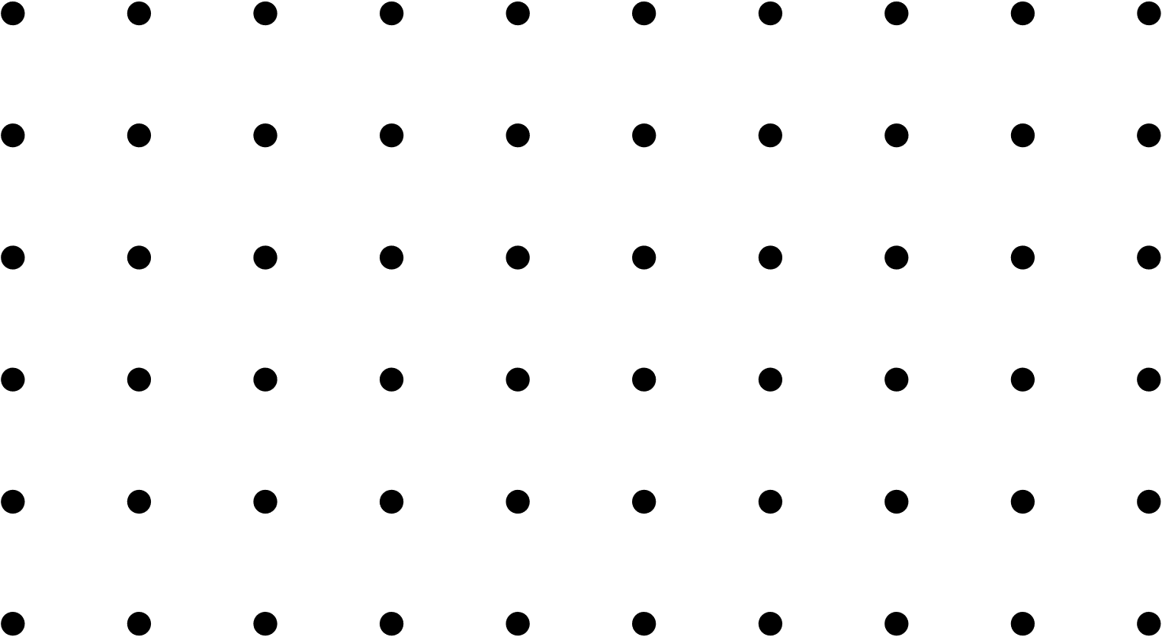
Chapter 1: Python Programming Fundamentals

Slide 2
Lesson 1.1: Python Concepts

Slide 3

Preliminary Activity: “Know, Think, Want to Know” Chart
Instructions:
1. Bring out 1 piece of paper.
2. Fill out the table below
What I Know | What I Think I Know | What I Want to Know
List any facts or ideas you already know about Python. | Write things you believe to be true but aren't sure of. | List questions or topics you’re curious about regarding Python.

Slide 4
What is Python Programming?
Currently, Python is among the commonly used programming languages. It is used for Web development: (server-side), software development, mathematics and system scripting. Also, it is a high-level, interpreted, object-oriented programming language known for its readable syntax and versatility which allow programmers to express complex logic in fewer lines of code compared to other languages such as C++, Java, or PHP.
It was originally created by Guido van Rossum in the late 1980s and officially released in 1991, Python supports multiple programming paradigms, including procedural, object-oriented, and functional programming.

Slide 5
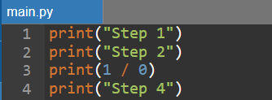
Characteristics of Python Programming
1. Interpreted Language - It executes code line by line, as opposed to compiled languages like C or Java that are converted into machine code before running.
Example:
2. Dynamic Typing - Python uses dynamic typing, meaning that you do not declare the data type of a variable. The type is determined at runtime based on the value assigned.
Runtime error occurs here.
This will NOT run.

Slide 6
Characteristics of Python Programming
3. High Level - A high-level language allows you to write programs in a way that is close to human language. For example, when using a function, python handles the complexity while not worrying about how it works internally. Compare this to a low-level language like machine language where every instruction should be written in form of 0 and 1 and it’s very challenging to understand and use as primary language.
4. Multi-paradigm - Python supports multiple programming styles, which makes it highly flexible and adaptable to different types of projects. It supports procedural, object-oriented, and functional programming styles.

Slide 7
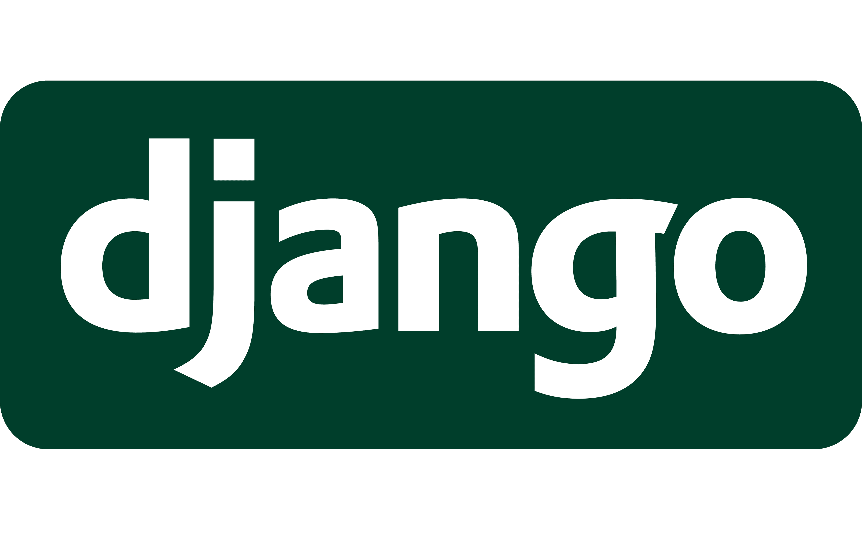
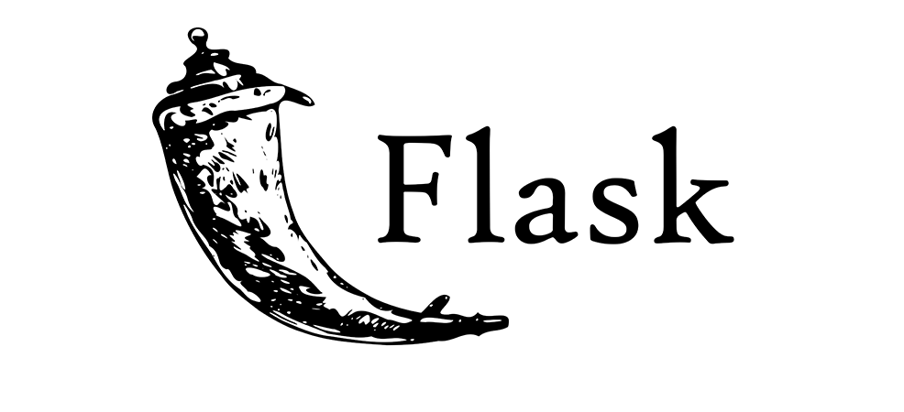
Use Cases of Python
1. Web Development - Python is widely used to build the back end (server-side) of web applications. It offers robust frameworks like Django and Flask, which help developers create secure, scalable, and maintainable websites and APIs.
Frameworks:
- Django: A high-level framework that follows the "batteries included" philosophy which includes everything needed to build a full-featured web app quickly.
- Flask: A lightweight framework that gives developers more control and flexibility.

Slide 8
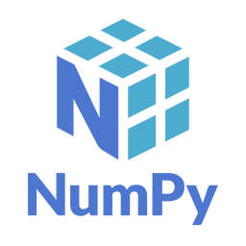
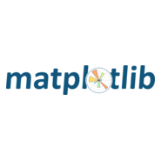
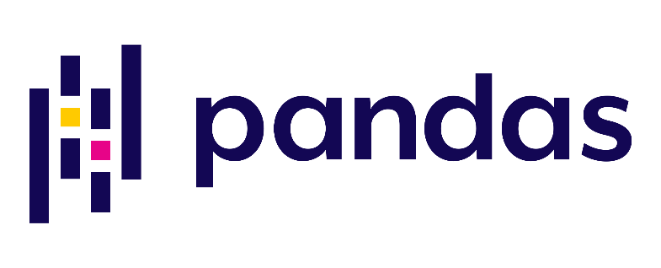
Use Cases of Python
2. Daya Analysis and Machine Learning - Python is a favorite in the data science world because of its simple syntax and powerful libraries for data handling and machine learning.
Libraries:
- NumPy: For numerical computing and array manipulation.
- pandas: For structured data handling (like tables, CSV files, Excel files).
- Matplotlib: For data visualization.

Slide 9
Use Cases of Python
3. Automation and Scripting - Python is excellent for automating repetitive tasks, also called scripting. It's commonly used for file operations, sending emails, renaming files, scraping websites, and more.
4. Software Testing and Prototyping - Python is widely used in software development for writing test cases and quickly creating prototypes of applications.
5. IoT, Robotics, Game Development, and Cybersecurity - Python also extends into emerging and technical fields, offering tools for interacting with hardware, developing games, and building secure systems. For example, Raspberry Pi which is used to control sensors and devices.

Slide 10
Learning Activity 1: Match the concept
Concept | Definition
1. Interpreted | A. Variables do not need a declared type; their type is determined at runtime.
2. Dynamic Typing | B. Code is close to human language and hides low-level system details.
3. High-Level Language | C. The program is executed line by line rather than compiled beforehand.
4. Object-Oriented | D. Uses functions as building blocks and treats them as data.
5. Functional Programming | E. Organizes code using objects that contain data and behavior.

Slide 11
Learning Assessment
Identification: Write the correct answer in the space provided.
 | 1. | Python was created by ___________________.
 | 2. | A lightweight framework that gives developers more control and flexibility
 | 3. | Python executes code line by line which makes it a/an ____________ language.
 | 4. | It is used for numerical computing and array manipulation.
 | 5. | It would be most useful for creating graphs and visualizations.
 | 6. | True or False: Variable types are assigned at runtime.
 | 7. | True or False: High-level languages allow writing programs closer to machine language
 | 8. | True or False: Python is a statically typed language.
 | 9. | True or False: Python supports multiple programming paradigms.
 | 10. | Flask is used for data visualization.
Guido van Rossum
Flask
interpreted
NumPy
Matplotlib
True
False
False
True
False

Slide 12
Generalization
What kind of programming language is Python—compiled or interpreted?
Why is Python often described as a "high-level" language?
In what ways does Python support multiple programming paradigms?
How does dynamic typing in Python affect how we declare variables?

Slide 13
Lesson 1.2: Why Learn Python

Slide 14
Preliminary Activity: “Think-Pair-Share”
Instructions:
1. Think silently for 3 minutes.
2. Pair with a seatmate and share your ideas.
Question: Why do you think some programming languages are easier to learn and more popular than others?

Slide 15

Why Python?
Python has become one of the most popular programming languages in the world and not just by chance. Its rise in popularity is backed by strong practical, technical, and economic reasons that make it a top choice for students, educators, developers, and major tech companies. Here are some reasons why:
1. Beginner-friendly - Python is known for its clear and readable syntax. You don’t need to memorize complex rules or structures just to write your first program. It reads almost like English, making it easier to understand what each line of code does.
For example: Python simply executes the command and prints the message. No semicolons, no class definitions, no main() function required.

Slide 16
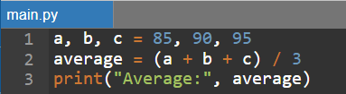
Why Python?
2. Fast Learning Curve - Python is so readable and intuitive where beginners can pick it up faster than other programming languages.
For example, instead of writing 6-10 lines of code to calculate the average of three numbers, python lessen it since there are no more data type declarations:
3. Free and Open-source - Python is 100% free to use. You don’t need to pay for a license or subscription, and it’s available for Windows, macOS, and Linux. Being open source also means that anyone can contribute to its development and access its source code. So, if anyone wants to build a data dashboard, they can freely use libraries like pandas and matplotlib.

Slide 17
Why Python?
4. Versatile and Flexible - Python can be used in a wide range of fields, making it a flexible language for different interests and career paths.
Whether you're a future web developer, data analyst, scientist, or game designer, Python has tools for you.
- Web apps using Django or Flask
- Data science using NumPy and pandas
- Machine learning using scikit-learn or TensorFlow
- Games using Pygame
- Automation using scripts

Slide 18
How python become popular?
Characteristic | How It Helps
Simple syntax | Makes code easier to read, write, and maintain even for beginners.
Interpreted language | It can run code directly without compiling, which speeds up testing and learning.
Dynamic typing | It doesn’t need to declare variable types, allowing quicker development.
Large standard library | Includes built-in tools for math, file handling, web access, and more.
Cross-platform | Python works on Windows, macOS, and Linux without major code changes.
Community support | Millions of developers contribute solutions and tools that make your work easier.

Slide 19
Learning Activity
Characteristic Sorting Drill: Write PY if the statement describes Python, and THON if it does not.
 | 1. | Python is an interpreted language, meaning it runs code line by line.
 | 2. | Python syntax is more complex than C++ and requires semicolons.
 | 3. | Python supports object-oriented, functional, and procedural programming.
 | 4. | Python requires declaring data types before using variables.
 | 5. | Python can only be used to develop mobile apps.
 | 6. | Python has a large community and many free libraries and tools.
 | 7. | Python can be used in fields like data science, automation, and AI.
 | 8. | Python programs can only run on Windows and MacOS.
 | 9. | Python is beginner-friendly because of its readable and simple syntax.
 | 10. | Python is a paid software and needs a license to use.
PY
THON
PY
THON
THON
PY
PY
THON
PY
THON

Slide 20
Learning Activity
Fill in the blank
 | 1. | Python is known for its ___________ syntax, which makes it beginner friendly.
 | 2. | In data science, the ___________ library is commonly used for handling large datasets.
 | 3. | Python is used in web development with frameworks like __________ and ___________.
 | 4. | One feature of Python is ______ typing, where variable types are assigned at runtime.
 | 5. | Interpreted language can run code directly __________ compiling
readable
Pandas
Django, Flask
dynamic
without

Slide 21
Generalization
Why is Python considered a beginner-friendly programming language?
In what ways does Python’s versatility make it suitable for different industries?
How do Python’s features like dynamic typing and readable syntax benefit new learners?
What real-world applications or fields can you explore by learning Python?

Slide 22
Lesson 1.3: Implementation of Python Environment

Slide 23
Overview of What is Needed to Start Python Development
Before writing any Python code, it's important to prepare the tools that make coding, testing, and running programs easy and efficient. These tools together form Python development environment.
1. Python Interpreter - The Python interpreter is the core software that runs your Python programs. It reads your .py file line by line and translates it into actions your computer can perform. Without the interpreter, your code is just plain text, thus the interpreter gives it meaning.
Example:

Slide 24
Overview of What is Needed to Start Python Development
2. Code Editor or IDE - This is where you write your Python code.
Types of editors:
- IDLE – comes with Python installation, great for beginners.
- VS Code – a powerful, customizable editor.
- PyCharm – a full IDE for serious Python development.
- Jupyter Notebook – ideal for writing code with explanations and outputs (often used in data science).

Slide 25


Overview of What is Needed to Start Python Development
3. Terminal or Command Prompt - This is a text-based interface where you can run commands like launching Python scripts or navigating folders.
Example: When running a python script, use either of the following commands on the root directory of the file/s:

Slide 26
Overview of What is Needed to Start Python Development
4. Package Manager - pip is Python’s package installer to add external libraries.
Example:
Installing
pip install numpy
Uninstalling
pip uninstall numpy
Upgrading
pip install --upgrade numpy

Slide 27
File Management
Python scripts are saved with the .py file extension. It is good practice to organize scripts in separate folders based on topic or project. This helps avoid confusion and makes your workspace cleaner.
PythonProjects/
├── Lesson1/
│ └── hello.py
└── Lesson2/
└── calculator.py

Slide 28
How to run code using the IDE
1. Using IDLE
Open IDLE
Click File > New File, write your code.
Save file with a .py extension
Press F5 or Click Run > Run Module to see the output.
2. Using VS Code
Create new .py file.
Press Ctrl + Shift + P > Python; Run Python File in Terminal to run or Open the integrated terminal then run the following command:
py <filename.py>
python <filename.py>

Slide 29
Lesson 1.4: Installation of Python Application and Interpreter

Slide 30
Preliminary Activity: Check your computer
Let’s check whether Python is already installed by running this command:
python --version

Slide 31
What is Python Application and Interpreter
Python Application: the official software package containing everything needed to run Python.
Interpreter: the program that executes Python code line by line. Without it, your computer cannot understand Python.
Think of Python as a new language. The interpreter acts like a translator that converts your words into something the computer understands.

Slide 32
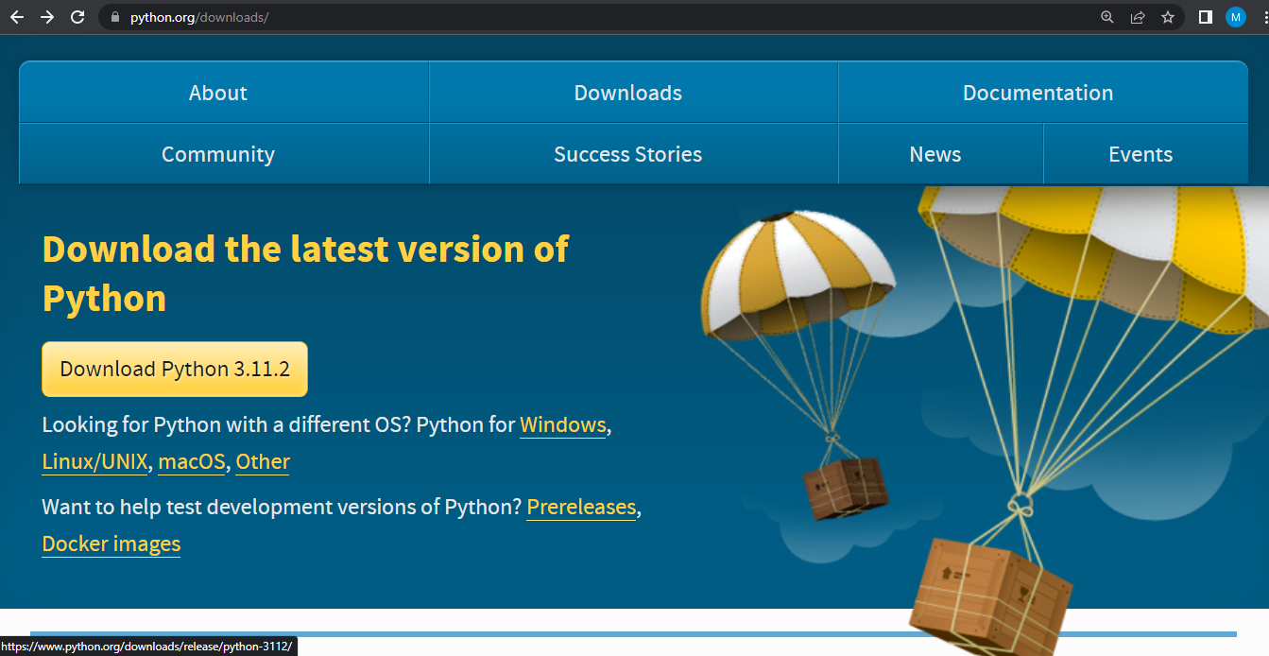
Steps to Install Python
Step 1: Download Python - Go to the official Python website: https://www.python.org/downloads/. Choose the correct version for your OS (Windows, macOS, Linux).

Slide 33
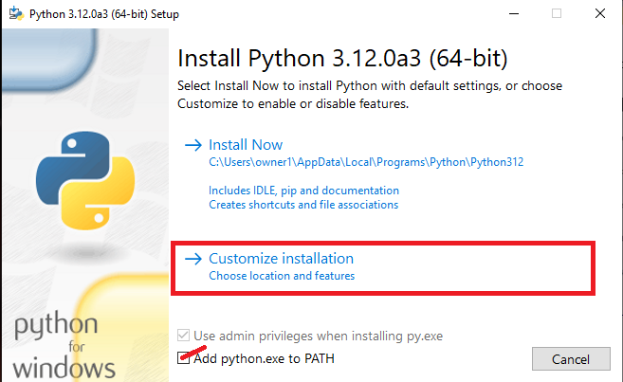
Steps to Install Python
Step 2: Run the installer
Check on “Add python.exe to PATH” then select “Customize installation”.

Slide 34
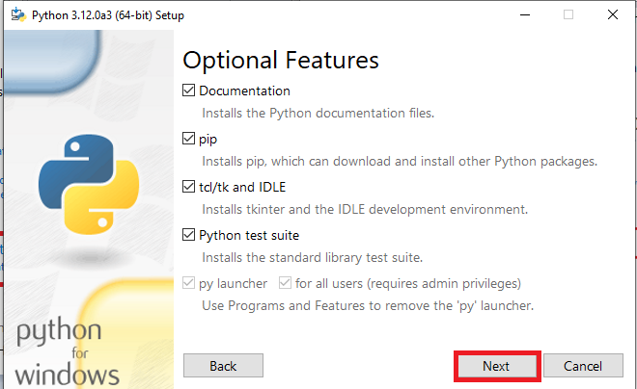
Steps to Install Python
Step 2: Run the installer
Click Next

Slide 35
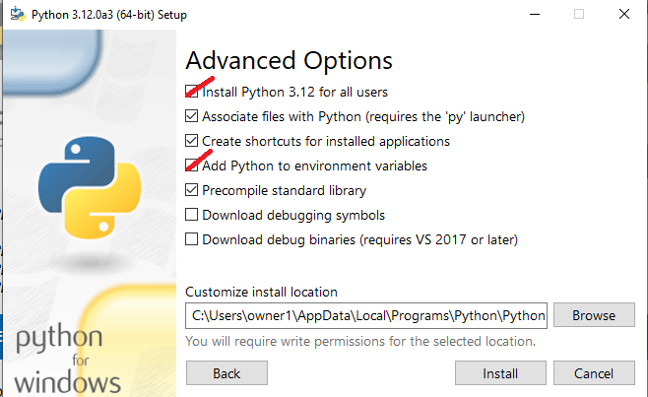
Steps to Install Python
Step 2: Run the installer
Check on “Install Python 3.12 for all users” and “Add Python to environment variables” then, click install. A dialogue box will appear, click “Yes” then wait for the installation to be done.

Slide 36
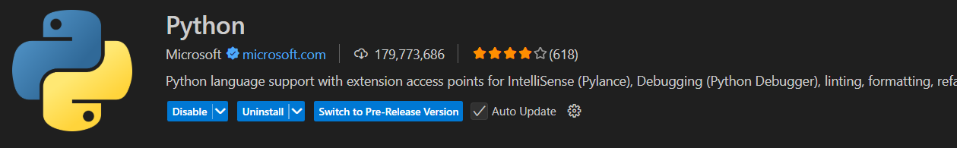
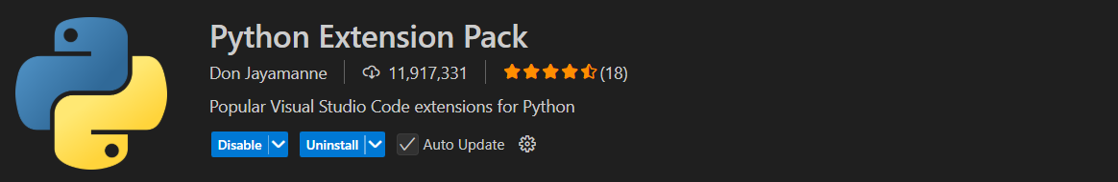
Installing Python on VSCode
Step 1: On your VSCode, go to extensions and download the following extensions
Step 2: Create python file then run the program to test.

