Slide 1




Chapter 4: Intermediate Elements 1

Slide 2
Lesson 4.2: Python Functions

Slide 3

Python functions
A function is a block of reusable code that performs a specific task. It makes code modular, reusable, and easier to debug.
Built-in functions - These are pre-defined codes in Python.
User-defined functions - Created by the programmer using the def keyword.

Slide 4
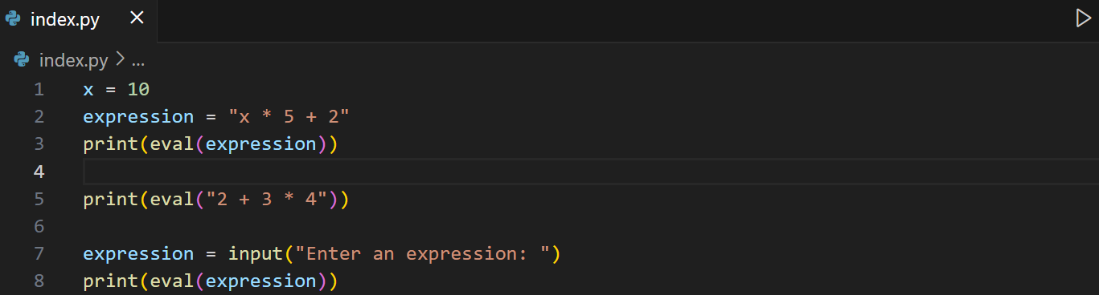
Python built-in functions
1. eval() - Evaluates a string as a Python expression. Also works with user input (string only).
Syntax: eval(expression)
          -> expression : str
Example:

Slide 5
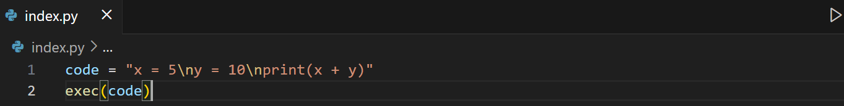
Python built-in functions
2. exec() - The exec() function in Python allows you to dynamically execute Python code (as a string or object). This means you can create and run Python code at runtime. Syntax: eval(object)
          object -> The string or code object you want to execute.
Example 1:

Slide 6
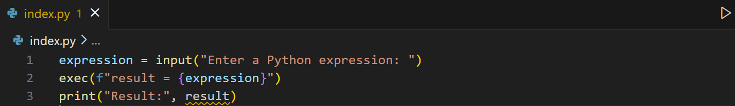
Python built-in functions
2. exec() - The exec() function in Python allows you to dynamically execute Python code (as a string or object). This means you can create and run Python code at runtime. Syntax: eval(object)
          object -> The string or code object you want to execute.
Example 2:

Slide 7
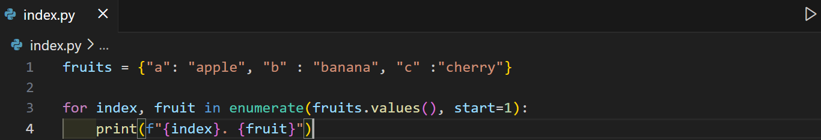
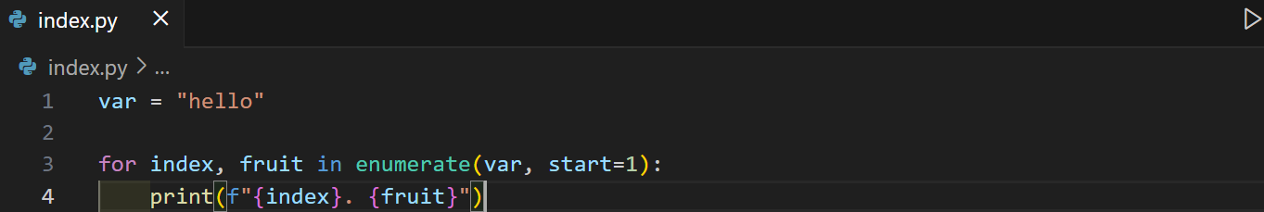
Python built-in functions
3. enumerate() - Adds a counter (index) to an iterable.
Syntax: enumerate(iterable, start = 0)
          start :int -> index start value (default = 0) optional
Example:

Slide 8
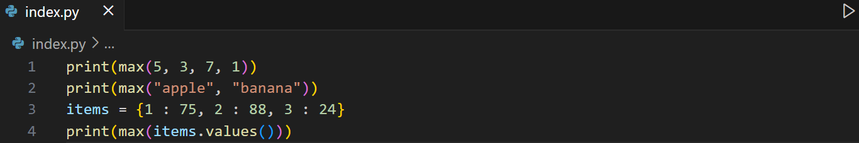
Python built-in functions
4. max() - Returns the largest value.
Syntax: max(iterable) or max(n1, n2, n3)
Example:

Slide 9
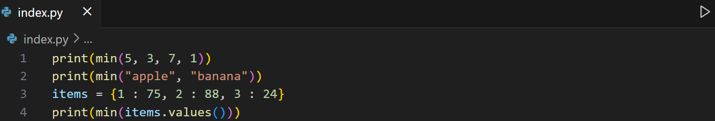
Python built-in functions
5. min() - Returns the smallest value.
Syntax: min(iterable) or min(n1, n2, n3)
Example:

Slide 10
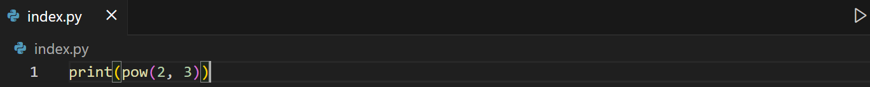
Python built-in functions
6. pow() - Raises a number to a power.
Syntax: pow(base, exponent)
          base :int
          exponent : int
Example:

Slide 11
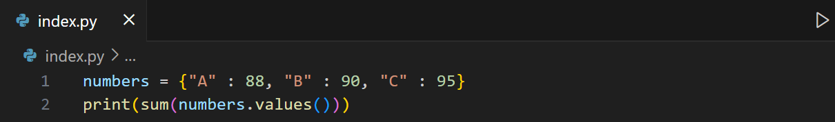
Python built-in functions
7. sum() – The sum() function returns a number, the sum of all items in an iterable.
Syntax: sum(iterable, start)
start : float -> A value that is added to the return value
Example:

Slide 12
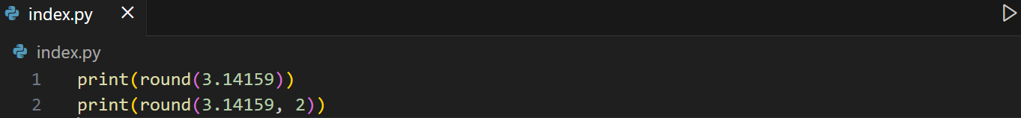
Python built-in functions
8. round() - Rounds a number to nearest integer or given decimals.
Syntax: round(number, ndigits)
          ndigits : int -> number of decimal places (optional)
Example:
Other built-in methods: str(), int(), float(), complex(),
list(), tuple(), dict(), set() bool(), print(), input(), type(), len()

Slide 13
Learning Activity
Write a program that:
Asks the teacher to input multiple student scores (loop until -1 is entered) and stores all scores in a dictionary.
Display the maximum, minimum score, rounded average(2 decimal places)
Displays all scores with their index numbers.
Sample output:
Enter score (-1 to stop): 80
Enter score (-1 to stop): 90
Enter score (-1 to stop): 75
Enter score (-1 to stop): -1
Scores entered:
1. 80
2. 90
3. 75
Highest Score: 90
Lowest Score: 75
Average (rounded): 82
Notes:
scores = {}
count = 0
while True:
score = input("Enter score: ").strip()
if score.isnumeric():
scores.update({count : int(score)})
count += 1
else:
if score == "-1":
break
print("Invalid score")
total = 0
for index, score in enumerate(scores.values(), start =1):
print(f"{index}. {score}")
total += score
if len(scores) != 0:
print(f"Highest Score: {max(scores.values())}")
print(f"Lowest Score: {min(scores.values())}")
print(f"Average: {round(total/count,2)}")
else:
print(f"Highest Score: 0")
print(f"Lowest Score: 0")
print(f"Average: 0")

Slide 14
Python user-defined functions
Syntax:
def function_name(parameters):
return value
def -> keyword to define a function
function_name -> name of the function
parameters -> inputs (optional)
return -> sends value back to caller (optional)

Slide 15
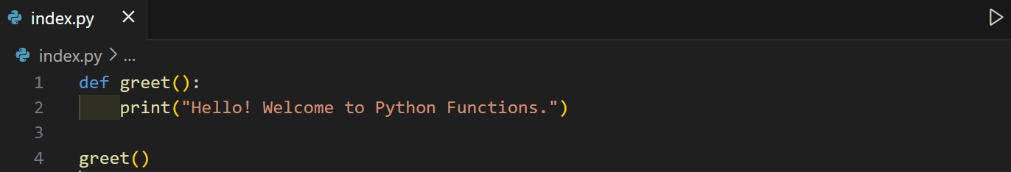
Python user-defined functions
1. Function without parameters & without return
Example:

Slide 16
Learning Task
Write a function print_greeting() that displays:
Welcome to Python Functions!

Slide 17
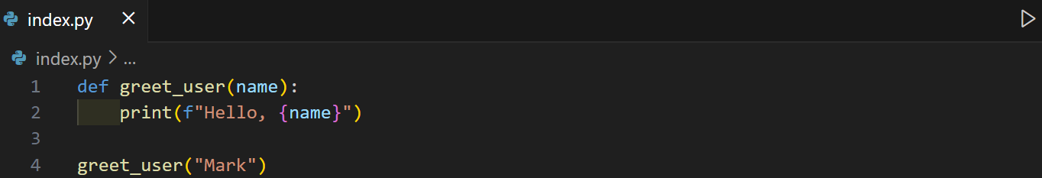
Python user-defined functions
2. Function with 1 or more parameters
Example:

Slide 18
Learning Task
Write a function calculate_area(length, width) that takes two parameters and prints the area of a rectangle.
Write a function calculate_discount(price, discount) that takes an item’s price and a discount percentage, then prints the final price after applying the discount.
Notes:
IT4A
def calculate_discount(price, discount):
print(f"Original price: {price}")
print(f"Discounted price: {price - (price * (discount/100))}")
while True:
price = input("Enter price: ").strip()
discount = input("Enter discount: ").strip()
if price.isnumeric() and discount.isnumeric():
calculate_discount(int(price), int(discount))
break
else:
print("Invalid amounts.")

Slide 19
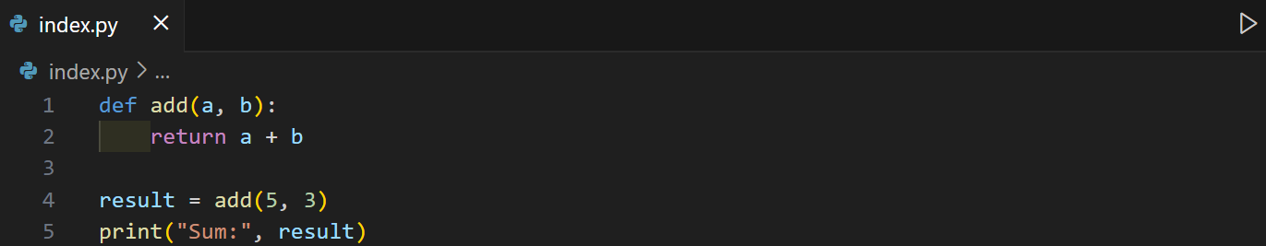
Python user-defined functions
3. Function with 1 or more return value
Example 1:

Slide 20
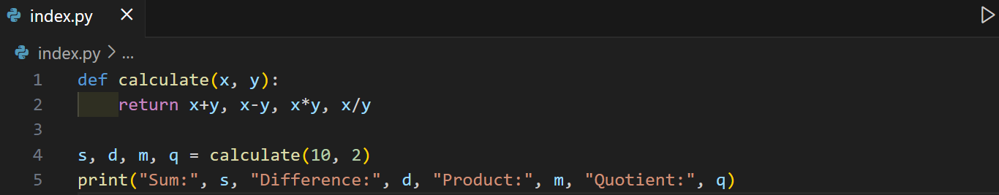
Python user-defined functions
3. Function with 1 or more return value
Example 2:
Note: The number of return values should match the number of variables.

Slide 21
Learning Task
Ask the user for student name and their score and store it on a dictionary terminated when the user input for the student's name is “stop”.
If a name already exist, notify the user that it is already exist then prompt the user to enter a new name. Provide sanitation for user inputs (extra spaces, case-insensitive, no inputs, etc.)
Create a function get_min_max(grades) that accepts a dictionary of student names as keys and student scores as values and returns both the lowest and highest score.
Notes:
def get_min_max(studList):
return max(studList.values()), min(studList.values())
grades = {}
while True:
name = input("Enter your name: ").lower().strip()
if name == "stop":
break
elif name in grades:
print(f"{name} already exists.")
elif name.isalpha():
while True:
score = input(f"Enter {name}'s score: ")
fscore = score.replace(".", "")
if fscore.isnumeric():
grades.update({name : float(score)})
break
else:
print(f"{score} is invalid.")
else:
print(f"{name} is invalid.")
if len(grades) > 0 :
high, low = get_min_max(grades)
print("Highest scores: ")
for key, val in grades.items():
if val == high:
print(f"{key} : {val}")
print("Lowest scores: ")
for key, val in grades.items():
if val == low:
print(f"{key} : {val}")
else:
print("Highest scores: None")
print("Lowest scores: None")

Slide 22
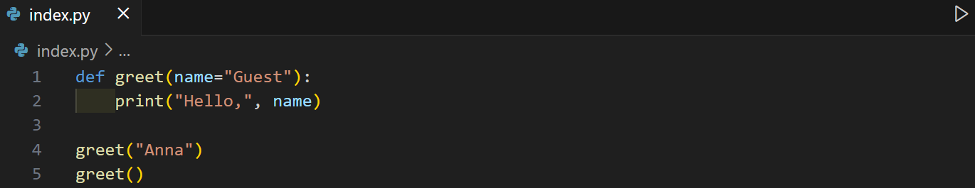
Python user-defined functions
4. Function with default parameter
Example:
Note: If function has multiple parameters, the one with default values should be at the last or else you get a
SyntaxError: non-default argument follows default argument

Slide 23
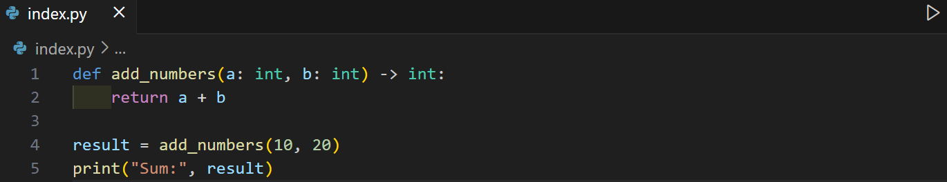
Python user-defined functions
5. Function with data type hints
Example 1:

Slide 24

Python user-defined functions
5. Function with data type hints
Example 2:

Slide 25
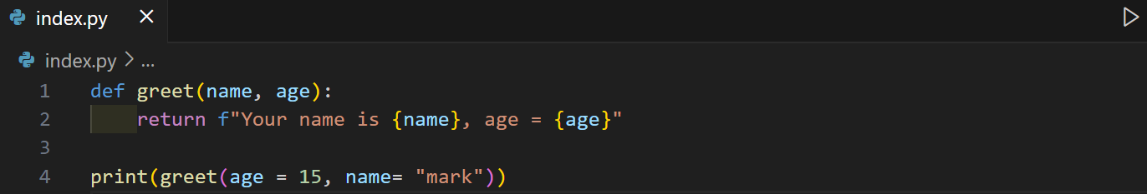
Python user-defined functions
6. Function Keyword Arguments - You can also send arguments with the key = value syntax. This way the order of the arguments does not matter.
Example:

Slide 26
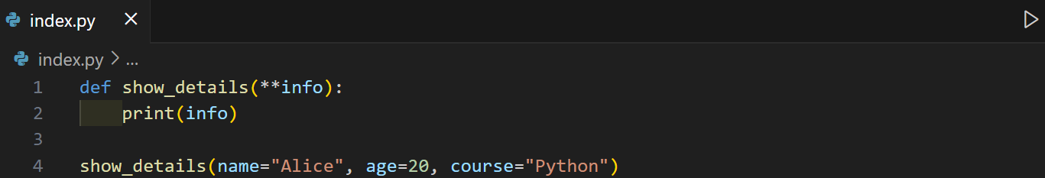
Python user-defined functions
7. Function with variable number of keyword arguments (**kwargs)
- It allows multiple keyword arguments. If the number of keyword arguments is unknown, add a ** before the parameter name. This way the function will receive a dictionary of arguments and can access the items accordingly.
Example 1:

Slide 27
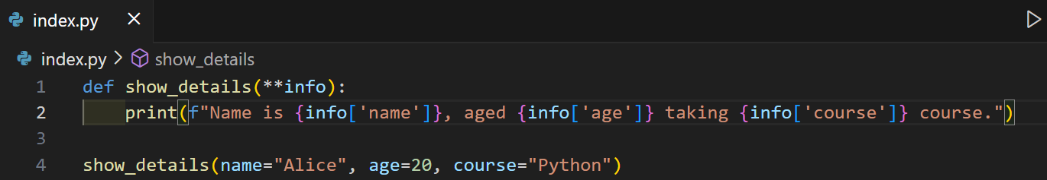
Python user-defined functions
7. Function with variable number of keyword arguments (**kwargs)
- It allows multiple keyword arguments. If the number of keyword arguments is unknown, add a ** before the parameter name. This way the function will receive a dictionary of arguments and can access the items accordingly.
Example 2:

Slide 28
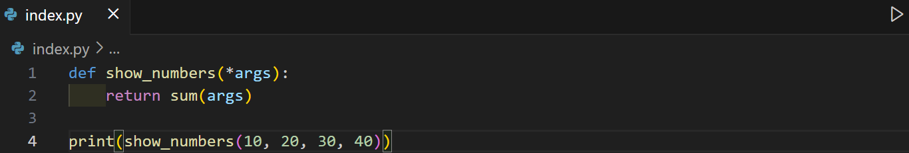
Python user-defined functions
8. Function with variable number of arguments (*args)
- It allows multiple positional arguments. If the number of arguments is unknown, add a * before the parameter name. This way the function will receive a tuple of arguments and can access the items accordingly.
Example 1:

Slide 29
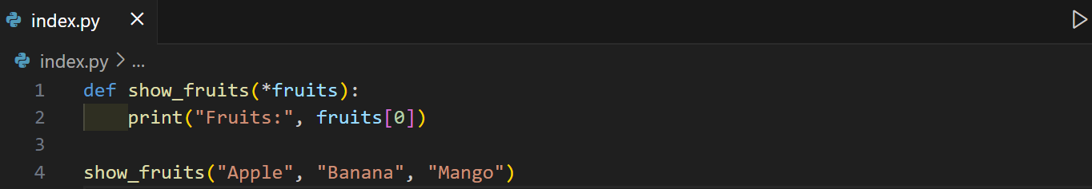
Python user-defined functions
8. Function with variable number of arguments (*args)
- It allows multiple positional arguments. If the number of arguments is unknown, add a * before the parameter name. This way the function will receive a tuple of arguments and can access the items accordingly.
Example 2:

Slide 30
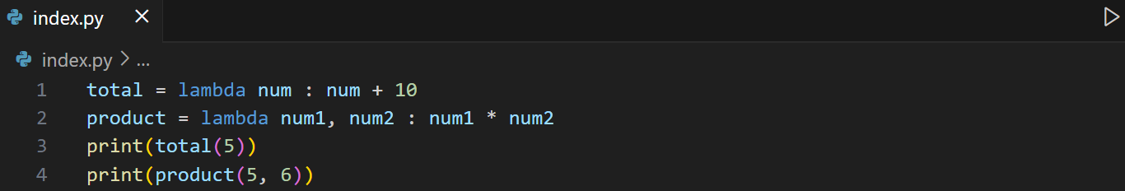
Python user-defined functions
9. Lambda Functions (Anonymous Functions)
- A lambda function is a small anonymous function. A lambda function can take any number of arguments but can only have one expression.
Syntax: lambda arguments : expression
Example:

Slide 31
Learning Task
Write a program that asks the user for a number and uses a lambda function to return whether it is even or odd.
Write a program that asks the user for a 1-word string then use a lambda function to return whether it is a palindrome or not.
Notes:
number = int(input("Enter a number: "))
result = lambda num: "even" if num % 2 == 0 else "odd"
##def total(num1, num2):
## return num1 + num2
print(result(number))

Slide 32
Python user-defined functions
10. Recursive function
- Recursion is a programming technique where a function calls itself to solve a problem. It is typically used for problems that can be broken down into smaller, similar sub-problems. A recursive function must have:
Base Case: A condition that stops the recursion.
Recursive Case: The part of the function where it calls itself to continue the process.

Slide 33
Python user-defined functions
10. Recursive function
How it works?
Each function call is placed on the call stack, which keeps track of its execution context. The call stack is a data structure that tracks function calls in a program.
The base case ensures the recursion terminates, preventing infinite loops. It acts as the "exit condition" for the recursive function.
As the function unwinds, the results of smaller sub-problems are combined to solve the original problem.

Slide 34
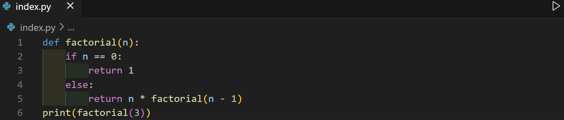
Python user-defined functions
10. Recursive function
Example 1: The factorial of a number n is defined as:
n! = n×(n−1)!
Base case: 0! = 1

Slide 35
Learning Task
Write a Python program to get the sum of a non-negative integer using recursion.
Sample Output:
Enter a number: 345
The sum is 12.

Slide 36
Learning Assessment 1
You are given an integer n. You have to print all numbers from 1 to n.
Note: You must use recursion only and print all numbers from 1 to n in a single line, separated by spaces.
Input: n = 10
Output: 1 2 3 4 5 6 7 8 9 10
Input: n = 1
Output: 1

Slide 37
Learning Assessment 2
Program Requirements:
Add Student Record - Create a function adds a student’s name as the key and their grade as the value in the dictionary. If the name already exists (case-insensitive), notify the user then ask again.
Update Student Grade - Create a function to update the grade of an existing student. Ask for a name to search (case-insensitive) then, if exist, ask for the new grade, otherwise, notify the user that name not found.
Compute Class Statistics - Create a function that returns the average, highest & lowest grade with their name.
Display all records – Create a function that prints all student names and grades in a clean format.
Create a loop that allows users to choose: add student, update student, show class statistics, display all records, exit

Slide 38
Lesson 4.3: Python Exceptions

Slide 39
Python Exceptions
An exception is an error that occurs while a program is running. If not handled, it stops the program. Exceptions are different from syntax errors (which occur before running).
Syntax:
try:
# code that may raise error
except ExceptionType:
# code to handle the error

Slide 40
Python Common Exceptions
Common Exception Classes | Definition
Exception | Base class for all exceptions
AttributeError | Raised when attribute reference or assignment fails
ImportError | Raised when an imported module does not exist
IndentationError | Raised when indentation is not correct
IndexError | Raised when an index of a sequence does not exist
KeyError | Raised when a key does not exist in a dictionary

Slide 41
Python Common Exceptions
Common Exception Classes | Definition
NameError | Raised when a variable does not exist
StopIteration | Raised when the next() method of an iterator has no further values
SyntaxError | Raised when a syntax error occurs
TypeError | Raised when two different types are combined
ValueError | Raised when there is a wrong value in a specified data type
ZeroDivisionError | Raised when the second operator in a division is zero

Slide 42
Python Basic try-except
Example: Handling invalid integer input from a user.
try:
age = int(input("Enter your age: "))
print("Your age is", age)
except ValueError:
print("Invalid input. Please enter a number.")

Slide 43
Learning Task
Write a program that ask for 2 integer values. If any input is invalid, catch the exception then ask again for a new values.
If all inputs are valid, display the sum.

Slide 44
Python multiple except blocks
Example: Handling zero division error.
try:
num1 = int(input("Enter first number: "))
num2 = int(input("Enter second number: "))
print("Result:", num1 / num2)
except ValueError:
print("Error: Please enter valid integers.")
except ZeroDivisionError:
print("Error: Division by zero is not allowed.")

Slide 45
Learning Task
Write a program that ask for 2 integer values (dividend and divisor). If any input is invalid, catch the exception then ask again for a new values.
If the divisor provided is zero, catch also the exception and ask again for new dividend and divisor.
If all inputs are valid, display the quotient.

Slide 46
Python single except for multiple exceptions
Example: Convert string to integer and perform math
try:
data = input("Enter a number: ")
result = int(data) + 5
print("Result:", result)
except (ValueError, TypeError) as e:
print("Error occurred:", e)
-> Try to enter letters on the input.

Slide 47
Python exception with else
Example: Square of a valid input
try:
x = int(input("Enter a number: "))
except ValueError:
print("Invalid number")
else:
print("Square is", x * x)
Note: The else block only runs if no exceptions occurred.

Slide 48
Python exception with finally
Example: Convert string to integer and perform math
try:
data = input("Enter a number: ")
result = int(data) + 5
except (ValueError, TypeError) as e:
print("Error occurred:", e)
else:
print("Result:", result)
finally:
print("Done.")
Note: The finally block always run even if exception is occurred.

Slide 49
Python raising exceptions
It force an error to occur.
Example:
def withdraw(amount: float):
if amount <= 0:
raise ValueError("Withdrawal amount must be positive.")
print("Withdrawn:", amount)
try:
withdraw(-500)
except ValueError as e:
print("Error:", e)

Slide 50
Python custom exceptions
We can define your own error type by creating a class.
Example:
class NegativeNumberError(Exception):
pass
def compute_sum(numbers: list[int]) -> int:
for n in numbers:
if n < 0:
raise NegativeNumberError("Negative numbers not allowed.")
return sum(numbers)
try:
nums = [10, 20, -5, 30]
print("Sum =", compute_sum(nums))
except NegativeNumberError as e:
print("Custom Error:", e)
You need to pass Exception as the parent class if you want to define a custom exception as it was the base class for all built in exceptions.

Slide 51
Learning Assessment 1
The program should:
Ask the user how many students they want to enter.
For each student, input name and 3 grades and store it in a dictionary.
Validate inputs: Name should be a string (letters only).
Grades must be numeric and between 0–100.
Define a function to compute the student’s average grade.
Assign remarks: "Pass" if average ≥ 75, otherwise "Fail".
Use exception handling to catch errors.
Custom message if grade is out of range.
Use loops for a) entering multiple students, b) Re-prompting if input is invalid.
Display all students in a formatted output.

Slide 52
Learning Assessment 2
Start with a default balance of ₱10,000.
The program should repeatedly show a menu:
1. Deposit
2. Withdraw
3. Check Balance
4. Exit
Use a function for each transaction
Validate inputs: Deposit and withdrawal amounts must be numeric and positive.
Withdrawal should not exceed available balance (raise exception if insufficient).
Use exception handling to catch invalid inputs.
Use a loop so the program continues until the user chooses Exit.

