Slide 1




Chapter 4: Intermediate Elements 1

Slide 2
Lesson 4.4: Lists

Slide 3

Python list
A list is a collection that can store multiple items in a single variable. It is ordered, mutable, and can hold different data types. It is defined using square brackets []. List allow duplicate values since elements are indexable.

Slide 4
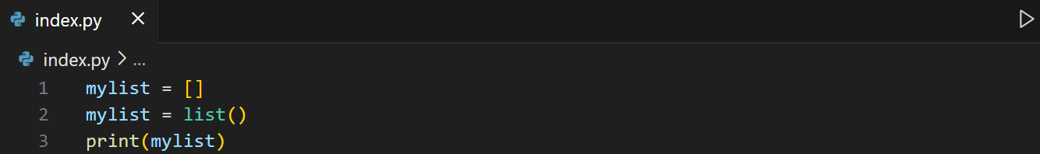
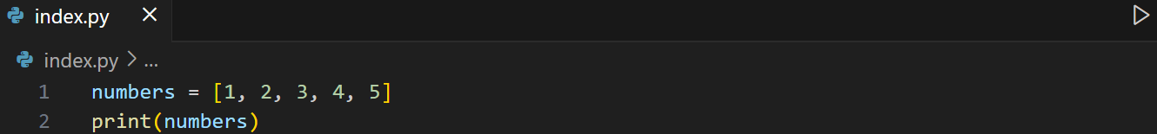
Creating lists
Example 1: Empty list
Example 2: List of the same data type

Slide 5
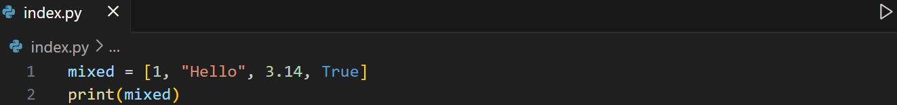
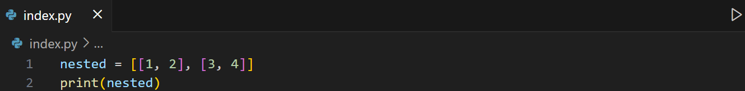
Creating lists
Example 3: List with mixed data types
Example 4: Nested list

Slide 6
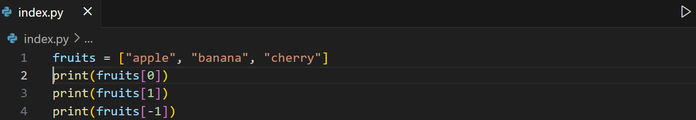
Accessing list elements
To access list elements, use an index.
Example 1: Single index

Slide 7
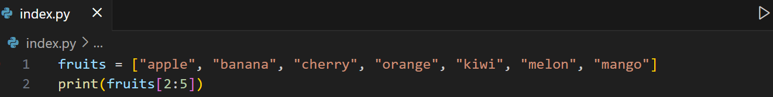
Accessing list elements
To access list elements, use an index.
Example 2: Range of indexes
Note: Negative indexes can be also applied.

Slide 8
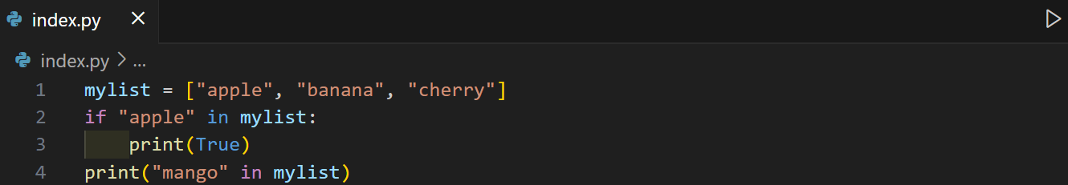
Checking if element exists
Use in operator to check.
Example:

Slide 9
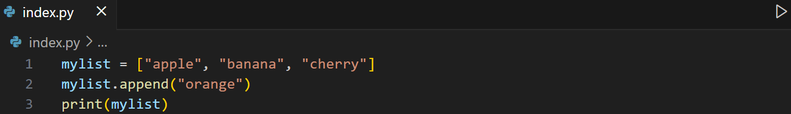
Adding list elements
1. append() method – add 1 item at a time.
Syntax:
var.append(elem)
Example:

Slide 10
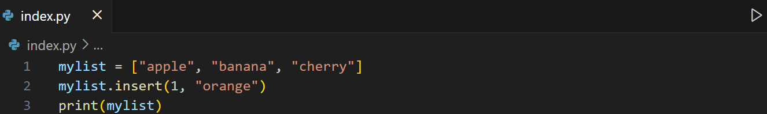
Adding list elements
2. insert() method – add 1 item at a time at the specified index.
Syntax:
var.insert(index, elem)
Example:

Slide 11
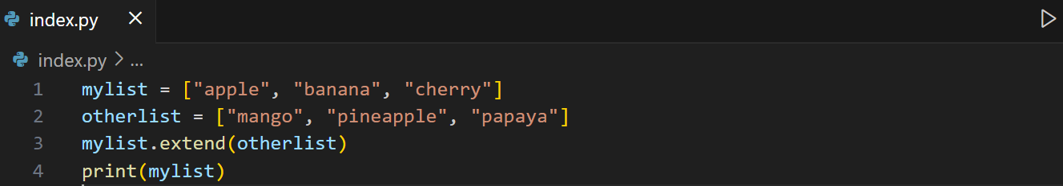
Adding list elements
3. extend() method – add elements from another list or iterable.
Syntax:
origlist.extend(iterable)
Example:

Slide 12
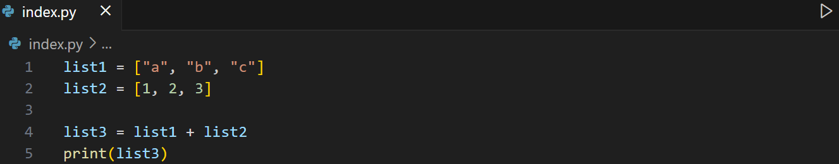
Adding list elements
4. Using the + operator – add elements from another list.
Syntax:
finalist = firstList + secondList + … + otherlist
Example:

Slide 13
Learning Activity
Write a program that:
Asks the teacher to input multiple student scores (loop until -1 is entered) and stores all scores in a list.
Display the maximum, minimum score, rounded average(2 decimal places)
Displays all scores with their index numbers.
Sample output:
Enter score (-1 to stop): 80
Enter score (-1 to stop): 90
Enter score (-1 to stop): 75
Enter score (-1 to stop): -1
Scores entered:
0. 80
1. 90
2. 75
Highest Score: 90
Lowest Score: 75
Average (rounded): 82

Slide 14
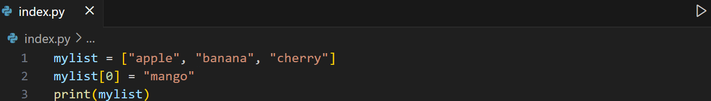
Updating list elements
1. To change value of a specific item, refer to the index number.
Syntax:
var[index] = NV
Example:

Slide 15
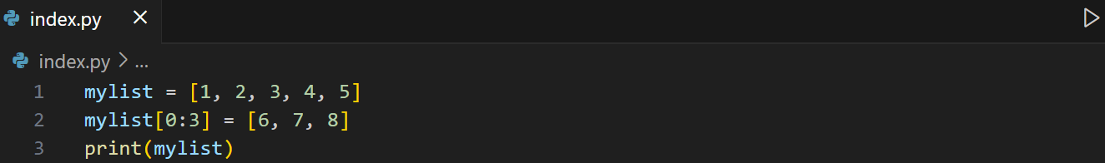
Updating list elements
2. To change value of items, define a list with the new values and refer to the range of indexes.
Syntax:
var[startindex : endindex] = [V1, V2, etc]
Example 1: Exact number of new values

Slide 16
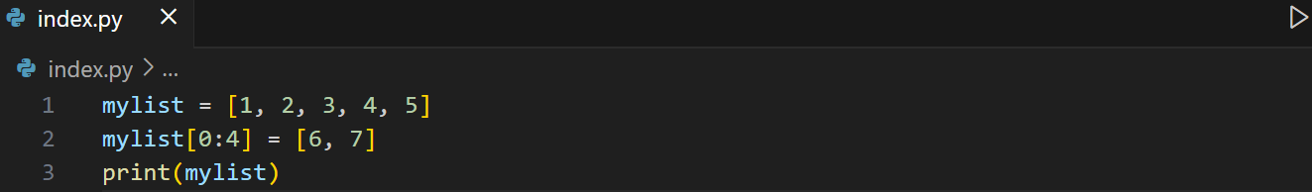
Updating list elements
2. To change value of items, define a list with the new values and refer to the range of indexes.
Syntax:
var[startindex : endindex] = [V1, V2, etc]
Example 2: More range of index, less values
Note: If less values are provided than the index range, the list length changed.

Slide 17
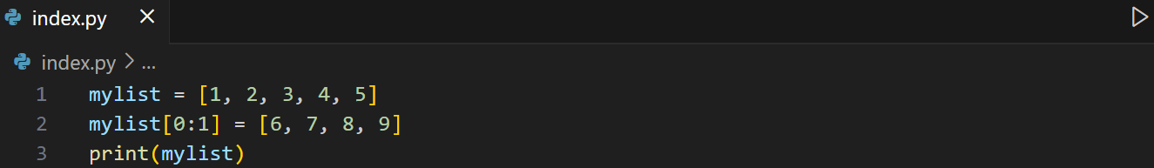
Updating list elements
2. To change value of items, define a list with the new values and refer to the range of indexes.
Syntax:
var[startindex : endindex] = [V1, V2, etc]
Example 3: Less range of index, more values
Note: If more values are provided than the index range, all the excess values will be added after the startindex and remaining elements will move accordingly.

Slide 18
Learning Activity
Revise your code on the previous learning activity:
After showing the highest, lowest, and average score, ask for a search value terminated by "stop". If search value is in the list, ask for a new value to replace it, otherwise, ask again for a new search value.
Once user entered "stop", show again the updated highest, lowest, and average score.
Notes:
scores = []
while True:
score = int(input())
if score == -1:
break
else:
scores.append(score)
high = max(scores)
low = min(scores)
print(f"Highest:")
for i in scores:
if i == high:
print(i)
print(f"Lowest: ")
for i in scores:
if i == low:
print(i)
print(f"Average: {sum(scores) / len(scores)}")
index = 0
while index < len(scores):
print(index ,"", scores[index])
index += 1
while True:
searchVal = input("Enter search value: ")
if searchVal == "stop":
break
else:
for i, val in enumerate(scores):
if val == int(searchVal):
newVal = int(input("Enter new value: "))
scores[i] = newVal
break
else:
continue
high = max(scores)
low = min(scores)
print(f"Updated Highest:")
for i in scores:
if i == high:
print(i)
print(f"Updated Lowest: ")
for i in scores:
if i == low:
print(i)
print(f"Updated Average: {sum(scores) / len(scores)}")

Slide 19
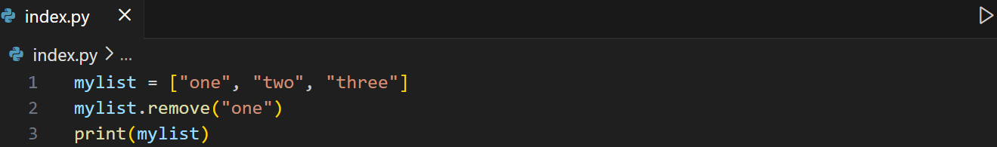
Removing list elements
1. remove() – It removes 1 item at a time with the specified value.
Syntax:
var.remove("value") -> if value not string, they’re not quoted
Example:
Note: You can still store the value of the remove item in a variable.

Slide 20
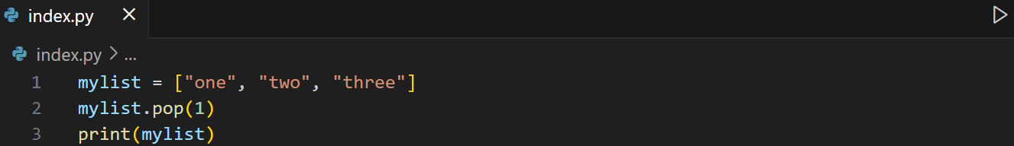
Removing list elements
2. pop() – It removes 1 item at a time with the specified index. If not, it removes the last inserted element.
Syntax:
var.pop(index) -> index : int (optional)
Example:
Note: You can still store the value of the remove item in a variable.

Slide 21
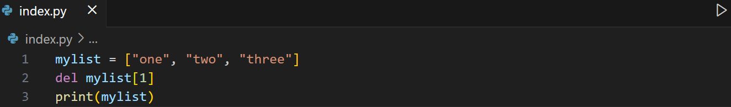
Removing list elements
3. clear() – It removes all the list elements
Syntax:
var.clear()
4. del keyword – removes 1 element with the specified index. It can also delete the list completely.
Example:

Slide 22
Learning Activity
Revise your code on the previous learning activity:
Loop through the scores, remove any duplicate values using while loop and pop() method. After removing duplicates, show the highest, lowest, and average scores.

Slide 23
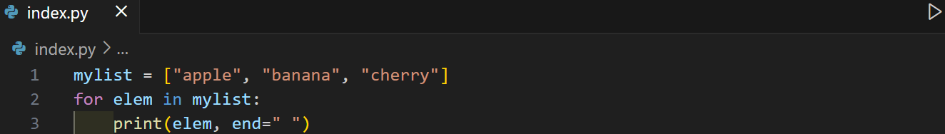
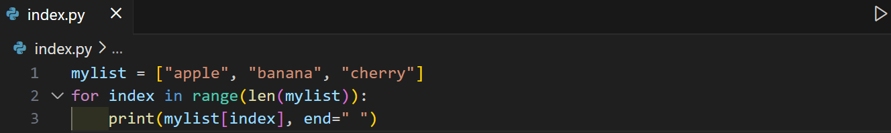
Looping list elements
Example 1: Looping through list
Example 2: Using range() and len()

Slide 24
List comprehension
With list comprehension, it lessens the number of lines coded.
Syntax:
new_list = [expression for item in iterable if condition]
Where:
expression -> what to put in the new list (can be the item itself, or some operation on it)
item -> variable representing each element from the iterable (like a loop variable)
iterable -> a collection (list, range, string, etc.) that you’re looping through
condition (optional) -> filter; only include items that satisfy this

Slide 25
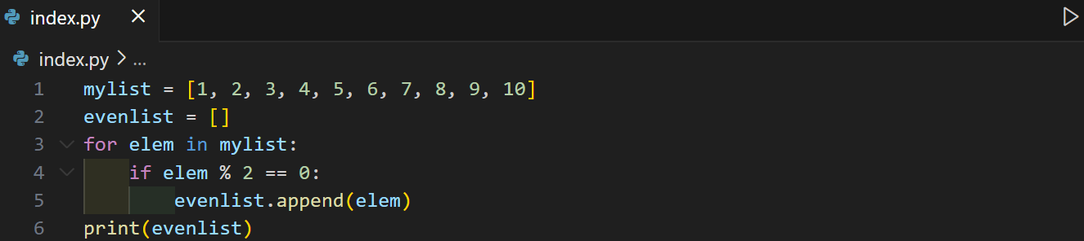
List comprehension
Scenario: Let’s say you want a new list containing only the even numbers in a list. Some write the code like this:

Slide 26
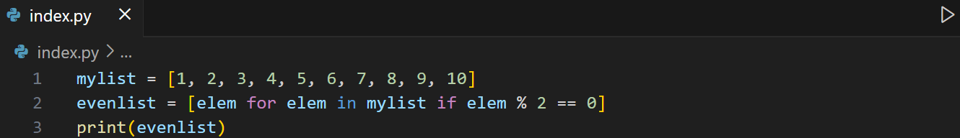
List comprehension
Using list comprehension, it just 1 line.

Slide 27
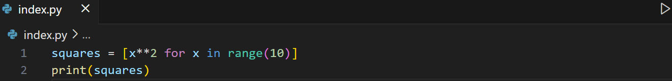
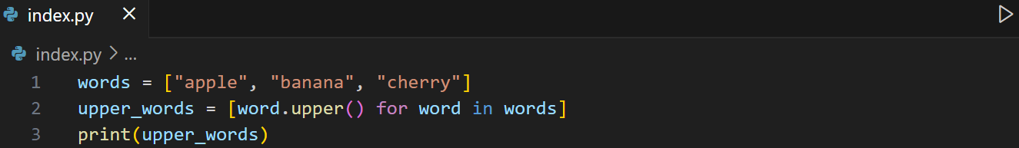
List comprehension
Another examples:
Square of numbers 0–9
Convert words to uppercase

Slide 28
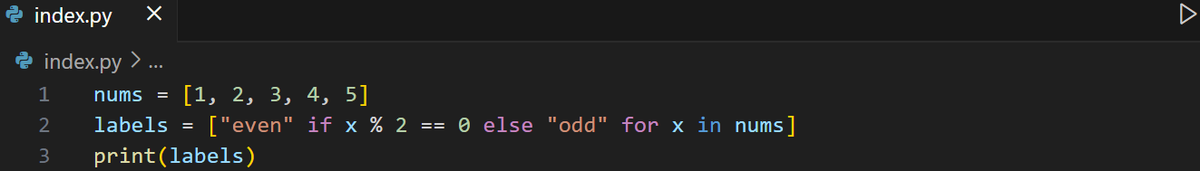
List comprehension
Another examples:
c) Using if else

Slide 29
Learning Activity
Write a program that asks the user for how many students score he/she needs to enter. Use exceptions to catch any errors. Then create a function that ask the scores for each of the student. Then use list comprehension to filter only the even numbers.
Display all the scores with equivalent remarks
greater than or equal to 75 – pass
Less than 75 - failed

Slide 30
Sorting list
sort() - modifies the original list in place.
sorted() - returns a new sorted list, leaving the original list unchanged where you need a new variable to display its output.
reverse() – reverses the arrangement of the list

Slide 31
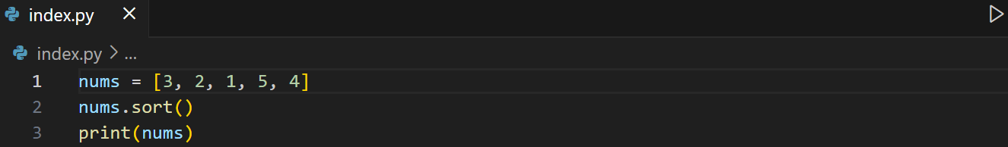
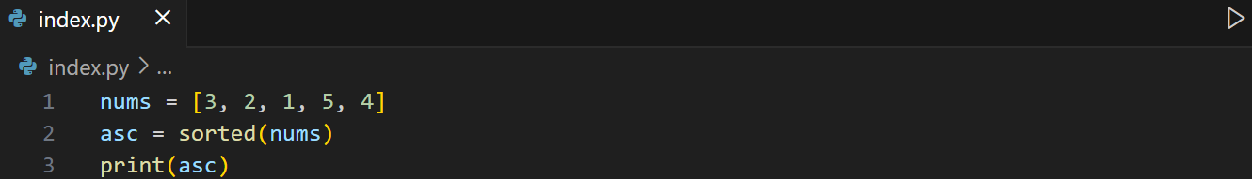
Sorting list
1. Ascending – use sort() method to arrange the list of the same data type ascending.

Slide 32
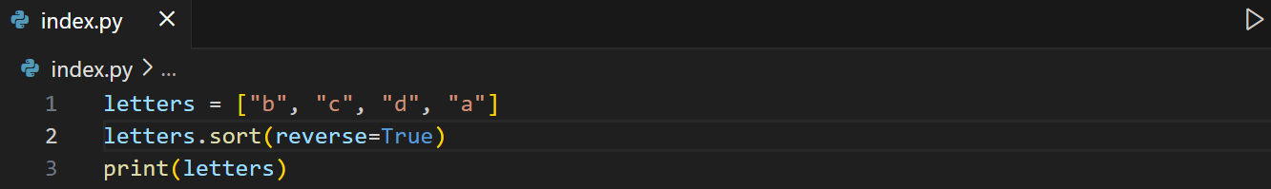
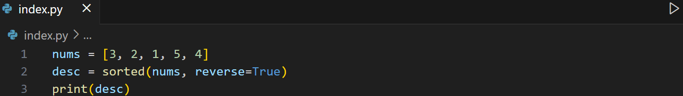
Sorting list
2. Descending – use keyword argument: reverse = True in the sort() method to arrange the list of the same data type descending.

Slide 33
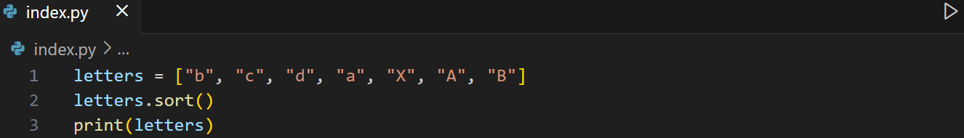
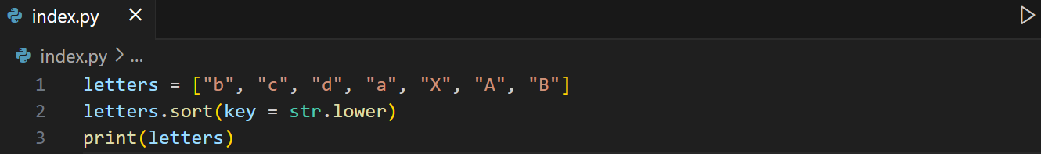
Sorting list
3. Case insensitive sort – by default, the sort() method is case sensitive where it arranged first the capital letters then the lowercase letters.
We can use the key function: key = str.lower

Slide 34
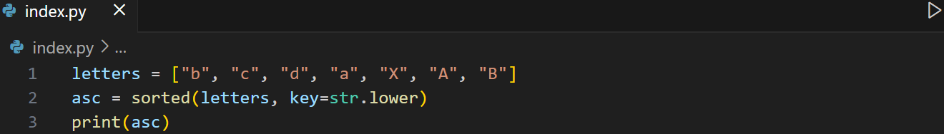
Sorting list
3. Case insensitive sort – by default, the sort() method is case sensitive where it arranged first the capital letters then the lowercase letters.
We can use the key function: key = str.lower

Slide 35
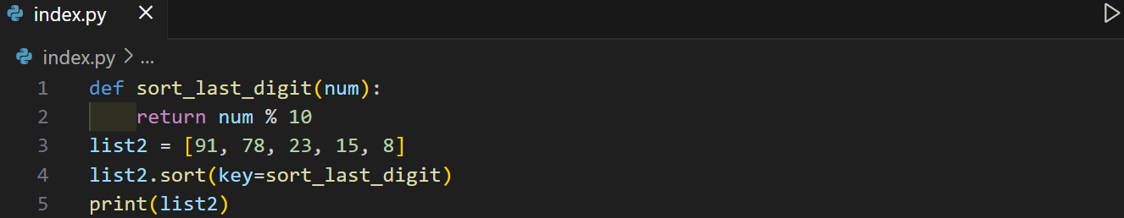
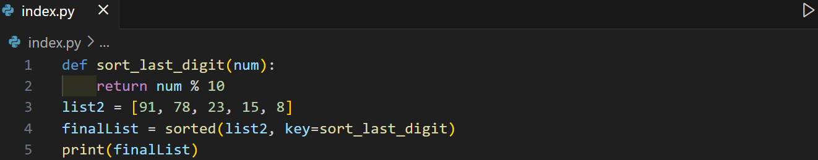
Sorting list
4. We can also pass a function to the key argument of the sort() method.

Slide 36
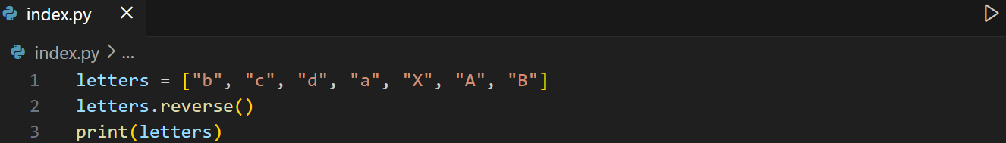
Sorting list
5. Reverse Order – Use reverse() method to reverse the arrangement of the list elements.

Slide 37
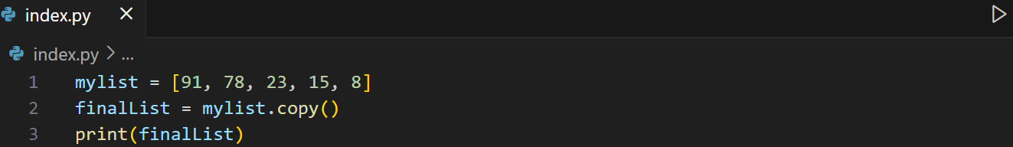
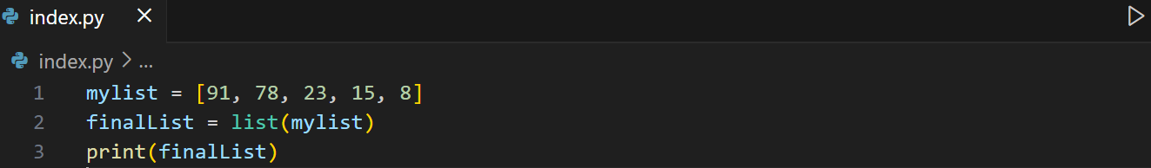
Copying list
copy() method
2. list() method

Slide 38
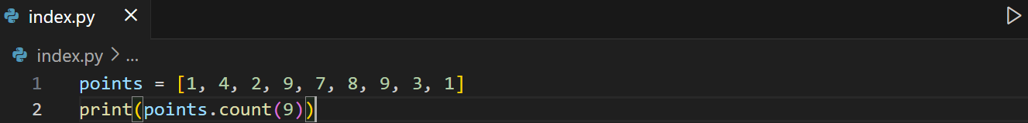
Counting occurrence
1. count() method – returns the number of elements with the specified value
Syntax: var.count(value)

Slide 39
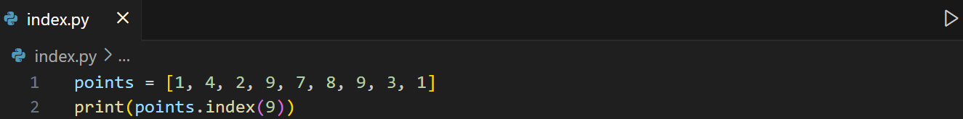
Finding index
1. index() method – returns the position at the first occurrence of the specified value.
Syntax: var.index(elem, start, end)
-> start : int and optional (where to start the search)
-> end : int and optional (where to end the search)

Slide 40
Learning Assessment
Start with an empty list of scores.
Provide a menu with the following options:
  1. Add Scores (with validation: 0–100 only) – terminated by -1
  2. Display Scores (all, max, min, mean, median, mode).
  3. Search and Replace Score.
  4. Remove Duplicates without affecting the original list (without using set()).
  5. Sort Scores (Ascending/Descending).
  6. Exit Program.
Use loops to keep showing the menu until exit is chosen.
Use functions for each item for modularity.
Use validations & exception handling for input validation.

