Slide 1

Page Header: Are you a Conspiracy Theorist?
Nav Bar
Home
Predictor
Analysis
Google Slides
Paragraph Explaining Outline of Project
Description of Project
Topic Decision
What do we want to answer
Identify the datasource
Dataset Limitations

Slide 2
Nav Bar
Home
Predictor
Analysis
Page Header: Conspiracist or Not??
Table of Drop Down Questions for the Predictor:
Questions such as:
Age
Relgion
Family Size
Urban
Orientation
Education
Gender
Race
Hand
Voted
Married
Button to Predict the Outcome from the questions entered
Reset Button to Reset Drop Down Sets

Slide 3
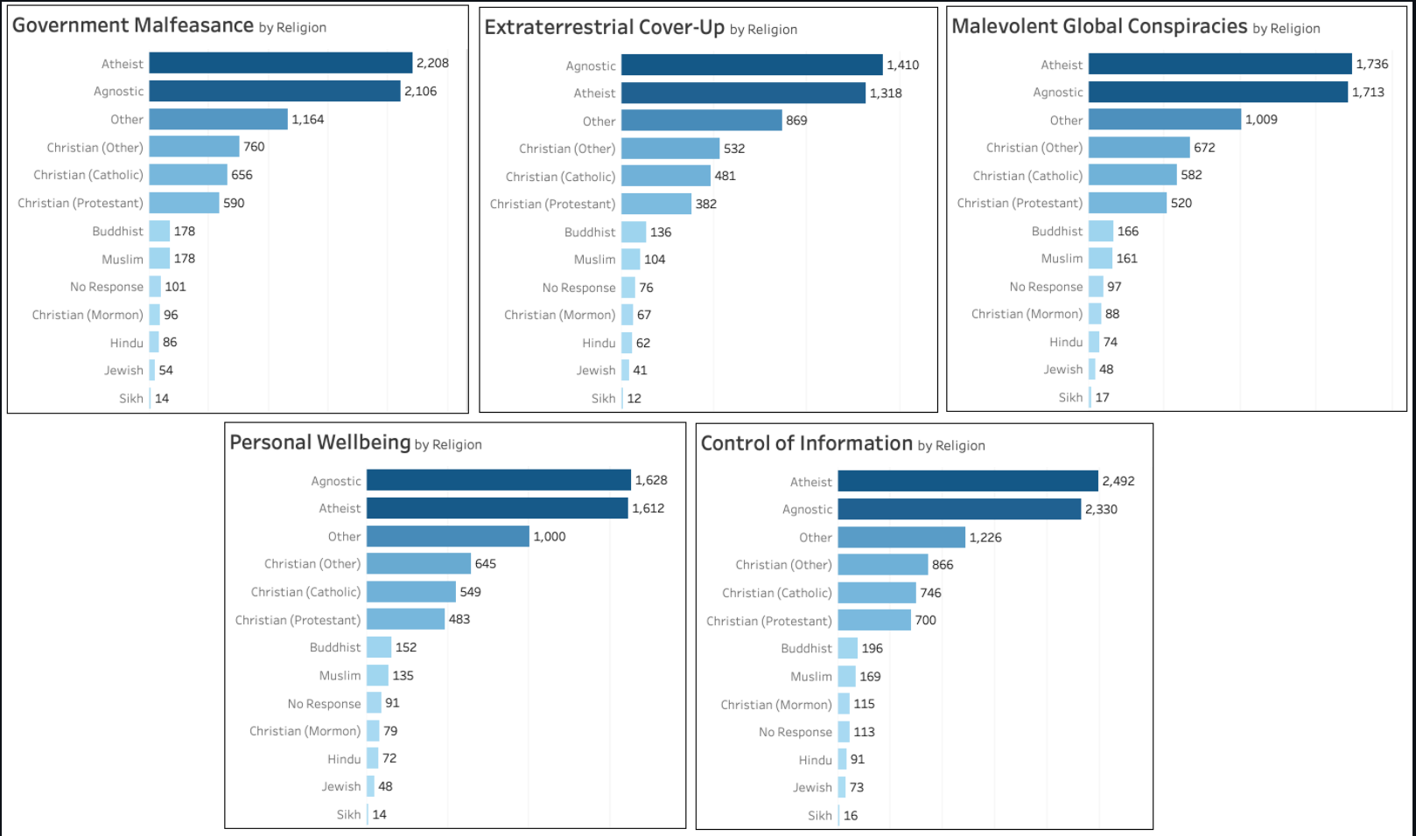
Page Header: Analysis
Nav Bar
Home
Predictor
Analysis
Graphs of Anomalies and/or Interesting Insights form the dataset

