Slide 1
Sharing
open data policy
at Korea Customs Service
Sun Min Park
Deputy Director
R&D and Equipment Division
KCS
Notes:
With icons from flaticon.com, pixabay.com, freepik.com

Slide 2

With the increasing importance of
utilizing data…

Slide 3




Data policy in Korea
Who’s in charge?

Slide 4
Data policy in Korea
“PUBLIC DATA”
wise…
Data Opening
Strategy
Set up standards for data opening
Public data
quality analysis
Public Data Act
2013
2014
2015
2016
2020
2019
2018
2017
Public data map,
Data platform
Total inspection of
public data
State-centered
Data opening
Inspection of unstructured
public data
Notes:
행정안전부> 업무안내> 정부혁신조직실> 공공데이터 개방> 공공데이터 개방 (mois.go.kr)

Slide 5

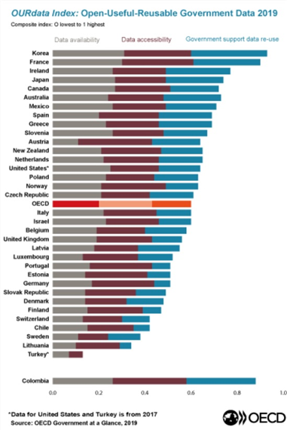
Data policy in Korea
Global leader in government data policy
Complete real estate data
National address data
Food and drugs data
Weather data
Traffic data
“http://www.data.go.kr”

Slide 6
Customs Data
What About Customs Data?

Slide 7
Customs Data
Clearance
Clearance_No | Name | Address | HS_code | … | Price(USD) | …
M189DHF123 | Sun | Daejeon, Seogu 210 chungsa | 012321 | … | 15150 | …
H593JDO023 | Chae | Cheonan,Namdonggu yeonsuwon 1 | 493940 | … | 837 | …
K239DCW049 | Dong | Seoul Teukbyul si 5 Gangnamdaero | 374704 | … | 2003 | …
Audit
Case_No | Company | Date | Tax(KRW) | … | Officer | …
001 | Marvin Inc. | 20201101 | 1231223 | … | Yoon | …
002 | Daun | 20091010 | 34320378 | … | Jae | …
003 | Never Inc. | 19790227 | 6007 | … | Min | …
Investigation
Case_No | Branch | Suspect | Goods | … | Fine | …
001 | Incheon | Kim | Gold | … | 8800 | …
002 | Busan | Park | Drug | … | 5767 | …
003 | Seoul | Lee | Tobacco | … | 420900 | …

Slide 8


Customs Data
Personal info
Taxation Data
NOT for public disclosure
Notes:
과세자료: 내부직원에게도 공개 불가

Slide 9


Customs Data
We need
SYNTHETIC DATA
Pseudonymization
Is NOT enough
To open to assess,
process,
analyze,
interpret…
Notes:
가명정보로는 불충분함 // 머그샷
‘that CLOSELY resembles REAL WORLD’

Slide 10

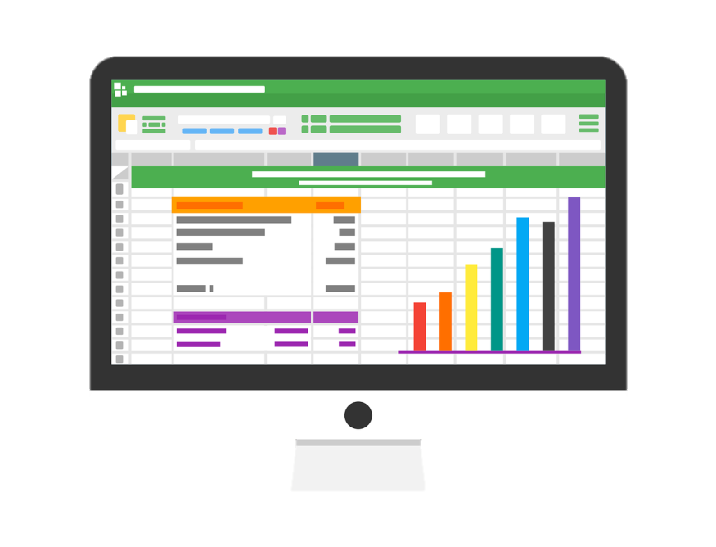

Synthetic Data
What can the people do with them?
Study
Predict
New business
Notes:
Honestly, the private sector are always better innovators. I cannot imagine what they can generate out of it.

Slide 11
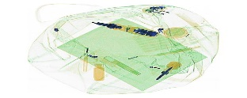

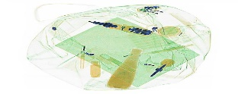
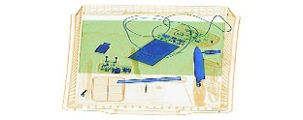


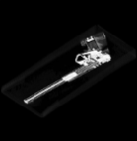

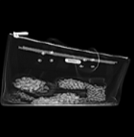
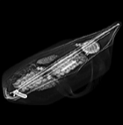
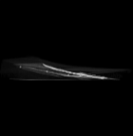

Synthetic Data
Future Goals : synthetic unstructured data
(text, image, video, sound…)
Synthetic image generated
3-D X-Ray image generation
Background
Object
Output image
Images for
training
Base image
extracted
synthesized
3-D images are generated from 2-D ones

