Slide 1
University of applied Sciences
Departement: Computer Science
Term Paper
Subject : Backdoors in Software Implementations
Submitted by : Maurice Tollmien – minf8914@fh-wedel.de

Slide 2
Overview
Outline, motivation and look ahead
Backdors – A definition
A special kind of Backdoor
How to implement this Backdoor
Is it possible to verifice our system ?
Backdoor examples
Conclusion

Slide 3
Outline, motivation and look ahead
What do you trust the most when programming ?
  Your Compiler
  The System environment
What about ´diff` on Linux systems ?

Slide 4
Backdoors – A definition
Symmetric Backdoors
Asymmetric Backdoors

Slide 5
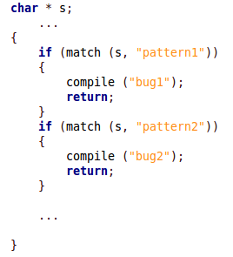
A special kind of Backdoor
→ The Backdoor Compiler

Slide 6
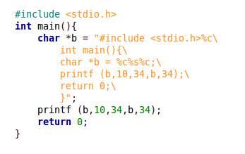
How to implement this Backdoor
Self-reproducing program as a key aspect of the Backdoor compiler

Slide 7
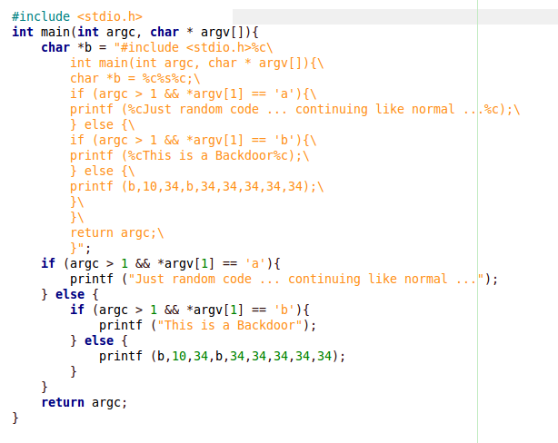
… to go even further …
You can transfer that to any most complex program!

Slide 8
Is it possible to verifice our system ?
Different attempts of compiler testing:
  Write a new compiler
  Testing through obfuscation
  Auditing machine code
  Compiler bootstrapping test
  Diverse double compiling

Slide 9
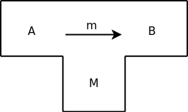
Compiler bootstrapping test
A compiler:
Input language
Implementation language
Output language

Slide 10
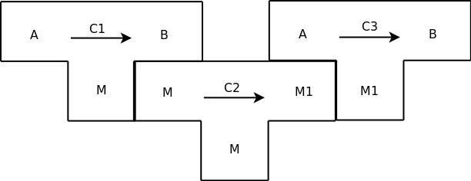
Compiler bootstrapping test
Compilers
Applied to
each other:
C2 is applied to C1, resulting in C3

Slide 11
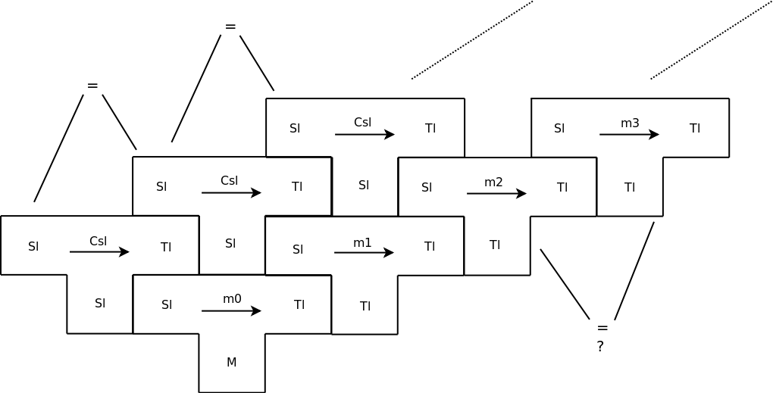
Compiler bootstrapping test

Slide 12
Is it possible to verifice our system ?
Different attempts of compiler testing:
  Write a new compiler
  Testing through obfuscation
  Auditing machine code
  Compiler bootstrapping test
  Diverse double compiling

Slide 13
Backdoor examples
Backdoor in Linux kernel
Backdoor.OptixPro.12, a remote control program for Microsoft Windows

Slide 14
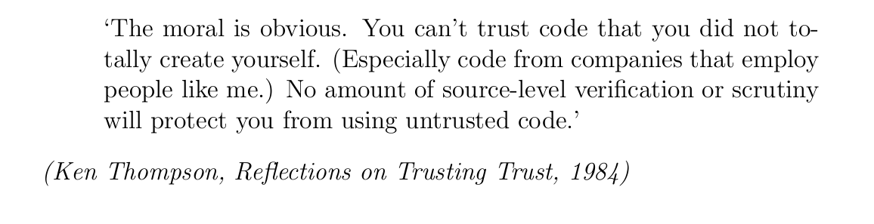
Conclusion

Slide 15
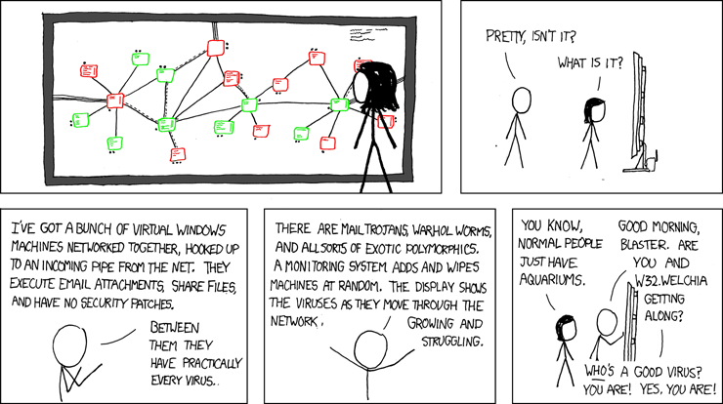
Thank you for the attention!

