Slide 1
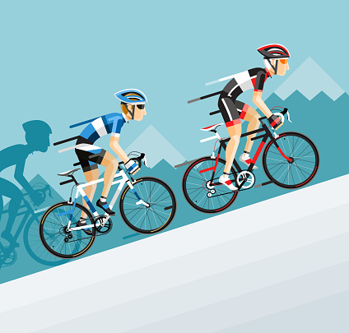
Cycle Company Analysis
By Huy Pham

Slide 2
Acknowledgement
This is a business study of an American-based cycle manufacturer.
They have various locations all over the world, including those in the continents of Australia, Europe, and the Americas.
Data was available from 2017 to 2021.
We can identify this company's issues based on the questions found from data so that we can assist them in performing better.

Slide 3
Table of contents
01
02
03
04
05
Sales
Target
Regions
Resellers
Conclusion

Slide 4
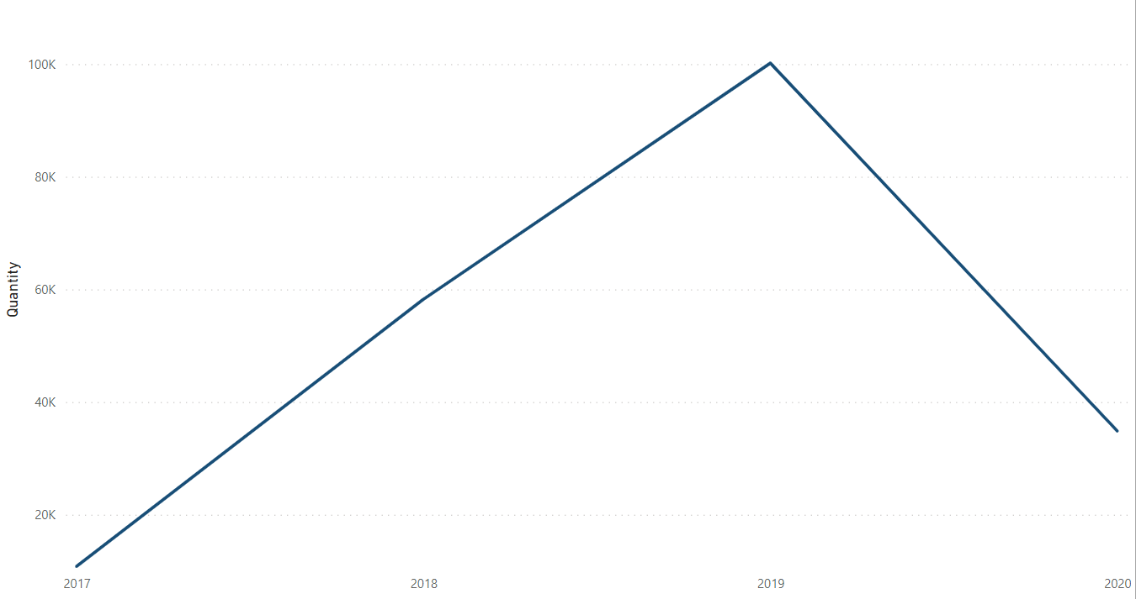
The Sales analysis
Total quantity from 2017 to 2020 was 204K, which brought to $77.5M in total revenue, $999.5K in profit (1.29%)

Slide 5
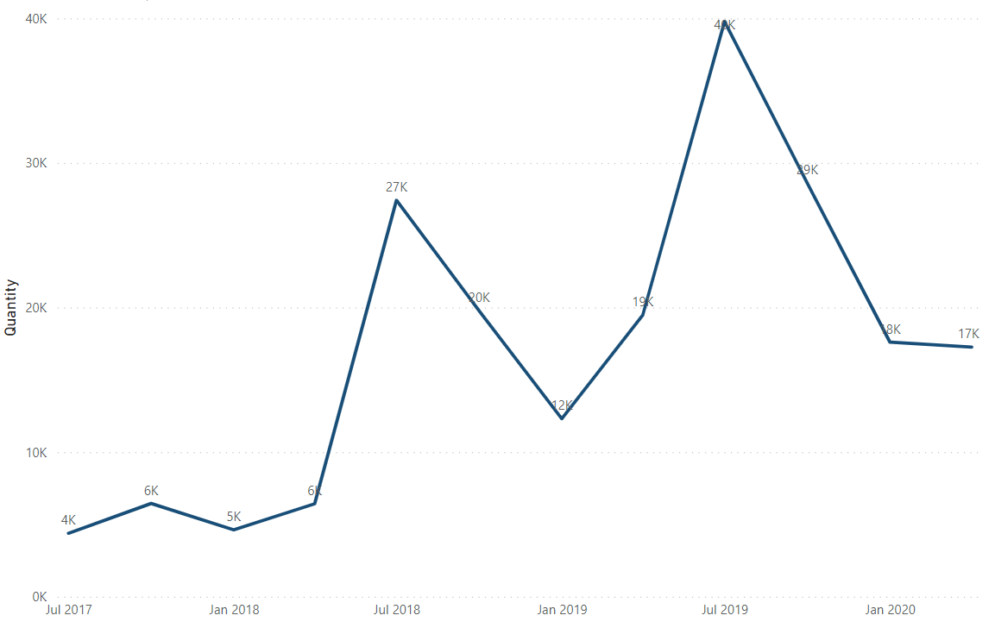
Which months have the most quantity sold?
Key takeaways:
Total quantity often went up at peak from May to July:
This is because every year, one of the most famous World Cycle Competitions are held up in the Fall, this led to the fact that people would more likely to buy new gears and cycles.

Slide 6
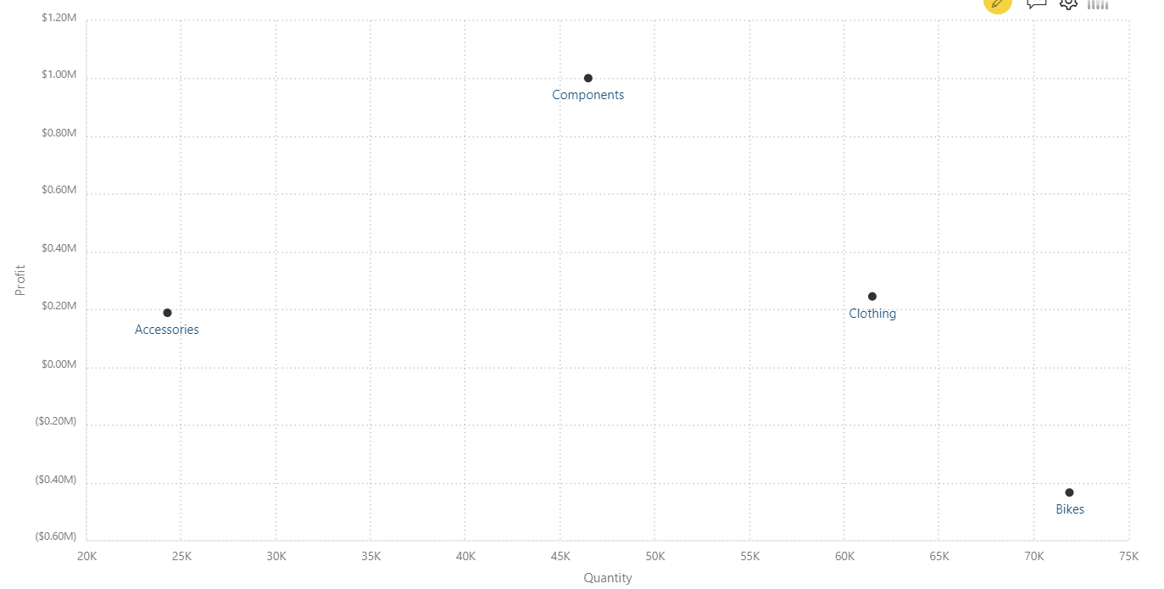
Was there any correlation between Revenue and Profit among categories?
The answer is NO
Observations:
As we can see, though Bikes is best seller category but was not the most profitable.
Additionally, sales of components like bicycle frames, brakes, etc. were ordinary but they were the most lucrative ($1M) category.

Slide 7
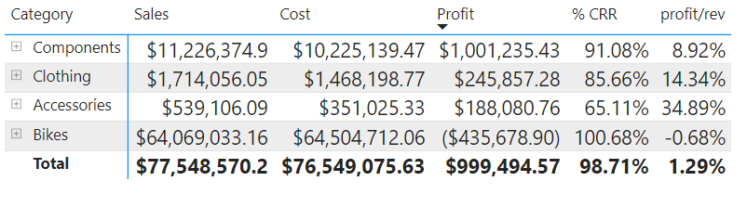
Which products are the most profitable?
Clothing came in second place to Components in terms of profit. However, the profit-to-revenue ratio between those two categories was the exact reverse.
The percentage Profit/Revenue of Clothing is twice more than Components (14.34% and 8.92$)
Key takeaways:
Clothings had less %CRR than Components, which means the Cost on Revenue of Clothing is less than the Components.

Slide 8
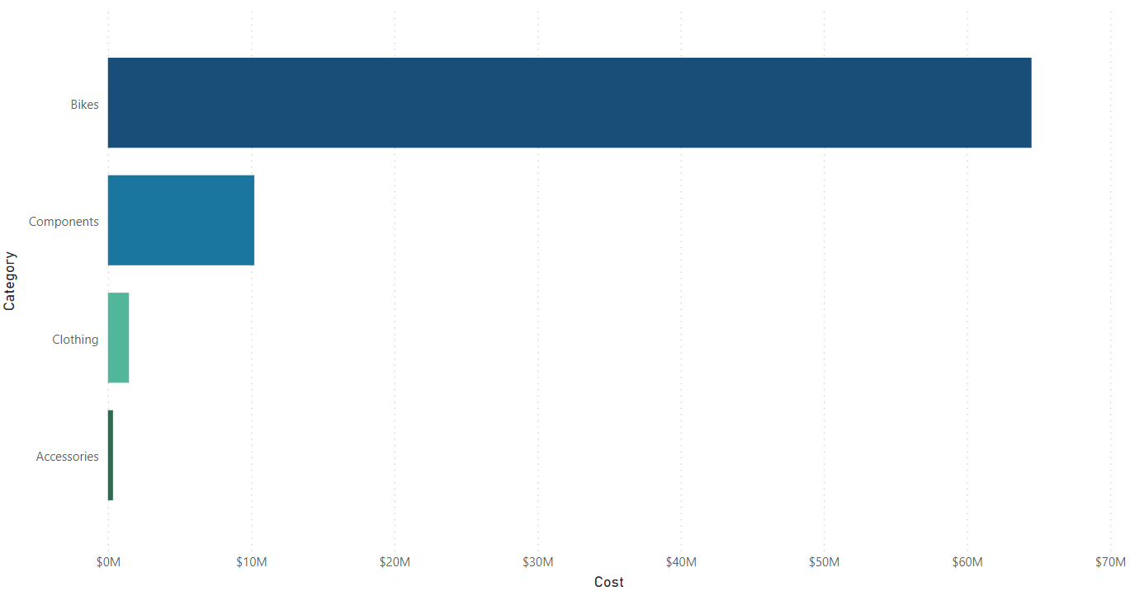
Where did the loss come from?
Bikes was the highest in Cost, why?
Bikes take up a lot more space than others. As the manufacturer produces more motorcycles each year, the price of the older models must drop, which caused a significant loss for resellers.

Slide 9
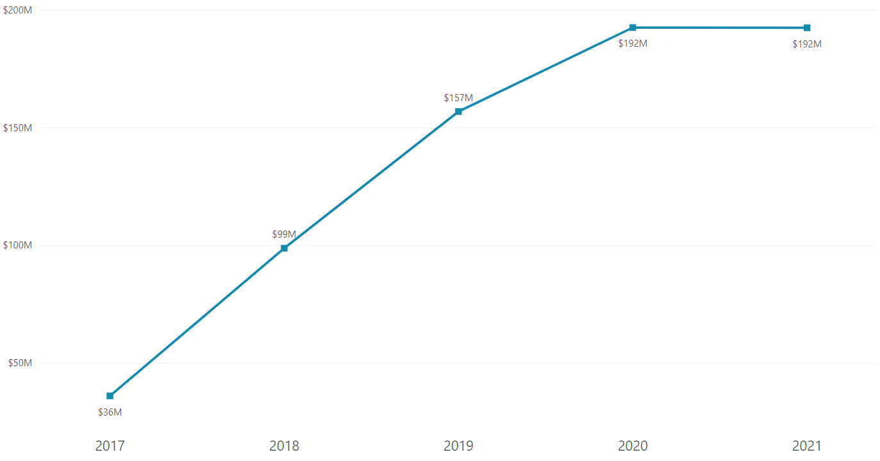
The target per year
Observations:
The Total Target of employess was $676M from 2017 to 2021.
They poorly achieved the target (11.46%).
2020 was where the target at peak.
2017 was at the bottom at target.
Key takeaways:
Setting unrealistic goals can have a negative impact on both the business and the personnel.

Slide 10
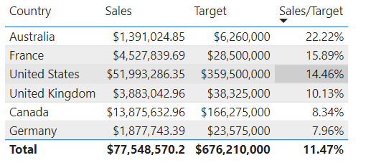
Target over countries
Top 3 countries by Sales/Target
22.2% by Australia
15.9% by France
14.5% by the US
Observations:
Australia was the top performing nation, but the US ended up being the highest seller ($52M).

Slide 11
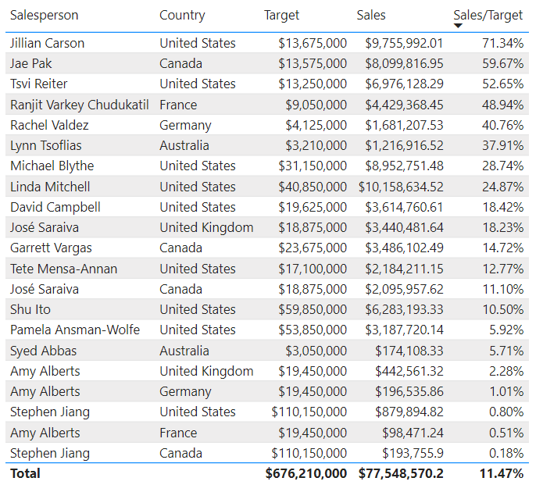
Target by person
Observations:
In top 5 person at Sales/Target
Jillian Carson is the best employee (71.3%)
There were 2 Americans in top 5
Stephen Jiang needs to try more (0.18%)

Slide 12
Regions

Slide 13
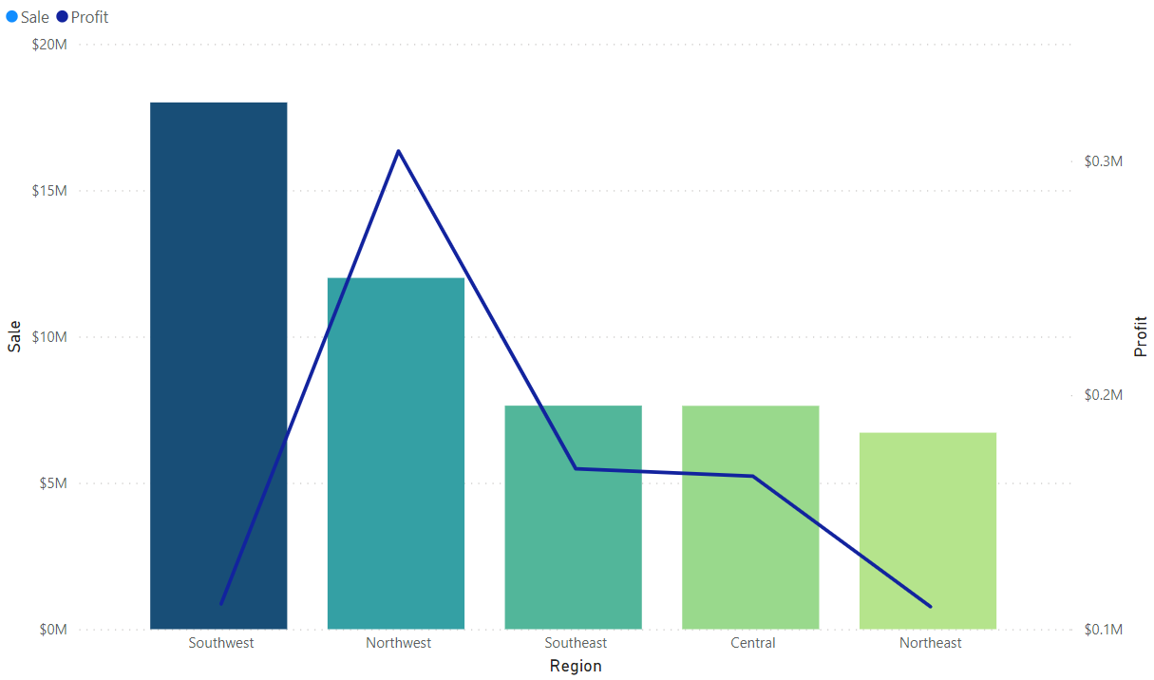
Sales and Profit by Regions
Observations:
The Southest was the best Region when it comes to total sales.
The Northest stood 2nd but led first in Profit.

Slide 14
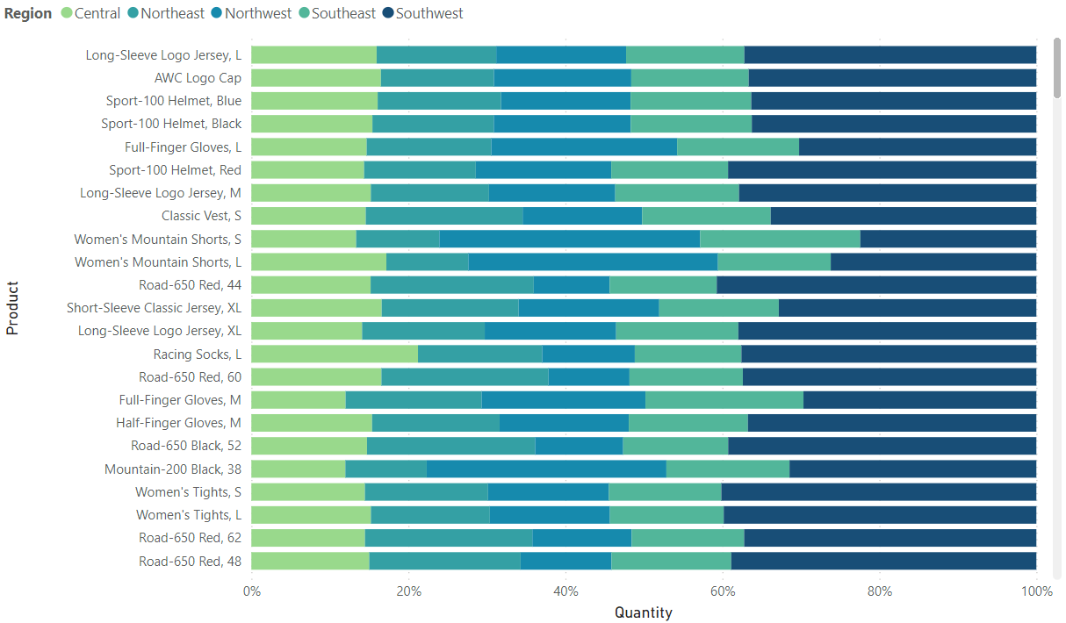
Total quantity of product sold by Region
As we discussed, the Southest had better total number of product sold than the rest.

Slide 15
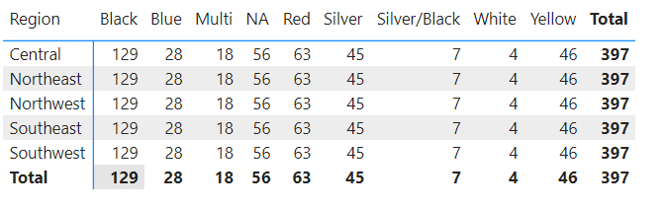
Color of product by Region
Observations:
There are 9 colors among products, but Black seems to be the most favorite color.
This could be that black products will be able to last longer than other colors.

Slide 16
04. Reseller

Slide 17
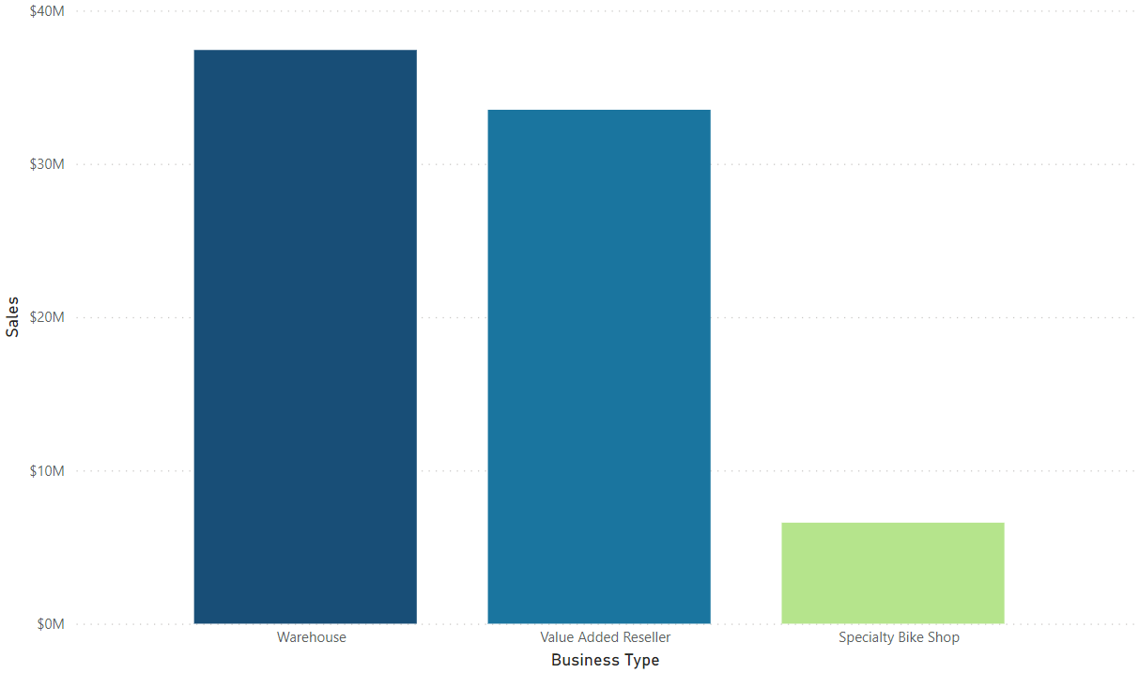
Sales of Business type
Observations:
Warehouse, Reseller played a keyrole in sales.
Local Bike Shop had the least contribution to revenue of company

Slide 18
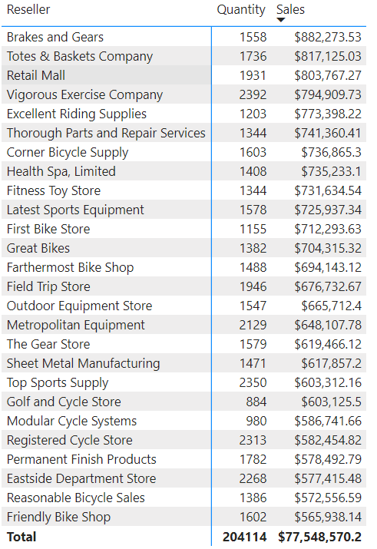
Top Resellers by Revenue
Observations:
Even though Vigorous Exercise Company sold the most quantity (2392) but could not bring the most revenue ($795M).
Brakes and Gears reseller is the best reseller with $882M.

Slide 19
1
Conclusion
2
3
4
Always prepare enough bikes in stock in May, July.
Remind employees to set the target reasonably for motivation.
Southest is the great continent if we want to have more new branches.
We can make PR campaigns at Warehouse for better performance.

Slide 20
Thanks
Do you have any questions?
qhuy1508@gmail.com
+84 70 280 6152

