Slide 1

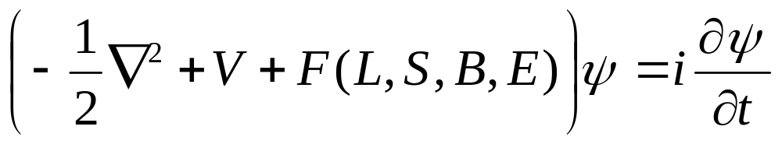
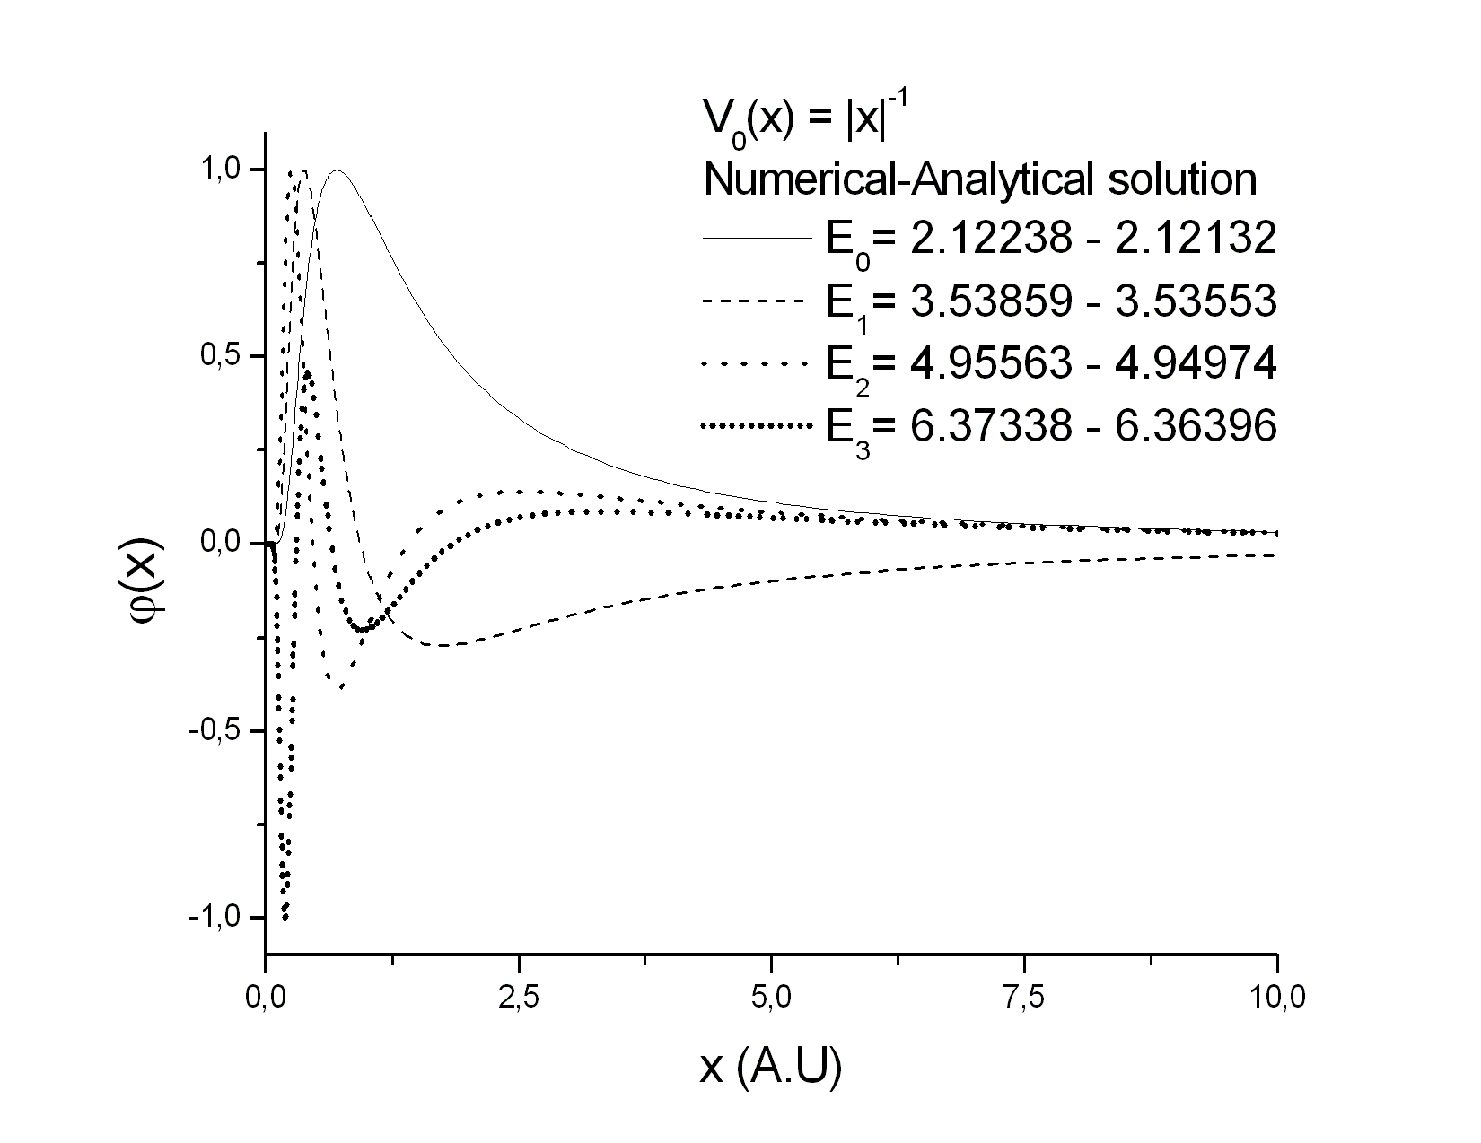
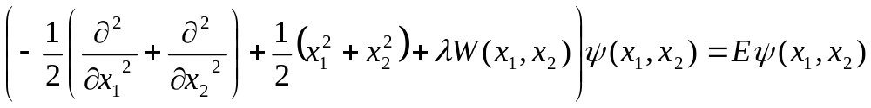
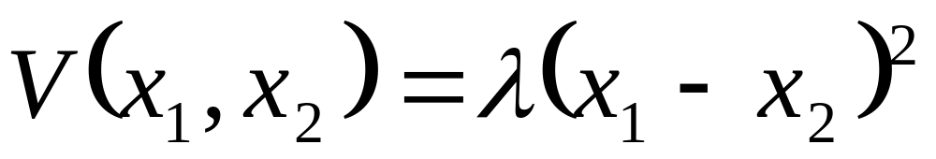
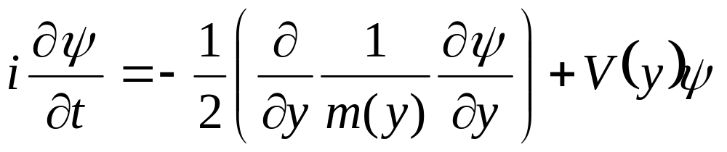
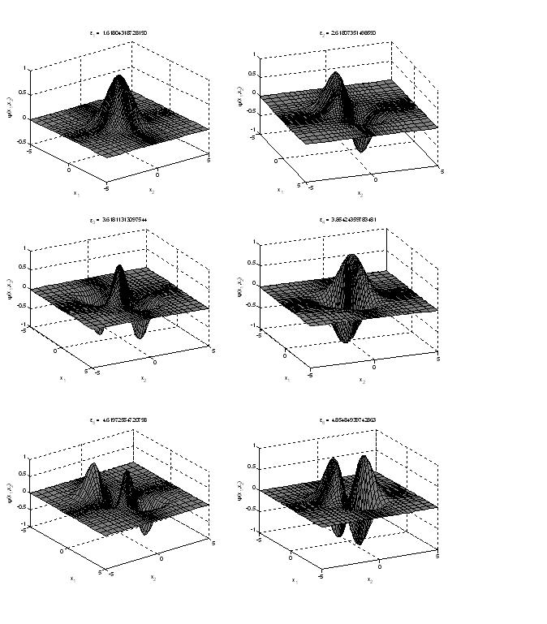
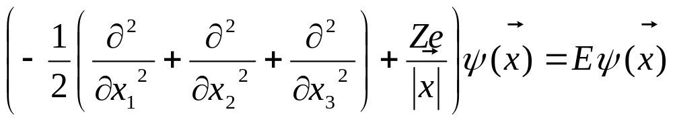
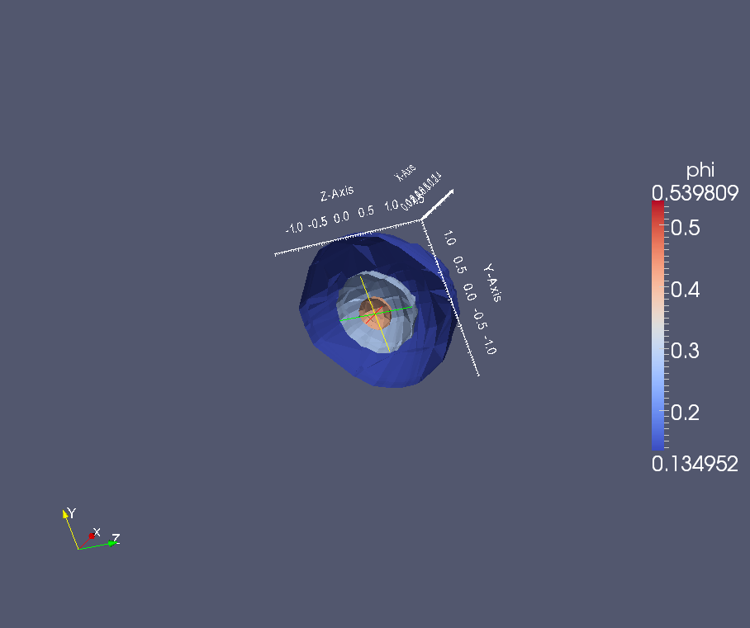
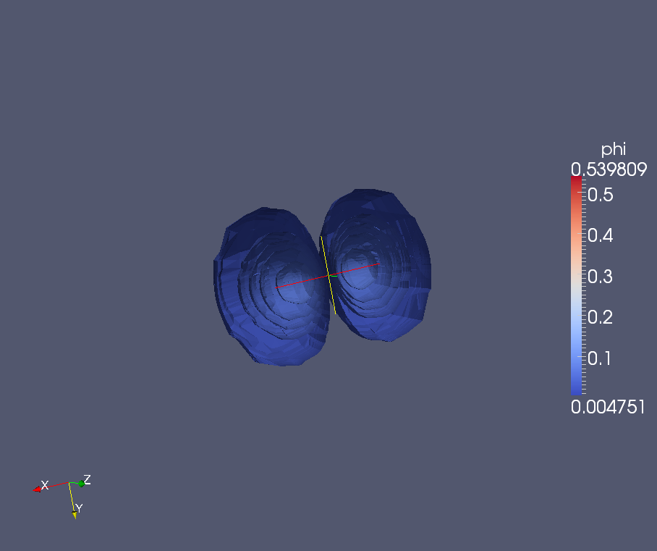
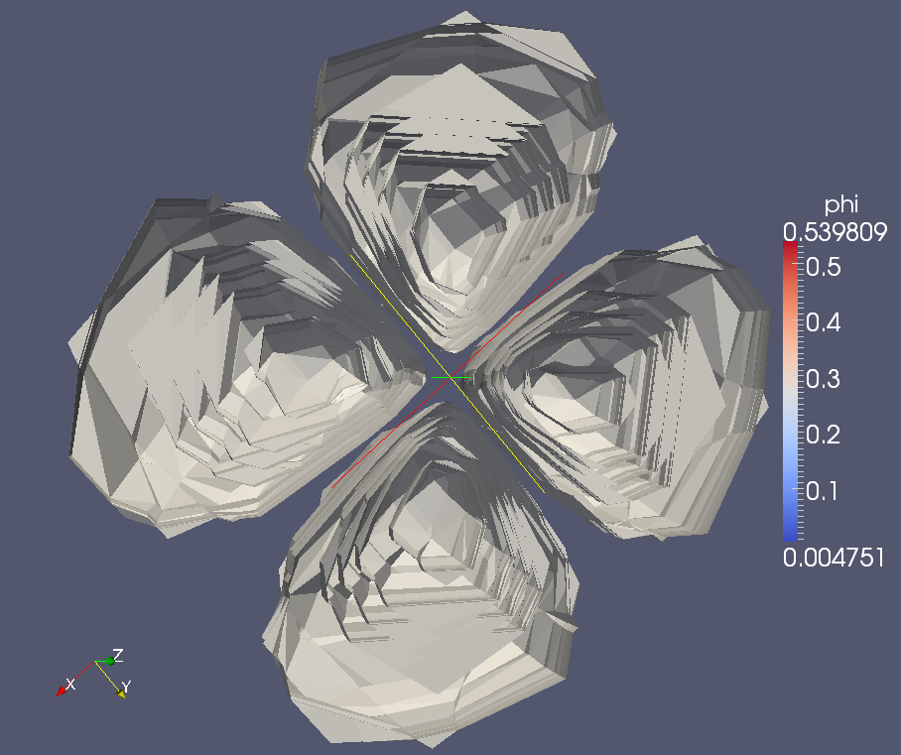
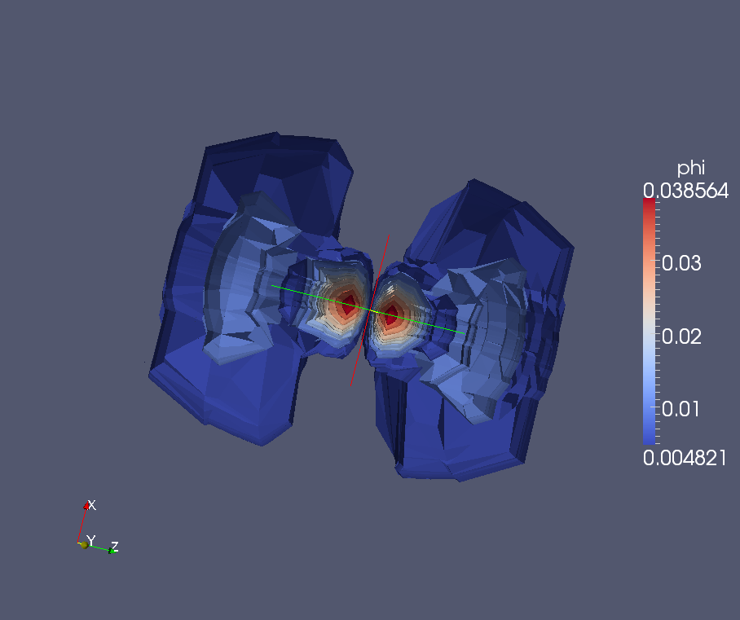
A multidimensional solver for the Schrödinger equation based on finite element method
Mauricio Alfonso LSC, FCEyN.
Alejandro Soba, CSC-CONICET.
Guillermo Marshall, INFIP, CONICET
This work presents a general solver based on FEM aimed at solving stationary and time-dependent Schrödinger equations, allowing to face complex quantum problems in one, two and three dimension. These equations have analytical solutions in only a few known problems, which are used in books on quantum mechanics to illustrate several points of the theory, i.e. the harmonic oscillator, the hydrogen-like system, or in the case of dynamical problems, spreading of a traveling wave packet in space and time. More complex potentials require the use of more sophisticated methods, such as perturbation theory, variational methods or numeric approximations.
The equation to be solved has the general form (atomic units are used):
where V represents the external potential and the function F is a general expression which may contain interactions between external magnetic or electrical fields, spin orbit coupling, etc.
Results
Two-Dimensional: Coupled Quantum Harmonic Oscillator
One-Dimensional: Mass-position Dependent system
Several normalized wave functions of the Coupled Quantum Harmonic Oscillator The amount of nodes crossing the zero planes is directly related with the n+p quantity.
Auto -energies and wave functions of the Coulomb-like potential for the first four eigen values. (Normalized wave function.)
Tree-Dimensional: Hydrogen like-system
Several normalized wave functions or the Hydrogen Atom for the 1s, 2p, 3d, and 3p5 states.
Discussion
Selected References
It is possible use the code with a great variety of coupled potentials with an irrelevant modification. This code also allows an extension, with minimal modifications, to bi-dimensional systems like the hydrogen like system in cylindrical coordinates or the bidimensional harmonic oscillator with perturbation terms.
The tri-dimensional case shows results with less accuracy that similar to that obtained in the cases of one and two dimensions, because the mesh used for the discretized spatial domain is not as fine as in such cases
Ling Jiang, Liang-Zhong Yi, Chun-Sheng Jia, Exact solutions of the Schrodinger equation with position-dependent mass for some Hermitian and non-Hermitian potentials. Physics Letters A 345, 279-286, (2005).
M.W. Cadilhe, J.J. Soares Neto, A finite element algorithm using linear tetrahedral elements for quantum mechanical calculations, Comp. Phys. Comm, 136 (2001) 183–197
A. Soba, A Finite Element Method Solver for Time-Dependent and Stationary Schrodinger Equations with a Generic Potential. Commun. Comput. Phys. Vol. 5, 5, pp. 914-927 (2009)

