Slide 1

Parallelization of quantum few-body calculations
Roman Kuralev
Saint-Petersburg State University
Department of Computational Physics
Joint Advanced Student School 2008

Slide 2
Outline
Introduction
Problem statement
Calculation methods
Finite Element Method
ACE program package
Message Passing Interface (MPI)
Results & conclusions
TODO list

Slide 3
Introduction
The main goal is calculation of the bound and resonant states properties of quantum three-body systems.
This problem is important for the quantum mechanics. It presents a challenge from the computational point of view because few-dimensional Schrödinger equation should be solved.

Slide 4
Introduction
It is important to make calculations with high accuracy (~ 4 ppm) because some experimental methods allow to measure spectra with high accuracy and calculation methods must ensure such accuracy.
The sequential code of the ACE program was parallelized. Then test was performed (calculation of ground state energy of the helium atom).

Slide 5

Problem statement
1. Three-body quantum system
2. Central-force interaction
3. Coulomb potential
4. The problem is to calculate bound and resonant states.
5. The eigenvalue problem is solved for large sparse matrices (up to 100 000 elements with matrix sparseness of order 0.01)

Slide 6

Problem statement
For three-body system problem it is necessary to solve six-dimensional equation.

Slide 7



Calculation methods

Slide 8
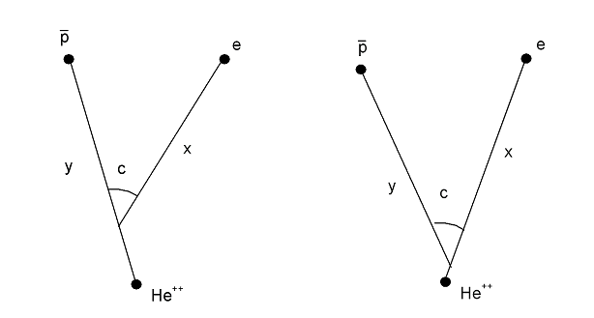
Calculation methods

Slide 9

Calculation methods
The wavefunction is obtained by means of FEM. The coefficients v_{im} and the energy E are obtained by means of minimization of a functional <Ψ|H|Ψ>

Slide 10


Calculation methods
The best approximation is evaluated by
solving generalized eigenvalue problem.

Slide 11

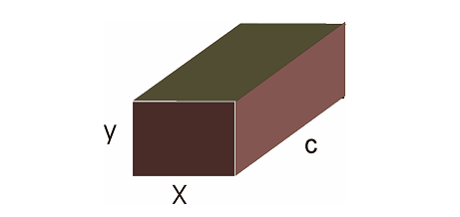
Finite elements method

Slide 12
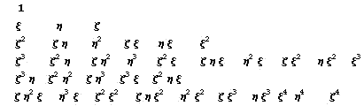
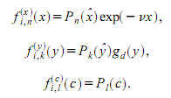

Finite elements method
Basis functions
35 basis functions
This basis reduces more three-dimensional
integrals to the one-dimensional ones.

Slide 13
Arnoldi method
Arnoldi iteration is a typical large sparse matrix algorithm. It does not access the elements of the matrix directly, but rather makes the matrix map vectors and makes its conclusions from their images. This is the motivation for building the Krylov subspace.
The resulting vectors are not orthogonal, but after the
orthogonalizaion process we obtain the basis of the
Krylov’s subspace and it gives good approximation of the
eigenvectors corresponding to the n largest eigenvalues.

Slide 14
Arnoldi method
Start with an arbitrary vector q₁ with norm 1.
Repeat for k = 1,2,3,…
  q_{k} ← Aq_{k-1}
  for {j=1; j<=k-1; j++}
    H_{j,k-1} ← q*_{j}q_{k}
    q_{k} ← q_{k} – h_{j,k-1}q_{j}
  h_{k,k-1} ← ||q_{k}||
  q_{k} ← q_{k} / h_{k,k-1}
The algorithm breaks down when q_{k} is the zero vector.

Slide 15
Calculation algorithm
Three stages of calculation:
Basis definition
Matrix elements calculation (FEM)
Solving of generalized eigenvalue problem

Slide 16
ACE
Data input (*.inp file)
Building a 3D grid, establishing the topology, implementing boundary conditions
Matrix building
Generalized eigenvalue problem solving
Data output (eigenvalue goes to the screen and saves to the *.eig file)

Slide 17
Message Passing Interface
A message-passing Application Programmin Interface (API)
Standard de facto for parallel programming for computing systems with distributed memory
Includes routines callable from Fortran, C/C++
The latest version is MPI-2 (MPI-2.1 under discussion)

Slide 18
Message Passing Interface
MPI_Init
MPI_Comm_size
MPI_Comm_rank
MPI_Send
MPI_Recv
MPI_Reduce
MPI_Barrier
MPI_Finalize

Slide 19
Message Passing Interface
Data input
Task distribution
Parallel matrix calculation
MPI_Reduce
Eigenvalue problem solving
Data output

Slide 20
Results & conclusions
The program was parallelized. It is obvious that the parallel version is much more faster then sequential.
The parallel version works correctly and it was confirmed by calculation of the helium atom energy. This result is in good agreement with the experiment.

Slide 21
Results & conclusions
Theoretical energy value (helium) is:
E_{th} = -2.9032 conventional units (the proton mass is 1, the Plank’s constant is 1)
Experimental energy value is:
E_{exp} = -2.9037 c.u.

Slide 22
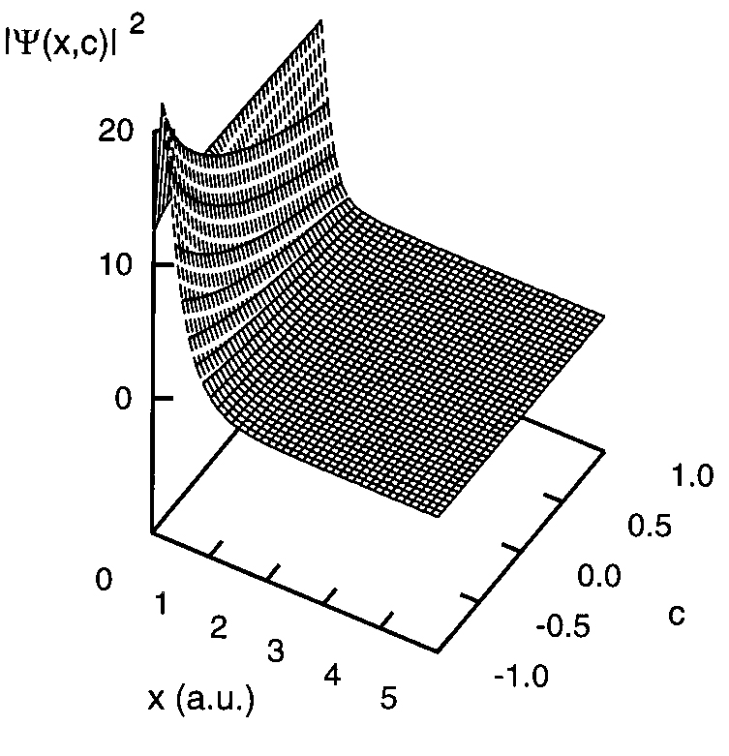
Results & conclusions

Slide 23
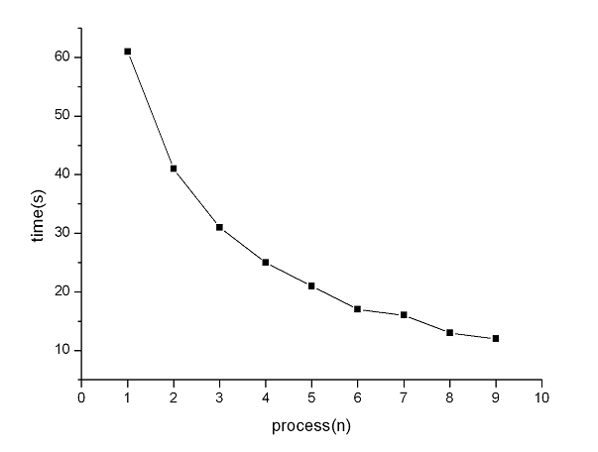
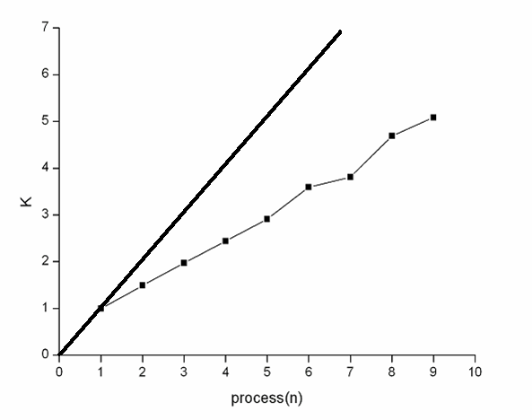
Results & conclusions
Time of calculation
Speedup

Slide 24
TODO List
Another parallelization (intensive)
More parallelizations (extensive)
Other realization of MPI (Intel)
More optimizations to the sequential code

Slide 25
Hardware and software
Pentium 4 D (dual core) – 3.4 Ghz
Core2Duo – 2.4 Ghz
RAM – 2 Gb
Scientific Linux 4.4 (64 bit)
MPICH 2.x

Slide 26
Acknowledgments
Sergei Andreevitch Nemnyugin
Sergei Yurievitch Slavyanov
Erwin Rudolf Josef Alexander Schrödinger

Slide 27
Thank you for attention!

