Slide 1
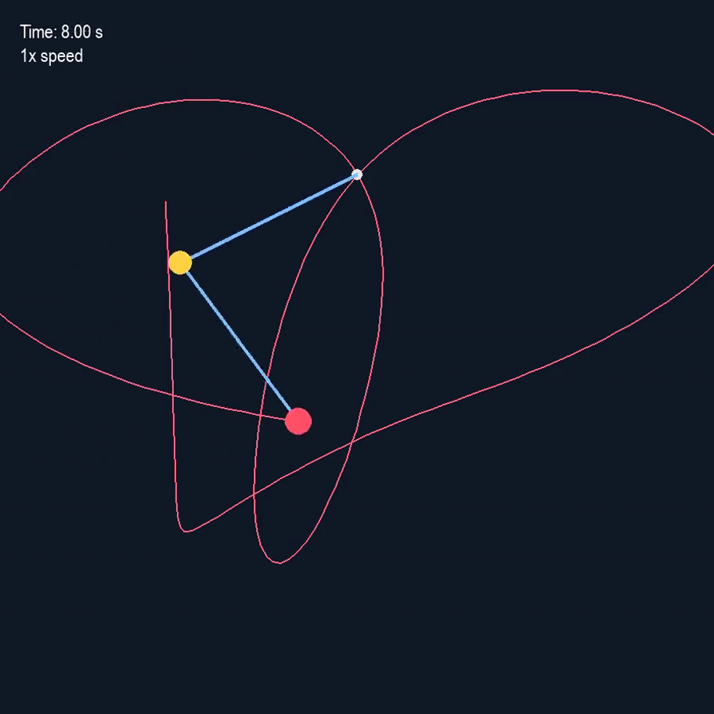
DOUBLE PENDULUM
Simulation & Numerical Validation
Python • RK2 midpoint method • Energy conservation • Pygame visualization
Numerical modeling
Validation
Visualization
Mauricio Sanchez
Portfolio extension of a PHYS 3910 group project
30 s simulation
Double Pendulum | Mauricio Sanchez

Slide 2
Physics Model
Two equal point masses connected by massless rods of equal length
State representation
y = [ θ₁ ω₁ θ₂ ω₂ ]ᵀ
θ₁, θ₂ angular positions
θ₁
ω₁, ω₂ angular velocities
l
m
l
Coupled nonlinear equations of motion
θ₂
m
Angles are measured from the downward vertical.
Each acceleration depends on the motion of the other link.
Double Pendulum | Mauricio Sanchez

Slide 3

Numerical Method & Simulation Setup
Second-order Runge–Kutta midpoint integration
Simulation parameters
1
Evaluate current derivative
Δt
0.001 s
2
Estimate midpoint state
Duration
30 s
g
9.81 m/s²
3
Evaluate midpoint derivative
l
1 m
4
Advance full timestep
m
2 kg
Initial conditions
θ₁(0)=π ω₁(0)=0
θ₂(0)=π/2 ω₂(0)=0
Double Pendulum | Mauricio Sanchez

Slide 4
Python Implementation
Model → solver → validation → visualization
Equations of Motion
RK2 Solver
30 s Trajectory
diffeq(y)
move_RK2()
state history
Energy Analysis
Pygame Animation
RK2 midpoint implementation
def move_RK2(f, y, dt):
ydot = f(y)
y_half = y + ydot * dt/2
ydot_half = f(y_half)
return y + ydot_half * dt
The same state history is reused for both numerical validation and the interactive visualization.
This separates the solver from the presentation layer and keeps the test calculations tied to the exact simulated trajectory.
Double Pendulum | Mauricio Sanchez

Slide 5
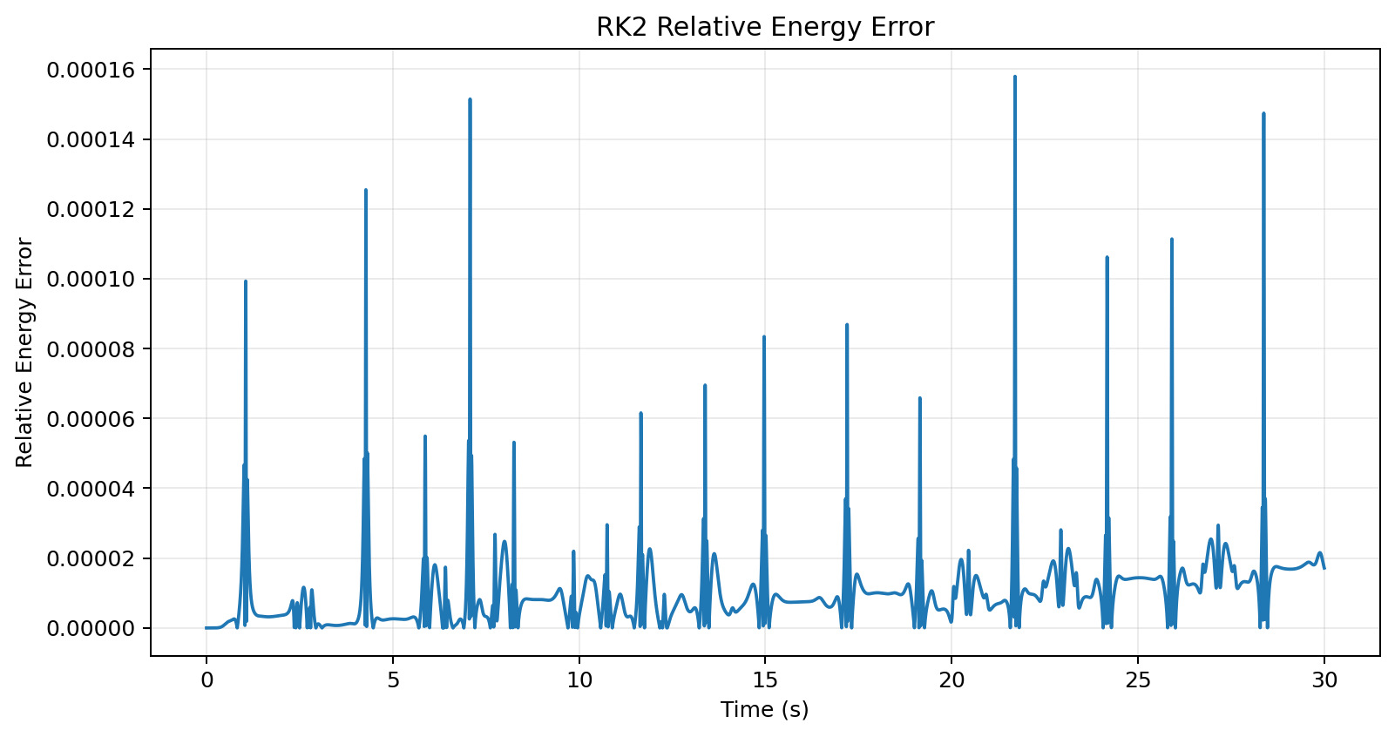
Test & Numerical Validation
Energy conservation used as a quantitative check on the RK2 solution
Relative energy error
MAX RELATIVE ERROR
1.58 × 10⁻⁴
≈ 0.0158%
Test objective
Verify that the chosen timestep produces a numerically stable solution with minimal mechanical-energy drift.
Conclusion
The 0.001 s timestep keeps the maximum error below 0.02% over the 30-second test.
Double Pendulum | Mauricio Sanchez

Slide 6
Interactive Visualization
Pygame animation built from the same validated trajectory
Playback controls
SPACE
Pause / resume
R
Restart + clear trail
↑
Increase speed
↓
Decrease speed
Visualization features
• 900 × 900 window
• second-mass trajectory trail
• simulation timer
• 1×–10× playback speed
• every 10th solver point displayed
Double Pendulum | Mauricio Sanchez

Slide 7
Results & Engineering Takeaways
What the project demonstrates beyond the animation
Results
Future work
Implemented a nonlinear physical model in Python
1
Compare Euler, RK2, and RK4 accuracy
Integrated 30 seconds of motion with RK2 at Δt = 0.001 s
2
Run a systematic timestep-convergence study
Validated numerical stability through energy conservation
3
Quantify sensitivity to nearby initial conditions
Measured a maximum relative energy error of ≈ 0.0158%
4
Compare numerical accuracy versus compute cost
Built an interactive Pygame visualization with playback controls
Project history
Engineering relevance
Originally developed as a PHYS 3910 group project with Araceli Herrera Mondragon and Joseph Morin. This portfolio version was subsequently extended and revised by Mauricio Sanchez.
Modeling • test planning • numerical validation • data analysis • troubleshooting • technical communication
Double Pendulum | Mauricio Sanchez

