Slide 1

THEORETICAL COMPUTER SCIENCE TUTORING (1)
Maurizio Fiusco

Slide 2

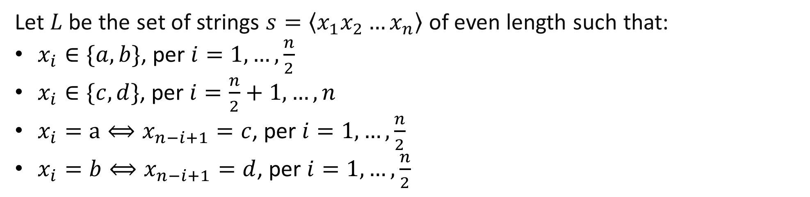
Problem 2.1 from EsMacchineTuring.pdf (uniroma2.it)
Let $L$ be the set of strings $s=\left\langle x_{1}x_{2}…x_{n}\right\rangle$ of even length such that:
$x_{i}∈\{a,b\}$, per $i=1,…,\frac{n}{2}$
$x_{i}∈\{c,d\}$, per $i=\frac{n}{2}+1,…,n$
$x_{i}=a⟺x_{n−i+1}=c$, per $i=1,…,\frac{n}{2}$
$x_{i}=b⟺x_{n−i+1}=d$, per $i=1,…,\frac{n}{2}$
👌
👌
👌
👌
👌
a | b | a | c | d | c

Slide 3
Problem 2.1 from EsMacchineTuring.pdf (uniroma2.it)
Let $L$ be the set of strings $s=\left\langle x_{1}x_{2}…x_{n}\right\rangle$ of even length such that:
$x_{i}∈\{a,b\}$, per $i=1,…,\frac{n}{2}$
$x_{i}∈\{c,d\}$, per $i=\frac{n}{2}+1,…,n$
$x_{i}=a⟺x_{n−i+1}=c$, per $i=1,…,\frac{n}{2}$
$x_{i}=b⟺x_{n−i+1}=d$, per $i=1,…,\frac{n}{2}$
👌
👌
👌
👌
👌
a | a | b | b | d | d | c | c

Slide 4

Problem 2.1 from EsMacchineTuring.pdf (uniroma2.it)
Let $L$ be the set of strings $s=\left\langle x_{1}x_{2}…x_{n}\right\rangle$ of even length such that:
$x_{i}∈\{a,b\}$, per $i=1,…,\frac{n}{2}$
$x_{i}∈\{c,d\}$, per $i=\frac{n}{2}+1,…,n$
$x_{i}=a⟺x_{n−i+1}=c$, per $i=1,…,\frac{n}{2}$
$x_{i}=b⟺x_{n−i+1}=d$, per $i=1,…,\frac{n}{2}$
👎
a | b | a | d | c

Slide 5
Problem 2.1 from EsMacchineTuring.pdf (uniroma2.it)
Let $L$ be the set of strings $s=\left\langle x_{1}x_{2}…x_{n}\right\rangle$ of even length such that:
$x_{i}∈\{a,b\}$, per $i=1,…,\frac{n}{2}$
$x_{i}∈\{c,d\}$, per $i=\frac{n}{2}+1,…,n$
$x_{i}=a⟺x_{n−i+1}=c$, per $i=1,…,\frac{n}{2}$
$x_{i}=b⟺x_{n−i+1}=d$, per $i=1,…,\frac{n}{2}$
👌
👌
👌
👎
👎
a | a | b | b | a | d | d | d | c | c

Slide 6
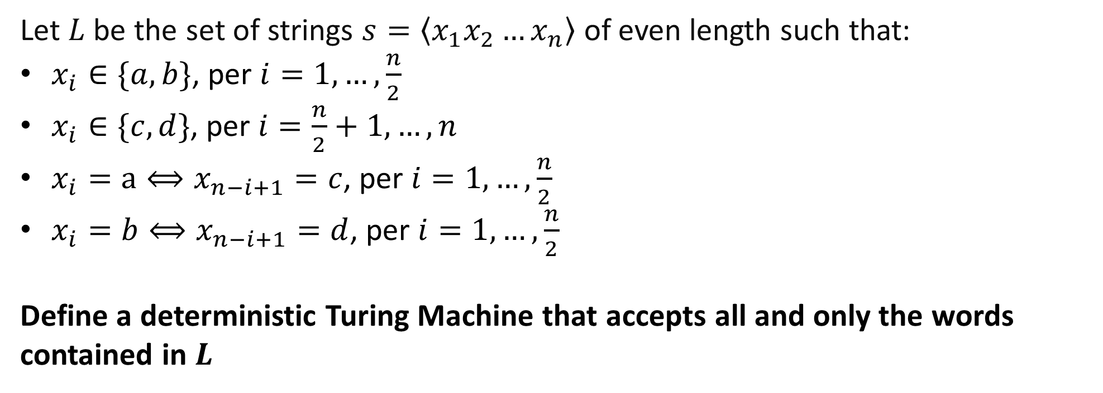
Problem 2.1 from EsMacchineTuring.pdf (uniroma2.it)
Let $L$ be the set of strings $s=\left\langle x_{1}x_{2}…x_{n}\right\rangle$ of even length such that:
$x_{i}∈\{a,b\}$, per $i=1,…,\frac{n}{2}$
$x_{i}∈\{c,d\}$, per $i=\frac{n}{2}+1,…,n$
$x_{i}=a⟺x_{n−i+1}=c$, per $i=1,…,\frac{n}{2}$
$x_{i}=b⟺x_{n−i+1}=d$, per $i=1,…,\frac{n}{2}$
Define a deterministic Turing Machine that accepts all and only the words contained in $L$

