Slide 1
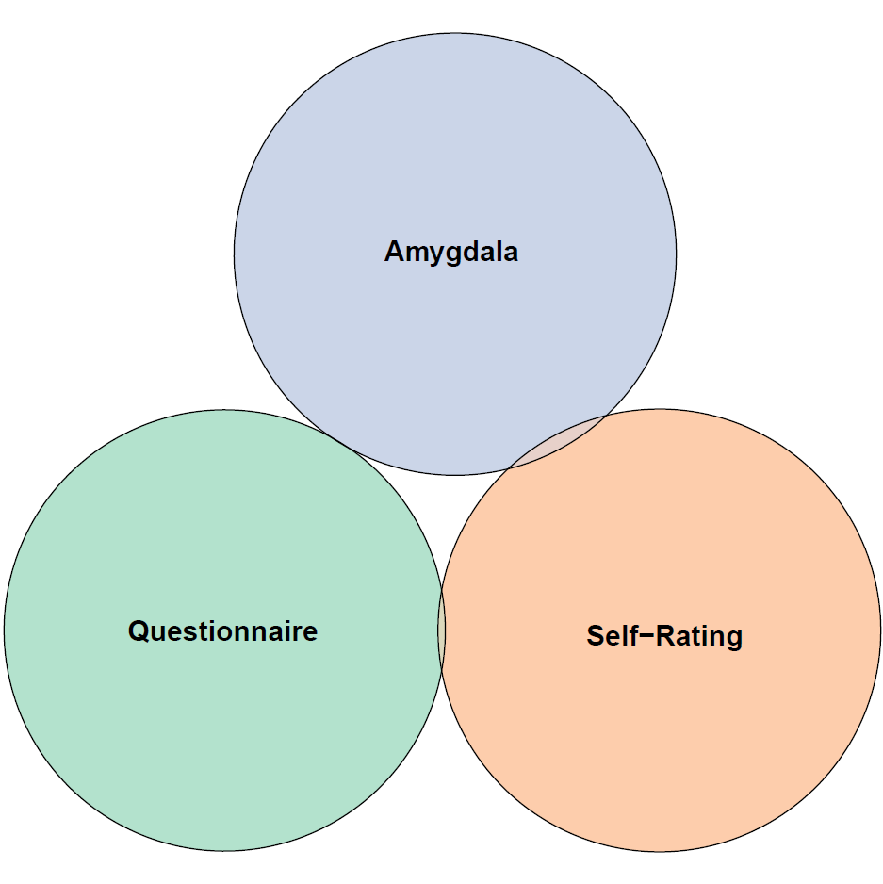
r = .01
r = .08*
r = .05

Slide 2
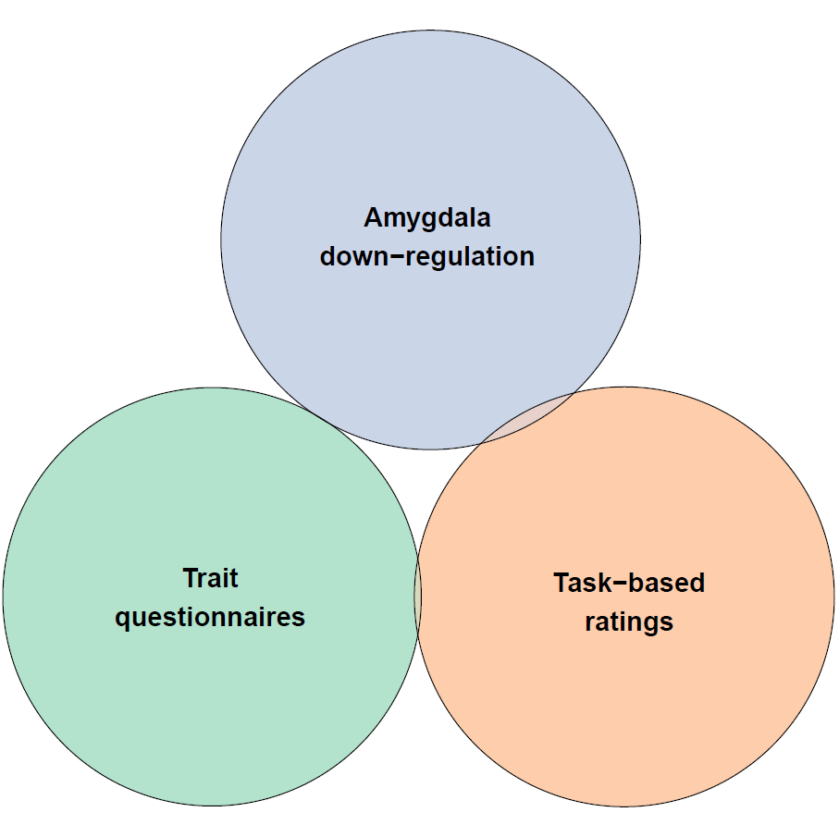
r = .01
r = .08*
r = .05

Slide 3
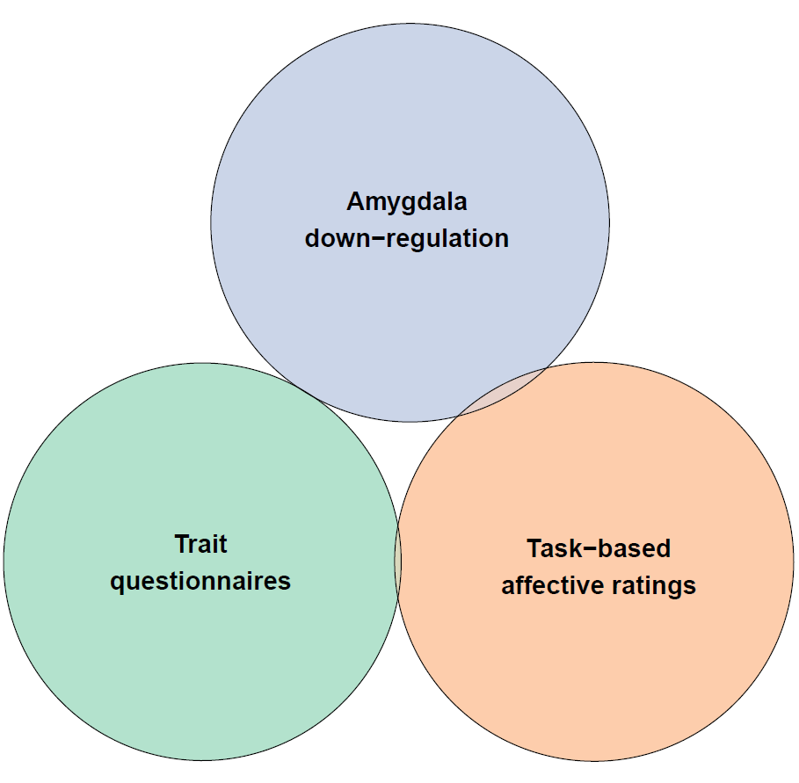
r = .01
r = .08*
r = .05

Slide 4
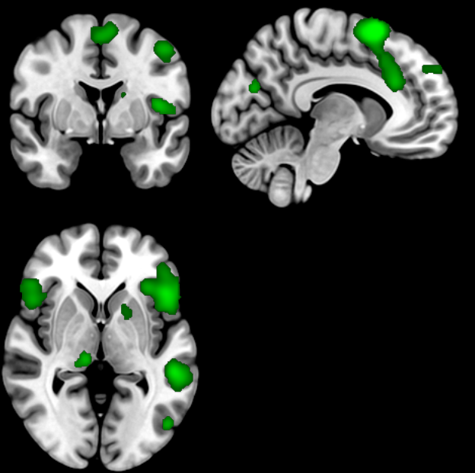

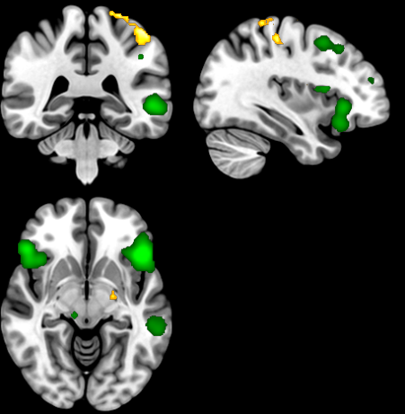
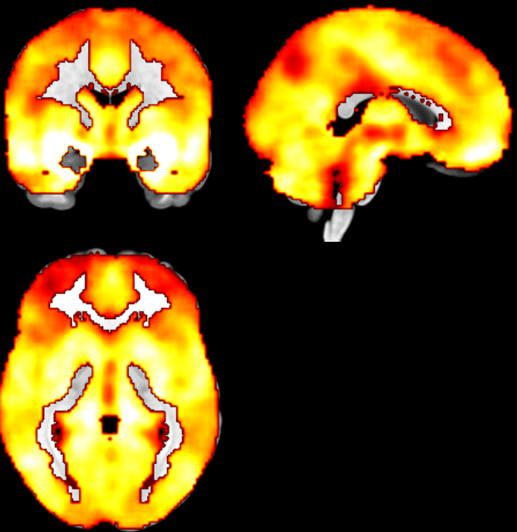
Network
Questionnaires
Ratings
Amygdala

Slide 5
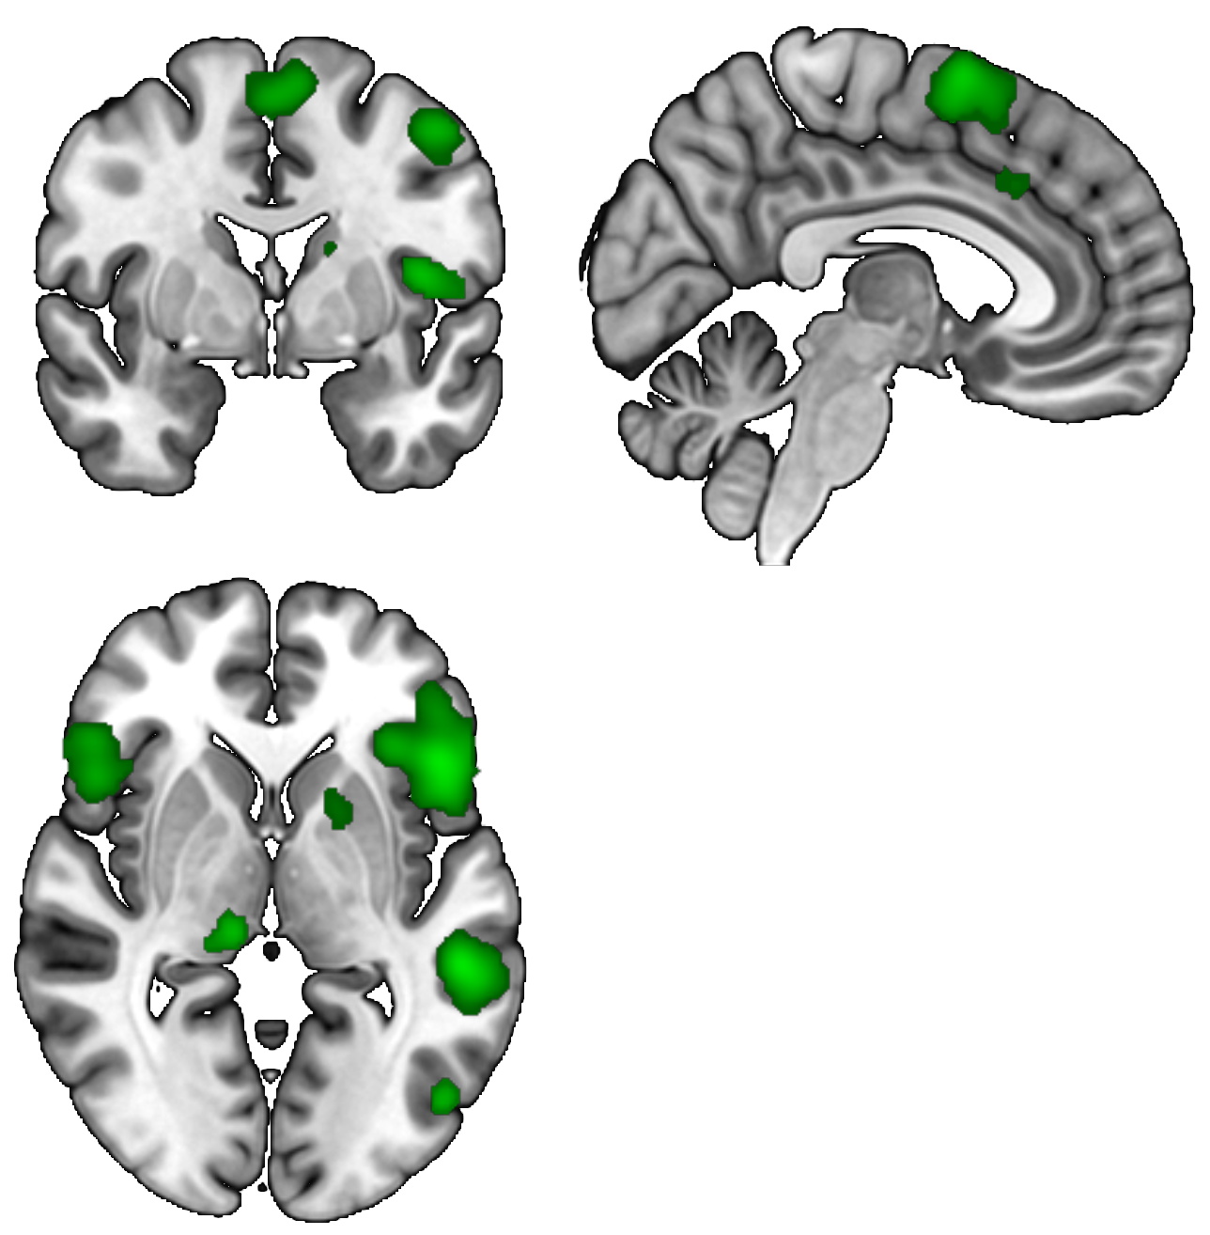
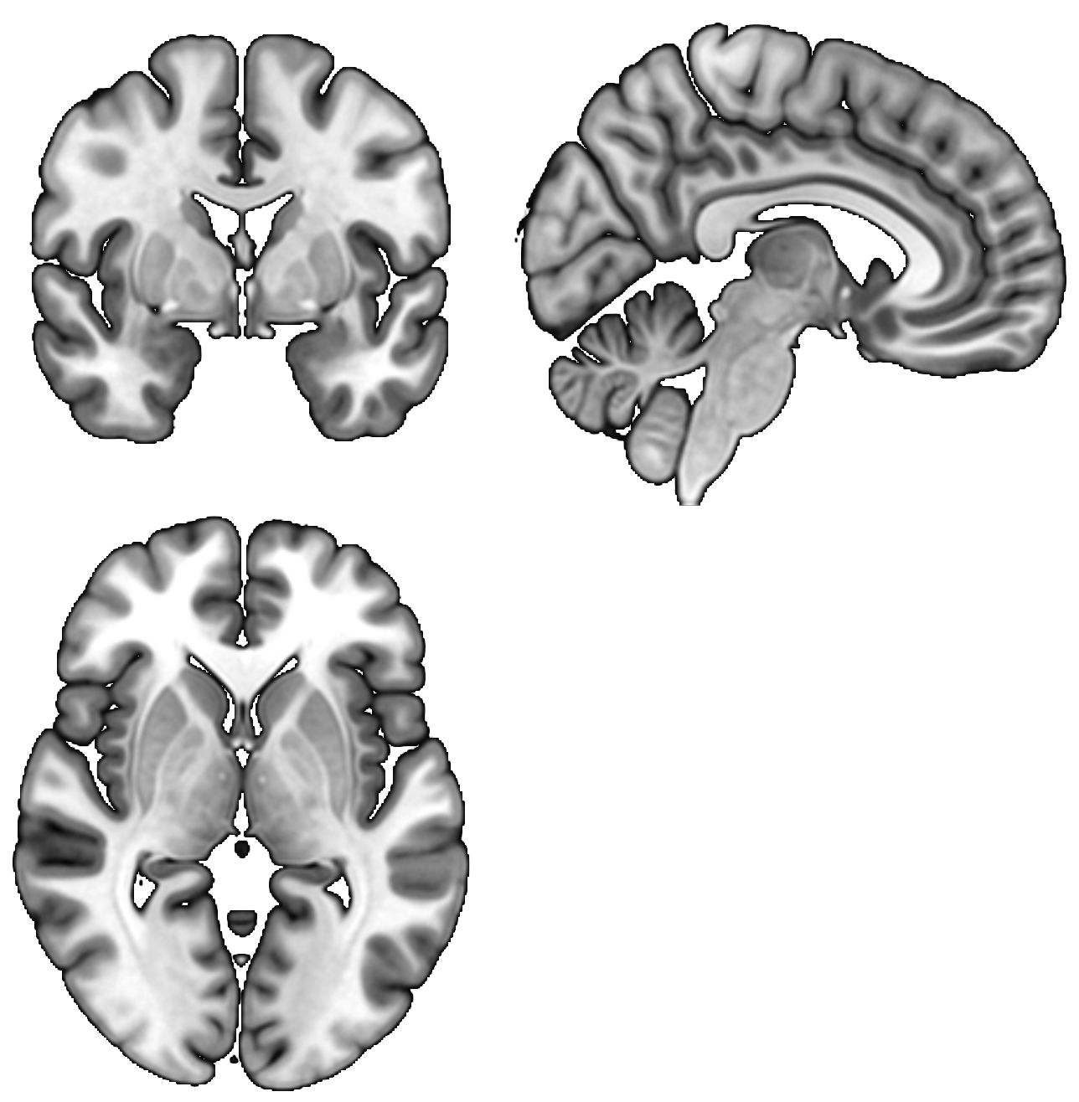
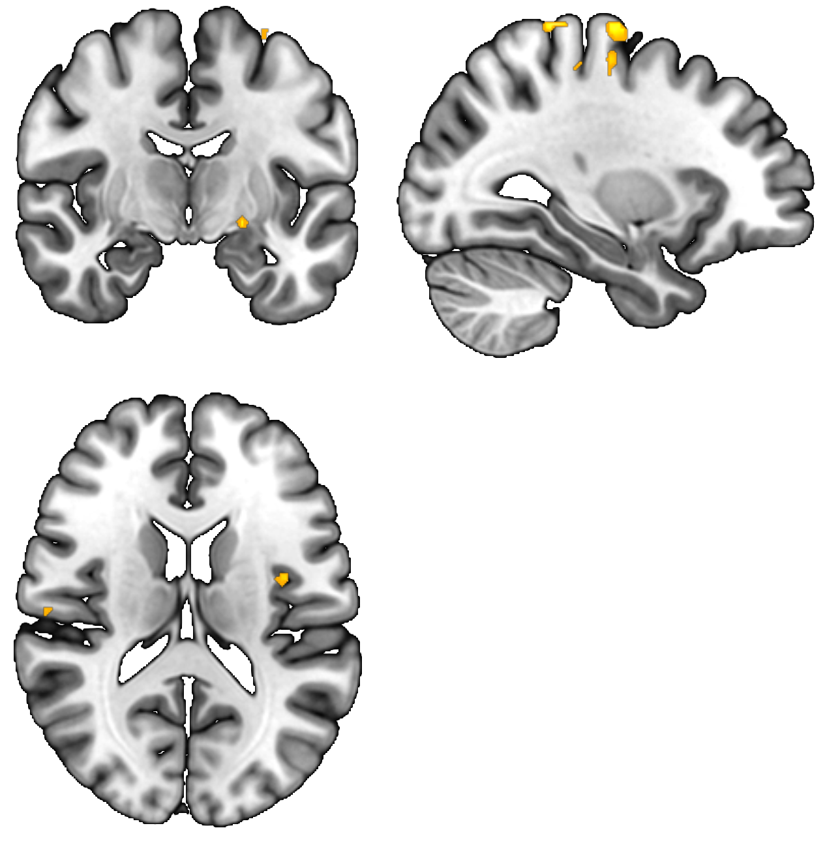
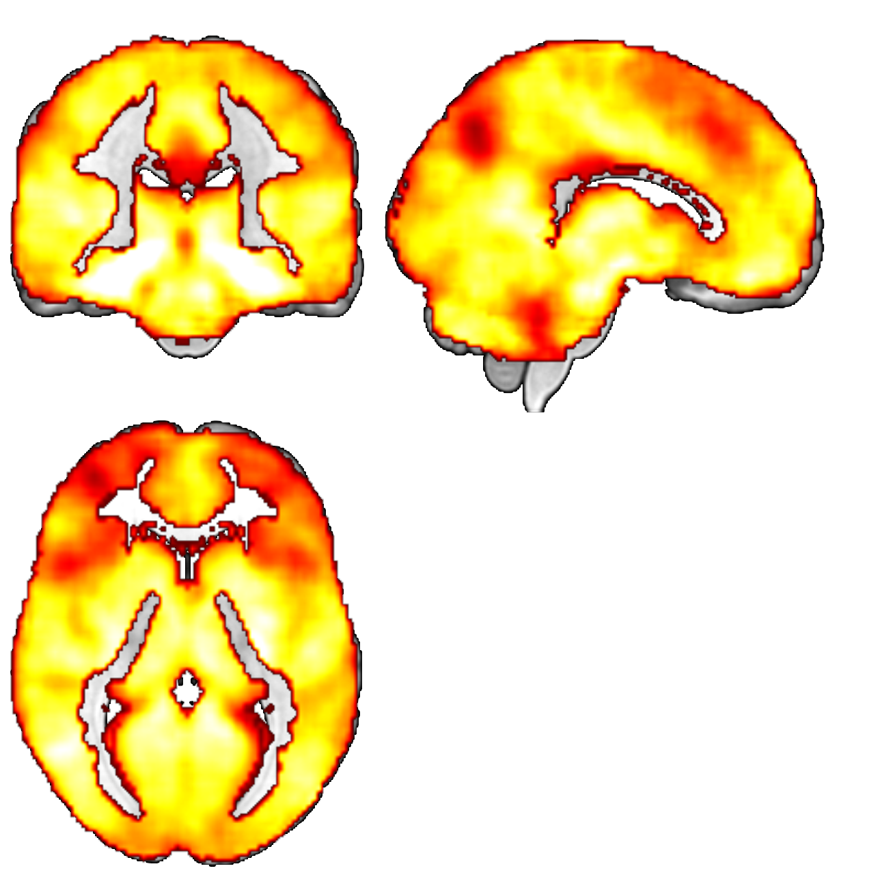
A priori Network
Questionnaires
Ratings
Amygdala

Slide 6
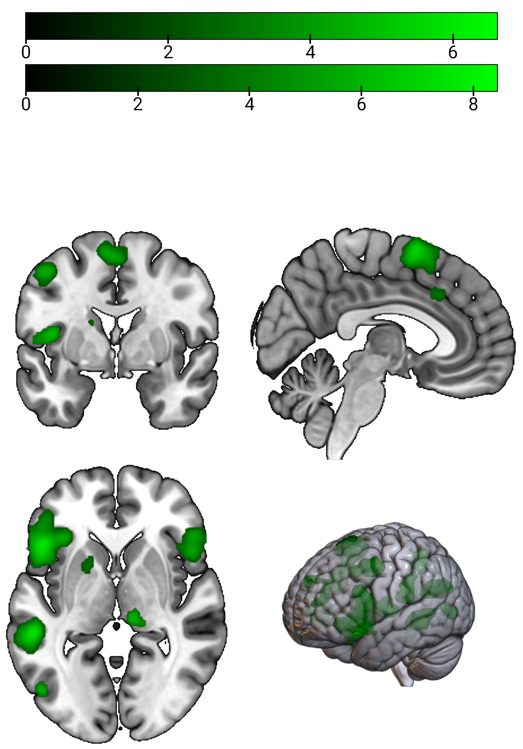
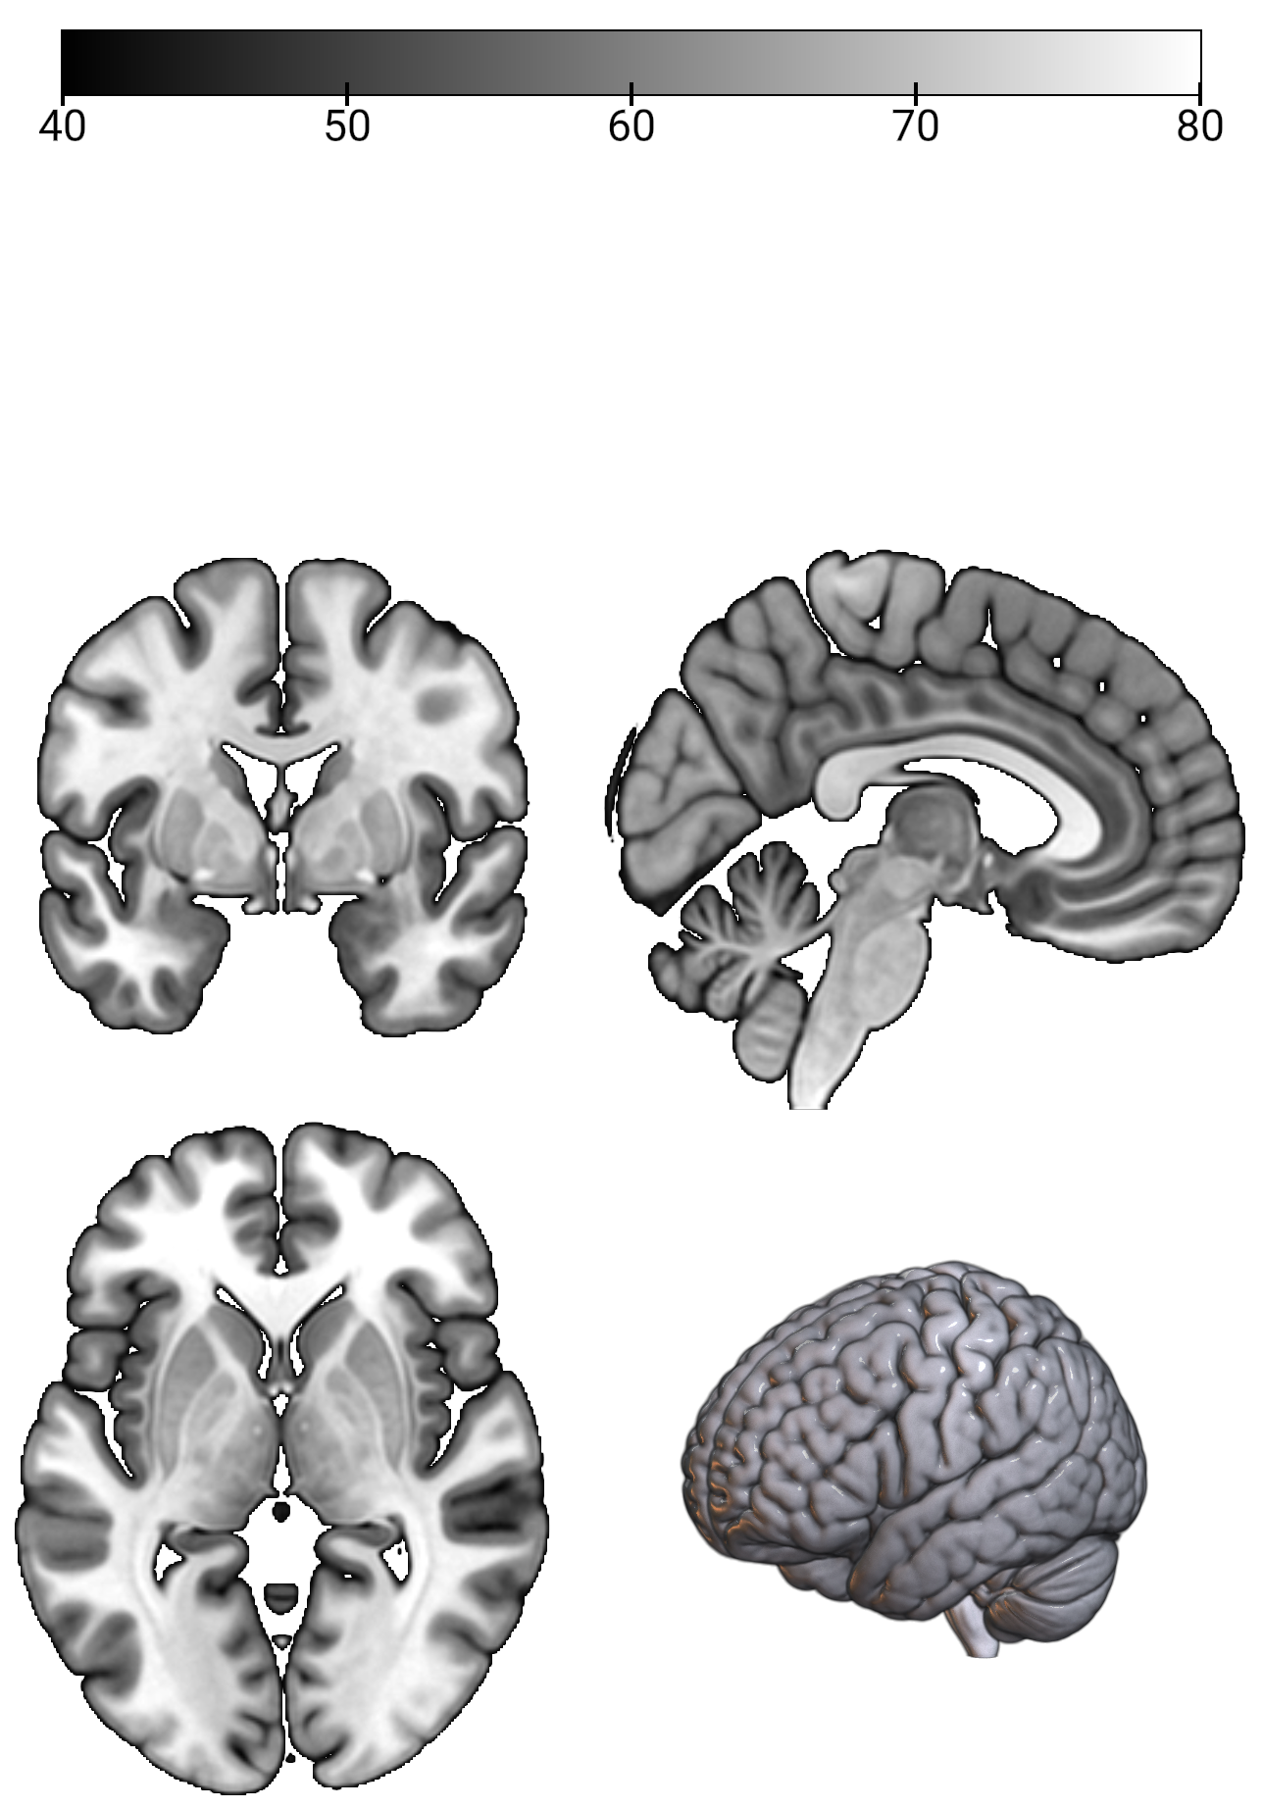
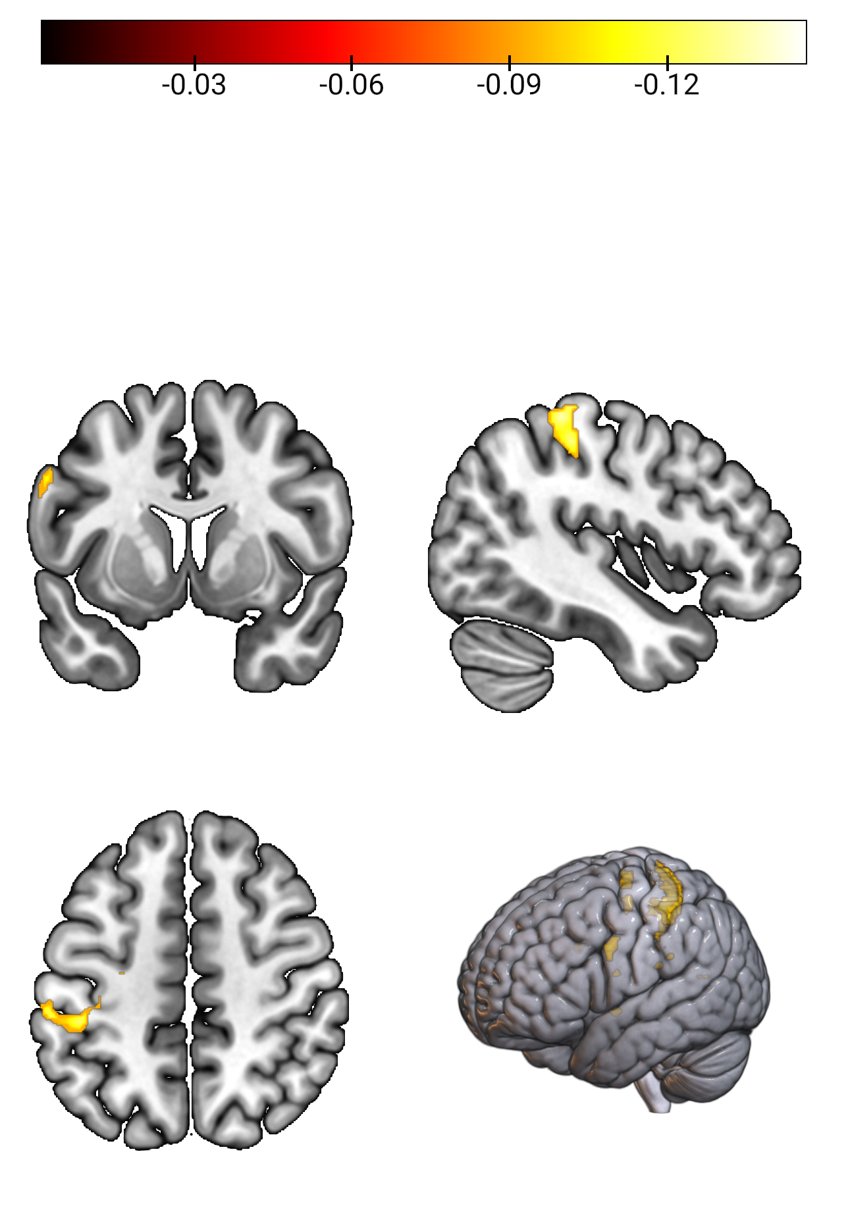
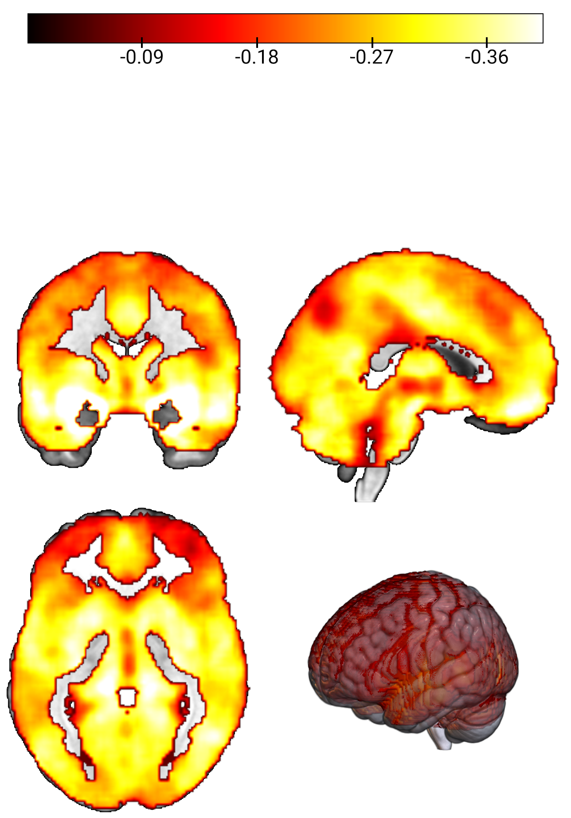

Slide 7
A priori emotion regulation network
A
x = 4, y = 0, z = 0
Trait questionnaires
B
x = 4, y = 0, z = 0
Task-based affective ratings
C
x = -44, y = 7, z = 4
Amygdala down-regulation
D
x = 0, y = 0, z = 0

Slide 8
A priori emotion regulation network
A
Trait questionnaires
B
Task-based affective ratings
C
Amygdala down-regulation
D

