Slide 1
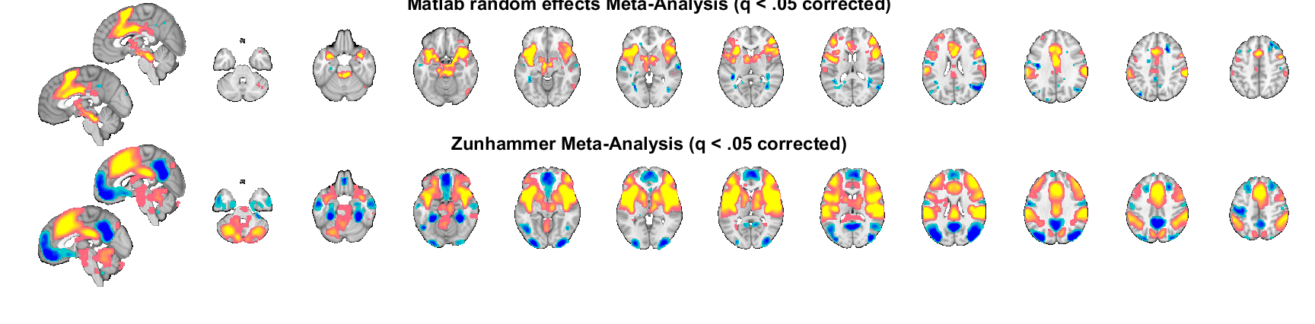
Custom Meta-Analysis (N = 279)
Zunhammer Meta-Analysis (N = 603)

