Slide 1
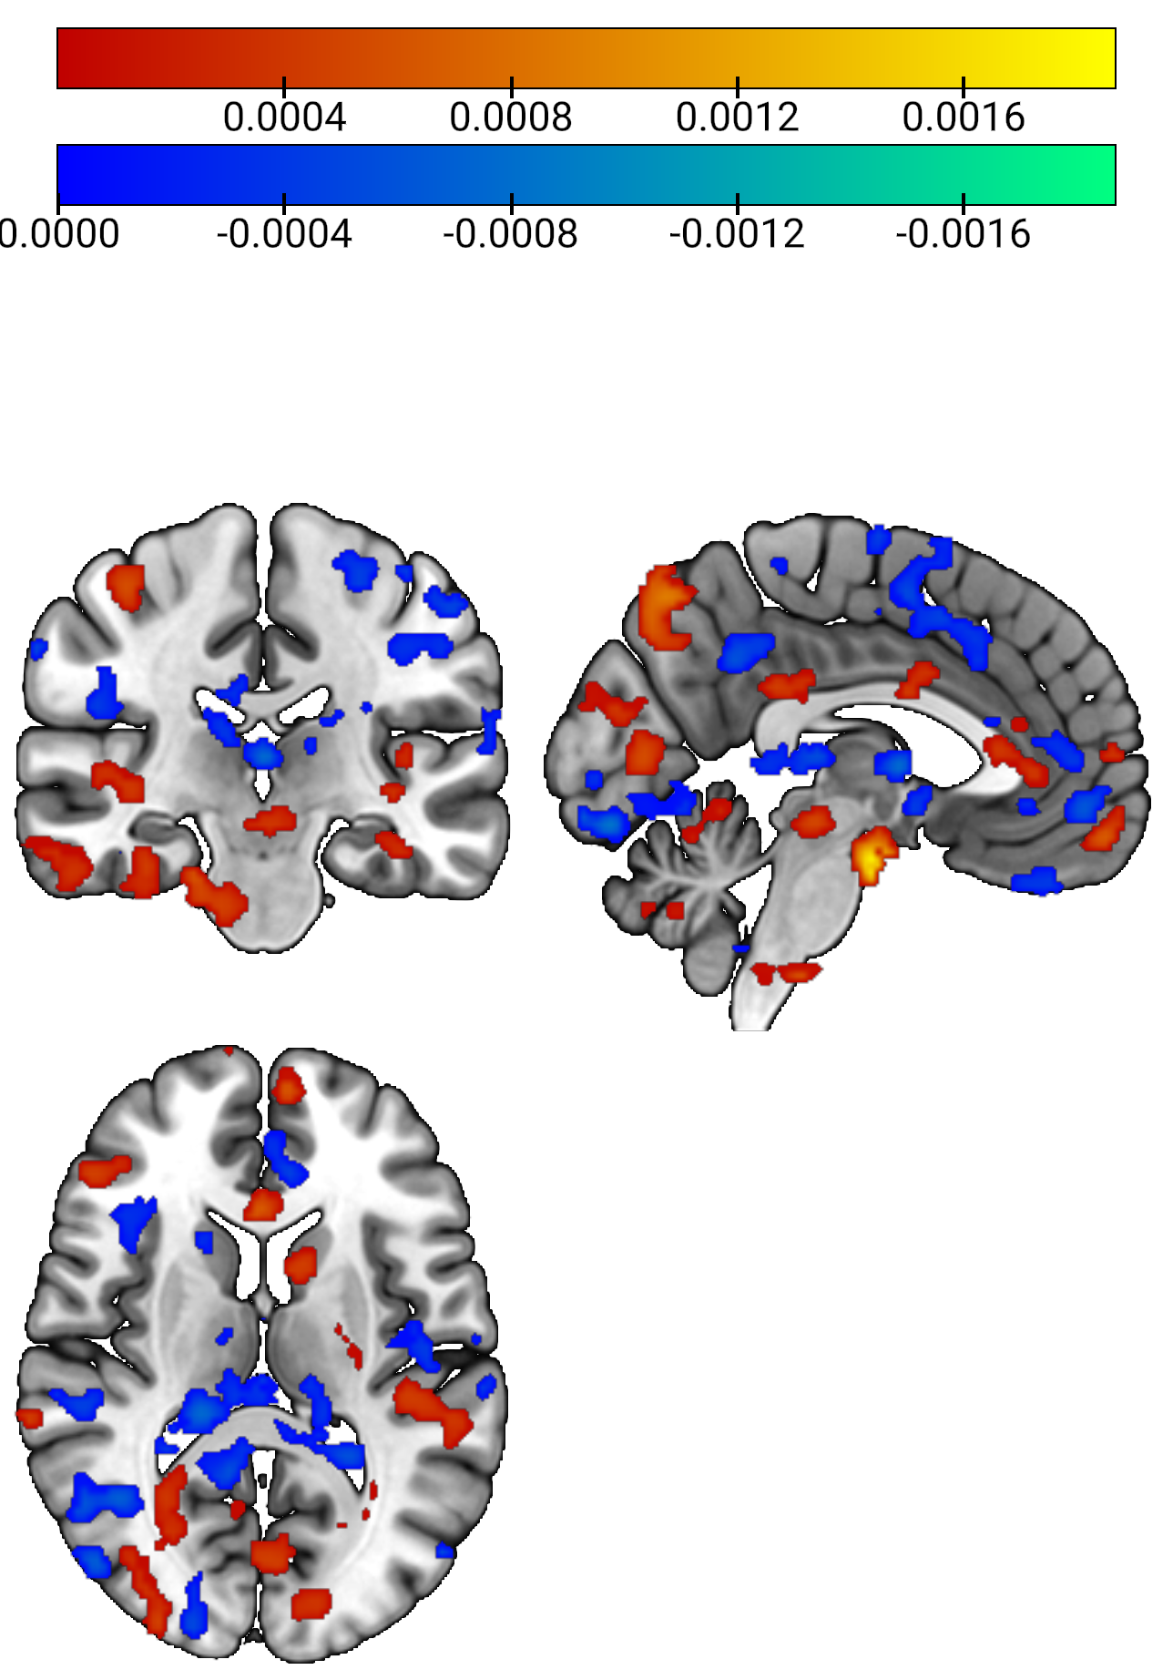

Slide 2
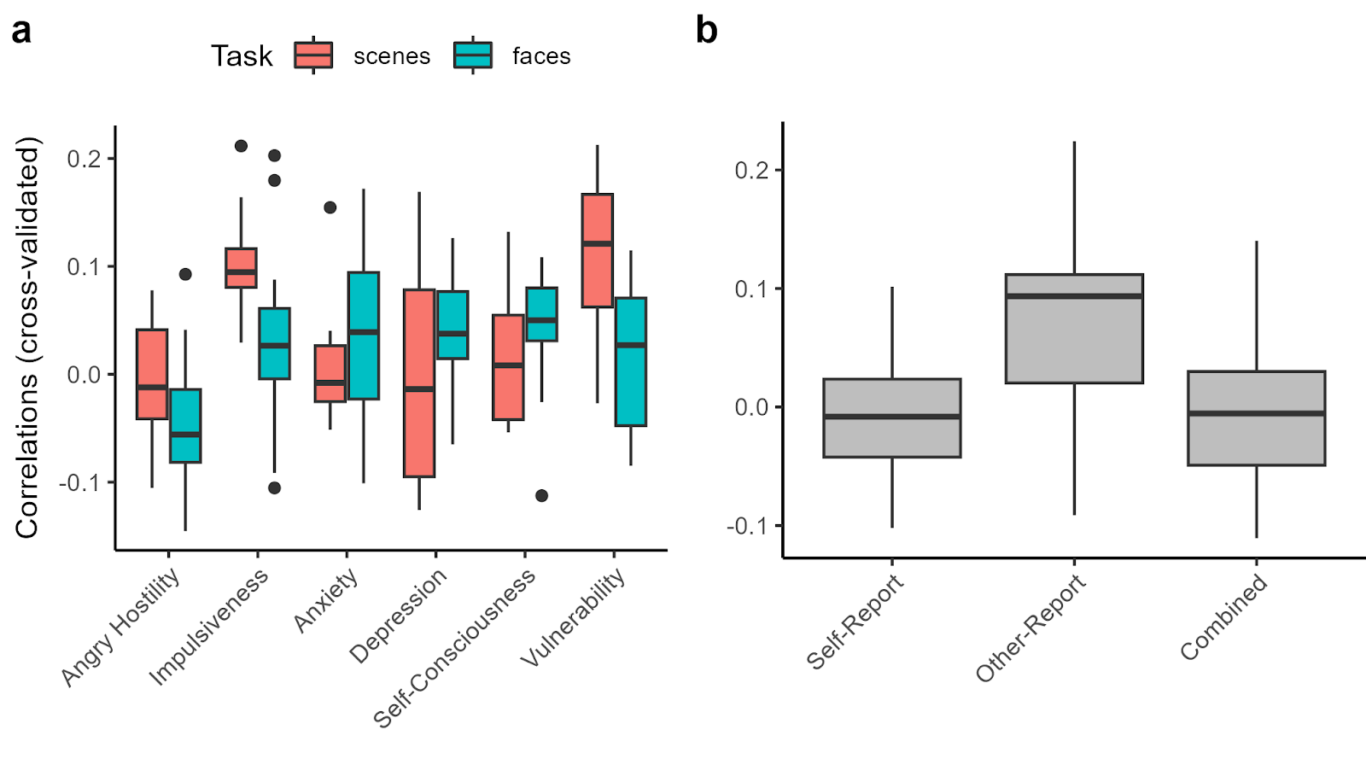
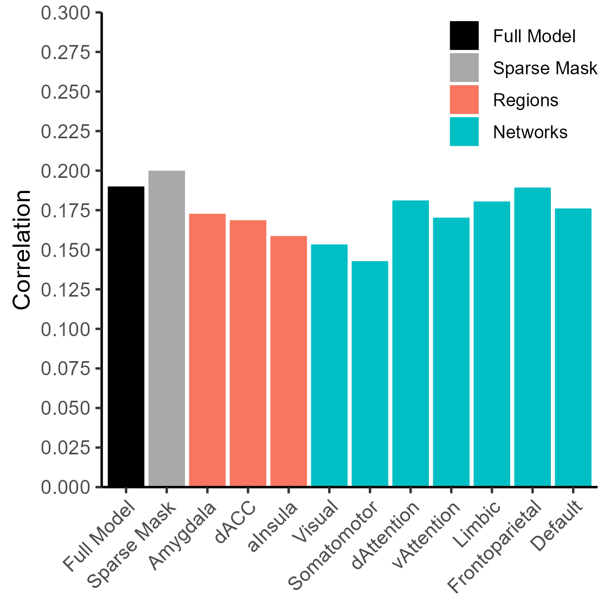
a) Neuroticism facets
b) Self- and other-reports
c) Vulnerability pattern
d) Virtual lesions

