Slide 1
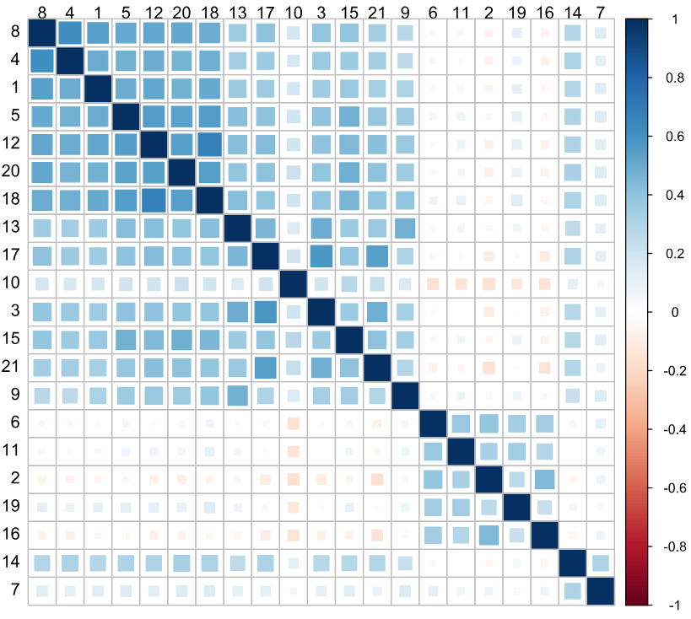
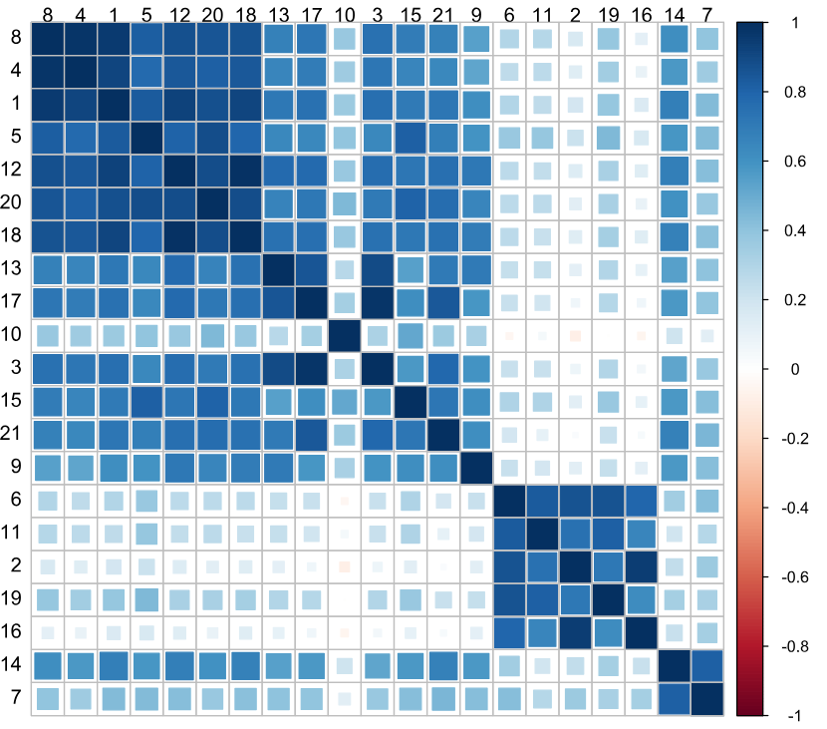
within
between

Slide 2
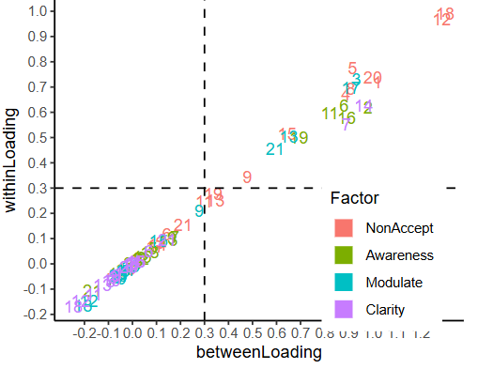
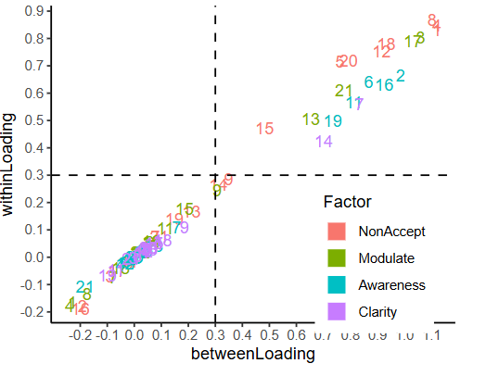
Construction Sample
Validation Sample

Slide 3
Within-person
Between-person
I feel ashamed with myself for feeling this way.
I am embarrassed for feeling this way.
I feel guilty for feeling this way.
I am feeling very bad about myself.
I am angry with myself for feeling this way.
I feel like I’m a weak person for feeling this way.
I am irritated with myself for feeling this way.
I am having difficulty controlling my behaviors.
My emotions feel out of control.
I believe that I will continue feeling this way for a long time.
I feel out of control.
I believe that I am going to end up feeling very depressed.
My emotions feel overwhelming.
I am having difficulty doing the things I need to do right now.
I am acknowledging my emotions.
I care about what I am feeling.
I am paying attention to how I feel.
I believe that my feelings are valid and important.
I am taking time to figure out what I am really feeling.
I am confused about how I feel.
I have no idea how I am feeling.

