Slide 1
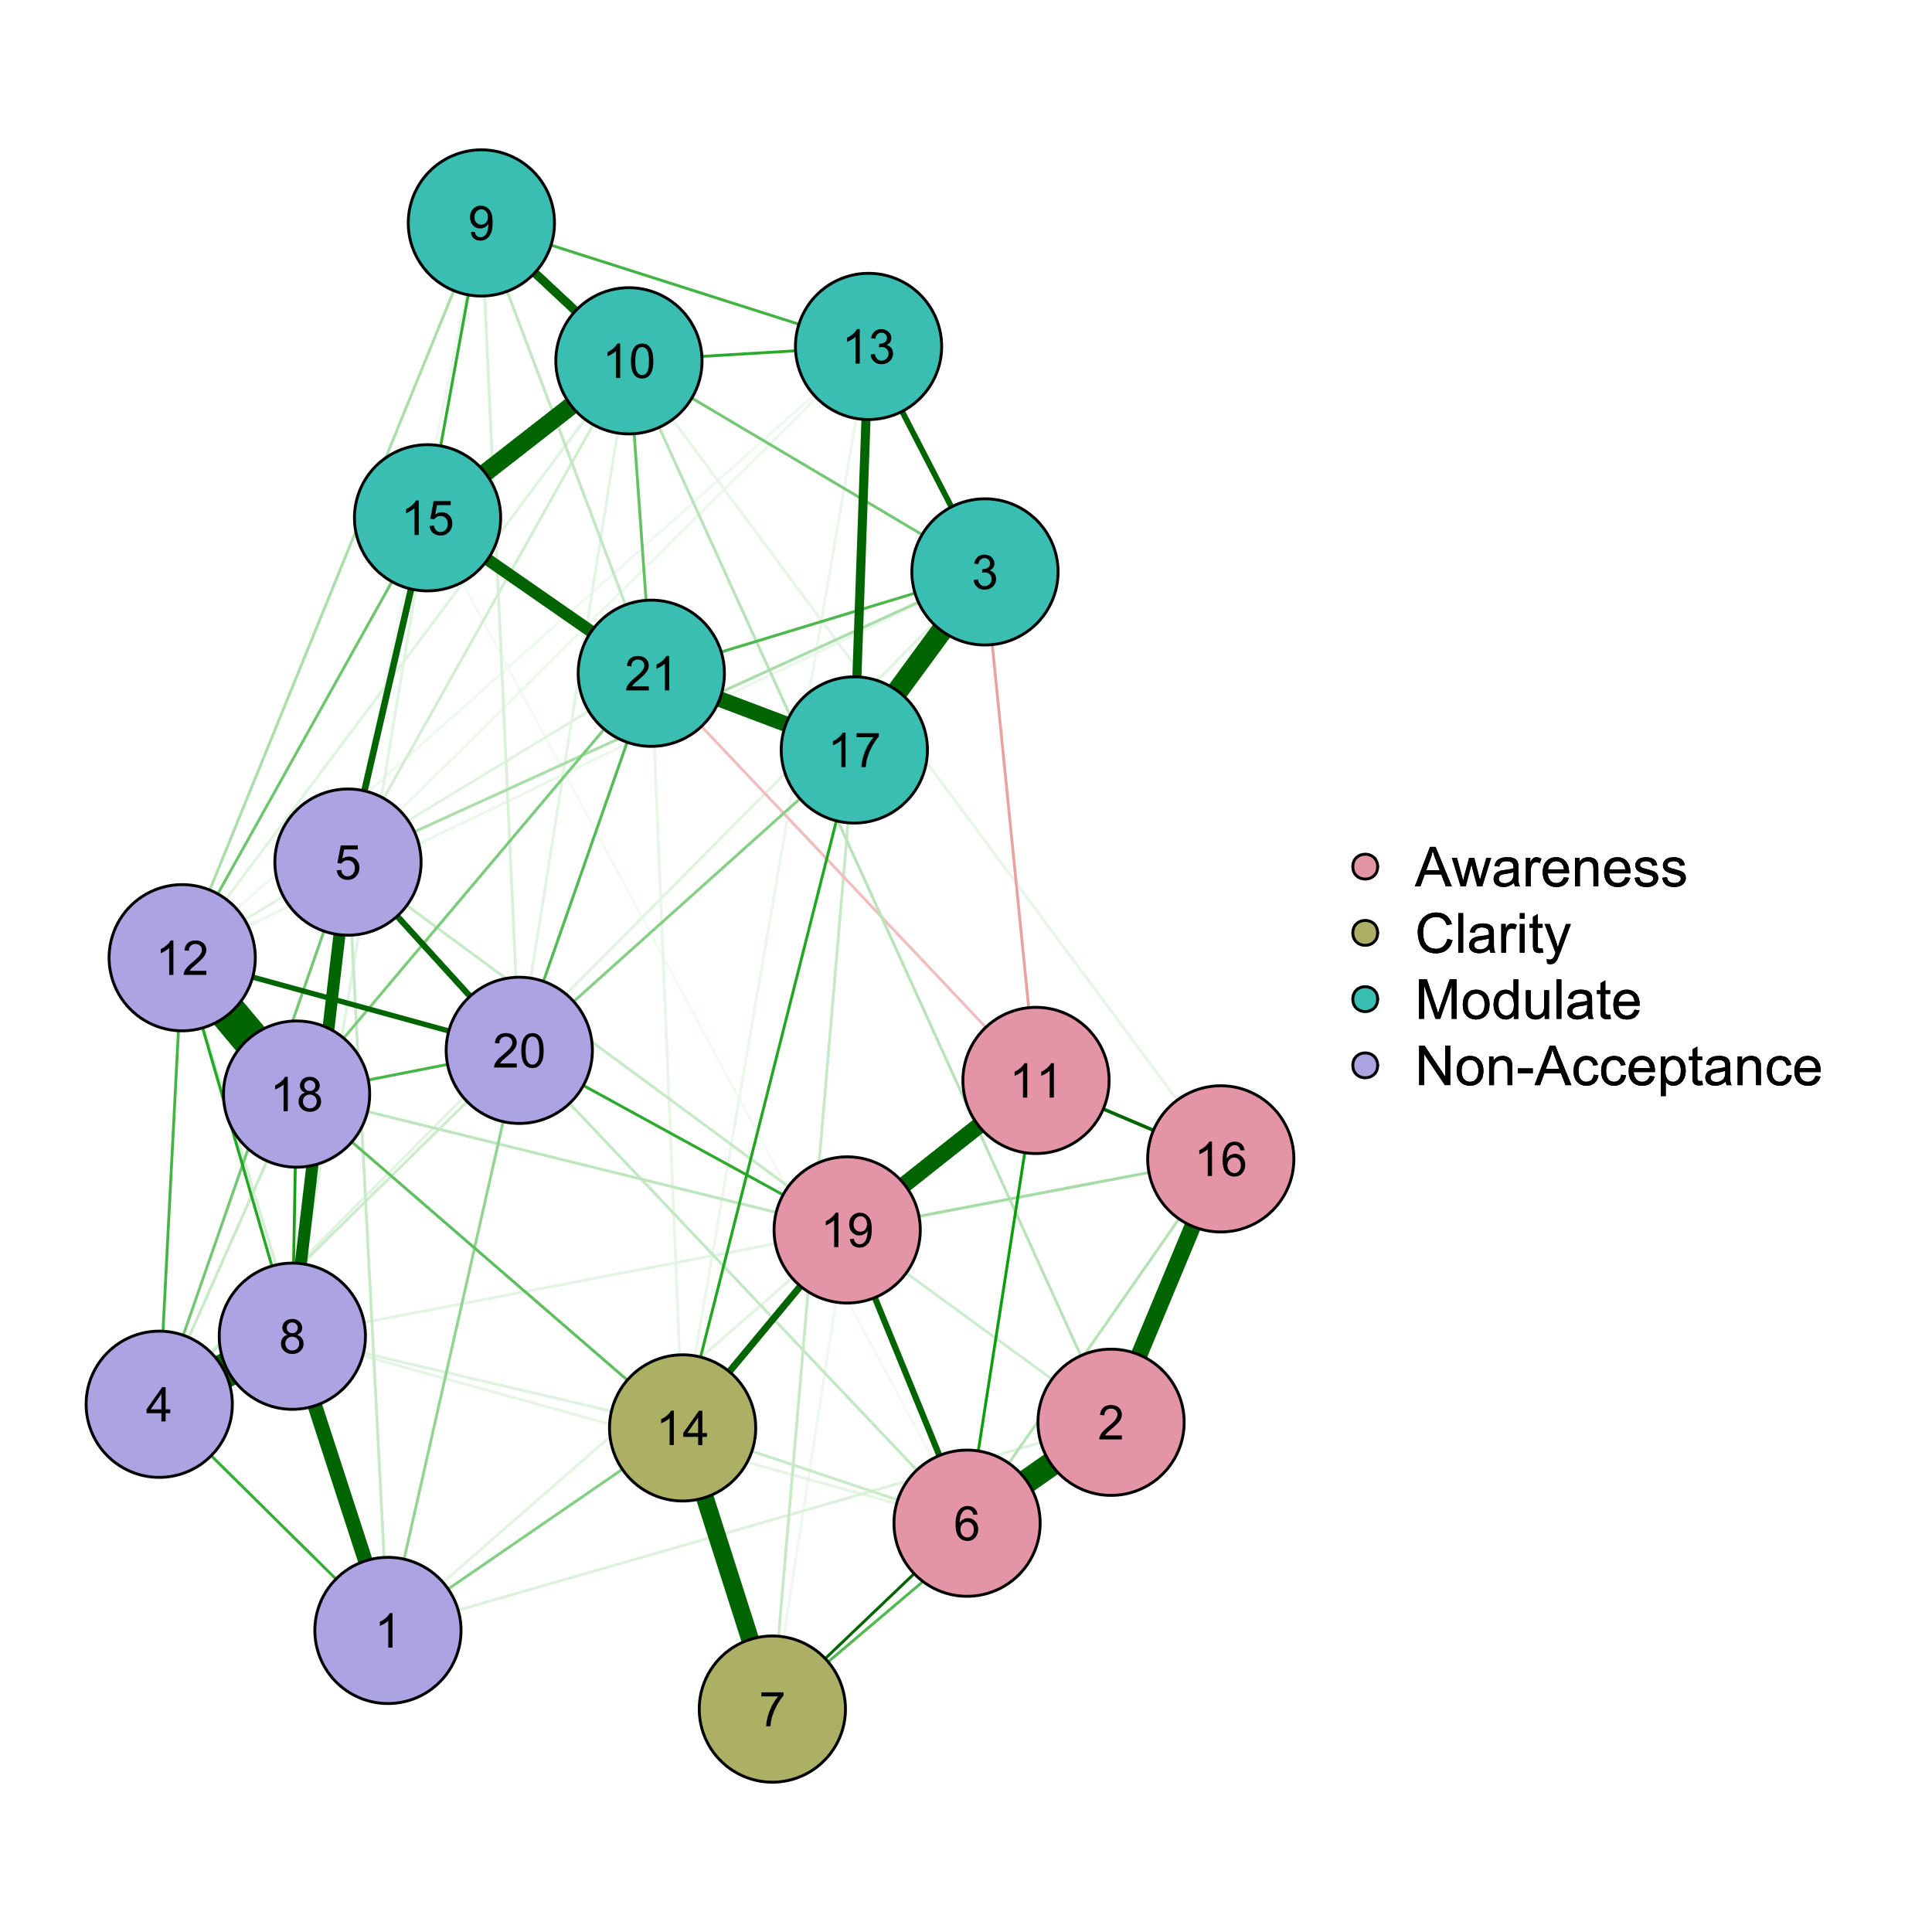
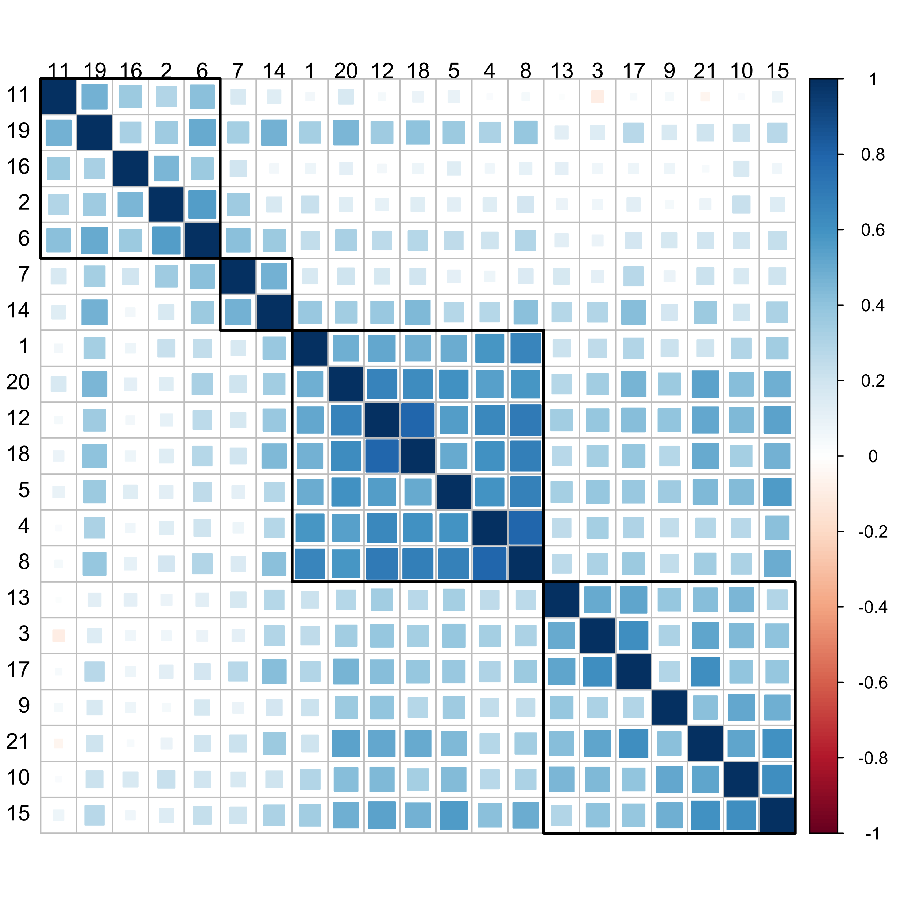
a
b
Clarity
Awareness
Modulate
Non-Acceptance

