Slide 1

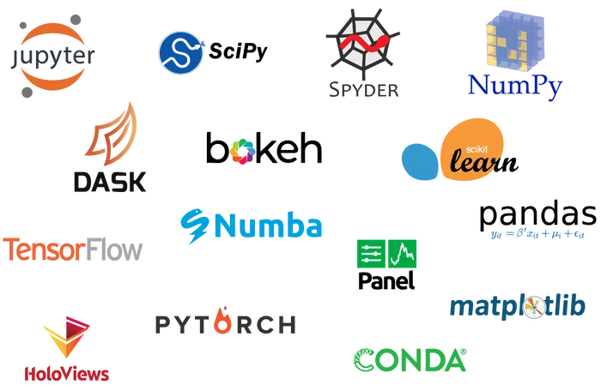
PhD Course on Python Language and Programming
Torino, 2022
Mauro Prencipe: mauro.prencipe@unito.it

Slide 2
Some of your possible motivations to take this course…
Because it’s fun;
because it will eventually free you by the slavery and dependence from programs written by others
because you would like to understand what programs, you already use, do

Slide 3
Some less obvious motivations…
Writing code to solve any problem means:
to be forced to understand the problem in depth
to be forced to understand the required algorithms very precisely
to enforce your logic and skills in the analysis of problems
to learn to think algorithmically

Slide 4
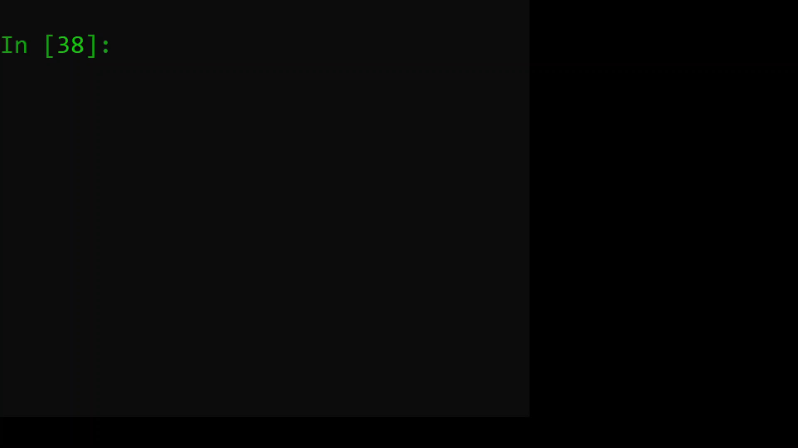
Think algorithmically
Imagine you have to swap the values stored in a pair of variables, a1 and a2...
For instance you start with a1 = 2 and a2 = 1 and you want to get a1 = 1 and a2 = 2
Intuitively, you do a1 = a2 and a2 = a1
Then, see what happens…
and what is the correct way to do that!

