Slide 1

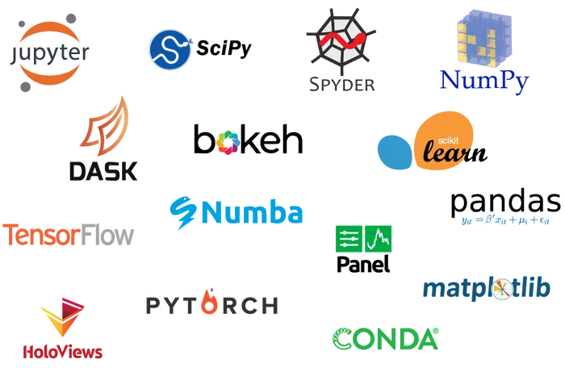
PhD Course on Python Language and Programming
Torino, 2022
Mauro Prencipe: mauro.prencipe@unito.it

Slide 2
Some of your possible motivations to take this course…
Because it’s fun;
because it will eventually free you by the slavery and dependence from programs written by others
because you would like to understand what programs really do under the hood…

Slide 3
Some less obvious motivations…
Writing code to solve any problem means:
to be forced to understand the problem in depth
to be forced to understand the required algorithms very precisely
to strengthen your logic and skills in the analysis of problems
to learn to think algorithmically

Slide 4
What you will get from this course…
You will get the basic tools to learn to write codes to manipulate and to elaborate data
Essentially to understand and write (esoteric) code like that…
for iset, ix, iname in zip(set_list, x, set_name):
exec(iset + '= data_class(iname, ix)')
l_set=list(eval(iset) for iset in set_list)
sets=np.array(l_set, dtype='object')
but…

Slide 5
… but, if you really want to learn, you must practice a lot…
learning how to use a programming language is much like learning a foreign language:
just studying the grammar, the syntax and learning by heart a more or less rich vocabulary is definitely not enough: you must practice the language until, al least, you start to think in that language!
So, you should start…

Slide 6
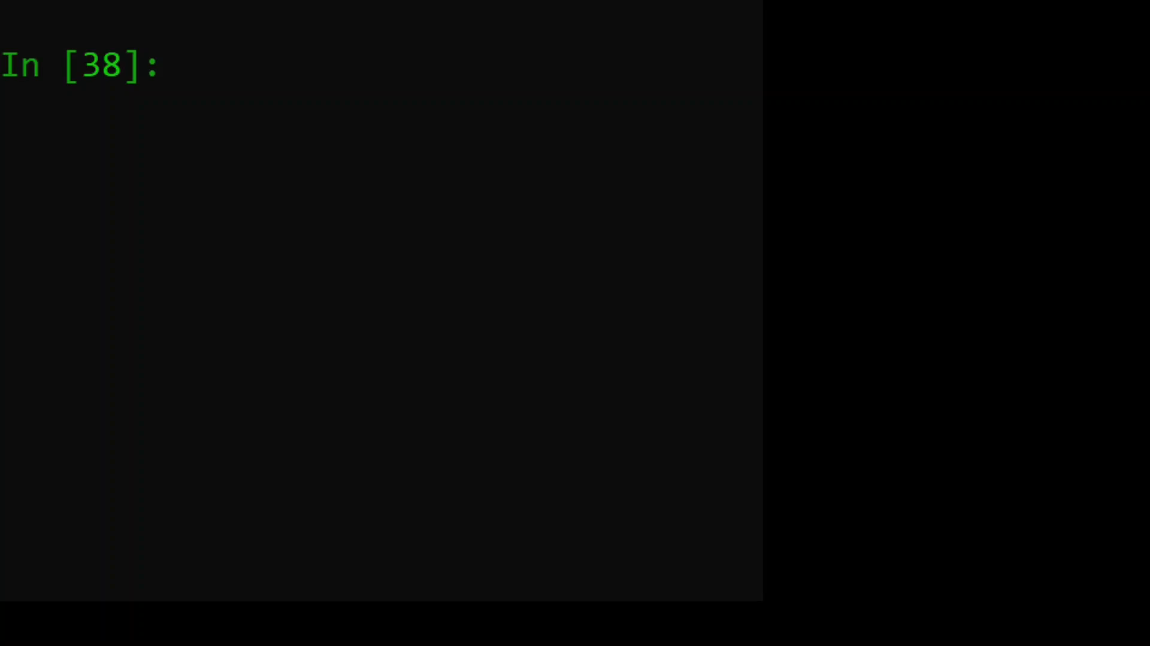
… to think algorithmically
Imagine you have to swap the values stored in a pair of variables, a1 and a2...
For instance, you start with a1 = 2 and a2 = 1 and you want to get a1 = 1 and a2 = 2
Intuitively, you do a1 = a2 and a2 = a1
Then, see what happens…
and what is the correct way to do that!

Slide 7
Why Python?
Python is open source
it is relatively young (born in the 90s), so probably it will last for many years to come
it is widely popular
it has a very large community of developers
You easily find help for any problem you might have
if you need of some particular feature or function, it is probable that someone else already developed it…

Slide 8
What is Python?
High level language
Interpreted
Supports OOP (Object Oriented Programming)
Main advantage over compiled languages: interactivity
main disadvantage: relatively low efficiency

Slide 9

Where to find (valuable) support…
Official sites
Conferences and Tutorials
Specific topics
python.org
anaconda.org
numpy.org
scipy.org
pandas.pydata.org
sympy.org
conference.scipy.org
Pandas (David Chen 2019)
Numpy (Alex Chabot-Leclerc; 2019)
YouTube playlist of tutorials
2018
2016
2014
Conferences by Bob Martin (Uncle Bob)
A must!
Logics
Clean code

Slide 10
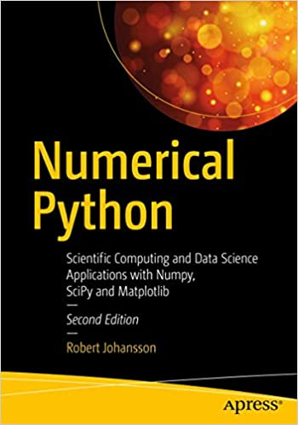
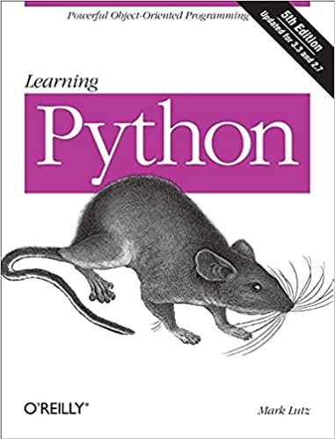
Books
Overview, recipes, practical advices, specialized topic in scientific computing
Very in depth analysis of the language: logics, grammar, syntax

Slide 11
Topics specifically covered in this course
Variables and types
conditional and cycles
functions
files
variable scoping
classes
least squares and general fits
Matplotlib
Basic elements of the
language
Python, Numpy, Matplotlib
(Pandas)
Object Oriented Programming
Structuring the code
Some specialized aspects
(Scipy)

