Slide 2

$𝒢$: set of unfesible generators , $𝒢_{i}$: set of unfesible generators at i-th iteration
Objective function $min f=\min{\sum_{g=1}^{|𝒢|}{\cos{φ^{∗}−{\cos{φ}}_{g}}}}$
(en el codigo: f = sum_diff)

Slide 3
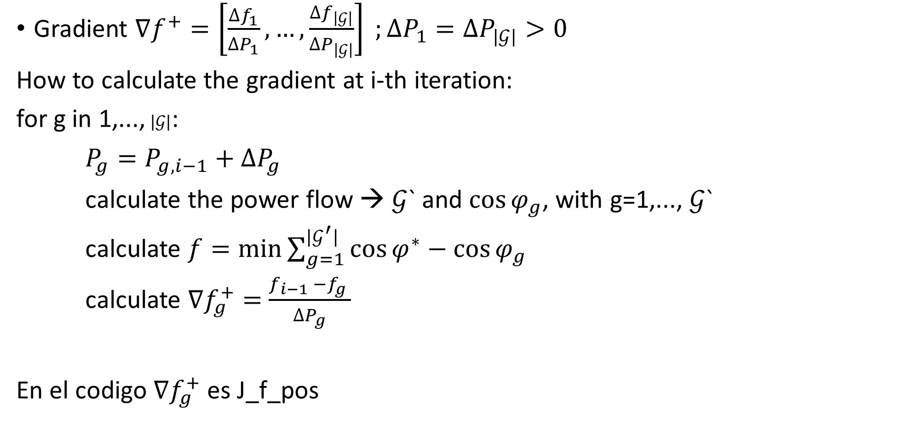
Gradient $∇f^{+}=\left[\frac{∆f_{1}}{∆P_{1}},…,\frac{∆f_{\left|𝒢\right|}}{∆P_{\left|𝒢\right|}}\right] ;∆P_{1}=∆P_{|𝒢|}>0$
How to calculate the gradient at i-th iteration:
for g in 1,..., $|𝒢|$:
$P_{g}=P_{g,i−1}+∆P_{g}$
calculate the power flow → $𝒢$` and ${\cos{φ}}_{g}$, with g=1,..., $𝒢$`
calculate $f=\min{\sum_{g=1}^{|𝒢^{′}|}{\cos{φ^{∗}−{\cos{φ}}_{g}}}}$
calculate $∇f_{g}^{+}=$ $\frac{f_{i−1 }−f_{g} }{∆P_{g}}$
En el codigo $∇f_{g}^{+}$ es J_f_pos

