Slide 1

Data Task E-commerce shop
XY

Slide 2

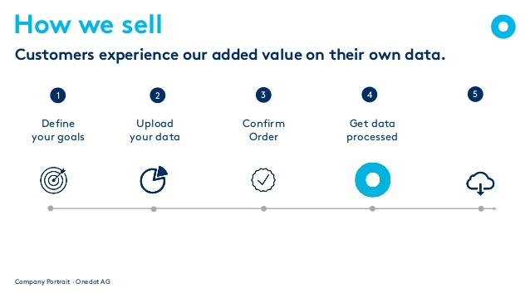

Support Chain

Slide 3
Input Data
One entry with 8 variables
 | Variables:
 | ID | 976.0
 | MakeText | MERCEDES-BENZ
 | TypeName | McLaren
 | TypeNameFull | MERCEDES-BENZ SLR McLaren
 | ModelText | SLR
 | ModelTypeText | SLR McLaren
 | Attribute Names | Seats
 | Attribute Values | 2
 | entity_id | 0001fda6-192b-46a8-bc08-0e833f904eed

Slide 4
Target Data
18 variables
Variables:
carType | Convertible / Roadster, Coupé, …
color | Beige, Black, Blue, …
condition | New, Original Condition, Restored, Used, …
currency | CHF, EUR, USD, …
drive | Left Hand (LHD), Right Hand (RHD)
city | Tokyo, Wien, Zurich, …
country | JP, AT , CH, …
make | Alfa Romeo, Mercedes-Benz, Porsche, ...
manufacture_year | 1920, 1999, 2010, …
Variables:
mileage | 12'302, 190'000, 18'000, …
mileage_unit | mile, kilometer, mile, …
model | RZ, SLR McLaren, 928, …
model_variant | no. 218, Roadster Serie 1 4.2 Lt, …
price_on_request | false, true
type | car
zip | Tokyo, spain, BUCKINGHAMSHIRE, …
manufacture_month | 0 : 12
fuel_consumption_unit | l_km_consumption, null

Slide 5
Changes to Input Data
Step 1: Normalization
 | Input Data:
 | ID | 976.0
 | MakeText | MERCEDES-BENZ
 | TypeName | McLaren
 | TypeNameFull | MERCEDES-BENZ SLR McLaren
 | ModelText | SLR
 | ModelTypeText | SLR McLaren
 | Attribute Names | Seats
 | Attribute Values | 2
 | entity_id | 0001fda6-192b-46a8-bc08-0e833f904eed
 | Output Data:
 | ID | 976.0
 | MakeText | Mercedes-Benz
 | TypeName | McLaren
 | TypeNameFull | Mercedes-Benz Slr McLaren
 | ModelText | SLR
 | ModelTypeText | SLR McLaren
 | Attribute Names | Seats
 | Attribute Values | 2
 | entity_id | 0001fda6-192b-46a8-bc08-0e833f904eed

Slide 6
Changes to Input Data
Step 2: Integration
 | Input Data:
 | ID | 976.0
 | MakeText | Mercedes-Benz
 | TypeName | McLaren
 | TypeNameFull | Mercedes-Benz Slr McLaren
 | ModelText | SLR
 | ModelTypeText | SLR McLaren
 | Attribute Names | Seats
 | Attribute Values | 2
 | entity_id | 0001fda6-192b-46a8-bc08-0e833f904eed
 | Input Data:
 | ID | 976.0
 | MakeText | Mercedes-Benz
 | TypeName | McLaren
 | TypeNameFull | Mercedes-Benz Slr McLaren
 | ModelText | SLR
 | ModelTypeText | SLR McLaren
 | Attribute Names | Seats
 | Attribute Values | 2
 | entity_id | 0001fda6-192b-46a8-bc08-0e833f904eed
 | Input Data:
 | ID | 976.0
 | MakeText | Mercedes-Benz
 | TypeName | McLaren
 | TypeNameFull | Mercedes-Benz Slr McLaren
 | ModelText | SLR
 | ModelTypeText | SLR McLaren
 | Attribute Names | Seats
 | Attribute Values | 2
 | entity_id | 0001fda6-192b-46a8-bc08-0e833f904eed
 | Additional Information:
 | type | car

Slide 7
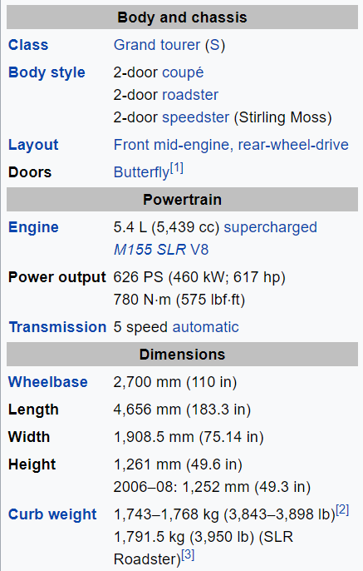
What we can do for You
Search for additional Information
 | Information given by customer
 | carType | Coupé
 | make | Mercedes-Benz
 | ModelText | SLR
 | model | SLR McLaren
 | type | car
 | Possible Additional Information:
 | Model_variant | 5.4 L (5,439 cc) supercharged M155 SLR V8

Slide 8
What we can do for You
Search for additional Information:
Price Range (From www.cars.com)
 | Mercedes-Benz McLaren SLR
 | Year | Price Range
 | 2005 | 237’851 $ - 385’015 $
 | 2006 | 214’554 $ - 335’962 $
 | 2007 | 695’750 $ - 695’750 $
 | 2008 | 239’196 $ - 382’452 $
 | 2009 | 248’591 $ - 424’271 $

Slide 9
Important to define your goals,
(nearly) everything is possible!

