Slide 1

Data Task E-commerce shop
XY

Slide 2

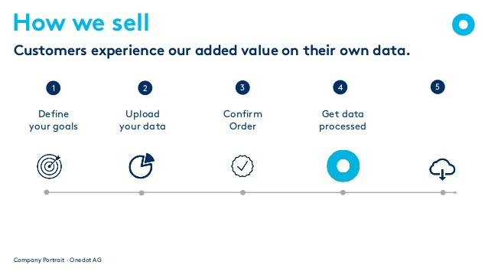

Support Chain

Slide 3
Input Data
21906 entries with 9 variables
 | Variables:
 | ID | 976.0 | Every entry is 19x repeated
 | MakeText | MERCEDES-BENZ | Every entry is 19x repeated
 | TypeName | McLaren | Every entry is 19x repeated
 | TypeNameFull | MERCEDES-BENZ SLR McLaren | Every entry is 19x repeated
 | ModelText | SLR | Every entry is 19x repeated
 | ModelTypeText | SLR McLaren | Every entry is 19x repeated
 | Attribute Names | Seats | Every entry is 1153x repeated
 | Attribute Values | 2
 | entity_id | 0001fda6-192b-46a8-bc08-0e833f904eed

Slide 4
Input Data
21906 entries with 9 variables
 | Variable: Attribute Names
 | BodyColorText | 976.0 | Silber m@t, grÃ¼n,…
 | BodyTypeText | MERCEDES-BENZ | Cabriolet, SUV, Kombi,…
 | Ccm | McLaren | 0:998
 | City | MERCEDES-BENZ SLR McLaren | Zuzwil, St. Gallen,…
 | Co2EmissionText | SLR | […] g/km
 | ConditionTypeText | SLR McLaren | Neu, Occasion,…
 | ConsumptionRatingText | Seats | C, D, E,…
 | ConsumptionTotalText | 2 | […] l/100km
 | Doors | 0001fda6-192b-46a8-bc08-0e833f904eed | 0:5
 | DriveTypeText | 976.0 | Allrad,...
 | FirstRegMonth | MERCEDES-BENZ | 0:12
 | FirstRegYear | McLaren | 2010,2012,…
 | FuelTypeText | MERCEDES-BENZ SLR McLaren | Benzin,…
 | Hp | SLR | Numeric
 | InteriorColorText | SLR McLaren | Rot, weiss, …
 | Km | Seats | 1:99999
 | Properties | 2 | 2
 | Seats | D | 0:7
 | TransmissionTypeText |  | Automat, manuell

Slide 5
Input Data
21906 entries with 9 variables
 | Variable: Attribute Names
 | BodyColorText | 976.0 | Silber m@t, grÃ¼n,…
 | BodyTypeText | MERCEDES-BENZ | Cabriolet, SUV, Kombi,…
 | Ccm | McLaren | 0:998
 | City | MERCEDES-BENZ SLR McLaren | Zuzwil, St. Gallen,…
 | Co2EmissionText | SLR | […] g/km
 | ConditionTypeText | SLR McLaren | Neu, Occasion,…
 | ConsumptionRatingText | Seats | C, D, E,…
 | ConsumptionTotalText | 2 | […] l/100km
 | Doors | 0001fda6-192b-46a8-bc08-0e833f904eed | 0:5
 | DriveTypeText | 976.0 | Allrad,...
 | FirstRegMonth | MERCEDES-BENZ | 0:12
 | FirstRegYear | McLaren | 2010,2012,…
 | FuelTypeText | MERCEDES-BENZ SLR McLaren | Benzin,…
 | Hp | SLR | Numeric
 | InteriorColorText | SLR McLaren | Rot, weiss, …
 | Km | Seats | 1:99999
 | Properties | 2 | Ab MFK, Tuning,…
 | Seats | D | 0:7
 | TransmissionTypeText |  | Automat, manuell

Slide 6
Target Data
18 variables
Variables:
carType | Convertible / Roadster, Coupé, …
color | Beige, Black, Blue, …
condition | New, Original Condition, Restored, Used, …
currency | CHF, EUR, USD, …
drive | Left Hand (LHD), Right Hand (RHD)
city | Tokyo, Wien, Zurich, …
country | JP, AT , CH, …
make | Alfa Romeo, Mercedes-Benz, Porsche, ...
manufacture_year | 1920, 1999, 2010, …
Variables:
mileage | 12'302, 190'000, 18'000, …
mileage_unit | mile, kilometer, mile, …
model | RZ, SLR McLaren, 928, …
model_variant | no. 218, Roadster Serie 1 4.2 Lt, …
price_on_request | false, true
type | car
zip | Tokyo, spain, BUCKINGHAMSHIRE, …
manufacture_month | 0 : 12
fuel_consumption_unit | l_km_consumption, null

Slide 7
Changes to Input Data
Step 1: Pre-Processing

Slide 8
Changes to Input Data
Before:
21906 observations with 9 variables
Fix character encoding
Data from long to wide format:
Step 1: Pre-Processing
After:
1153 observations with 25 variables

Slide 9
Changes to Input Data
Fix uppercase / lowercase
Recode and translate into English
Step 2: Normalization
 | Output Data:
 | MakeText | Mercedes-Benz
 | TypeNameFull | Mercedes-Benz SLR McLaren
 | Input Data:
 | MakeText | MERCEDES-BENZ
 | TypeNameFull | MERCEDES-BENZ SLR McLaren
 | BodyColorText | Silber mét
 | BodyTypeText | Cabriolet
 | ConditionTypeText | Neu
 | Output Data:
 | MakeText | Mercedes-Benz
 | TypeNameFull | Mercedes-Benz SLR McLaren
 | BodyColorText | Silver
 | BodyTypeText | Convertible
 | ConditionTypeText | New

Slide 10
Changes to Input Data
 | Additional Information:
 | type | car
 | Variables from Attribute Names
 | BodyColorText | 976.0 | Silver
 | BodyTypeText | MERCEDES-BENZ | Convertible
 | Ccm | McLaren | 455
 | City | MERCEDES-BENZ SLR McLaren | Zuzwil
 | Co2EmissionText | SLR | […] g/km
 | ConditionTypeText | SLR McLaren | New
 | ConsumptionRatingText | Seats | C
 | ConsumptionTotalText | 2 | […] l/100km
 | Doors | 0001fda6-192b-46a8-bc08-0e833f904eed | 3
Step 3: Integration
 | DriveTypeText | 976.0 | Rennwagen
 | FirstRegMonth | MERCEDES-BENZ | 7
 | FirstRegYear | McLaren | 1999
 | FuelTypeText | MERCEDES-BENZ SLR McLaren | Benzin
 | Hp | SLR | 107
 | InteriorColorText | SLR McLaren | weiss
 | Km | Seats | 0
 | Properties | 2 | Ab MFK
 | Seats | D | 2
 | TransmissionTypeText |  | Automat
 | Variables from Beginning:
 | ID | 976.0
 | MakeText | Mercedes-Benz
 | TypeName | McLaren
 | TypeNameFull | Mercedes-Benz SLR McLaren
 | ModelText | SLR
 | ModelTypeText | SLR McLaren
 | entity_id | 0001fda6-192b-46a8-bc08-0e833f904eed

Slide 11
Changes to Input Data
 | Additional Information:
 | type | car
 | Variables from Attribute Names
 | BodyColorText | 976.0 | Silver
 | BodyTypeText | MERCEDES-BENZ | Convertible
 | Ccm | McLaren | 455
 | City | MERCEDES-BENZ SLR McLaren | Zuzwil
 | Co2EmissionText | SLR | […] g/km
 | ConditionTypeText | SLR McLaren | New
 | ConsumptionRatingText | Seats | C
 | ConsumptionTotalText | 2 | […] l/100km
 | Doors | 0001fda6-192b-46a8-bc08-0e833f904eed | 3
Step 3: Integration
 | DriveTypeText | Rennwagen
 | FirstRegMonth | 7
 | FirstRegYear | 1999
 | FuelTypeText | Benzin
 | Hp | 107
 | InteriorColorText | weiss
 | Km | 0
 | Properties | Ab MFK
 | Seats | 2
 | TransmissionTypeText | Automat
 | Variables from Beginning:
 | ID | 976.0
 | MakeText | Mercedes-Benz
 | TypeName | McLaren
 | TypeNameFull | Mercedes-Benz SLR McLaren
 | ModelText | SLR
 | ModelTypeText | SLR McLaren
 | entity_id | 0001fda6-192b-46a8-bc08-0e833f904eed

Slide 12
Changes to Input Data
 | Variables from Attribute Names
 | color | 976.0 | Silver
 | carType | MERCEDES-BENZ | Convertible
 | city | MERCEDES-BENZ SLR McLaren | Zuzwil
 | condition | SLR McLaren | New
Step 3: Integration
 | Variables from Beginning:
 | MakeText | Mercedes-Benz
 | TypeName | McLaren
 | TypeNameFull | Mercedes-Benz SLR McLaren
 | ModelText | SLR
 | ModelTypeText | SLR McLaren
 | manufacture_month | 7
 | FirstRegYear | 1999
 | Additional Information:
 | type | car
 | mileage | 0
 | mileage_unit | Kilometer
 | country | Based on city

Slide 13
Target Data
4 from 18 variables are empty
Variables:
carType | Convertible / Roadster, Coupé, …
color | Beige, Black, Blue, …
condition | New, Original Condition, Restored, Used, …
currency | CHF, EUR, USD, …
drive | Left Hand (LHD), Right Hand (RHD)
city | Tokyo, Wien, Zurich, …
country | JP, AT , CH, …
make | Alfa Romeo, Mercedes-Benz, Porsche, ...
manufacture_year | 1920, 1999, 2010, …
Variables:
mileage | 12'302, 190'000, 18'000, …
mileage_unit | mile, kilometer, mile, …
model | RZ, SLR McLaren, 928, …
model_variant | no. 218, Roadster Serie 1 4.2 Lt, …
price_on_request | false, true
type | car
zip | Tokyo, spain, BUCKINGHAMSHIRE, …
manufacture_month | 0 : 12
fuel_consumption_unit | l_km_consumption, null

Slide 14
What we can do for You
Search for additional Information
Get ‘currency’ and ‘drive’ based on country.

Slide 15
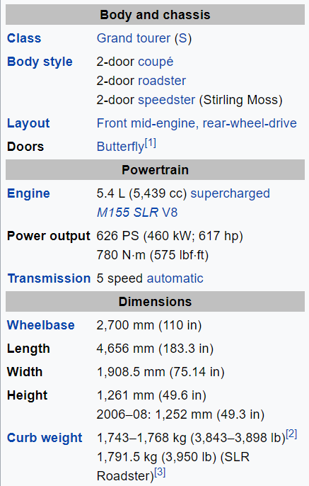
What we can do for You
Search for additional Information:
Price Range (From www.cars.com)
 | Mercedes-Benz McLaren SLR
 | Year | Price Range
 | 2005 | 237’851 $ - 385’015 $
 | 2006 | 214’554 $ - 335’962 $
 | 2007 | 695’750 $ - 695’750 $
 | 2008 | 239’196 $ - 382’452 $
 | 2009 | 248’591 $ - 424’271 $

Slide 16
Important to define your goals,
(nearly) everything is possible!

