Slide 1
B+ Tree Implementation
Maurya Jadhav
Praveen Singh
Priyanka Meena
Rashmi G R
Shubham Kumar
CS315A - Group Project

Slide 2
Acknowledgements
We would like to thank
Dr. Arnab Bhattacharya sir for giving
us this opportunity to explore
and implement a B+ Tree.
We had an incredible learning experience through the workings of this project.

Slide 3
Introduction
01.
The Project
The project idea is to implement a B+ Tree data structure in C++ for a database
02.
Importance of a B+ Tree
A B+Tree helps store a large amount of data. It is a self-balancing structure which also allows faster functionalities like search and delete making it a useful implementation
03.
Key Functionalities
The key functionalities include insertion, deletion, search, and image display

Slide 4




Project Objectives
Implement a B+ tree data structure in C++
Incorporate functionalities for inserting, deleting, and searching data in the B+ tree
Enhance the visualization of the B+ tree structure through image display using the Graphviz library
Provide efficient and balanced operations for managing data in the B+ tree

Slide 5
Project Methodology
01
02
03
04
C++
OOPs & Algorithms
Graphviz
Testing & Evaluation
We used C++ as the programming language for implementing the B+ tree.
OOPs principles were followed while designing the B+ tree data structure with algorithms for search, insert and delete features
Utilised the Graphviz library to generate images of the B+ tree structure
A thorough testing and evaluation was conducted to ensure correctness and efficiency of the implementation

Slide 6
Insertion Algorithm
The insertion operation in the B+ tree follows these steps:
1. Search for the appropriate leaf node where the key should be inserted by recursively traversing the tree from the root.
2. If the leaf node has space for the key, insert the key-value pair into the node in the correct position to maintain the ascending order of keys.
3. If the leaf node is full, split the node into two halves and promote the middle key to the parent node. Insert the key-value pair into the appropriate half of the split node.
4. If the parent node is also full, repeat the split operation recursively until a node with space is found or until a new root node is created if the split operation reaches the root.

Slide 7
Deletion Algorithm
The deletion operation in the B+ tree follows these steps:
1. Search for the node containing the key that needs to be deleted by recursively traversing the tree from the root.
2. If the key is found in a leaf node, delete the key-value pair from the node and rebalance the tree if necessary by borrowing keys from adjacent nodes or merging nodes.
3. If the key is not found in a leaf node, continue the search in the appropriate child node and repeat the deletion process recursively until the key is found or the search reaches a leaf node indicating that the key does not exist in the tree.

Slide 8
Search Algorithm
The search operation in the B+ tree follows these steps:
1. Start from the root node and compare the target key with the keys in the node.
2. If the target key is found in the node, return the associated value.
3. If the target key is smaller than the smallest key in the node, follow the leftmost child pointer and repeat the search process in the child node.
4. If the target key is larger than the largest key in the node, follow the rightmost child pointer and repeat the search process in the child node.
5. If the target key falls between the keys in the node, follow the appropriate child pointer and repeat the search process in the child node.

Slide 9
Implementation Details
We used two main classes to implement the B+ tree: Node and BPlusTree. The Node class represents a single node in the tree, and the BPlusTree class represents the entire tree structure.
The Node class has the following attributes:
- Keys: An array of keys that are stored in the node in ascending order.
- Values: An array of values that are associated with the keys.
- Child Pointers: An array of pointers to child nodes, which represent the children of the node.
- Parent Pointer: A pointer to the parent node, except for the root node which has a null parent pointer.
- Leaf Node: A boolean flag that indicates whether the node is a leaf node or not.
- Key Count: An integer that represents the number of keys currently stored in the node.
The BPlusTree class has the following attributes:
- Root Node: A pointer to the root node of the tree.
- Order: An integer that represents the maximum number of keys that a node can contain.
- Leaf Nodes: A list of pointers to all the leaf nodes in the tree.

Slide 10
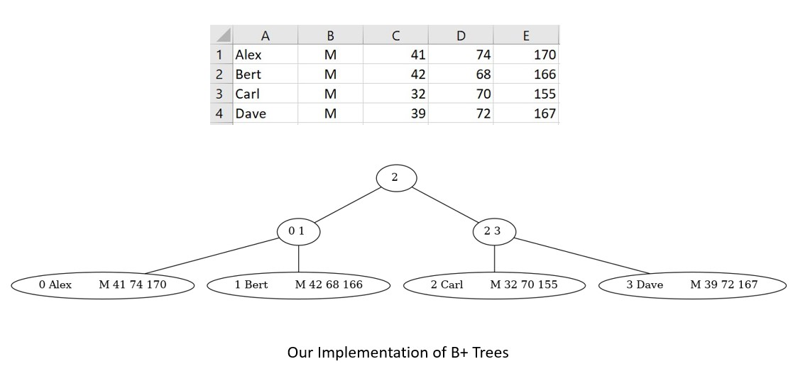
Results
An image produced by the implementation for a database is as seen.

Slide 11
Demonstration

Slide 12

References
1. Cormen, T. H., Leiserson, C. E., Rivest, R. L., & Stein, C. (2009). Introduction to Algorithms (3rd Edition). The MIT Press.
2. Garcia-Molina, H., Ullman, J. D., & Widom, J. (2008). Database Systems: The Complete Book (2nd Edition). Pearson.
3. Shaffer, C. A. (1994). A Practical Introduction to Data Structures and Algorithm Analysis (2nd Edition). Prentice Hall.
4. Graphviz - Graph Visualization Software. (n.d.). Graphviz - Graph Visualization Software.
5. B+ Tree Visualization - Visualgo
6. B+ Tree - Programiz

Slide 13
Thank You!
Any Questions?

