Slide 1


Slide 2
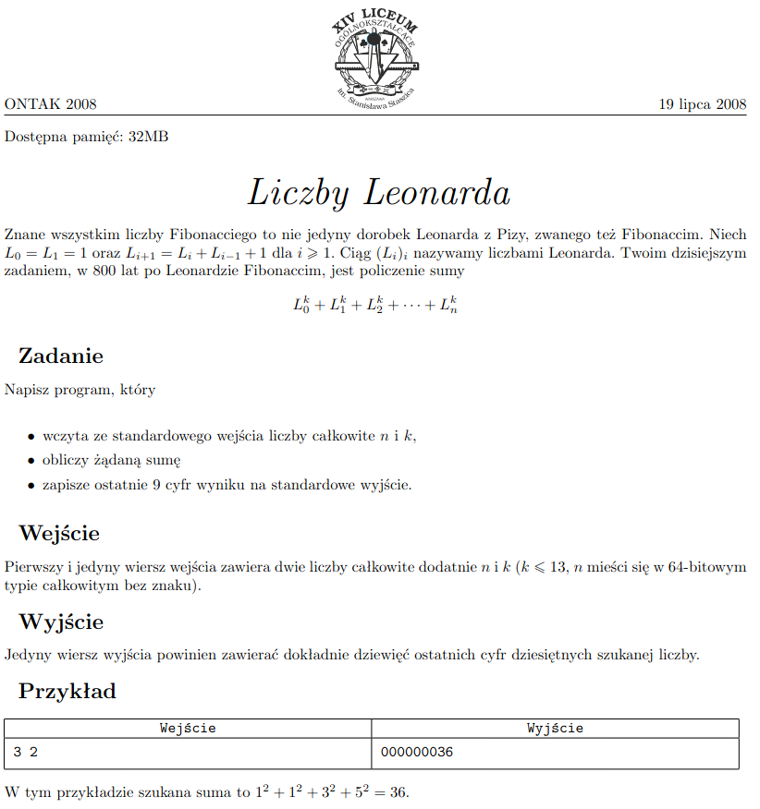
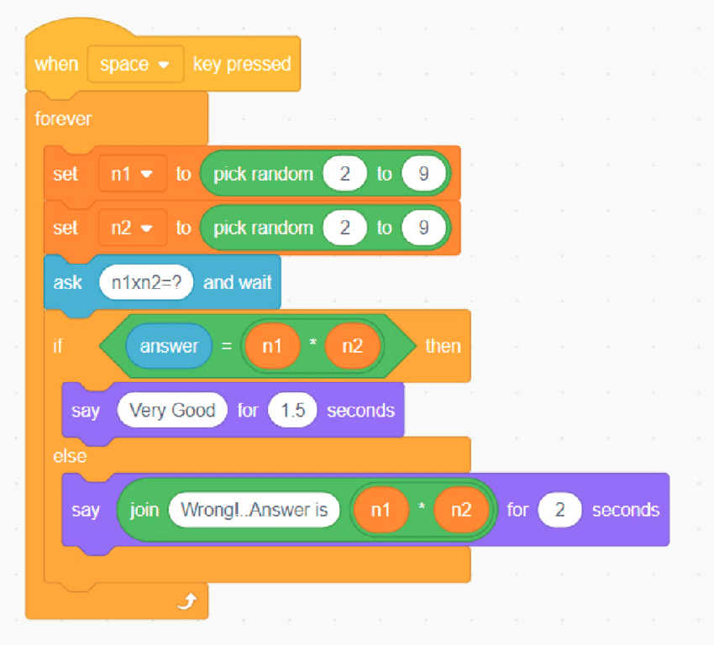
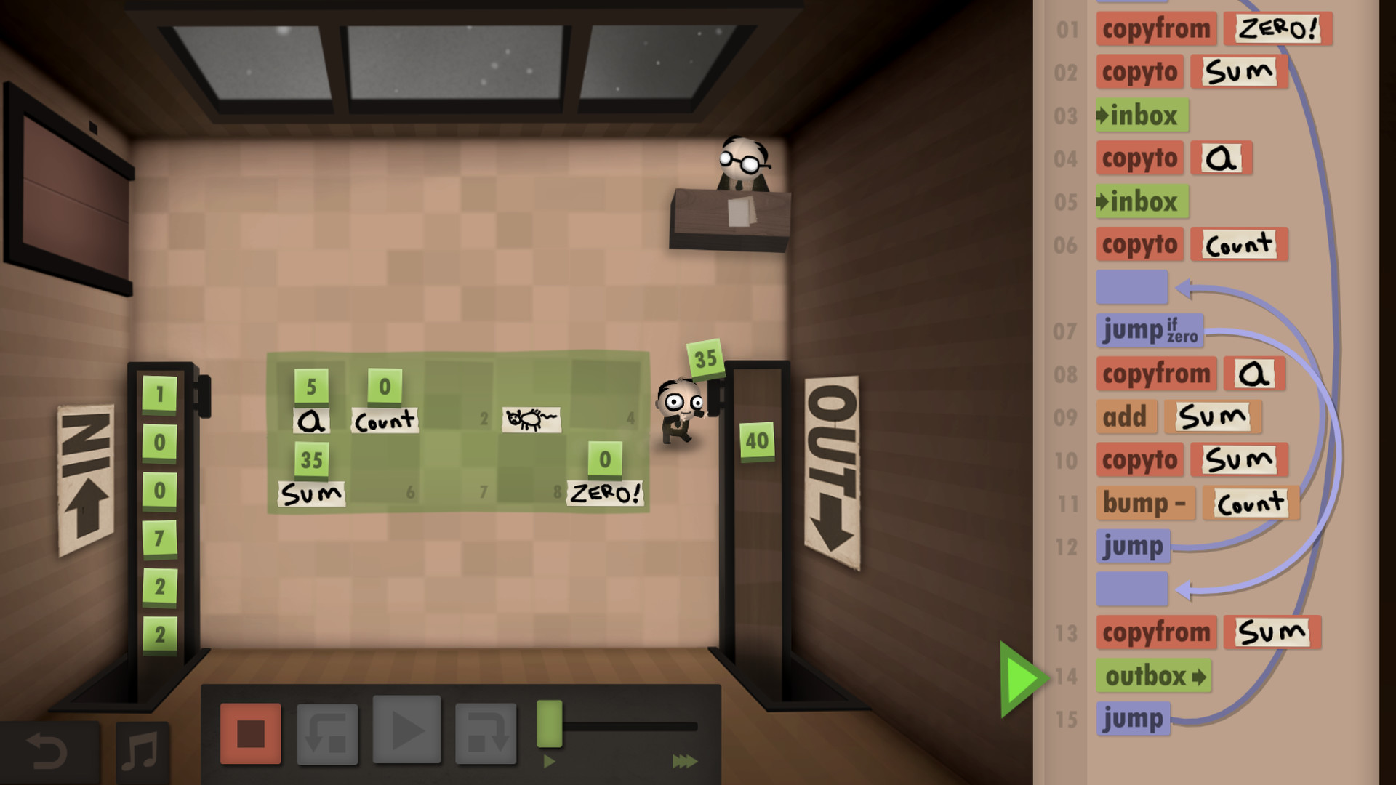
What inspired us
- Scratch
- SIO2
- Human Resource Machine
- Idle

Slide 3
The team
- Maurycy Wojda : CI/CD, problem package system, interaction with the operating system
- Kacper Chętkowski : Technology choice, project modularisation, design patterns, misc.
- Antoni Puch : Custom language backend, point economy, user data management
- Kacper Kramarz-Fernandez : UI, UI, UI
We communicated on Discord and sometimes during classes. Work on the project was very enjoyable for all of us, especially because we were all passionate about the subject.

Slide 4
The vision and functional requirements
- Application for learning about Data Structures and Algorithms
- Extrinsic motivation in the form of points
- Custom visual programming language
- Possibility to add own problem packages (with documentation)

Slide 5
Non-functional requirements
- Portability : screen, mouse, keyboard, Java 16+, make, g++ with -std=c++20
- System requirements : Ubuntu 20.04+ or Debian 11+, Intel Core i5 @3GHz+, 8GB of RAM
- Efficiency : 1M operations per second (we achieved 25M), load time of 10s (we achieved 2s)
- Reliability : <1 crash per hour under the condition that the program files aren't changed manually at runtime and there is only one instance of the app running.
- Reliability : Support for 1000+ problem packages and 1000+ simultaneously loaded instruction blocks

Slide 6
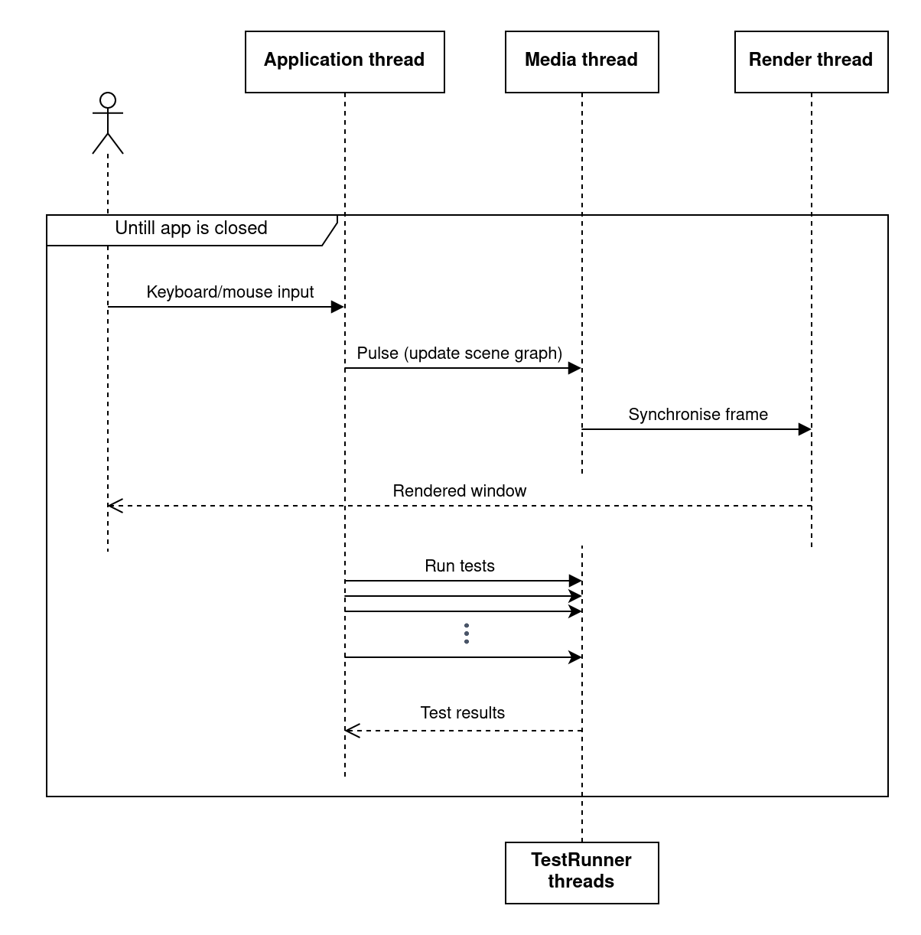
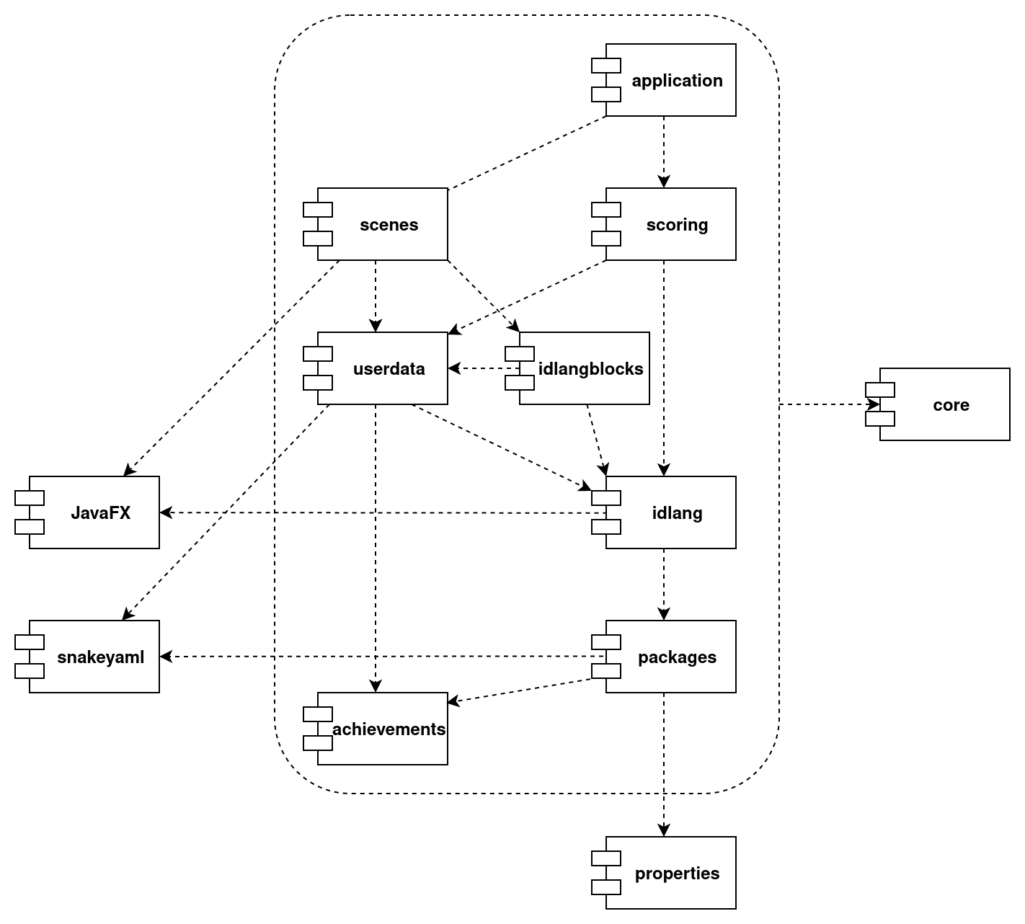
General high-level architecture

Slide 7
Main technological decisions
- General : Java, because it's convenient for large projects
- Graphics : JavaFX + SceneBuilder, because it was familiar
- Problem packages : C++, because of speed and familiarity with a similar system, "SIO2", used in competitive programming in Poland.
We could use C++ for the problem packages, because we interacted with the code written in C++ via the operating system's shell.

Slide 8
What went well and what went poorly
Poorly :
maven,
CI/CD,
modularisation,
installation script
Well :
building the scenes (UI),
data (de)serialization,
workload distribution,
setting goals,
communication,
issues

Slide 9
This is where we show a demo

