Slide 1
✈
BRITISH AIRWAYS
Customer Booking Prediction
Machine Learning Model — Findings Summary
Algorithm: Random Forest Classifier | Dataset: 50,000 customer records
Forage Virtual Internship • British Airways Data Science

Slide 2
Dataset Overview & Preparation
EXPLORE & PREPARE
50,000
14
14.9%
18
Customer
Records
Original
Features
Booking
Rate
Features After
Engineering
Feature Engineering
Key Observations
wants_any_extra — flag if any add-on selected
total_extras — count of all add-ons
is_weekend_flight — Sat/Sun departure
is_group_booking — 2+ passengers
purchase_lead_log — log-scaled lead time
Class Imbalance
85% no-booking vs 15% booking — balanced weights applied
No Missing Data
All 14 columns complete; no imputation required
Mixed Feature Types
Encoded 5 categorical columns with LabelEncoder
British Airways • Customer Booking Prediction
2 / 4

Slide 3
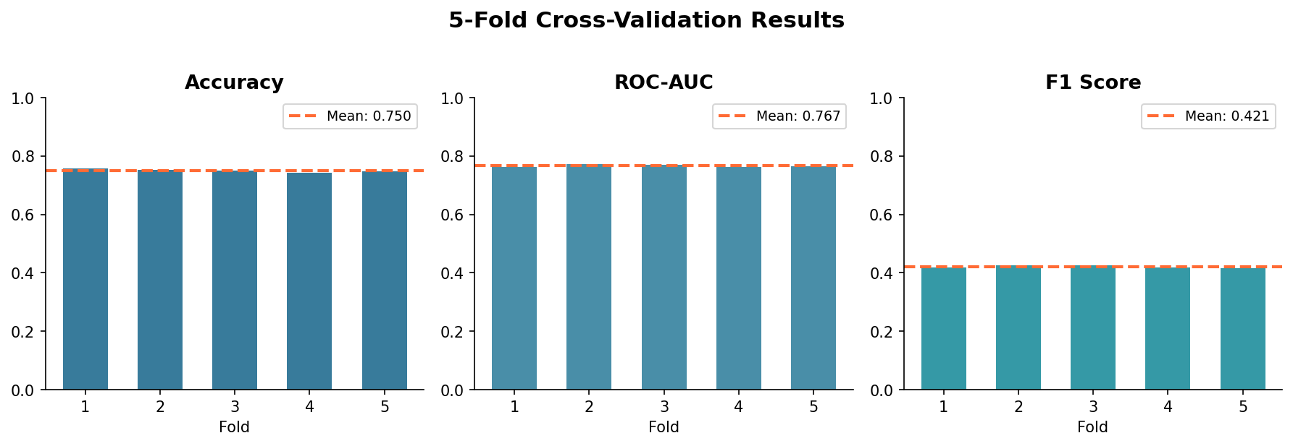
Model Training & Evaluation
75.0%
76.7%
42.1%
CV Accuracy
ROC-AUC Score
F1 Score
± 0.46%
± 0.38%
± 0.48%
5-Fold Cross-Validation Results
British Airways • Customer Booking Prediction
3 / 4

Slide 4
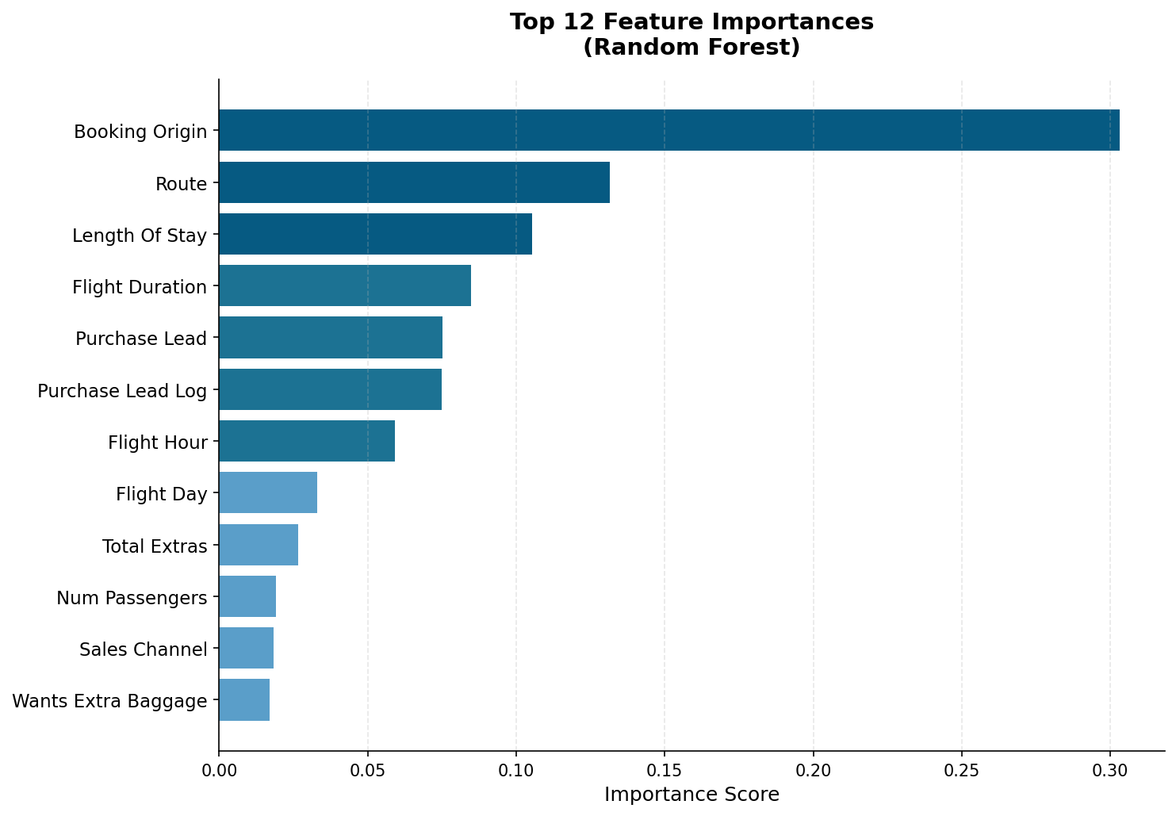
Feature Importance & Key Findings
Variable Contribution to Model
Key Insights
#1
Booking Origin
Top predictor — customer's country of origin drives booking behaviour most strongly (30.3%)
#2
Route
Specific flight route matters significantly — certain routes see much higher completion (13.1%)
#3
Length of Stay
Longer stays correlate with higher commitment to complete a booking (10.5%)
#4
Flight Duration
Longer flights show stronger booking intent — likely business or premium trips (8.5%)
British Airways • Customer Booking Prediction
4 / 4

