Slide 1
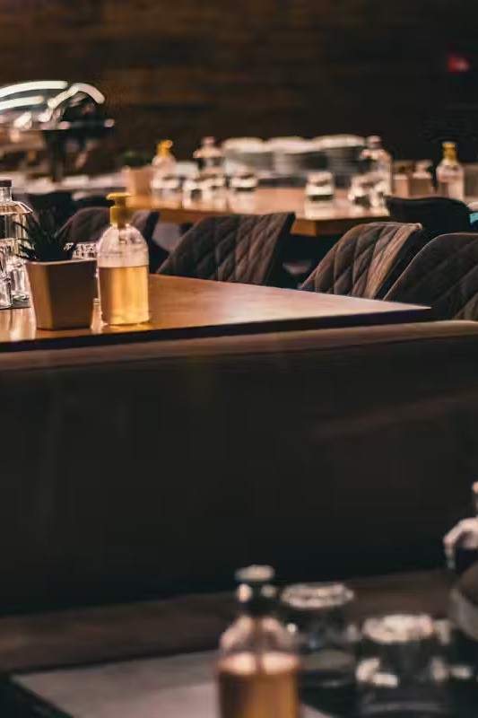
Restaurant Reservation Website: A Technical
Exploration
Welcome to our technical exploration of a restaurant reservation website! In this presentation, we'll dive into the design and development of a web application that simplifies the process of booking tables at restaurants. We'll discuss the key concepts, methodologies, and potential challenges involved in building this system, along with future opportunities and limitations.
by Mausam Tripathi
& Nishant Pandey

Slide 2
Topics Covered
Introduction
Methodology
ER Diagram & DFD
Results & Limitations
We'll start with a brief overview of the project's purpose, target audience, and the current landscape of restaurant reservation systems.
We'll delve into the development process, outlining the tools, technologies, and design approaches employed for building the website.
We'll explore the data model and process flow, using entity-relationship diagrams and data flow diagrams to illustrate the system's underlying structure.
We'll examine the key features and functionalities of the completed website and discuss any limitations or challenges encountered during development.

Slide 3

Introduction
In today's digital age, convenience and efficiency are paramount. For restaurant owners, managing reservations efficiently and providing a seamless customer experience is crucial. This project aims to develop a comprehensive website for restaurant reservation management, streamlining the process for both restaurants and diners.

Slide 4

Methodology
1
1. Requirements Gathering
We began by meticulously gathering and analyzing the requirements for the website, ensuring a clear understanding of user needs and business objectives.
2
2. Design & Development
We designed the website's user interface and backend logic, employing industry- standard tools and technologies like HTML, CSS, JavaScript, and a suitable backend framework.
3
3. Testing & Deployment
Thorough testing was conducted to ensure functionality, performance, and security. Upon successful completion, the website was deployed onto a secure server.

Slide 5
ER Diagram & DFD
Entity-Relationship Diagram
1
2
Data Flow Diagram
Database Design
3
These diagrams are crucial for defining the relationships between entities and understanding the flow of data within the system.

Slide 6
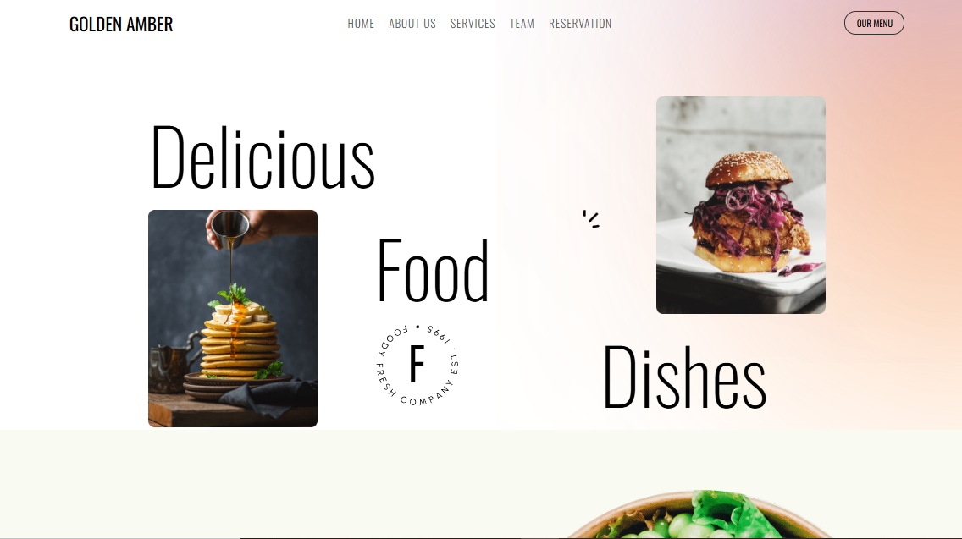
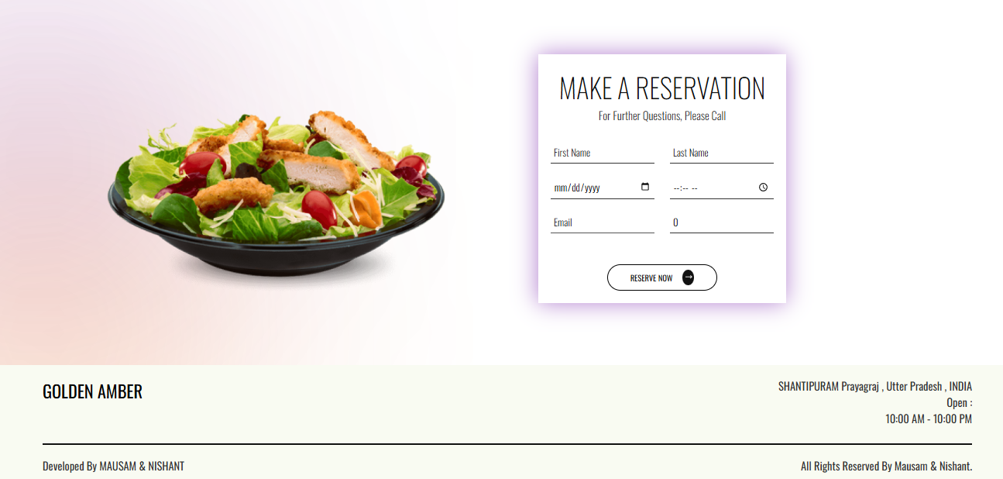
Results & Snapshots
User Interface
The website features an intuitive and user-friendly interface, enabling users to easily search for restaurants, view availability, and make reservations.
Confirmation System
Users receive automated confirmation emails after making reservations, minimizing errors and ensuring a smooth process.

Slide 7

Limitations
Scalability
The current system might face scalability challenges as the number of restaurants and users increases, requiring potential optimization.
Integration Challenges
Integrating with existing restaurant management systems or third-party payment gateways may present technical hurdles.
Security Concerns
Ensuring data security and preventing unauthorized access to user information is a critical concern that requires continuous vigilance.

Slide 8

Future Scope
Customer Reviews
Enabling users to leave reviews and ratings for restaurants, enhancing the platform's value and credibility.
Real-time Availability
Implementing real-time availability updates for reservations, ensuring accurate information for users.
1
2
3
Advanced Search Filters
Expanding search options to include dietary restrictions, price range, and specific cuisines.

Slide 9

References
The development of this restaurant reservation website drew inspiration from various sources, including industry best practices, technical documentation, and research on user experience design. The information gathered from these references helped shape the website's functionality and user interface.

