Slide 1
Project
SOFTWARE CONSTRUCTION

Slide 2
Project Description
This is a client /server application.
A client can ask for only one file in one connection.
The server can connect to multiple clients once it is run, using threads.

Slide 3
Concurrent Activities of our Project
The project utilizes the concurrency by allowing multiple simultaneous connections at one time to the server.

Slide 4
Fundamental issues Faces in managing the changes in your project
Race condition when creating variables
Possibility of a deadlock occurring when assigning resources to multiple clients at the same time

Slide 5
Solution/Approaches used to handle those issues
Ensured that there are no global variables that are used without sleep/lock functionality.

Slide 6
Refactoring and tuning

Slide 7

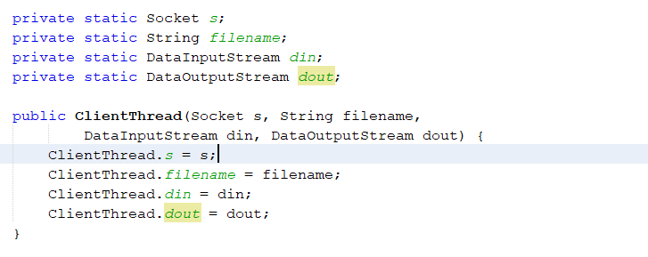
Declaring as class variables so we can use them in methods
Main method is performing 2 functions, i.e. connection setup and file receiving.
A method ‘startRecieving’ is created to perform the file receiving and is called from main
After creating method for receiving the try-catch in main method is not needed
Variables declared as static to increase scope

Slide 8
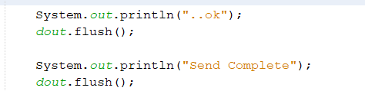
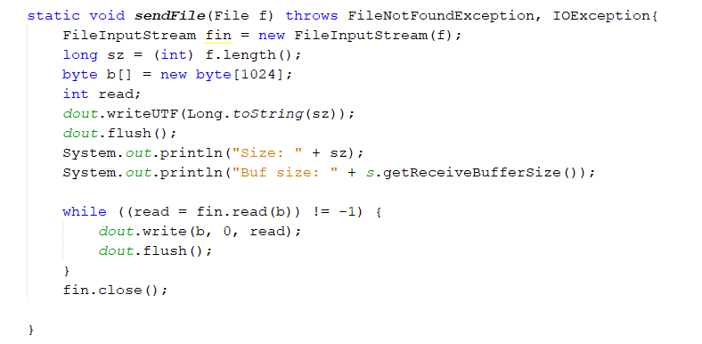
Extra flush statements removed
Variables to be renamed.
Created a ‘sendFile’ method that would be called from main

