Slide 1

Nanotechnology: The Revolution of Endless Possibilities
Presented by:
Christopher McCall
Jason Chen
March 27, 2001

Slide 2
What is Nanotechnology?
Nanotechnology is molecular manufacturing or, more simply, building things one atom or molecule at a time with programmed nanoscopic robot arms
Allow automatic construction of consumer goods without traditional labor (e.g. Xerox machine)
The trick is to manipulate atoms individually and place them exactly where needed to produce the desired structure
The payoff for mastering this technology will be far greater than anything we have achieved so far

Slide 3
The Next Euphoria
“Stocks with nano in the name will be all the next rage.”
-Tom Theis, director of physical sciences at IBM Research
VC’s looking for post Internet-meltdown opportunities
Nanotechnology has seen exciting recent breakthroughs
$500 M in government funding
Possibilities are endless

Slide 4
Industries Likely to be Affected
“It’s hard to think of an industry that isn’t likely to be disrupted by nanotechnolgy.”
– David Bishop of Lucent Technologies’ Bell Labs
        Consumer
        Technology
        Medical
        Ecological

Slide 5
Consumer
Self-assembling consumer goods
Safe and affordable space travel
Molecular food syntheses (end starvation)
Construction of buildings/houses

Slide 6


Slide 7
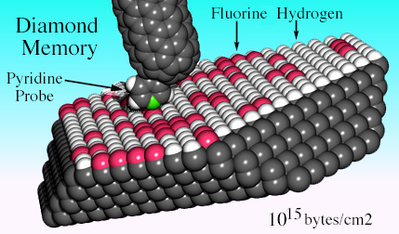
Technology
Computers billions of times faster
Optical Communications
Source: NASA

Slide 8
Medical
End to illness, aging, death
Programmable microscopic smart materials
Drexler artificial immune system
  Mmicroscopic submarines
  "Cell Sentinel“

Slide 9
Ecological
Reintroduction of many extinct plants and animals
End to pollution
  For instance, plastics
Automatic cleanup of already existing pollution
Viable alternative energy source
  Nanites = “Servants of Humanity”
    Pave roads and create wood

Slide 10
When Will Nanotechnology Arrive?
"Arrive", is broadly defined as the arrival of the first "Universal Assembler" that has the ability to build with single atoms anything one's software defines (like a microwave oven)
Possible creations could include: Doc Martens, Papa John’s, pizza, Pampers’ diapers, and Motorola cell phones
Tom R. Craver, a prominent nanothinkier asserts that nanotecnology will arrive in “full, undeniable” force by 2030

Slide 11
A Timeline for the Future
Below is a timeline taken from an August 1995 article from Wired magazine. The five experts have Ph.D’s.
Birge
Brenner
Drexler
Hall
Smalley
Molecular Assembler
2005
2025
2015
2010
2000
Nanocomputer
2040
2040
2017
2010
2100
Cell Repair
2030
2035
2018
2050
2010
Commercial product
2002
2000
2015
2005
2000
Nanotech laws
1998
2036
2015
1995
2000

Slide 12
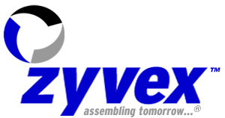



Who’s Doing Nanotechnology?
Zyvex is striving to become the industry leader in adaptable, affordable molecular manufacturing. It estimates 5-10years for its first product.
Nanogen has developed the NanoChipTM Molecular Biology Workstation that incorporates a proprietary microchip capable of rapid identification and precise analysis of biological molecules.
IBM is currently investigating carbon nanotubes (metals/semiconductors, strong materials, good conductivity), nanolithography, and silicon nanoelectronics.
Nanotechnology creates nanostructured materials (functional coatings, scratch resistant coatings, antistatic coatings, healthcare products, and advanced ceramics.
Lucent is currently involved in nanotechnology through its development of optical switching using MEMS (Microelectromechanical Systems).

Slide 13
How Do I Get a Degree in Nanotechnology?
Classes:
Applied Mathematics, Electronics, Drafting, Art, Embedded Systems, Hardware/Software Development, Genetics, Artificial Intelligence, Number Theory, Game Theory, Welding, Computer Graphics and Animation, Chaos Theory, & Cosmology
Universities offering degrees in Nanotechnology:
Rice, Caltech, USC, MIT, NC State, Harvard, & UC-Berkley

Slide 14
Nanotechnology Slide Show
From Molecular Robotics

