Slide 1
`

Slide 2

Team Kamadhenu Presents
User-Friendly Mobile Application For Live Stock Owners
Ministry/ Organization name: Government of Andhra Pradesh
Problem Statement: KB194

Slide 3
INTRODUCTION
India is Krishipradhan Rashtra
61.5% population in India is dependent on agricultural sector
4.5% of total GDP’s contribution is from Animal Husbandry Sector
Population of livestock is more than 53 crore
We don’t have an appropriate database for Livestock

Slide 4
PROBLEM STATEMENT
Livestock holdings are extremely fluid in nature. Ownership changes through sale and migration across different geographical areas confound the efforts to arrive at accurate estimations. Identification of livestock through suitable methods and regular recording of births, deaths and sale reduces the gap between actual and estimated values. So far, A.P. Animal Husbandry Department did not have any such software application. Hence, an app in this direction would be of potential use to the Department. Problem is : All India livestock census data base to design suitable fields to capture the dynamic events in livestock population changes. App should (1) Provide facility to operators to add,modify,delete livestock details using suitable identification mechanism during birth, sale, death (2) provide officials access to data and stats across different geographical areas Updated!

Slide 5
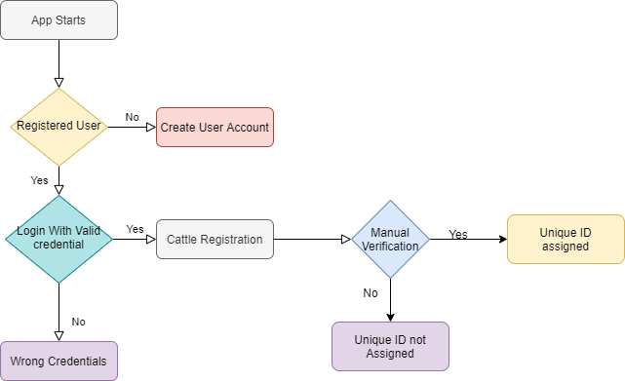
FLOWCHART

Slide 6
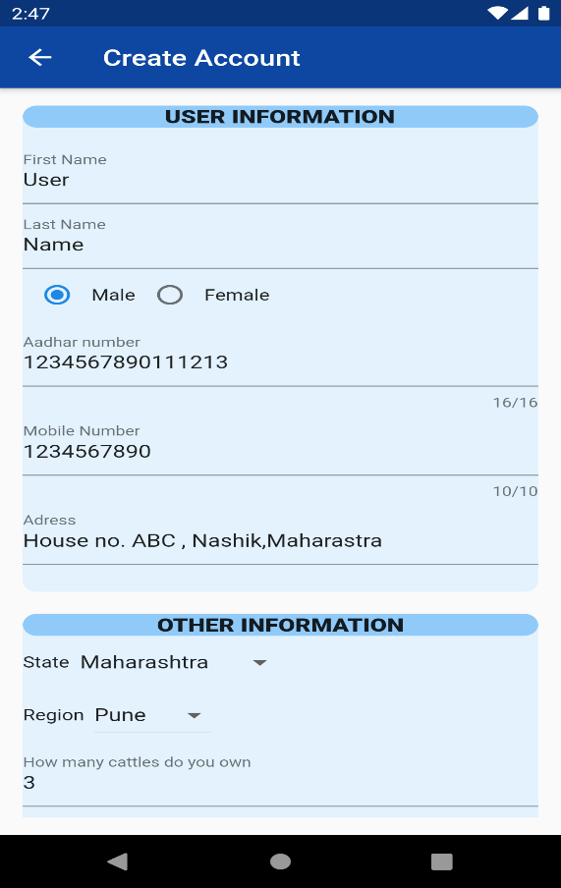
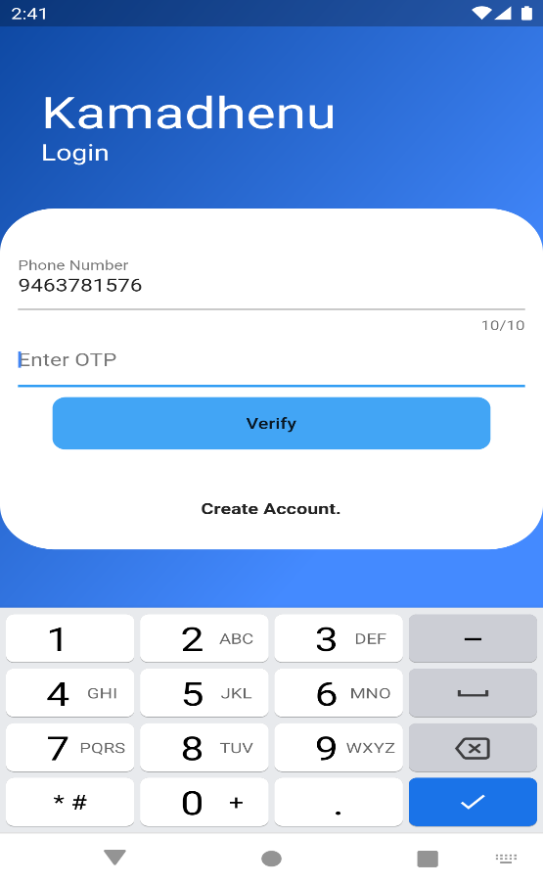
USER REGISTRATION

Slide 7
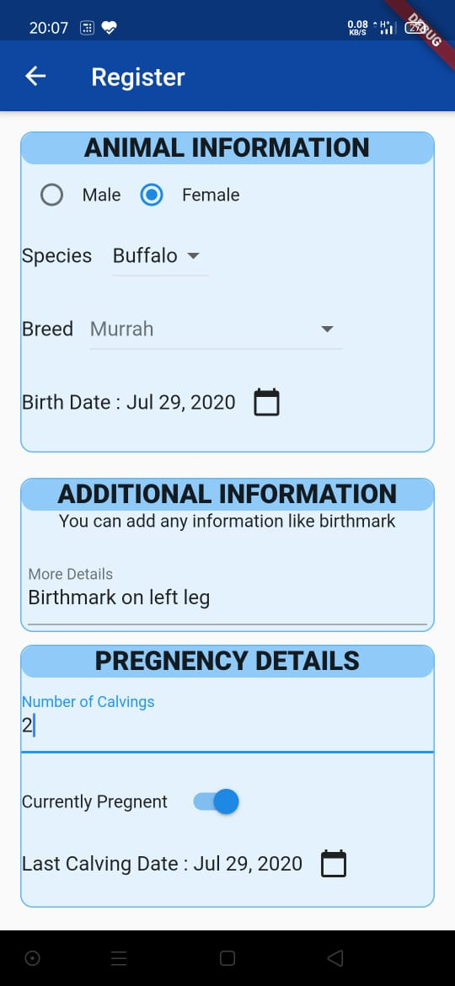
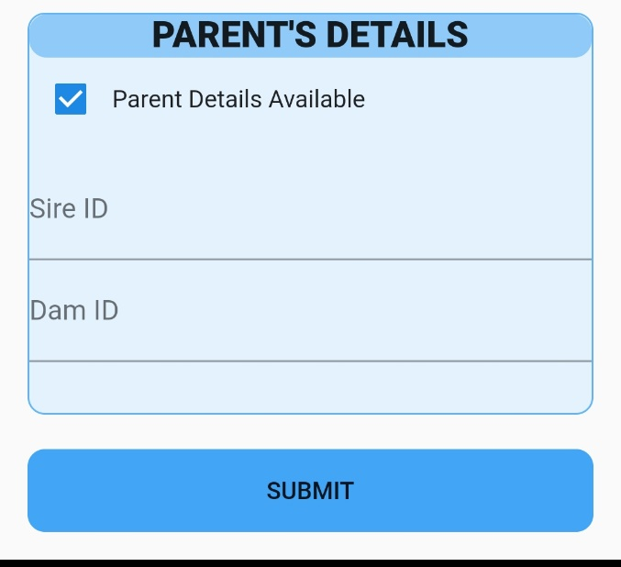
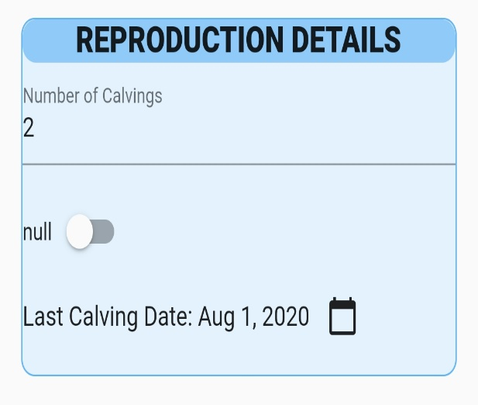
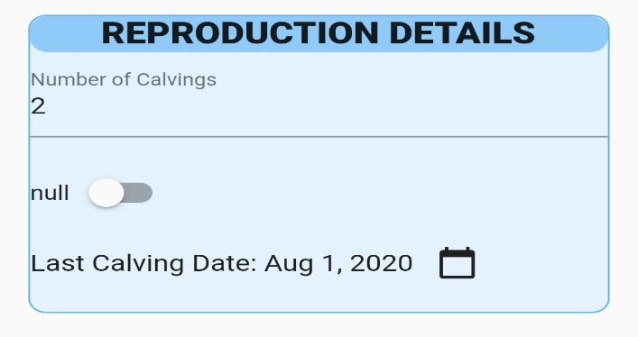
LIVESTOCK REGISTRATION

Slide 8
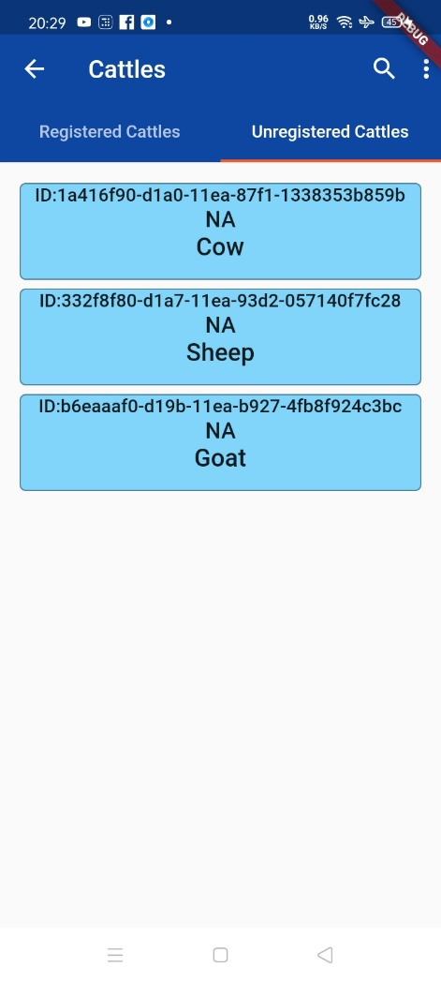
MANUAL VERIFICATION
Officials will be able to see a list of both verified and unverified animals on the Kamadhenu administrator app
Unverified animals will get verified after they have been assigned with a unique identity by the officials

Slide 9
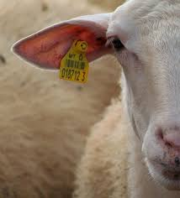
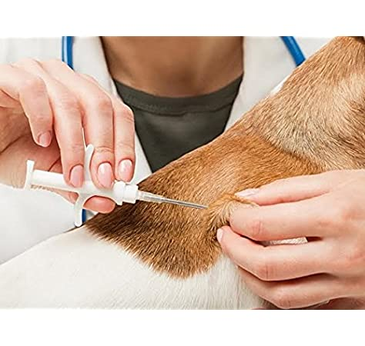
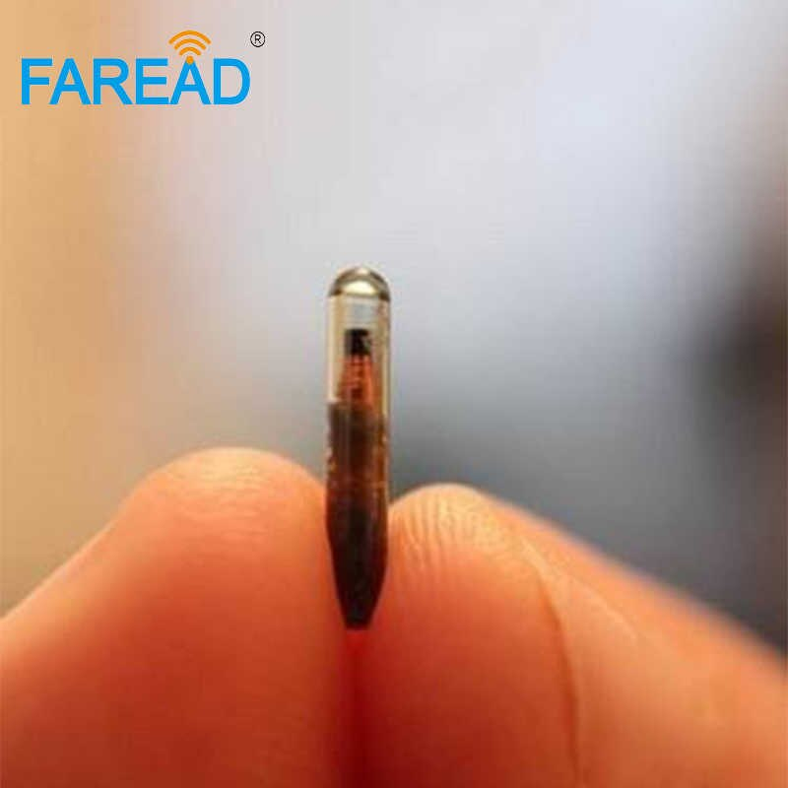
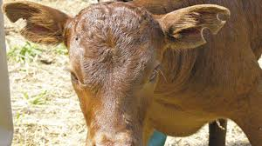
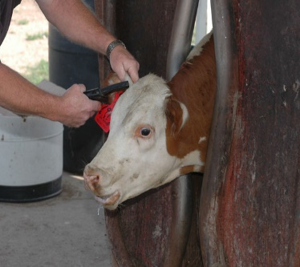
WHY RFID?
The traditional method that is used by the officials is to tag the ear of animals which is made of a plastic with barcode or ID printed on it
This causes pain and permanent damage to the ear of animals
On the other hand, RFID tags are encapsulated and are made of “bio glass 8625”

Slide 10
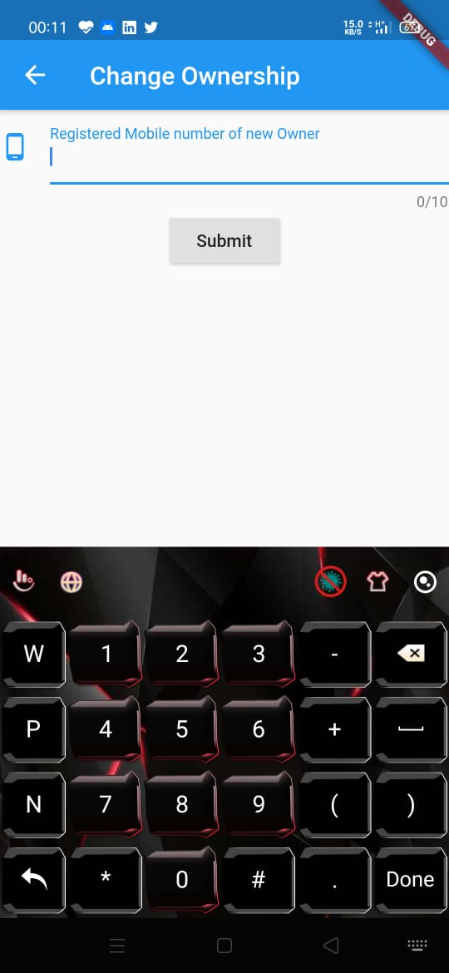
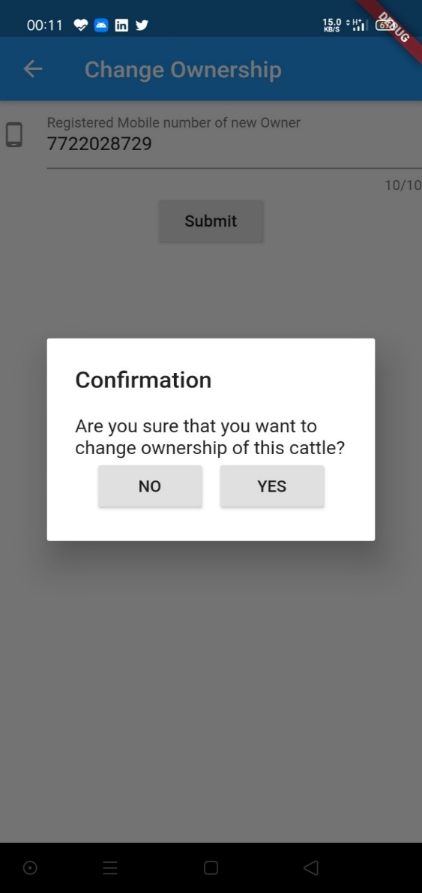
BUYING & SELLING
It is very easy to change the ownership of that animal in the database
Seller needs to enter the registered mobile number of the Buyer

Slide 11
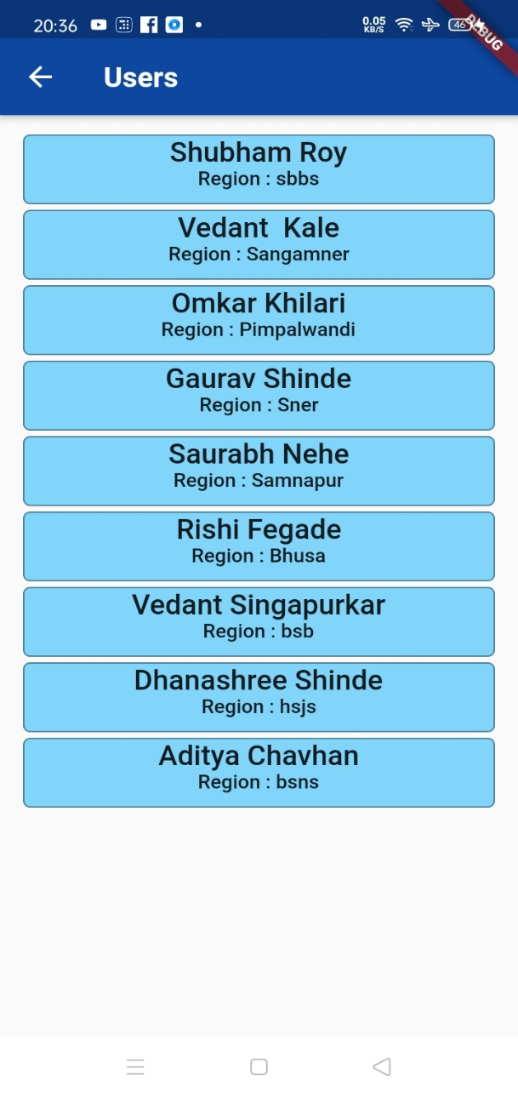
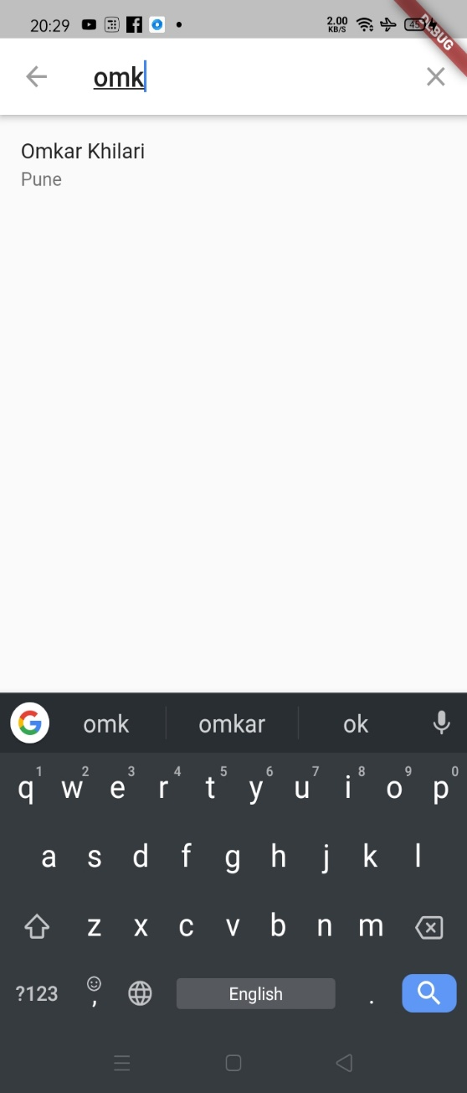
DATA ACCESIBILITY
Admin will have access to database of users and animals of his respective region
Admin can search for particular user in his region

Slide 12
FEATURES
1. Online Buying and Selling Portal
2. Subsidiary Details Collection
3. Statistical Analysis
4. Broadcast
5 .Localization of App
6. Speech Recognition

Slide 13
ONLINE BUYING & SELLING PORTAL
Users can upload the profile of the animal they want to sell
Buyers from various regions can search for the right animal they want to buy and can directly contact the owner for making further progress in deal
And if the Buyer and seller agree for the deal, Seller can change the ownership of the cattle, directly through the app

Slide 14
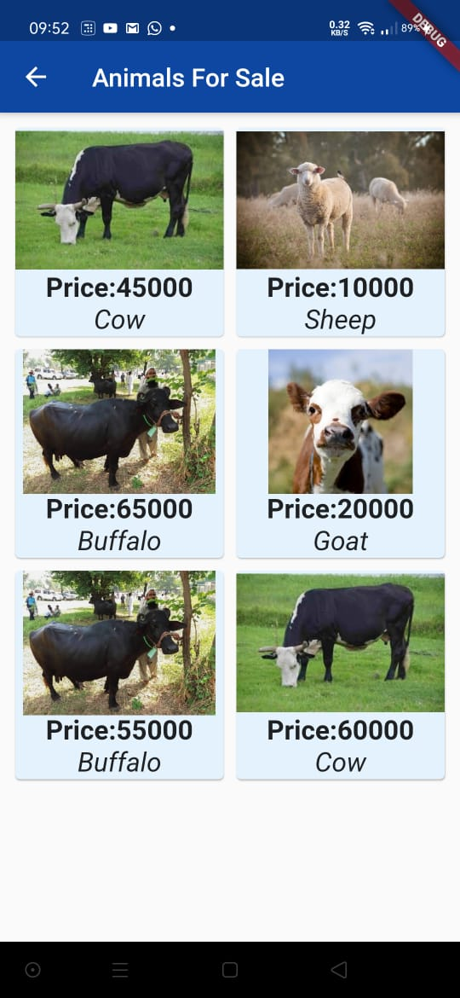
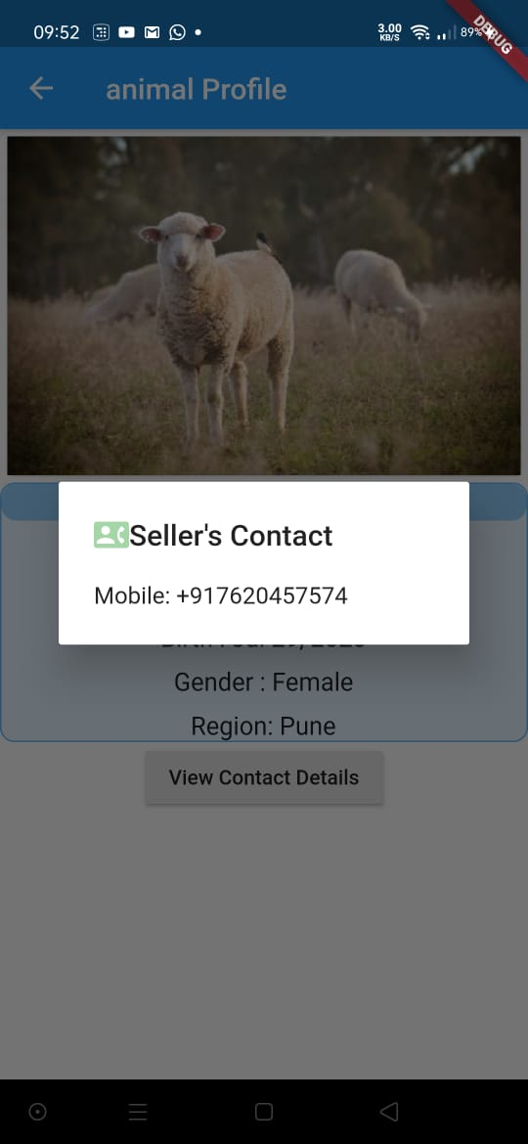
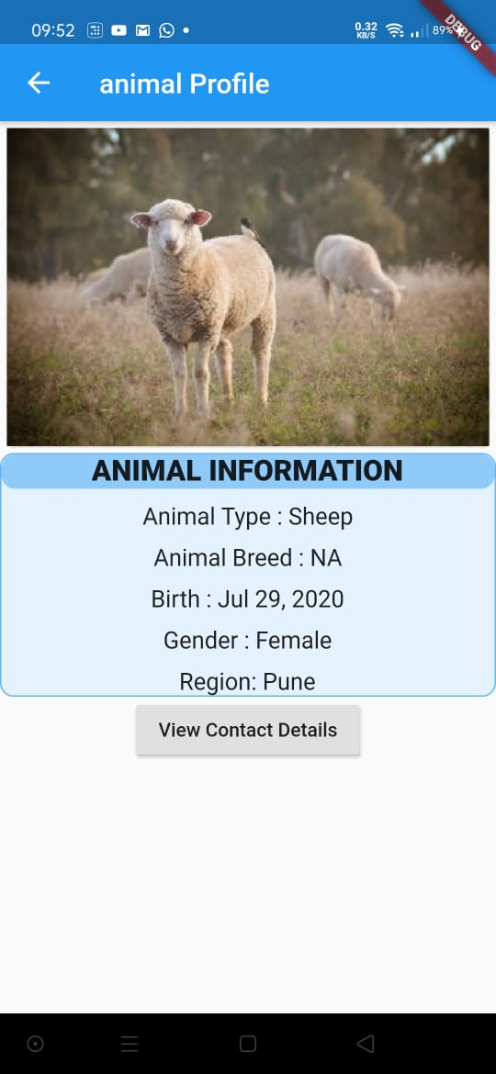
ONLINE BUYING & SELLING PORTAL

Slide 15
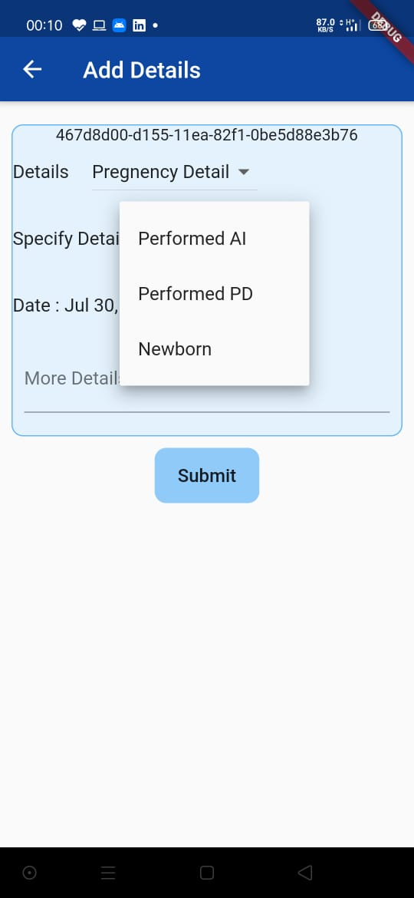
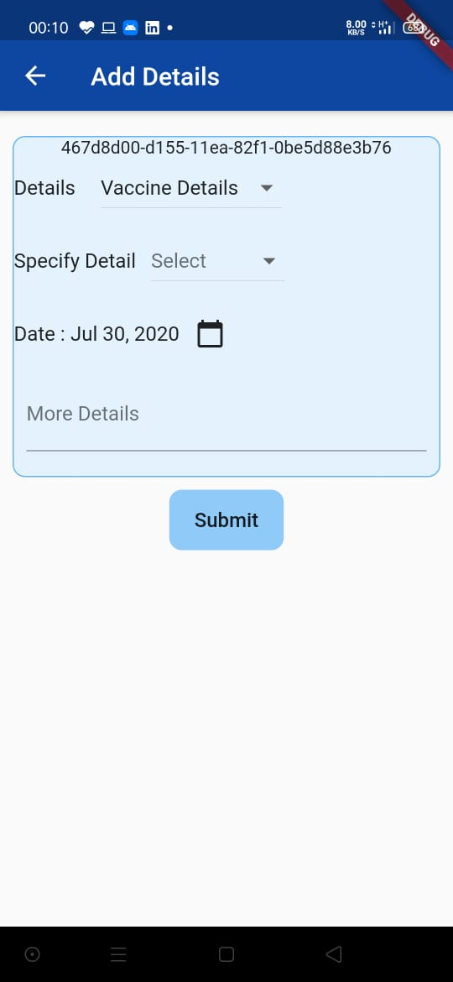
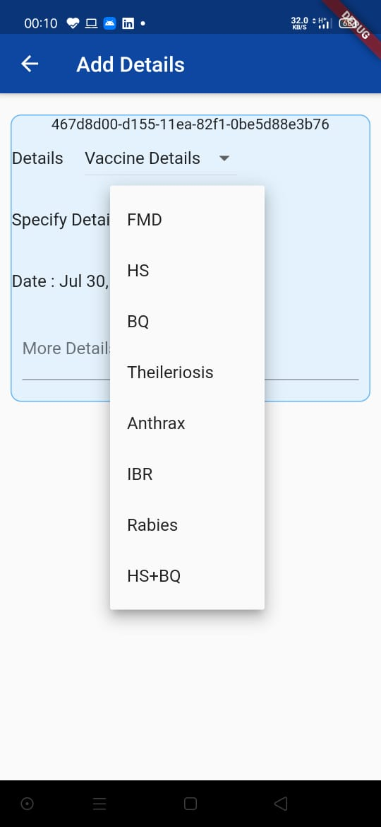
SUBSIDIARY DETAILS COLLECTON
Vaccination
Reproduction
Treatment

Slide 16
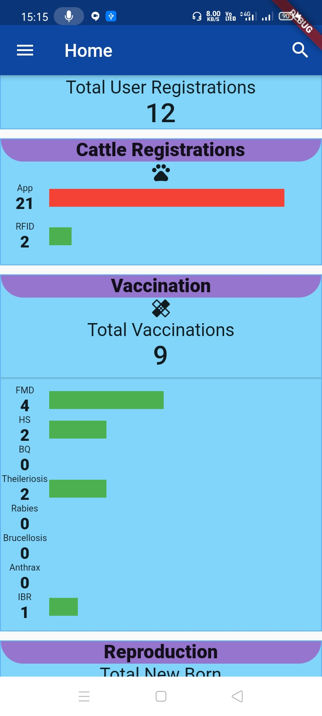
STATISTICAL ANALYSIS
Statistical Data with the GRAPHS:
Registrations
Reproduction
Vaccinations
Admin can analyze:
Animals remaining to be tagged with RFID
Rate of increase in population
Overall usage of vaccines
Type of vaccines required in a particular area

Slide 17
BROADCASTING
Admins broadcast any message they want to in their particular region
Broadcast’s example:
Vaccination drive
Government schemes and programme
Alerts for infectious diseases

Slide 18
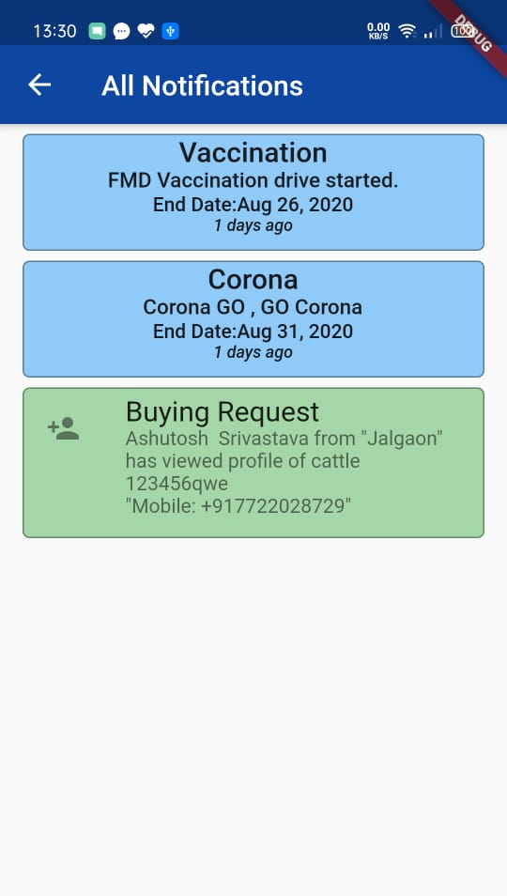
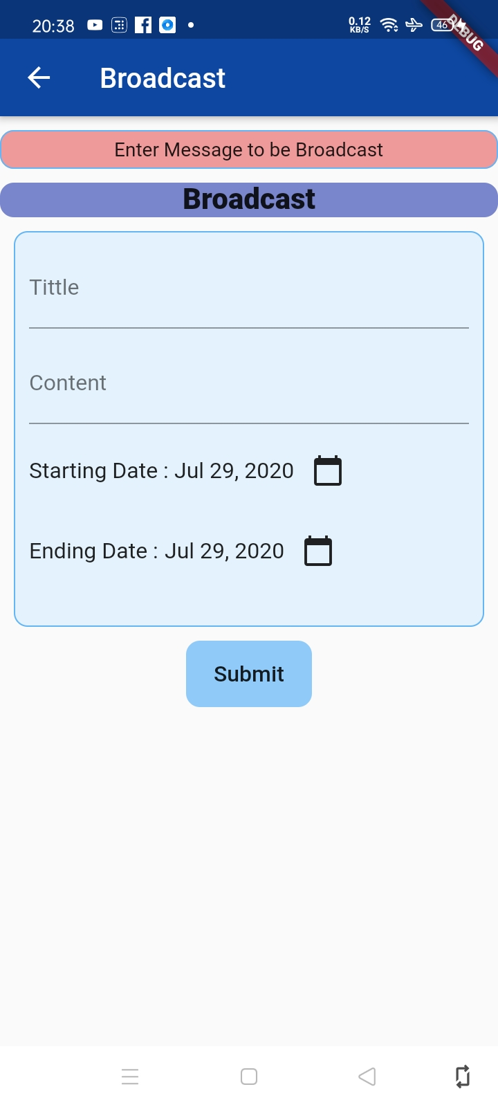

Slide 19
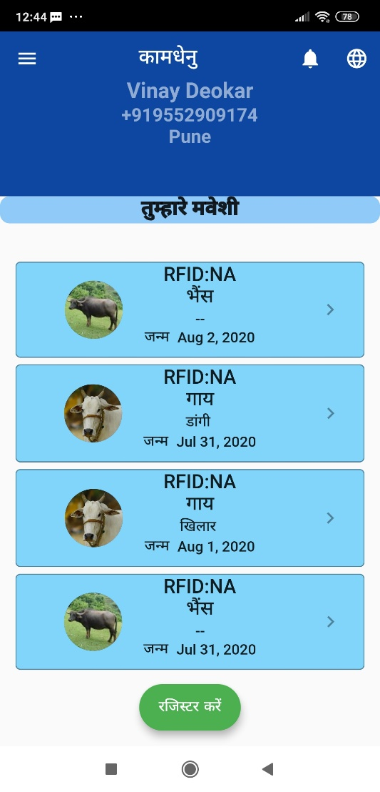
LOCALIZATION OF APP
We have also given multi-language support
As our targeted users might find difficulties in English language. Now they can use the app in their local language too

Slide 20
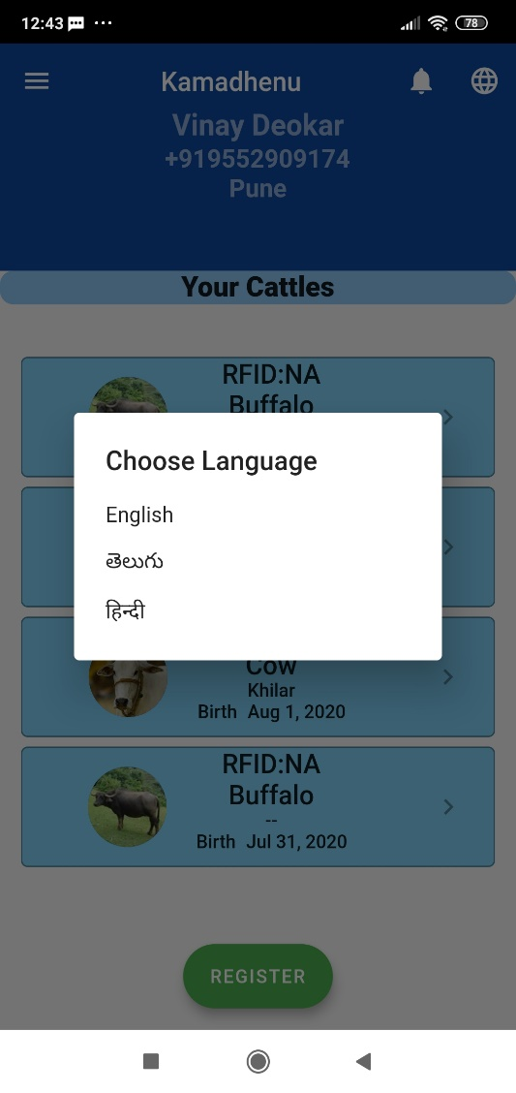
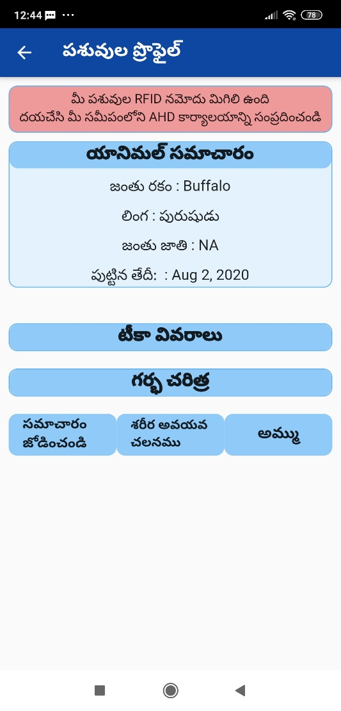

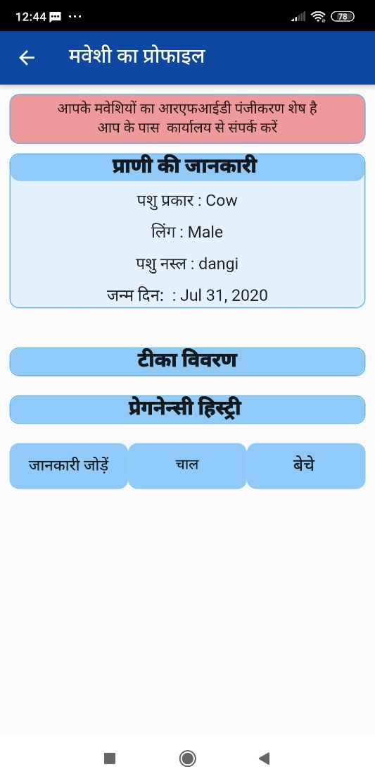
LOCALIZATION OF APP

Slide 21
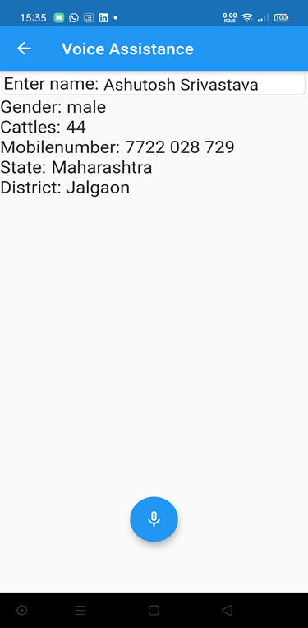
SPEECH RECOGNITION
Some of our users might be illiterate
Our app can directly convert spoken words into written texts
Packages used :
“Speech_to_text” : To convert speech into text
“Flutter_tts” : To convert text into speech

Slide 22


TECHNOLOGY STACK
Flutter:
Open source and free SDK provided by google
Mobile, web, and desktop applications require a Single codebase
High-performance rendering engine to draw widgets
Cloud Firestore:
NoSQL database
Flexible, scalable database
Tools for tracking analytics, reporting and fixing app crashes.
Keeps data in sync

Slide 23

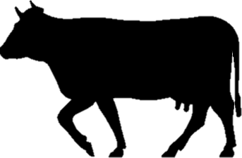
WHY KAMADHENU?
Simple UI design and Easy to operate
Authentication using mobile number
Every Government Veterinary Hospital will have its own Administrator account of their respective region
Unique id to every registered animal using RFID
Easy and flexible Buying and selling feature
Ownership can be changed no need to register same cattle again
Special features like Buying and selling portal, Broadcast, Statistical analysis, Local language support, Speech recognition, etc. are provided

Slide 24
REFERENCES
https://docs-flutter-io.firebaseapp.com/
https://firebase.google.com/docs
https://medium.com/google-developers/sharedpreferences-is-your-answer-to-simple-storage-a7c8499ea8ff
https://petercoding.com/firebase/2020/05/06/using-firebase-storage-in-flutter/
https://stackoverflow.com/questions/tagged/flutter
https://github.com/OmkarKhilari/NC_CMRCET_KB194_KAMADHENU
https://medium.com/@greg.perry/decode-streambuilder-e60948629d8e

Slide 25
THANK YOU

