Slide 1
Integrated Onion and Tomato Mandi Price Intelligence
Pune district crop prices with nearby weather and Mumbai fuel drivers
Generated on 2026-03-24

Slide 2
Data and Modeling Workflow
• Daily Pune district onion and tomato mandi prices were aggregated across markets.
• Weather features were built from Pune plus nearby districts: Ahmednagar, Nashik, Satara, Kalyan, and Mumbai.
• Mumbai petrol and diesel prices were added as logistics cost signals.
• Onion used longer lag windows because it is less perishable.
• Tomato used shorter lag windows because it is highly perishable.
• Models used 80 percent training, 20 percent test, and five fold time series cross validation.

Slide 3
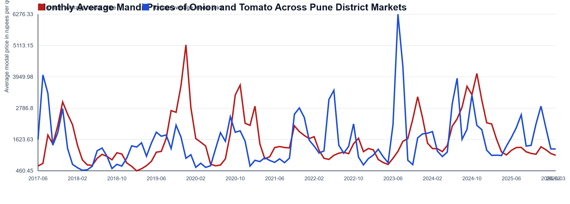
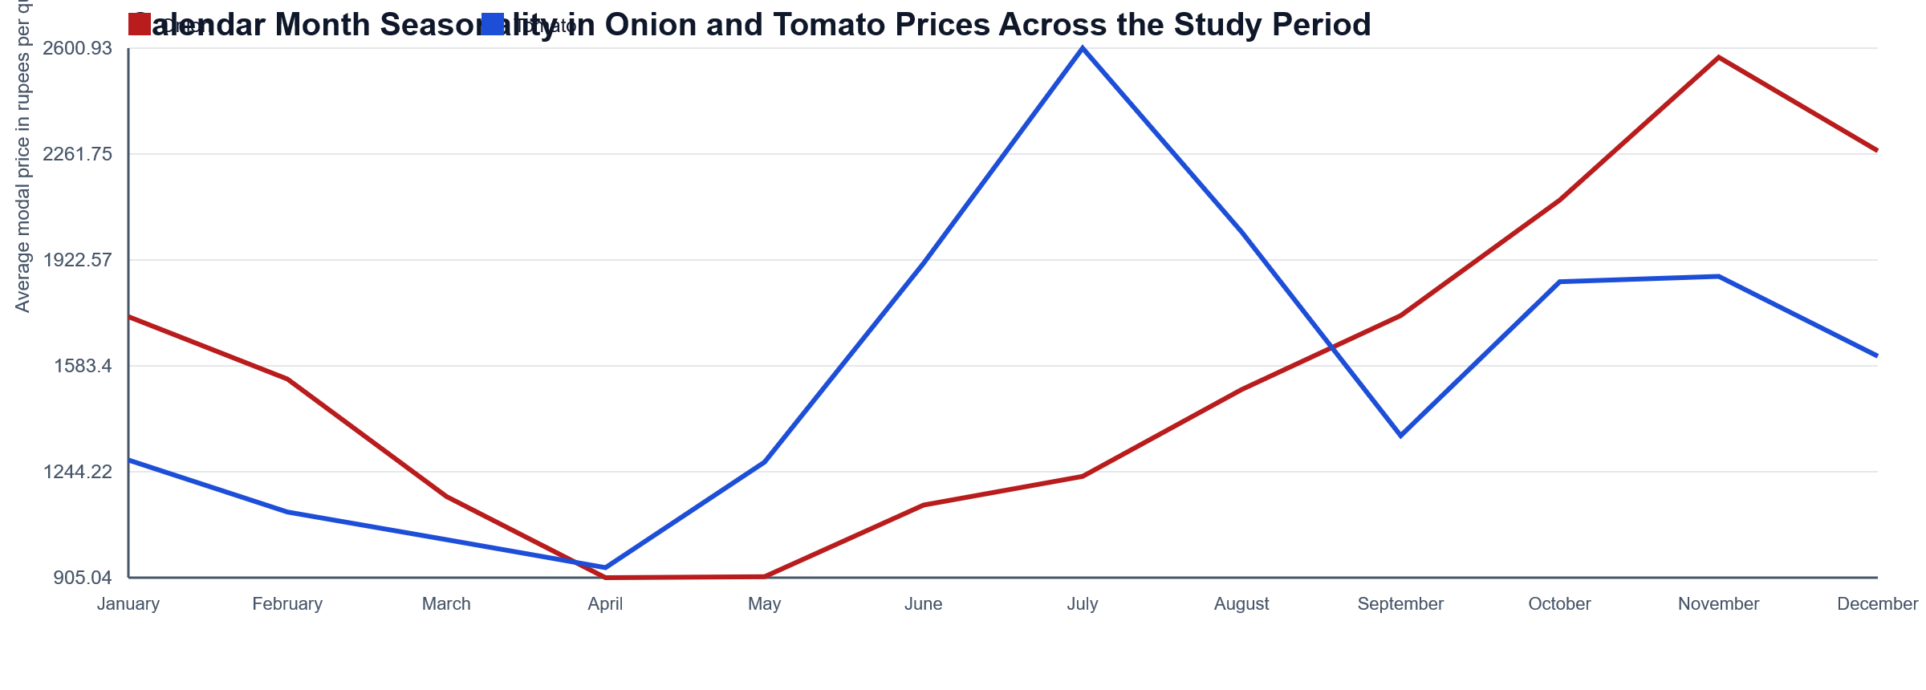
Exploratory Data Analysis
• Integrated common dates: 3085
• Study window: 2017-06-16 to 2026-03-06
• Both crops show strong seasonality and distinct fluctuation patterns.

Slide 4
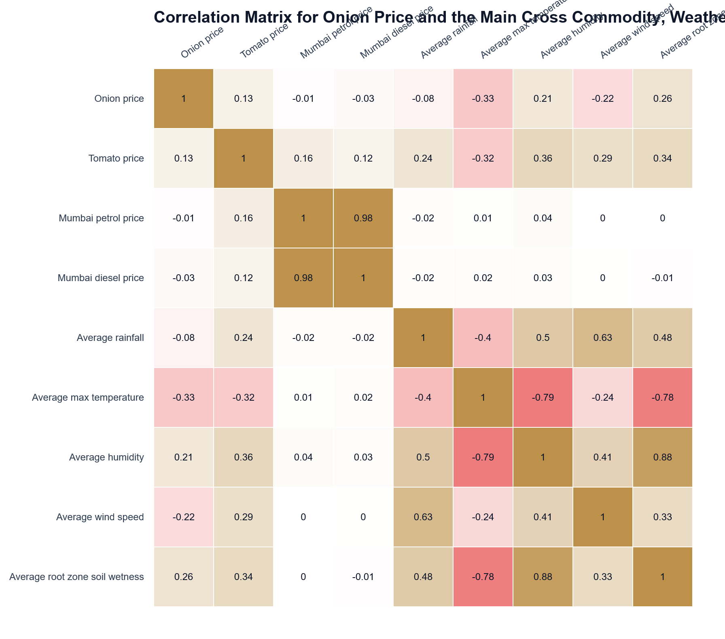

Correlation Structure and Key Drivers
• Heatmaps summarize crop, fuel, and weather correlations.
• Ridge regression was used to reduce multicollinearity sensitivity.
• Cross commodity effects were included in both crop models.

Slide 5
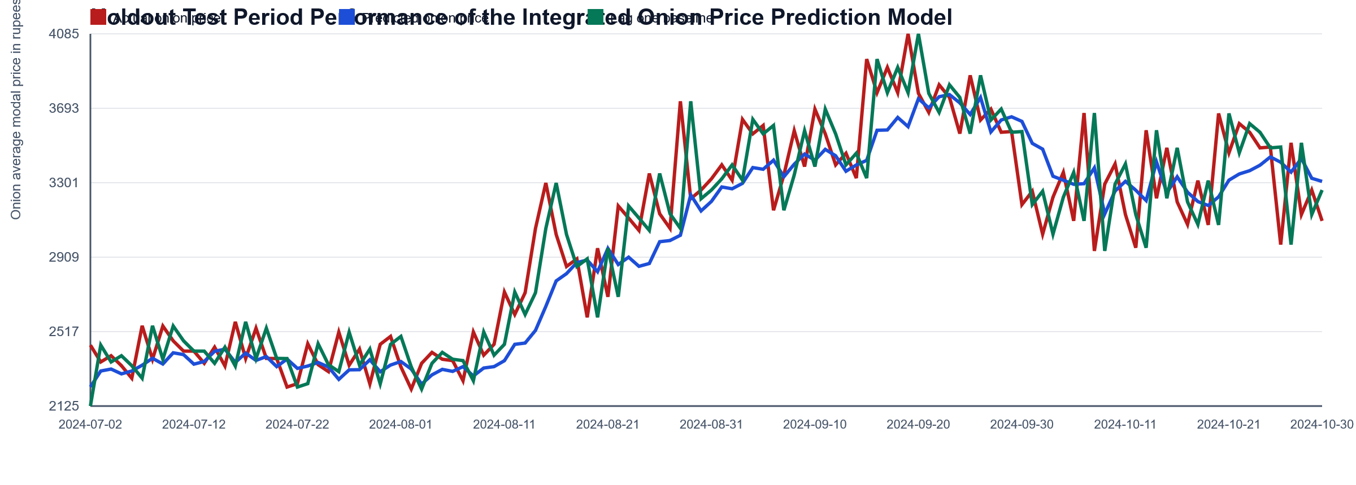
Onion Predictive Model
• Best lambda: 0.1
• R2: 0.9371
• RMSE: 247.88
• Baseline RMSE: 274.88
• Onion uses lag 1, 7, 14, 30, and 60 plus rolling windows.

Slide 6
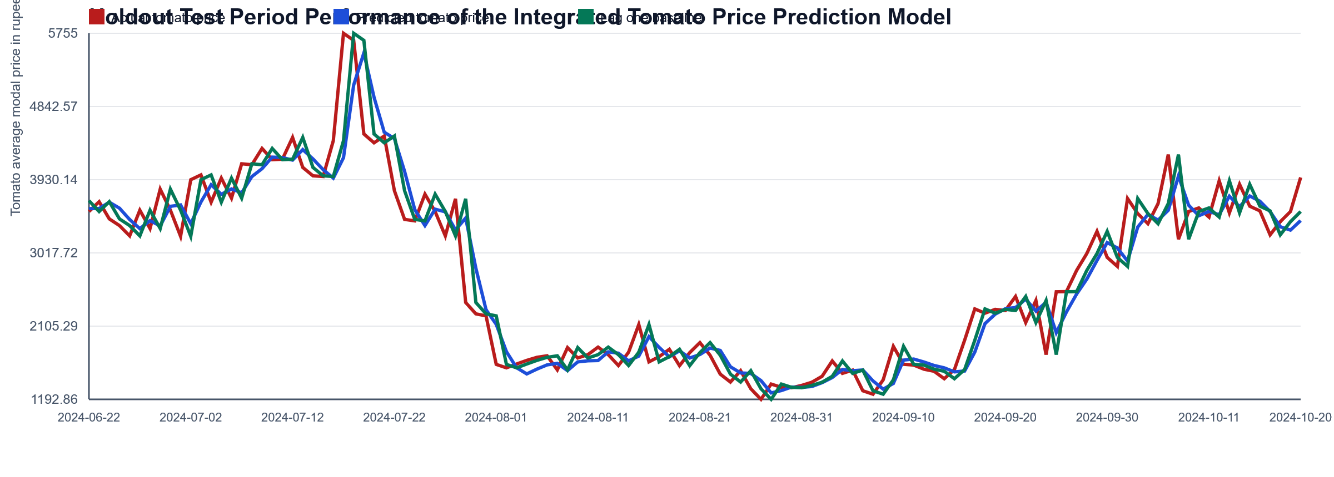
Tomato Predictive Model
• Best lambda: 0.1
• R2: 0.894
• RMSE: 287.84
• Baseline RMSE: 310.88
• Tomato uses shorter lags to reflect perishability and fast market response.

Slide 7
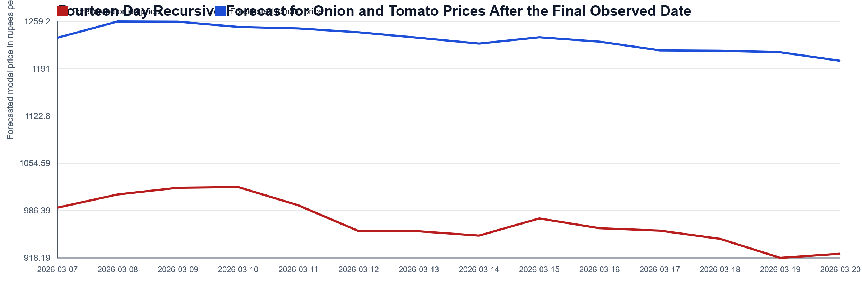
Diagnostics and Future Forecast
• Forecast horizon: 2026-03-07 to 2026-03-20
• Onion forecast softens over the horizon.
• Tomato forecast also weakens, indicating urgency in dispatch decisions.

Slide 8
Prescriptive Analysis and Recommendations
• Onion is forecasted to soften over the next two weeks, so traders should consider faster release, especially if holding costs and shrinkage risk increase.
• Tomato is forecasted to weaken or remain fragile, so the prescriptive action is to prioritize immediate harvesting, sorting, and dispatch to reduce spoilage losses.
• Current low rainfall conditions suggest transport friction is not the main constraint, so price planning can focus more on demand and arrivals.
• Higher Mumbai fuel prices imply transport cost pressure, so grouping shipments and optimizing route density can help protect margins.

