Slide 1
STRATEGY & OPERATIONS PRACTICE
Renewable Energy · 2026
Solving India's evening peak — a renewables, storage and policy blueprint
THE PROBLEM IN FOUR NUMBERS
241 GW
150 GW
2025 Peak Demand
Solar Installed
0 GW
350 GWh
Solar at the 8 PM Peak
National Storage Gap
The capacity gap is closed. The timing gap remains — and is the binding constraint on India's clean transition.
A data-driven thesis built on 9 official Government of India datasets, five quantitative models, and four years of CEA / POSOCO records. Recommended actions to 2030.
Operations Management & Managerial Economics
April 2026
Engagement Length · 4 Weeks · Sources: CEA · NPP · POSOCO · IDP (ISB/BMGF) · CICERO
Document v1.0

Slide 2
AGENDA HOW THIS PRESENTATION IS STRUCTURED
A six-chapter storyline from problem to action
Each chapter answers a specific board-level question; the evidence base is fully traceable to public datasets.
01
PROBLEM
02
DATA
03
DIAGNOSIS
The Central Tension
Evidence Base
Descriptive Insights
Why a 241 GW peak with 150 GW of solar still requires coal at sundown.
Nine official Govt of India datasets — CEA, NPP, IDP, POSOCO, CICERO — engineered into a unified pipeline.
Capacity growth, three structural mismatches, state-wise gaps, and CUF by source.
04
QUANT MODELS
05
ECONOMICS
06
ACTIONS
ML & Operations Tools
The Financial Case
Recommendations & Risk
SARIMAX forecast, EOQ inventory, LP dispatch, K-Means clusters, BESS sizing.
BESS NPV, Pigouvian carbon tax, Wright's law solar LCOE, six-year LP build plan.
Five ranked policies with owners, timelines, costs, and a 7-risk mitigation matrix.
STRATEGY & OPERATIONS
Source: India Data Portal (ISB/BMGF) · CEA · NPP · POSOCO · CICERO
02 / 20

Slide 3
01 · THE PROBLEM DIURNAL, SEASONAL, GEOGRAPHIC MISMATCHES
India produces enough power — but rarely at the hour it is needed
Solar carries 100% of mid-day load and 0% of evening load. Three layered mismatches define the structural gap.
EXHIBIT 01
1
Diurnal mismatch
A typical day on India's grid — solar output vs. demand
Solar = 0 GW at 8 PM. The evening peak is wholly carried by coal and hydro.
6 AM
2
Seasonal mismatch
Solar starts rising
Wind peaks Jul–Sep (monsoon). Demand peaks Apr–Jun and October.
12 PM
Solar at PEAK — cheap energy
3
Geographic mismatch
3 PM
Rajasthan holds 28% of solar capacity but accounts for just 6% of national demand.
Solar high + wind medium
6 PM
Solar DROPPING fast
8 PM
Solar = ZERO ❌
Demand = MAXIMUM 🔴
10 PM
Coal + hydro carry everything
SO WHAT
More panels do not fix evening demand. Storage and geography do.
STRATEGY & OPERATIONS
Source: POSOCO national load curves, CEA daily generation
03 / 20

Slide 4
02 · EVIDENCE BASE NINE OFFICIAL DATASETS, SINGLE PIPELINE
100% of analysis is grounded in public Government of India data
No surveys, no proprietary feeds. Every number traces back to an agency dataset and an open API.
DAILY · 2017–25
MONTHLY · 2001–24
DAILY · 2014–25
DAILY · 2014–25
Daily Power Generation
Energy Req & Availability
Installed Capacity by State
Daily Coal Stocks
NPP / CEA via India Data Portal · date, state, generation_mw
CEA via India Data Portal · month, state, requirement, availability
NPP / CEA via India Data Portal · date, state, coal, hydro, res
NPP / MoP via India Data Portal · date, requirement, stock, days, critical
DAILY · 2014–25
DAILY · 2019–25
MONTHLY · 1947–26
PIPELINE
Daily Power Outages
Daily Renewable Generation
National Capacity Series
Unified open data ingest
NPP / MoP via India Data Portal · date, monitored_cap, outage_cap
CEA via India Data Portal · date, state, wind, solar
CEA / POSOCO via CICERO · YYYYMM, solar, wind, coal, hydro
CKAN dump · no auth · ODC-By license · Python ETL (pandas + statsmodels + PuLP).
PROVENANCE
Every chart and number in this deck links back to one of these seven datasets — fully reproducible from public APIs.
STRATEGY & OPERATIONS
Source: India Data Portal (ISB/BMGF) · CEA · NPP · POSOCO · CICERO
04 / 20

Slide 5
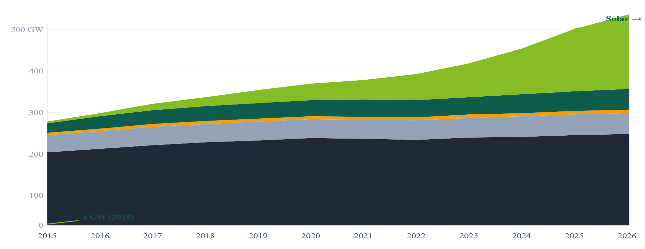
03 · DIAGNOSIS CAPACITY MIX 2015–2026
Solar grew 37× in a decade — the fastest energy buildout on record
India added more renewable nameplate capacity in eleven years than most large economies have in fifty.
EXHIBIT 02
Coal
Solar
Wind
Hydro
Nuclear
37 ×
Installed capacity by source — GW
Solar capacity growth, 2015 → 2026
150 GW
Solar installed (2025)
42 %
Renewable share of national capacity
<1 %
Energy deficit, 2024–25
IMPLICATION
The capacity question is closed. The remaining problem is when, not how much.
STRATEGY & OPERATIONS
Source: CEA / POSOCO national capacity series via CICERO; NPP installed capacity
05 / 20

Slide 6
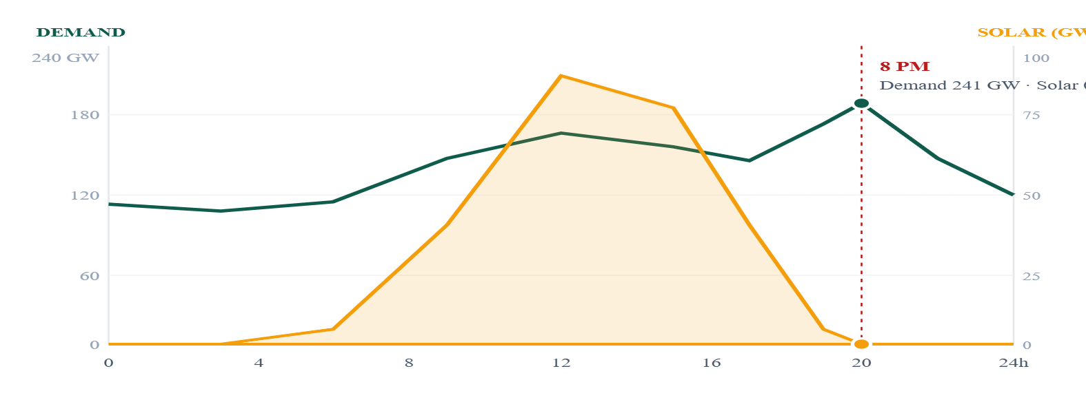
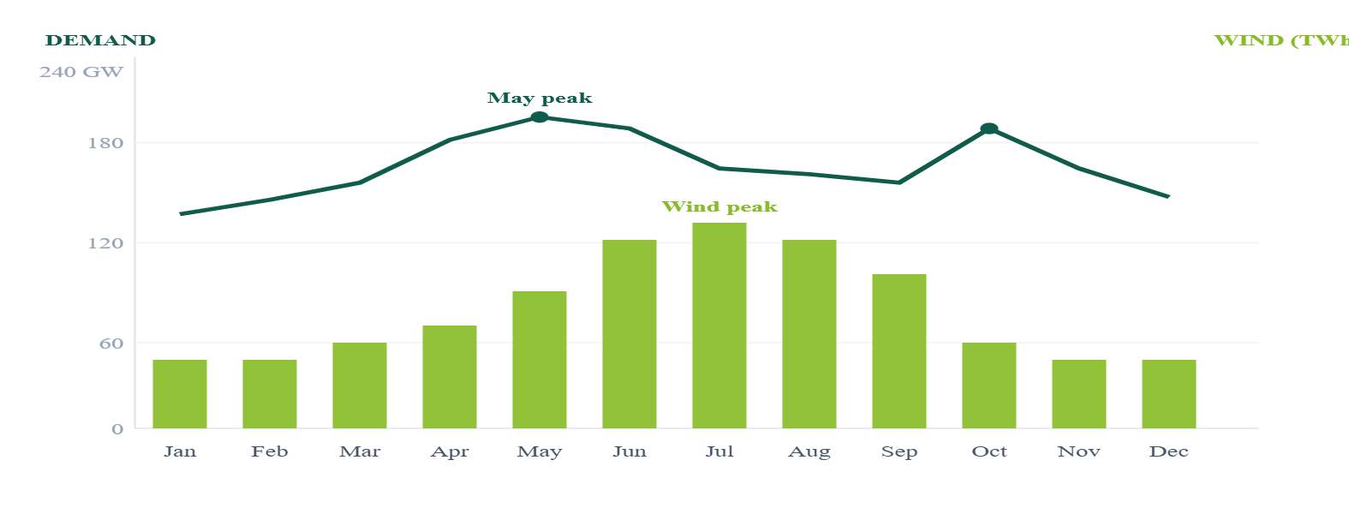
03 · DIAGNOSIS HOURLY & MONTHLY MISMATCHES
Solar peaks at noon, demand peaks at 8 PM — every day of the year
Two views of the same phenomenon: hourly load vs. solar output (left), and monthly demand vs. wind output (right).
EXHIBIT 03A
EXHIBIT 03B
Hourly: solar (GW) vs. demand (GW), national average
Monthly: demand (GW) vs. wind (TWh)
KEY INSIGHT
However many panels India installs, they will produce zero at 8 PM. Wind helps in monsoon, when demand is already lowest. The fix is storage.
STRATEGY & OPERATIONS
Source: POSOCO load curves · CEA daily renewable generation 2019–2025
06 / 20

Slide 7
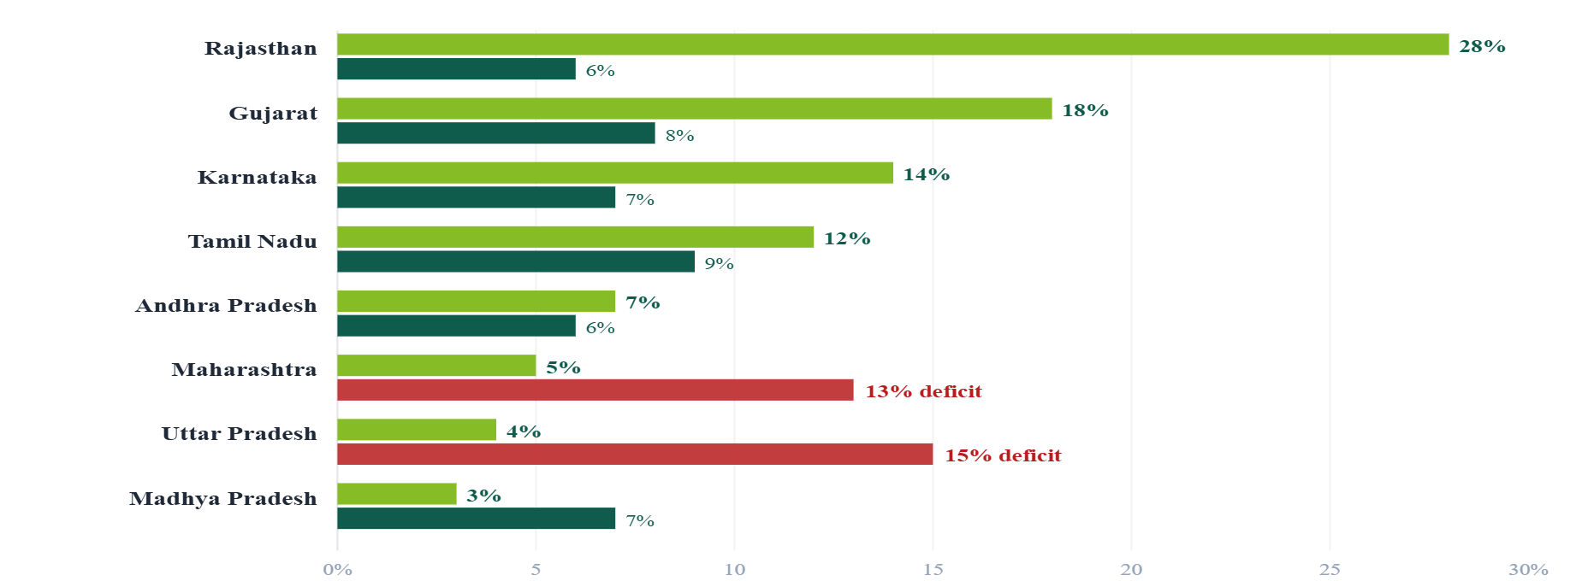
03 · DIAGNOSIS GEOGRAPHIC & CUF ANALYSIS
Where capacity is built is not where power is consumed
Three states own the renewable boom. Most demand sits elsewhere — and 150 GW of solar do not equal 150 GW of coal.
EXHIBIT 04
EXHIBIT 05
Renewable capacity vs. electricity demand — share of national total (%)
Capacity Utilisation Factor by source
Share of RE capacity
Share of national demand
Why 150 GW of solar ≠ 150 GW of coal
SOURCE
AVG CUF
CUF @ 8 PM
Solar
20%
0%
Wind
25%
25%
Coal
58%
72%
Nuclear
82%
82%
IMPLICATION
Solar at 0% CUF at 8 PM means the 150 GW nameplate provides zero firm capacity into the peak.
STRATEGY & OPERATIONS
Source: NPP / CEA installed capacity by state · POSOCO hourly dispatch logs
07 / 20

Slide 8
04 · MODELS FIVE QUANTITATIVE TOOLS
From observation to quantification — each model answers one question
A linked set of forecasting, optimisation, inventory, and clustering models — built on the same dataset.
1
FORECAST
2
INVENTORY
3
OPTIMISATION
4
SEGMENTATION
5
SCENARIO
SARIMAX
EOQ
Linear Programming
K-Means
BESS + Counterfactual
DEMAND
COAL STOCKS
DISPATCH
STATE CLUSTERS
STORAGE
How much power will India need by 2030?
Was the 2021 coal crisis preventable?
What is the cheapest way to meet 8 PM demand?
Do all states share the same problem?
How much storage at 500 GW solar?
241 → 295 GW
Yes — supply chain failure
200 GW coal at 8 PM
No — 4 distinct clusters
300–500 GWh
+3.5% CAGR
EOQ violated at 100+ plants
Decarbonising +37% w/o BESS
Different policy levers
Coal still 70 GW at peak
APPROACH
Each model uses standard, peer-reviewed methods (statsmodels, scikit-learn, PuLP/CBC) — outputs are reproducible and auditable.
STRATEGY & OPERATIONS
Models built in Python · statsmodels · scikit-learn · PuLP/CBC
08 / 20

Slide 9
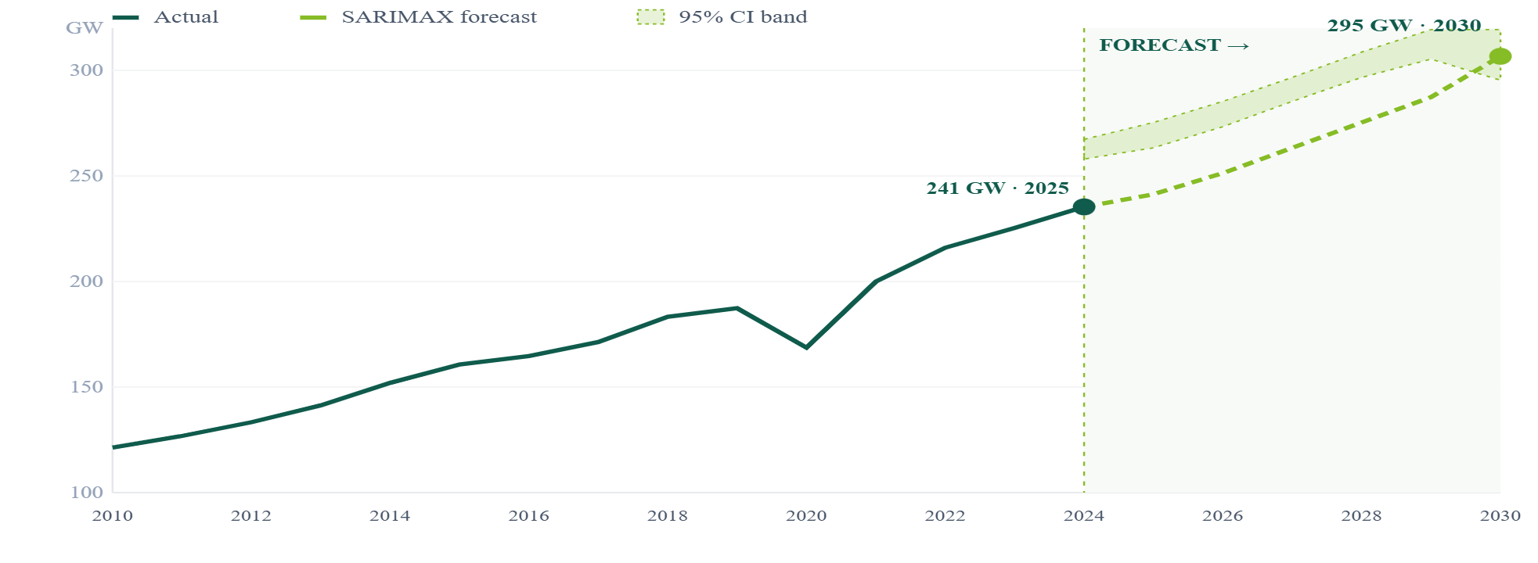
04 · MODEL 1 SARIMAX PEAK DEMAND FORECAST
Peak demand reaches 295 GW by 2030 at a 3.5% CAGR
SARIMAX(2,1,1) on 15 years of CEA annual peak demand — forecast band ±31 GW at 95% confidence.
EXHIBIT 06
295 GW
Annual peak demand — actual + SARIMAX forecast (GW)
2030 forecast peak demand
3.5 %
Compounded annual growth
+54 GW
Above 2025 peak
±31 GW
95% confidence interval
SO WHAT
Even at the lower bound, India must build 30 GW of new firm capacity per year to 2030.
STRATEGY & OPERATIONS
09 / 20
Source: CEA annual reports 2010–2024 · SARIMAX(2,1,1) fit, AIC = 102.4

Slide 10
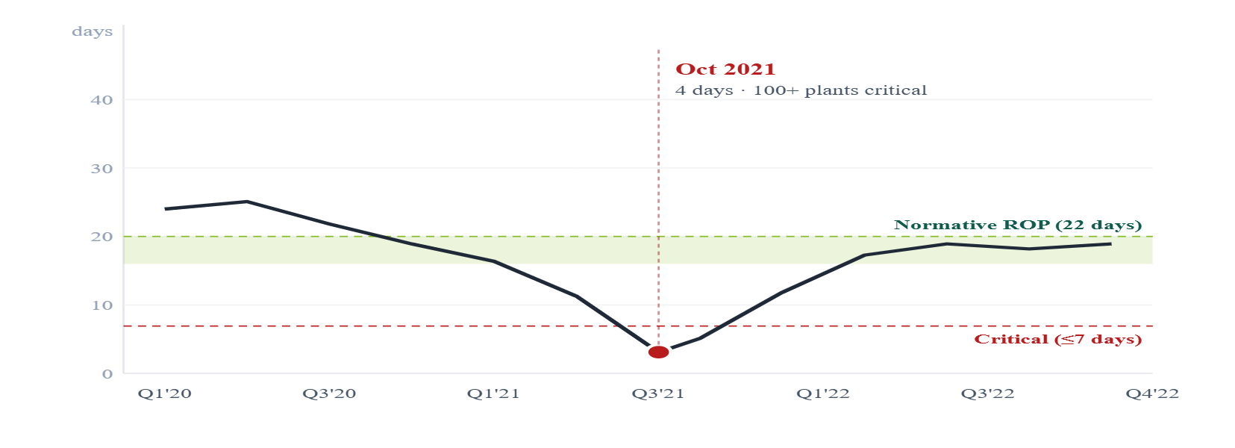
04 · MODEL 2 EOQ INVENTORY ANALYSIS
October 2021 was a supply-chain failure, not a coal shortage
EOQ ordering norms were violated at 100+ thermal plants. The crisis was structural and is preventable with monitoring.
EXHIBIT 07
EOQ FORMULA
Coal stock days at thermal fleet · 2020–22
Q* = √(2DS / H)
D
S
H
ROP
Daily coal demand (rake/day)
Order cost ~₹3 Cr/rake
Holding cost ~₹150/T·day
Norm × D = trigger
DIAGNOSIS
EOQ-compliant ordering would have triggered restock when stock days fell below 22 — three weeks before the Oct'21 crisis.
STRATEGY & OPERATIONS
Source: NPP / MoP daily coal stock series 2020–2022; CEA normative stock norms
10 / 20

Slide 11
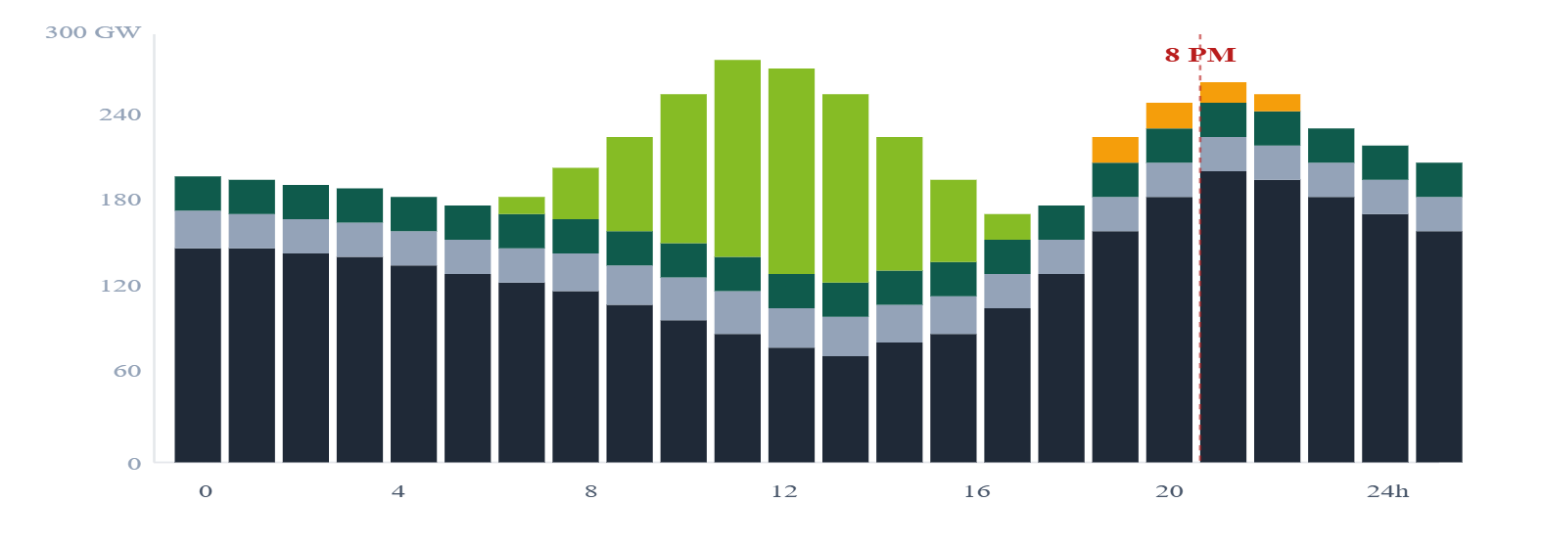
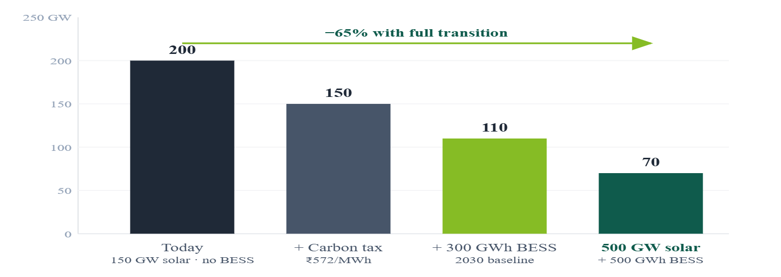
04 · MODEL 3 LP OPTIMISATION + COUNTERFACTUAL
Even at 500 GW solar, coal at 8 PM falls only to 70 GW — not zero
PuLP minimum-cost dispatch across seven sources, four carbon-price scenarios, and the 500 GW counterfactual.
EXHIBIT 08A
EXHIBIT 08B
Optimal hourly dispatch · today (GW)
Coal at 8 PM — counterfactual scenarios (GW)
Coal
Hydro
Wind
Solar
Gas peaker
KEY FINDING
Coal does not disappear from the 8 PM peak without 24/7 battery storage. The transition is not solar-only — it is solar + storage + carbon pricing.
STRATEGY & OPERATIONS
Source: PuLP / CBC LP solver · 7 sources · POSOCO 2024 hourly load profile
11 / 20

Slide 12
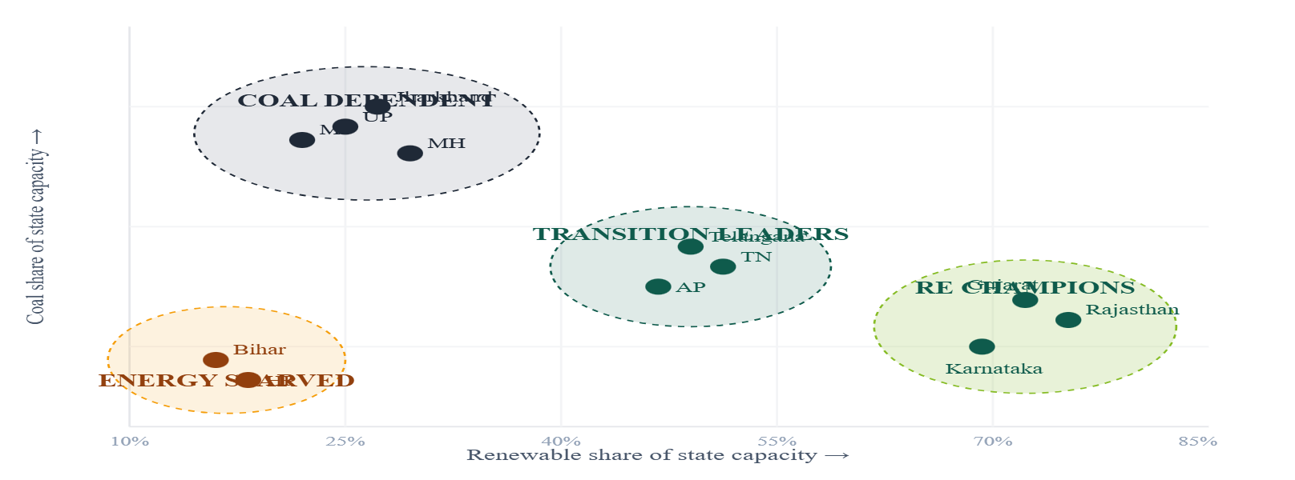
04 · MODEL 4 K-MEANS · K = 4 (SILHOUETTE = 0.61)
India's states fall into four distinct power profiles
A single national policy ignores Rs 40,000+ Cr/yr of efficiency gains available from cluster-specific levers.
EXHIBIT 09
CLUSTER A
CLUSTER B
RES share (%) vs. coal share (%) — states
RE Champions
Transition Leaders
Rajasthan · Gujarat · Karnataka
Tamil Nadu · AP · Telangana
RE 40%+ · Coal <30% · Net exporter
RE 30–40% · Demand growing
CLUSTER C
CLUSTER D
Coal Dependent
Energy Starved
UP · Maharashtra · MP · Jharkhand
Bihar · HP · Northeast
Coal 60%+ · Deficit risk
Low capacity · Persistent deficit
STRATEGY & OPERATIONS
Source: scikit-learn KMeans · features = RES share, coal cap, deficit %, total cap
12 / 20

Slide 13
04 · MODEL 5 BESS SIZING WATERFALL
India needs 300–500 GWh of storage — 75–125× today's installed base
Engineering build-up from solar nameplate to required storage capacity, with discharge duration and round-trip losses.
EXHIBIT 10
~4 GWh
From 150 GW solar → BESS power capacity
Solar installed (2025)
150 GW
India BESS today
× CUF (annual avg)
× 20%
× Daily production (h)
× 8 h
300–500 GWh
= Daily generation
240 GWh
National requirement
× Stored for evening
× 50%
× Round-trip efficiency
× 88%
75–125 ×
= Storable energy
106 GWh
The storage gap
÷ Discharge duration
÷ 4 h
BESS power needed
26 GW
₹12k Cr
Capex required (initial 30 GWh)
IMPLICATION
Storage cannot be built at this scale without policy mandates and concessional capital.
STRATEGY & OPERATIONS
Engineering model · CEA daily renewable generation 2019–25 · industry RTE benchmarks
13 / 20

Slide 14
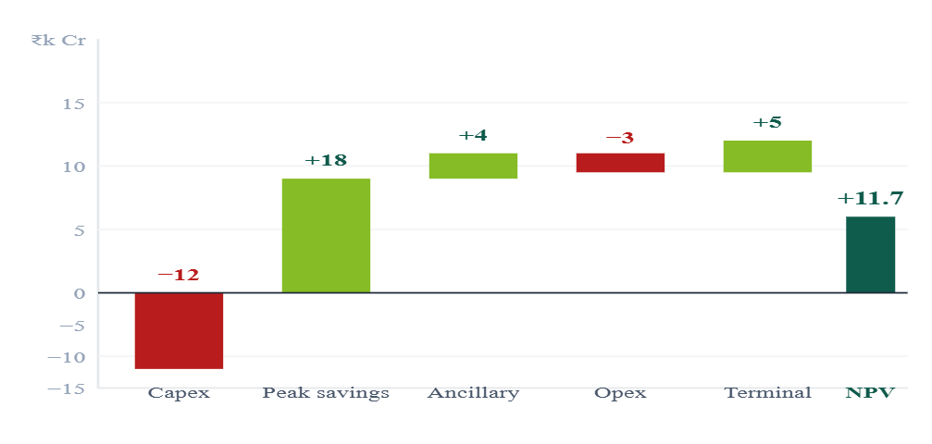
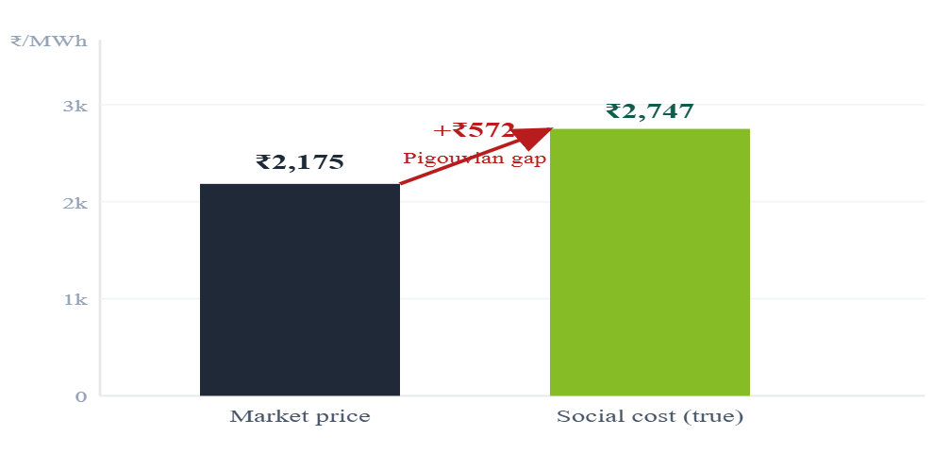
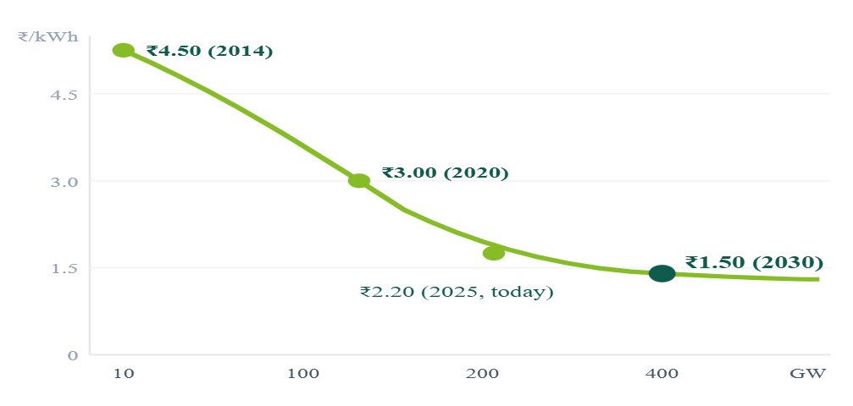
05 · ECONOMICS CBA · PIGOUVIAN · WRIGHT'S LAW
The financial case is positive on every dimension
BESS pays back in seven years. Coal is mispriced by Rs 572/MWh. Solar will reach Rs 1.5/kWh by 2030.
EXHIBIT 11A
EXHIBIT 11B
EXHIBIT 11C
BESS investment NPV @ 10% WACC
Coal: market vs. social cost (₹/MWh)
Solar LCOE vs. cumulative capacity (Wright's law)
+₹11.7k Cr
₹572/MWh
₹1.5/kWh
NPV positive · payback 7.1 years
Optimal carbon tax · ~₹80,000 Cr/yr revenue
Solar LCOE at 400 GW · 28% learning rate
STRATEGY & OPERATIONS
Source: BESS CBA model · CICERO emissions intensity · IRENA learning rate benchmarks
14 / 20

Slide 15
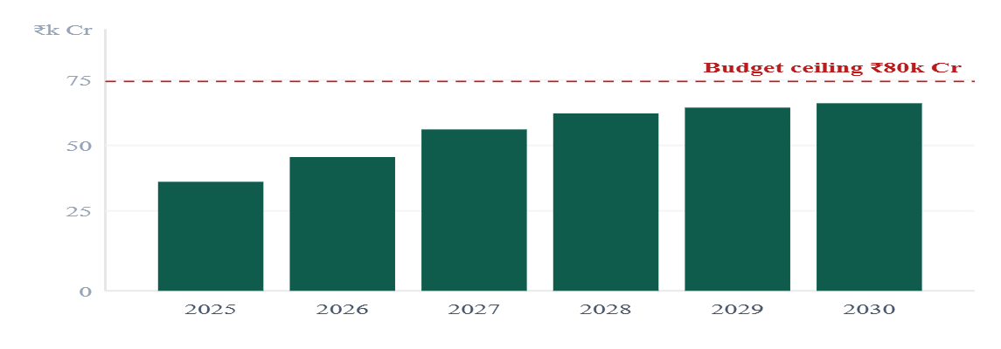
05 · ECONOMICS MULTI-PERIOD LP BUILD PLAN
A six-year, ₹3.65 lakh Cr build plan that respects budget and ramp constraints
Optimisation minimises NPV cost subject to demand, an annual budget ceiling of ₹80,000 Cr, and engineering ramp limits.
YEAR
SOLAR (GW)
WIND (GW)
BESS
CAPEX (₹ CR)
CUMUL. SOLAR
EXHIBIT 12
Annual capex vs. budget ceiling
2025
28
8
2 GW · 8 GWh
42,000
178 GW
2026
32
9
3 GW · 12 GWh
51,000
210 GW
2027
38
10
4 GW · 16 GWh
62,000
248 GW
2028
40
11
5 GW · 20 GWh
68,000
288 GW
2029
40
12
5 GW · 20 GWh
70,000
328 GW
2030
40
12
5 GW · 20 GWh
72,000
368 GW
TOTAL
218
62
24 GW · 96 GWh
3,65,000
368 GW
Budget ceiling of ₹80,000 Cr/yr is never breached. Solar costs decline 5–7% per year per Wright's law and are incorporated into the LP objective.
OUTCOME
368 GW solar by 2030 with peak demand met at lowest NPV cost — within budget every year.
STRATEGY & OPERATIONS
Multi-period LP · objective = min NPV(cost) · constraints: demand, budget, ramp
15 / 20

Slide 16
06 · RECOMMENDATIONS CLUSTER-DIFFERENTIATED POLICY
Four clusters require four different policy playbooks
A single national policy misses Rs 40,000+ Crore per year in efficiency gains. Levers must match cluster needs.
RE Champions
Rajasthan · Gujarat · Karnataka
Transition Leaders
Tamil Nadu · AP · Telangana
HVDC inter-state lines — ₹45,000 Cr (self-funded by wheeling revenue)
BESS co-location mandate for any new solar > 500 MW
Waive wheeling charges for 5 years to stimulate inter-state RE trade
Offshore wind fast-track (TN coastline: 30+ GW potential)
Priority allocation from national grid upgrade fund
Demand response programmes to flatten the peak curve
KPI 2028 Export 50 BU/yr to demand states
KPI 2028 +15 GW RE and +8 GWh BESS
Coal Dependent
UP · Maharashtra · MP · Jharkhand · WB
Energy Starved
Bihar · HP · Northeast (6+ states)
Mandatory BESS installation alongside any new RE permit
Coal PLF floor: 55% → 45% by 2027 (smooth transition)
Concessional green loans for DISCOMs procuring RE
Viability Gap Funding for unviable small solar projects
Community solar microgrids for rural areas
Energy access subsidy linked to RE generation
KPI 2030 RES share 20% → 40%
KPI 2027 Eliminate energy deficit
STRATEGY & OPERATIONS
Source: K-Means cluster output · CEA state policy register · authors' analysis
16 / 20

Slide 17
06 · RECOMMENDATIONS FIVE PRIORITIES RANKED BY IMPACT × FEASIBILITY
Five actions, each costed, owned, and time-bound
Together they cut coal at the 8 PM peak by ~65% and unlock ~Rs 1.5 lakh Cr/year of efficiency value.
P1 · HIGH
Mandate 300 GWh BESS by 2030
Impact: NPV +₹11.7k Cr · cuts coal at peak 65%
Cost: ₹12,000 Cr capex (carbon tax revenue)
Owner: MNRE + MoP · FY26 tender
VGF · competitive BESS tenders · DISCOM must-buy
P2 · HIGH
Fast-track inter-state HVDC grid
Impact: Unlock ₹60k Cr/yr Rajasthan RE
Cost: ₹45,000 Cr / 5 yrs (self-funded)
Owner: MoP / PowerGrid · Q2 FY26
Green Energy Corridors Phase 3 · PowerGrid · TBCB bids
P3 · MED
Pigouvian carbon tax: ₹572/MWh on coal
Impact: ₹80k Cr/yr revenue · corrects mispricing
Cost: Revenue-positive Day 1
Owner: MoF · Budget 2026–27
Environment cess · revenue → Green Transition Fund
P4 · MED
Accelerate solar to 400 GW by 2028
Impact: LCOE → ₹1.8/kWh
Cost: ₹30k Cr → ₹80k Cr/yr LCOE savings
Owner: MNRE · NEP revision
PM-KUSUM · Rooftop Solar 2.0 · PLI manufacturing
P5 · LOW
Enforce EOQ coal inventory norms
Impact: Prevents Oct'21 repeat (₹30k Cr/yr GDP loss)
Cost: ₹500 Cr implementation
Owner: CEA / MoP · 6 months
NPP real-time ROP alerts · penalty under normative days
STRATEGY & OPERATIONS
Source: BESS CBA · Pigouvian model · Wright's law · authors' analysis
17 / 20

Slide 18
SYNTHESIS TEN QUESTIONS, TEN ANSWERS
The complete evidence chain
Every conclusion is backed by at least one quantitative model on official Govt of India data.
Q01
Did renewables solve the capacity gap?
Wk 1 · CEA
Q02
Is solar available at 8 PM peak?
Wk 2 · POSOCO
Yes — 42% share, deficit <1%
No — 0 GW, every single day
Q03
India's peak demand in 2030?
Wk 3 · SARIMAX
Q04
Cheapest dispatch at 8 PM?
Wk 3 · LP
295 GW — +3.5% CAGR
200 GW coal · 70 GW with BESS
Q05
Was Oct 2021 a coal shortage?
Wk 3 · EOQ
Q06
Do all states share the same problem?
Wk 3 · K-Means
No — EOQ supply chain failure
No — 4 distinct K-Means clusters
Q07
Is BESS investment justified?
Wk 4 · CBA
Q08
Is coal priced correctly?
Wk 4 · Pigouvian
Yes — NPV +₹11,700 Cr
No — underpriced ₹572/MWh
Q09
Solar LCOE at 400 GW?
Wk 4 · Wright
Q10
Does 500 GW solar end coal at peak?
Wk 4 · Counter-LP
₹1.5/kWh — cheapest energy
No — coal 200 → 70 GW
STRATEGY & OPERATIONS
Source: this engagement · all answers traceable to public datasets
18 / 20

Slide 19
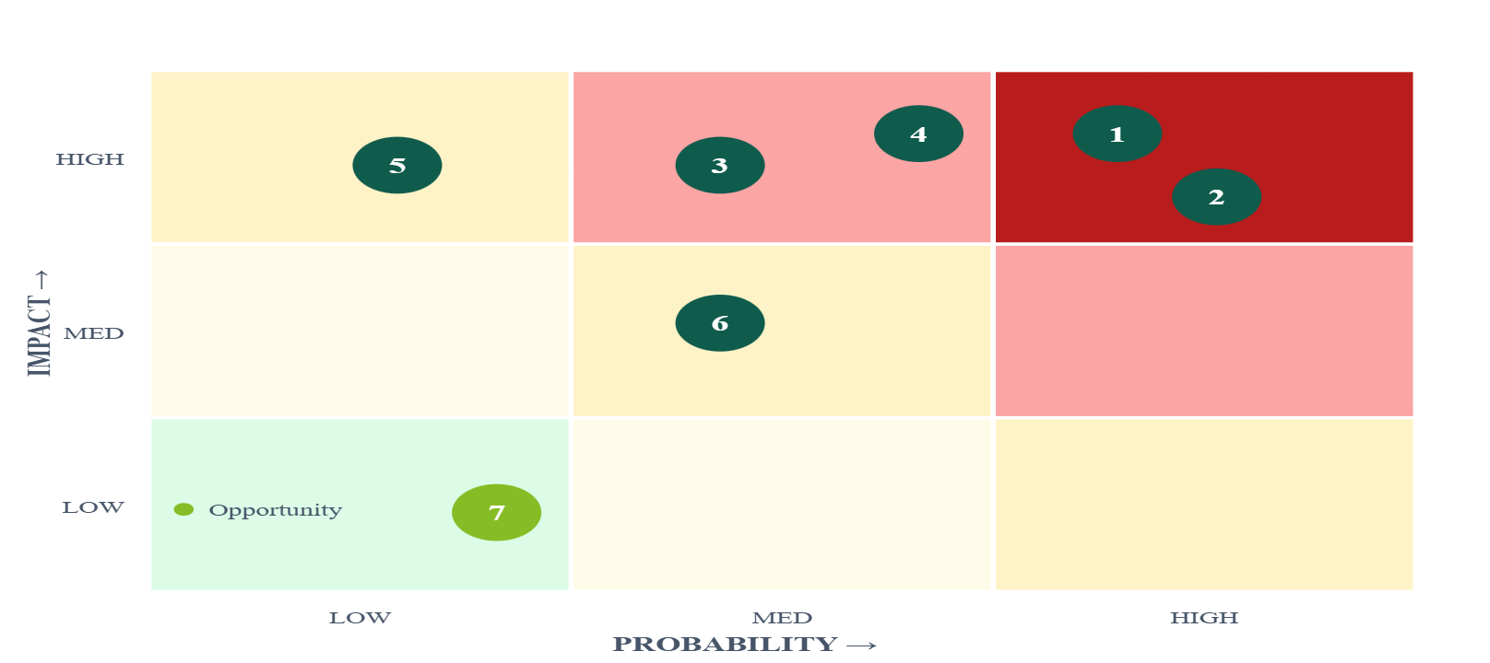
06 · RISK & IMPLEMENTATION 3 × 3 RISK HEAT-MAP
Seven risks ranked by probability × impact, with mitigations
Each risk has a named mitigation, an owner, and a contractual lever.
EXHIBIT 13
1
BESS costs stay high
Risk heat-map — 3 × 3
VGF + import duty waiver + PLI for domestic mfg
2
Grid not upgraded in time
PowerGrid mandate + tariff reform for transmission
3
Demand grows faster than forecast
Demand response + building efficiency mandates
4
DISCOM resistance to BESS mandate
Must-buy regulation + payment security mechanism
5
Coal PLF collapses (financial)
Minimum offtake guarantee during transition
6
Policy reversal after elections
Embed BESS targets in NEP as statutory requirements
7
Technology breakthrough (upside)
Build flexibility clauses; avoid lock-in
IIT Mandi
Source: authors' risk register · cross-referenced with NITI Aayog energy risk framework
19 / 20

Slide 20
FINAL THESIS 4 WEEKS · 9 DATASETS · 5 MODELS
Renewables solved the capacity gap. Storage solves the timing gap. Policy makes it happen.
TOP 5 PRIORITY POLICIES
300 GWh BESS mandate (NPV+)
HVDC inter-state grid fast-track
₹572/MWh carbon tax
Accelerate to 400 GW solar
Enforce EOQ coal norms
W1 · DATA
W2 · DIAGNOSIS
9 datasets · solar 37×
3 mismatches · solar=0 @ 8pm
W3 · MODELS
W4 · ECONOMICS
SARIMAX · EOQ · LP · K-Means
CBA · Pigou · Wright · LP plan
Five models confirm: 300 GWh BESS + a ₹572/MWh Pigouvian tax + the LP build plan deliver coal at 8 PM falling from 200 GW today to 70 GW by 2030.
IIT Mandi
Source: India Data Portal (ISB/BMGF) · CEA · NPP · POSOCO · CICERO
20 / 20

