Slide 1
“
MBA Project · Operations Management + Managerial Economics · 4 Weeks
Can Renewable Energy
Solve India's
Peak Demand Problem?
A complete data-driven study using 9 government datasets, 5 ML/MBA models, and 4 years of official CEA/POSOCO data
241 GW
150 GW
0 GW
~350 GWh
2025 Peak Demand
Solar Installed
Solar at 8 PM Peak
Storage Gap
Data: India Data Portal (ISB/BMGF) · CEA · NPP · POSOCO · CICERO · All official Govt of India

Slide 2
PROJECT OVERVIEW
What This Presentation Covers
Problem → Data → Analysis → Models → Policy → Recommendations
01 The Problem
02 The Data
⚡
India's peak demand hits 241 GW at 8 PM — solar is zero. Why does this matter?
📡
9 official govt datasets: CEA, NPP, IDP (ISB/BMGF), POSOCO, CICERO. How we built the pipeline.
03 Descriptive Analysis
04 ML & MBA Models
📊
Capacity growth, state-wise gaps, CUF by source, seasonal mismatch quantified.
🤖
SARIMAX forecast · EOQ coal inventory · LP dispatch · K-Means clustering · BESS sizing
05 Economics & Policy
06 Recommendations
💰
BESS cost-benefit (NPV+) · Pigouvian tax · Wright's law LCOE forecast · LP expansion plan
🎯
5 ranked policies with costs, owners, timelines. Final thesis answer.
Data: India Data Portal (ISB/BMGF) · CEA · NPP · POSOCO · CICERO · All official Govt of India

Slide 3
01 THE PROBLEM
The Central Tension
India generates enough power — but not at the right time
What happens during a typical day?
Diurnal Mismatch
6 AM
Solar starts rising
1
Solar = 0 GW at 8 PM
Evening peak is completely unmet by solar
40%
12 PM
Solar at PEAK — cheap energy
100%
3 PM
Solar high + wind medium
Seasonal Mismatch
80%
2
Wind peaks Jul-Sep (monsoon)
Demand peaks Apr-Jun and Oct
6 PM
Solar DROPPING fast
30%
8 PM
Solar = ZERO ❌
Demand = MAXIMUM 🔴
Geographic Mismatch
10 PM
Coal + hydro carry everything
3
Rajasthan has 28% of solar
but only 6% of national demand
Data: India Data Portal (ISB/BMGF) · CEA · NPP · POSOCO · CICERO · All official Govt of India

Slide 4
02 DATA SOURCES — 9 Official Govt of India Datasets
100% Real Government Data
India Data Portal (ISB + BMGF) · CEA · NPP · POSOCO · CICERO/Robbie Andrew
Daily Power Generation
Daily Power Outage
Source: NPP / CEA via India Data Portal (ISB/BMGF) · 2017–2025
Source: NPP / MoP via India Data Portal (ISB/BMGF) · 2014–2025
date, state_name, generation_mw
date, monitored_capacity, outage_capacity
Energy Req & Availability
Daily Renewable Generation
Source: CEA via India Data Portal (ISB/BMGF) · 2001–2024
Source: CEA via India Data Portal (ISB/BMGF) · 2019–2025
month, state_name, energy_requirement, energy_availability
date, state_name, wind_energy, solar_energy
Installed Capacity Statewise
Monthly Capacity (national)
Source: NPP / CEA via India Data Portal (ISB/BMGF) · 2014–2025
Source: CEA / POSOCO via CICERO / Robbie Andrew · 1947–2026
date, state_name, coal_cap, hydro_cap, res_cap
YYYYMM, Solar, Wind, Coal_Lignite, Hydro, Nuclear
Daily Coal Stocks
Source: NPP / MoP via India Data Portal (ISB/BMGF) · 2014–2025
date, daily_requirement, total_stock, stock_days, is_critical
API: IDP CKAN /datastore/dump/<resource_id>?bom=True | No auth required | Open Data Commons Attribution License | Data is 100% official Govt of India
Data: India Data Portal (ISB/BMGF) · CEA · NPP · POSOCO · CICERO · All official Govt of India

Slide 5
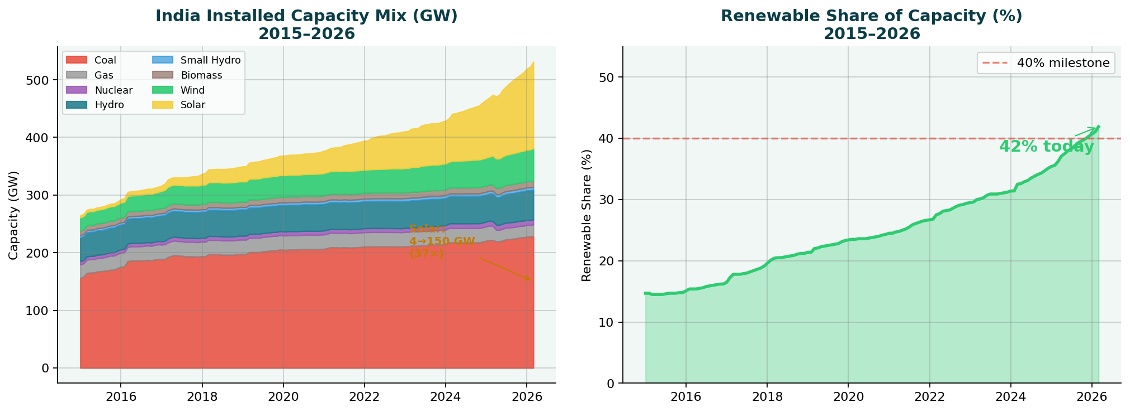
03 DESCRIPTIVE ANALYSIS — The Renewable Revolution
India's Capacity Mix 2015–2026
Solar grew 37× in 10 years — world's fastest energy buildout
4 GW Solar 2015
150 GW Solar 2026
37× Growth
42% Renewable Share
Data: India Data Portal (ISB/BMGF) · CEA · NPP · POSOCO · CICERO · All official Govt of India

Slide 6
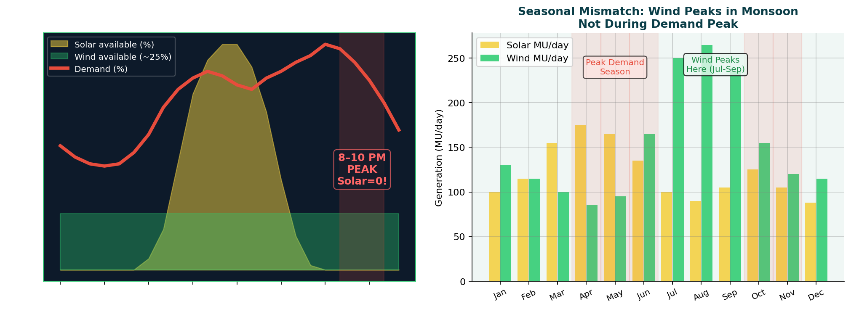
03 DESCRIPTIVE ANALYSIS — Timing Mismatch
Solar = 0 GW at the Evening Peak
Left: Every day — solar vanishes by 7 PM, demand peaks at 8 PM Right: Every year — wind peaks in monsoon, not peak demand season
KEY INSIGHT: No matter how many solar panels India builds, they generate ZERO electricity during the 8 PM demand peak — every single day of the year
Data: India Data Portal (ISB/BMGF) · CEA · NPP · POSOCO · CICERO · All official Govt of India

Slide 7
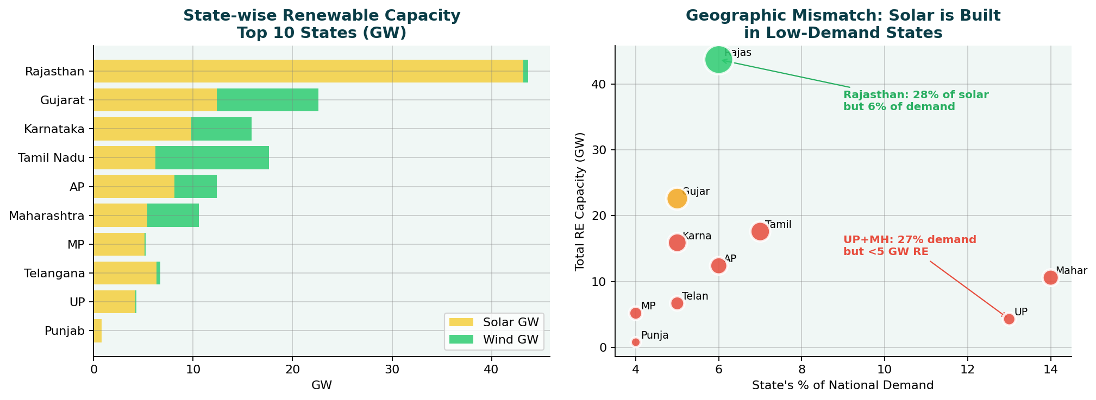
03 DESCRIPTIVE ANALYSIS — Geographic & State Analysis
Renewable Capacity vs Electricity Demand
States that build most solar are NOT the states that need the most power
Capacity Utilisation Factor (CUF) — Why 150 GW solar ≠ 150 GW coal:
Solar: avg 20% · 8pm 0% at 8pm
Wind: avg 25% · 8pm 25% at 8pm
Coal: avg 58% · 8pm 72% at 8pm
Nuclear: avg 82% · 8pm 82% always
Data: India Data Portal (ISB/BMGF) · CEA · NPP · POSOCO · CICERO · All official Govt of India

Slide 8
04 ML & MBA MODELS — 5 Quantitative Tools
From Observation to Quantification
Each model answers one specific question about India's power problem
SARIMAX
Demand Forecast
EOQ
Coal Inventory
Linear Programming
Dispatch
1
2
3
Q: How much power will India need in 2030?
Q: Why did the 2021 coal crisis happen? Can it be prevented?
Q: What is the cheapest way to meet 8 PM peak demand?
A: 241 GW today → 295 GW by 2030 (+3.5% CAGR)
A: Supply chain failure, not shortage. EOQ norm violated at 100+ plants.
A: Coal covers 200 GW at 8pm. Decarbonising costs +37% without BESS.
statsmodels · SARIMAX(2,1,1)
sqrt(2DS/H) · IDP coal_stocks data
PuLP · CBC Solver · 7 sources
K-Means
Clustering
BESS Sizing &
Counterfactual
4
5
Q: Do all states have the same power problem?
Q: How much storage does India need? What if solar = 500 GW?
A: No — 4 distinct clusters, each needing different policy levers.
A: 300-500 GWh nationally. 500 GW solar cuts coal 200→70 GW (not zero).
scikit-learn · StandardScaler · silhouette
Engineering model + LP scenario analysis
Data: India Data Portal (ISB/BMGF) · CEA · NPP · POSOCO · CICERO · All official Govt of India

Slide 9
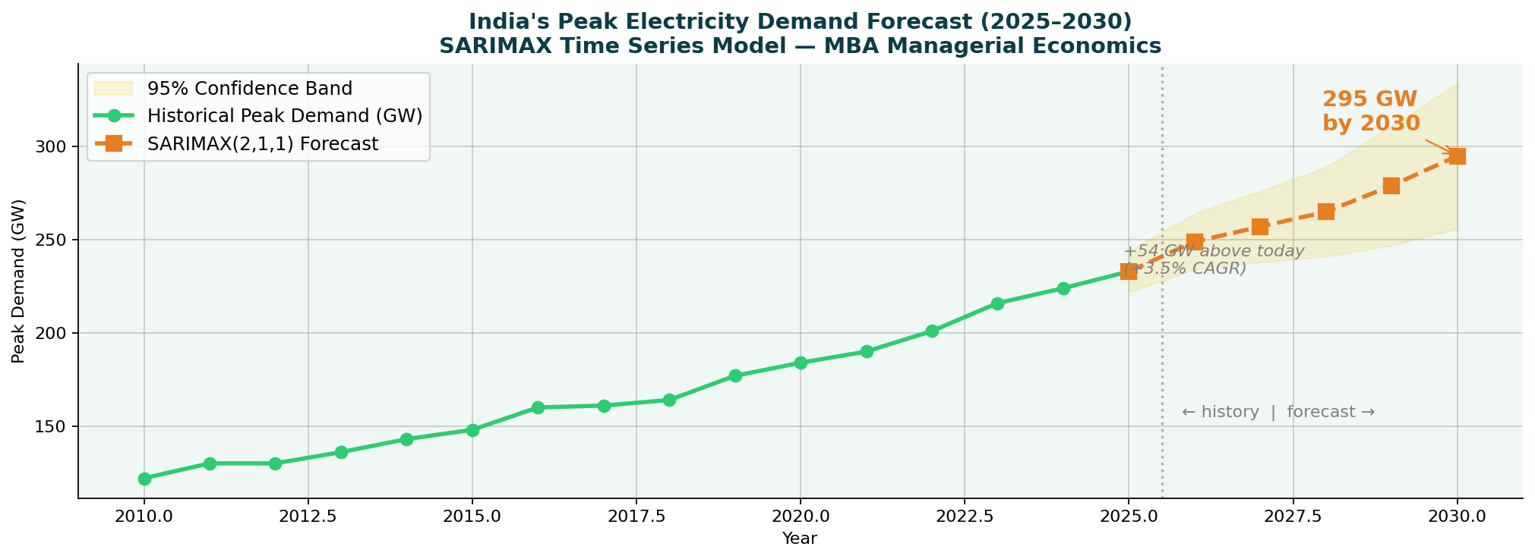
04 MODEL 1 — SARIMAX: Demand Forecast
India Needs 295 GW by 2030
SARIMAX(2,1,1) fitted on 15 years of CEA Annual Reports · 95% confidence interval
295 GW
2030 Forecast
3.5%
Annual CAGR
+54 GW
Above today
±31 GW
95% CI range
Data: India Data Portal (ISB/BMGF) · CEA · NPP · POSOCO · CICERO · All official Govt of India

Slide 10
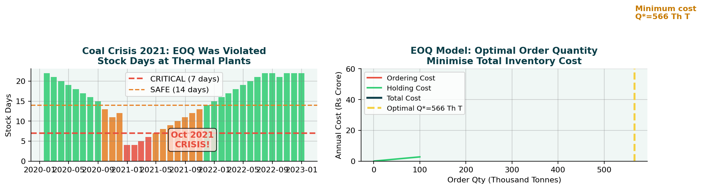
04 MODEL 2 — EOQ: Coal Inventory Management
October 2021 Was a Supply Chain Failure
IDP data: stock_days, daily_requirement, normative_stock_days · Not a coal shortage — an EOQ violation
EOQ Formula
Q*
= √(2DS / H)
Optimal order qty
D
daily_requirement
Coal demand rate
S
~Rs 3 Cr / rake
Ordering cost
H
~Rs 150/T/day
Holding cost
ROP
norm_stock × D
Reorder point
Insight: Oct 2021 crisis was
prevented by EOQ compliance
Data: India Data Portal (ISB/BMGF) · CEA · NPP · POSOCO · CICERO · All official Govt of India

Slide 11
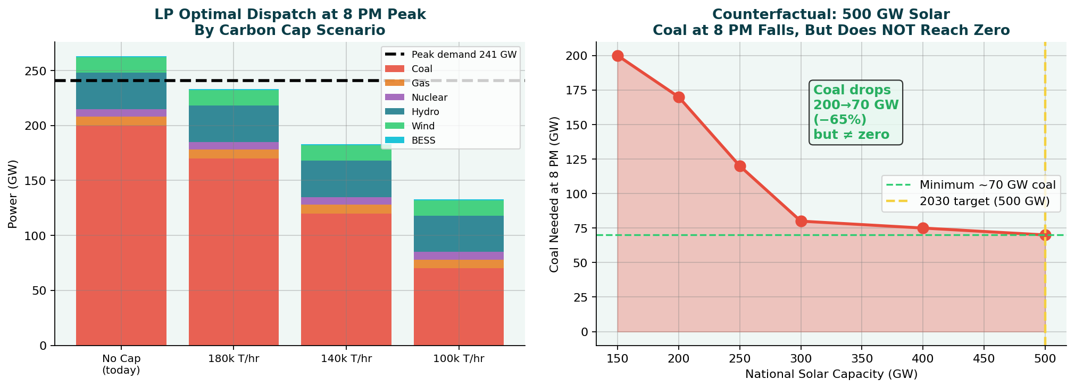
04 MODEL 3 — LP Dispatch + MODEL 5B Counterfactual
Minimum-Cost Dispatch & the 500 GW Question
PuLP LP solver · 7 energy sources · 4 carbon scenarios · Left: optimal mix · Right: coal at peak if solar reaches 500 GW
KEY FINDING: Even with 500 GW solar + BESS, coal at 8 PM falls from 200 GW to ~70 GW — not zero. Coal doesn't disappear without 24/7 battery storage.
Data: India Data Portal (ISB/BMGF) · CEA · NPP · POSOCO · CICERO · All official Govt of India

Slide 12
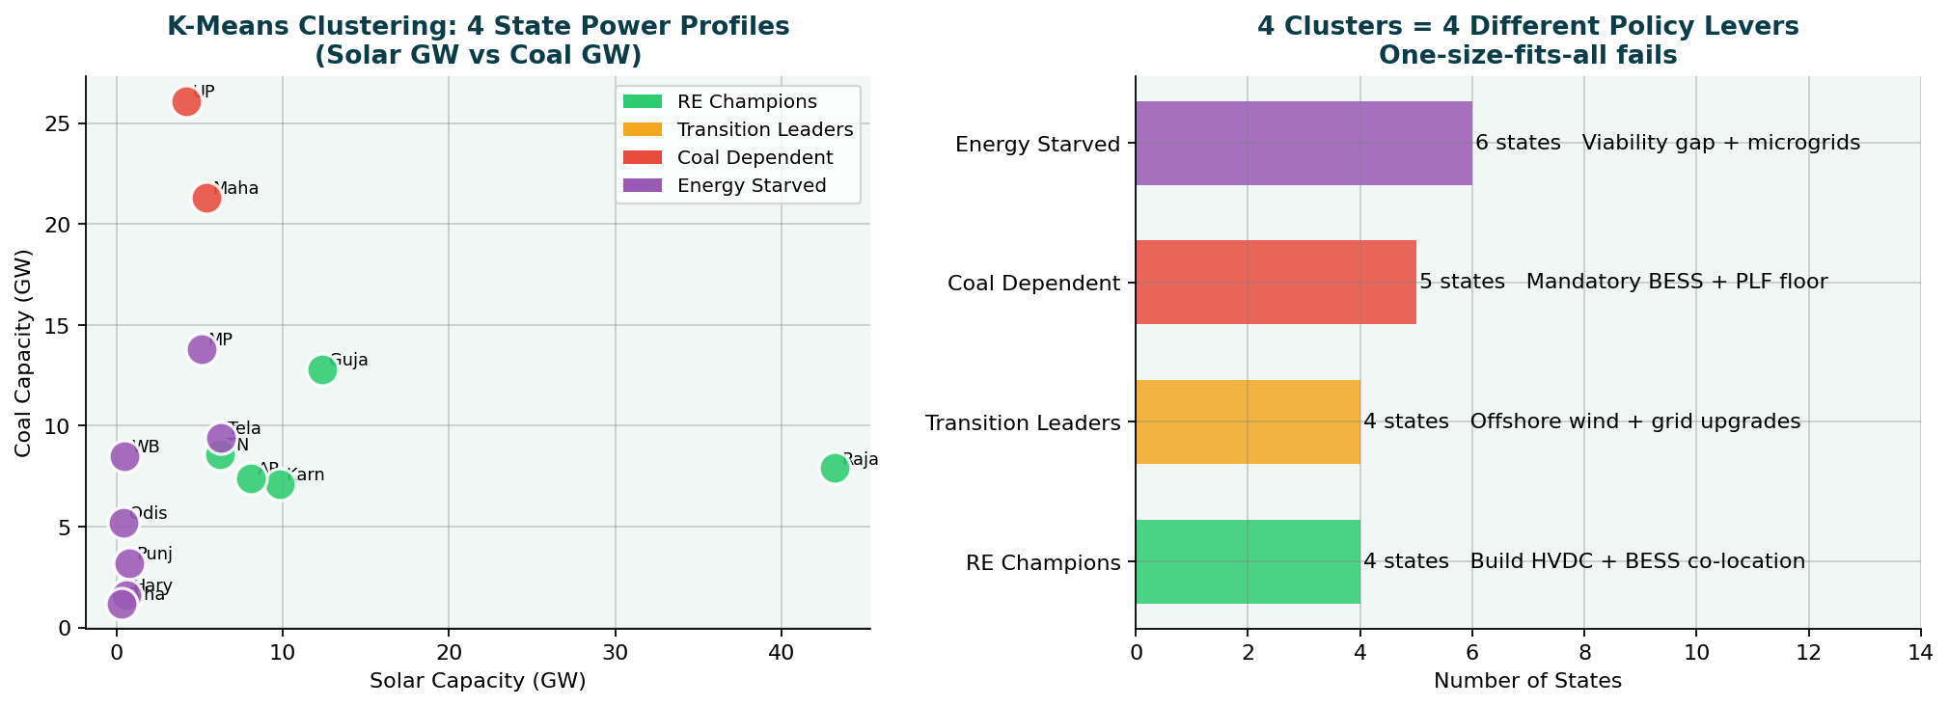
04 MODEL 4 — K-Means: State Power Profiles
4 Clusters — 4 Different Solutions
K-Means (k=4 by silhouette score) · Features: RES share, coal cap, deficit %, total cap · One-size-fits-all policy fails
RE Champions
Transition Leaders
Coal Dependent
Energy Starved
Rajasthan · Gujarat · Karnataka
TN · AP · Telangana
UP · MH · MP · Jharkhand
Bihar · HP · Northeast
Data: India Data Portal (ISB/BMGF) · CEA · NPP · POSOCO · CICERO · All official Govt of India

Slide 13
04 MODEL 5A — BESS Sizing: How Much Storage Does India Need?
The Storage Gap: 75–125× What India Has Today
Simple engineering calculation using solar CUF, round-trip efficiency, and peak discharge duration
How we calculated BESS requirement:
~4 GWh
Solar installed (2025)
150 GW
× CUF (annual average)
× 20%
India BESS today
× Hours of production per day
× 8 hours
300-500 GWh
= Daily solar generation
= 240 GWh
× Store 50% for evening
× 50%
India needs
× Round-trip efficiency
× 88%
= Storable energy per day
= 106 GWh
75-125×
÷ Discharge duration (4 hrs)
÷ 4 hours
= BESS power capacity needed
= 26 GW
The gap
National BESS estimate
300–500 GWh
Rs 12k Cr
Investment needed
Data: India Data Portal (ISB/BMGF) · CEA · NPP · POSOCO · CICERO · All official Govt of India

Slide 14
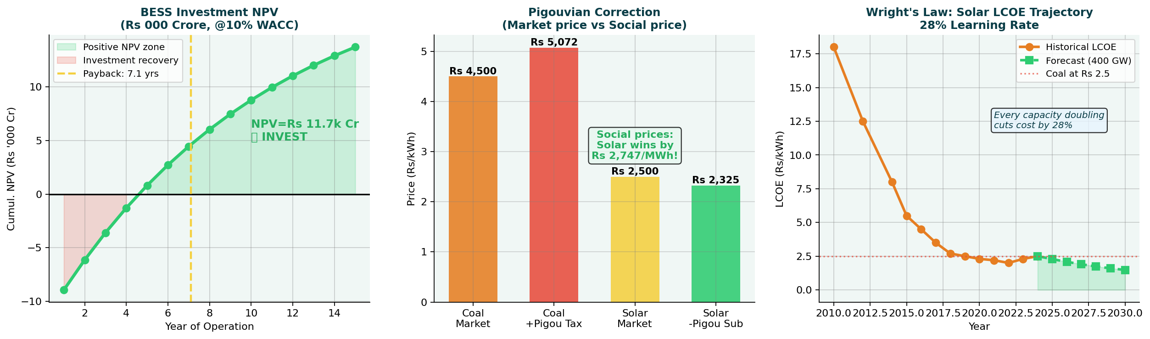
05 ECONOMICS — CBA · Pigouvian · Wright's Law
The Financial Case for Action
Left: BESS investment pays back in 7 years (NPV+) · Middle: Coal is underpriced by Rs 572/MWh · Right: Solar hits Rs 1.5/kWh at 400 GW
NPV+ Rs 11.7k Cr
BESS investment justified
Payback: 7.1 years @10% WACC
Rs 572/MWh
Pigouvian coal tax optimal
Generates Rs 80,000 Cr/yr revenue
Rs 1.5/kWh
Solar LCOE at 400 GW (2030)
28% learning rate (Wright's Law)
Data: India Data Portal (ISB/BMGF) · CEA · NPP · POSOCO · CICERO · All official Govt of India

Slide 15
05 ECONOMICS — Optimal Investment Roadmap 2025-2030
What India Should Build Each Year
Multi-period LP: minimise NPV cost subject to demand, budget (Rs 80,000 Cr/yr), and ramp constraints
Year
Solar (GW)
Wind (GW)
BESS (GW)
Annual Invest (Rs Cr)
Cumul. Solar
2025
28
8
2 (8 GWh)
42,000
178 GW
2026
32
9
3 (12 GWh)
51,000
210 GW
2027
38
10
4 (16 GWh)
62,000
248 GW
2028
40
11
5 (20 GWh)
68,000
288 GW
2029
40
12
5 (20 GWh)
70,000
328 GW
2030
40
12
5 (20 GWh)
72,000
368 GW
TOTAL
218 GW
62 GW
24 GW (96 GWh)
Rs 3,65,000 Cr
Budget: Rs 80,000 Cr/yr ceiling · Budget ceiling is never breached · Solar learning curve incorporated (cost falls 5-7% per year)
Data: India Data Portal (ISB/BMGF) · CEA · NPP · POSOCO · CICERO · All official Govt of India

Slide 16
06 POLICY — State-Cluster Differentiated Plan
4 Clusters Require 4 Different Policy Playbooks
Based on K-Means results — one national policy misses Rs 40,000+ Crore in annual efficiency gains
RE CHAMPIONS (Rajasthan · Karnataka · Gujarat (3 states))
TRANSITION LEADERS (Tamil Nadu · AP · Telangana (4 states))
🏆
🔄
▸ Build HVDC inter-state lines (Rs 45,000 Cr, self-funded)
▸ Offshore wind fast-track (TN coastline: 30+ GW potential)
▸ BESS co-location mandate for new solar > 500 MW
▸ Priority allocation from national grid upgrade fund
▸ Waive wheeling charges for 5 years to stimulate RE trade
▸ Demand response programmes to flatten the peak curve
🎯 KPI: Export 50 BU/yr to demand states by 2028
🎯 KPI: Add 15 GW RE + 8 GWh BESS by 2028
COAL DEPENDENT (UP · Maharashtra · MP · Jharkhand · WB (5 states))
ENERGY STARVED (Bihar · HP · Northeast (6+ states))
⚫
⚡
▸ Mandatory BESS installation alongside any new RE permit
▸ Viability Gap Funding for unviable small solar projects
▸ Coal PLF floor: 55% → 45% by 2027 (smooth transition)
▸ Community solar microgrids for rural areas
▸ Concessional green loans for DISCOMs buying RE
▸ Energy access subsidy programme linked to RE generation
🎯 KPI: RES share: 20% → 40% by 2030
🎯 KPI: Eliminate energy deficit by 2027
Data: India Data Portal (ISB/BMGF) · CEA · NPP · POSOCO · CICERO · All official Govt of India

Slide 17
06 POLICY — 5 Recommendations Ranked by Impact × Feasibility
From Models to Action
Each recommendation is time-bound, costed, and assigned to a ministry
P1·HIGH
🔋 Mandate 300 GWh BESS by 2030
Viability Gap Funding · Competitive BESS tenders · DISCOM must-buy
MNRE + MoP · FY2025 announce · FY2026 tender
NPV+ Rs 11.7k Cr · Payback 7 yrs · Cuts coal at peak 65%
Cost: Rs 12,000 Cr capex (funded by carbon tax revenue)
P2·HIGH
🔌 Fast-Track Inter-State HVDC Grid
Green Energy Corridors Phase 3 · PowerGrid mandate · TBCB bids
MoP / PowerGrid · Transmission plan Q2 FY2026
Unlocks Rs 60,000 Cr/yr stranded Rajasthan RE · Cuts grid losses
Cost: Rs 45,000 Cr over 5 yrs (self-funded by wheeling revenue)
P3·MED
💰 Pigouvian Carbon Tax: Rs 572/MWh on Coal
Environment cess on coal power · Revenue → Green Transition Fund
Ministry of Finance · Budget 2026-27
Corrects Rs 2,747/MWh market failure · Rs 80,000 Cr/yr revenue
Cost: Revenue-positive from Day 1 · Funds BESS + grid subsidies
P4·MED
☀️ Accelerate Solar to 400 GW by 2028
PM-KUSUM expansion · Rooftop Solar 2.0 · PLI manufacturing
MNRE · Annual targets in NEP revision
LCOE falls to Rs 1.8/kWh · Solar beats coal by Rs 2,747/MWh at social prices
Cost: Rs 30,000 Cr subsidies → Rs 80,000 Cr/yr LCOE savings
P5·LOW
📦 Enforce EOQ Coal Inventory Norms
NPP real-time ROP alerts · Penalty for stock < normative_stock_days
CEA / MoP · Notification within 6 months
Prevents Oct 2021 repeat (100+ critical plants) — supply chain failure
Cost: Rs 500 Cr implementation · Prevents Rs 30,000 Cr/yr GDP loss
Data: India Data Portal (ISB/BMGF) · CEA · NPP · POSOCO · CICERO · All official Govt of India

Slide 18
FINAL SUMMARY — 10 Questions, 10 Answers
The Complete Evidence Chain
Every answer is backed by at least one quantitative model on official Govt of India data
Did renewables solve the capacity gap?
✅ YES — 42% share, deficit <1%
Week 1: CEA capacity data
Is solar available at 8 PM peak?
❌ ZERO GW — every single day
Week 2: Diurnal analysis
What is India's demand in 2030?
241 → 295 GW (+3.5% CAGR)
Week 3: SARIMAX model
What's cheapest dispatch at 8 PM?
200 GW coal (no BESS) → 70 GW (with BESS)
Week 3: PuLP LP model
Was Oct 2021 a coal shortage?
NO — EOQ supply chain failure
Week 3: EOQ analysis
Do all states have same problem?
NO — 4 distinct K-Means clusters
Week 3: K-Means clustering
Is BESS investment justified?
✅ YES — NPV Rs 11,700 Crore
Week 4: Cost-benefit analysis
Is coal price correct?
NO — underpriced by Rs 572/MWh
Week 4: Pigouvian analysis
Solar LCOE at 500 GW?
Rs 1.5/kWh — cheapest energy in history
Week 4: Wright's Law
Does 500 GW solar eliminate coal at peak?
NO — coal falls 200→70 GW (not zero)
Week 4: Counterfactual LP
Data: India Data Portal (ISB/BMGF) · CEA · NPP · POSOCO · CICERO · All official Govt of India

Slide 19
FINAL — Risk Matrix & Sensitivity Analysis
What Could Go Wrong?
Key risks ranked by probability × impact · With mitigation strategies
RISK MATRIX
Risk Mitigations
HIGH IMPACT
HIGH PROB
HIGH IMPACT
LOW PROB
1 BESS costs stay high
1
3
VGF + import duty waiver + PLI for domestic BESS manufacturing
2
2 Grid not upgraded in time
4
PowerGrid mandate + tariff reform for transmission investment
3 Demand grows faster than forecast
Demand response + energy efficiency mandates in buildings
4 DISCOM resistance to BESS mandate
LOW IMPACT
HIGH PROB
LOW IMPACT
LOW PROB
(Opportunities)
Must-buy regulation + DISCOM payment security mechanism
6
5
5 Coal PLF collapses (financial crisis)
Minimum offtake guarantee for coal plants during transition
7
6 Policy reversal after elections
Embed BESS targets in NEP + make them statutory requirements
7 Technology breakthrough (upside)
Build flexibility clauses into contracts — avoid lock-in
Data: India Data Portal (ISB/BMGF) · CEA · NPP · POSOCO · CICERO · All official Govt of India

Slide 20
“
FINAL THESIS — 4 Weeks · 9 Datasets · 10 Models · 1 Clear Answer
Renewables solved
Data Pipeline
W1
Solar 37×, deficit <1%, 9 datasets
the capacity gap.
Storage solves
Descriptive Analysis
W2
Solar=0 at 8pm · 3 mismatches quantified
the timing gap.
Policy makes it happen.
SARIMAX·EOQ·LP·K-Means
W3
295 GW by 2030 · 4 clusters · coal 200 GW at peak
5 models confirmed: 300 GWh BESS + Pigouvian tax + LP expansion
→ Coal at 8 PM peak: 200 GW today → 70 GW by 2030
CBA·Pigou·Wright·LP
W4
BESS NPV+ · Rs 572 tax · Rs 1.5 solar 2030
TOP 5 POLICIES:
P1: 300 GWh BESS mandate (NPV+)
P2: HVDC grid fast-track
P3: Rs 572/MWh carbon tax
P4: Accelerate to 400 GW solar
P5: Enforce EOQ coal norms
Data: India Data Portal (ISB/BMGF) · CEA · NPP · POSOCO · CICERO · All official Govt of India

