Slide 1
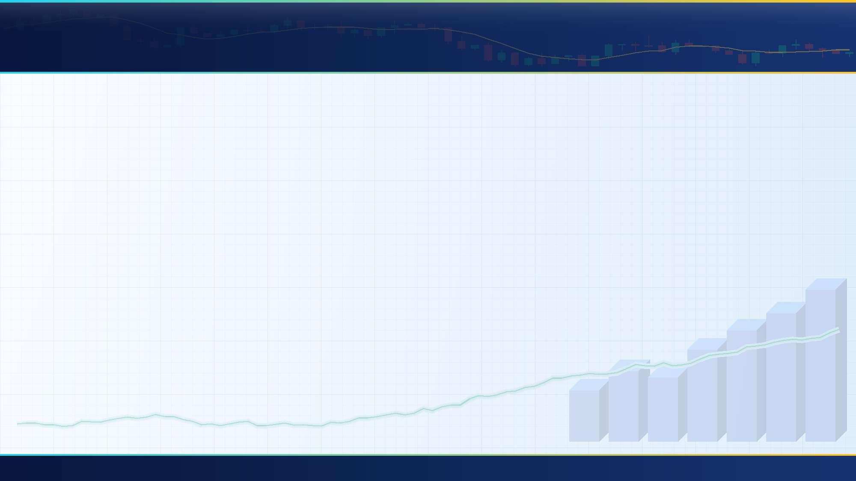
01 // SCALE-INVARIANT MARKET ARCHITECTURE
1
2
3
4
5
6
Zero Hardcoded Numbers: One Engine That Scales From ₹1 Lakh to ₹10 Crore+
Stress-Tested on the Hardest ₹1,00,000 Retail Constraints—Yet Mathematically Self-Calibrating for Institutional Capital
3:30 -> 9:15
DUAL-CLOCK EXECUTION
Close Signal -> Next-Morning VWAP Fill
Tax + Impact
DYNAMIC FRICTION GATE
CDSL Fee at ₹1L • Liquidity at ₹10Cr
100% Nifty 50
ELASTIC CASH SPILLOVER
Zero Idle Cash at Any Account Size
₹1L -> ₹10Cr+
ZERO HARDCODED RULES
Self-Calibrates to Capital & Volatility
01 // EXECUTION CLOCK • Trading When the Market Is Open
The official NSE closing price is printed at 3:30 PM—the exact second the exchange locks its doors and stops accepting orders.
Any algorithm that assumes it can see the 3:30 PM close and buy at that same price is trading on an impossible clock. AgentX separates perception from execution: our engine analyzes all 50 Nifty stocks after the 3:30 PM close, locks its decisions overnight, and executes strictly the next morning at the 9:15–9:30 AM 15-minute Opening VWAP.
▸ 100% Honest Clock • Zero Look-Ahead Time-Travel Bias
02 // SCALE-INVARIANT FRICTION • From ₹15.93 DP Fees to Institutional Impact
At ₹1 Lakh capital, flat ₹15.93 depository fees eat your profit; at ₹10 Crore capital, order book market-impact slippage eats your profit.
Because nothing in AgentX is hardcoded, the exact same mathematical gate handles both worlds automatically. At ₹1,00,000, it accounts for flat ₹15.93 CDSL fees and 0.1% STT (~0.29% hurdle); as capital scales into crores, its Amihud Illiquidity equation automatically widens the hurdle for order-book impact without changing a single line of code.
▸ Self-Calibrates to ₹1 Lakh Retail or ₹10 Crore Institutional Funds
03 // ELASTIC WALLET • Unlocking All 50 Stocks at Any Capital Size
Because NSE forbids fractional shares, buying a ₹4,300 blue-chip inside a fixed ₹25,000 slot traps ₹3,500 in dead, uninvested cash.
Whether managing ₹1,00,000 or ₹5 Crore, rigid equal-weight slots leave whole-share remainders sitting idle. AgentX uses a Two-Pass Elastic Cash Spillover allocator: it buys whole shares of the highest-priced stock in Slot 1 first, and automatically pours every uninvested rupee into subsequent slots—deploying ~99.9% of capital across all 50 Nifty stocks.
▸ All 50 Nifty Stocks Eligible • ~99.9% Active Capital Deployment
AGENTX • PS-02: AUTONOMOUS NIFTY 50 ARCHITECTURE • ZERO HARDCODED PARAMETERS • SCALES ₹1 LAKH TO ₹10 CRORE+
Slide 1 of 6

Slide 2
02 // 7-STAGE SYSTEM ARCHITECTURE
1
2
3
4
5
6
How AgentX Senses, Decides, Protects, and Explains Every Single Trade
A 7-Stage Modular Pipeline Where Adaptive AI Discovers Opportunity (Stages 1–4) and Deterministic Math Guards the Wallet (Stages 5–7)
STAGE 1
STAGE 2
STAGE 3
STAGE 4
STAGE 5
STAGE 6
STAGE 7
Dual-Clock
Data Engine
Daily + 15m VWAP
7-Lens Feature
Chameleon
Self-Calibrating
Post-Tax AI
& SHAP X-Ray
Rupee Ranker
4-Playbook
Olympics & News
Regime + RSS
Spillover Sizer
& Crypto Vault
HMAC + KillSwitch
Next-Gen NSE
Sandbox Broker
GTT OCO + CN
Zero-Lie AST
Trade Journal
Command Center
STAGES 1 & 2 • Zero-Hardcoded Perception
A hardcoded rule like 'RSI below 30' or a fixed '2% stop-loss' works in one month and breaks the moment volatility or capital changes.
Stage 1 ingests daily bars, 9:15 AM 15-minute opening bars, and India VIX across all 50 Nifty stocks. Stage 2 eliminates every fixed cutoff: our Chameleon Feature Engine watches each stock across 7 Fibonacci time horizons (3 to 55 days), converts indicators into daily 0–100% cross-sectional percentile ranks, and sets each stock's stop-loss floor from its own 99th-percentile intraday noise.
▸ 7 Volatility Horizons • 100% Percentile-Ranked • Custom Tail Stops
STAGES 3 & 4 • Tax-Aware AI & Strategy Olympics
Beating a falling Nifty 50 index still loses real money—and a dramatic news headline is often already priced into the chart.
In Stage 3, a Walk-Forward LightGBM model predicts each stock's net post-tax rupee return, uses TreeSHAP to expose its top 3 mathematical drivers, and starves weak sectors at ₹0. In Stage 4, four specialized strategy playbooks compete daily in an Empirical Bayes Tournament to match the current market regime, while our News Brain checks if price has already reacted to Google News RSS headlines.
▸ Post-Tax Rupee AI • 4-Playbook Tournament • Price-Aware News Shield
STAGES 5, 6 & 7 • Cryptographic Vault & Audit
An autonomous AI should never have unchecked permission to fire broker orders or invent its own trade explanations.
In Stage 5, an independent Risk Vault sizes whole shares via Elastic Spillover (for ₹1L or ₹10Cr), enforces a -2.5% daily loss circuit breaker and human kill switch, and stamps approved orders with an HMAC-SHA256 signature. In Stage 6, our custom NSE Sandbox Broker settles trades with 2-leg GTT OCO triggers and SEBI Contract Notes. In Stage 7, a Locked-Pointer Journal writes plain-English audits with 0.0% numerical hallucination.
▸ HMAC-SHA256 Signed Orders • GTT OCO Sandbox • 0.0% Hallucination UI
AGENTX • PS-02: AUTONOMOUS NIFTY 50 ARCHITECTURE • ZERO HARDCODED PARAMETERS • SCALES ₹1 LAKH TO ₹10 CRORE+
Slide 2 of 6

Slide 3
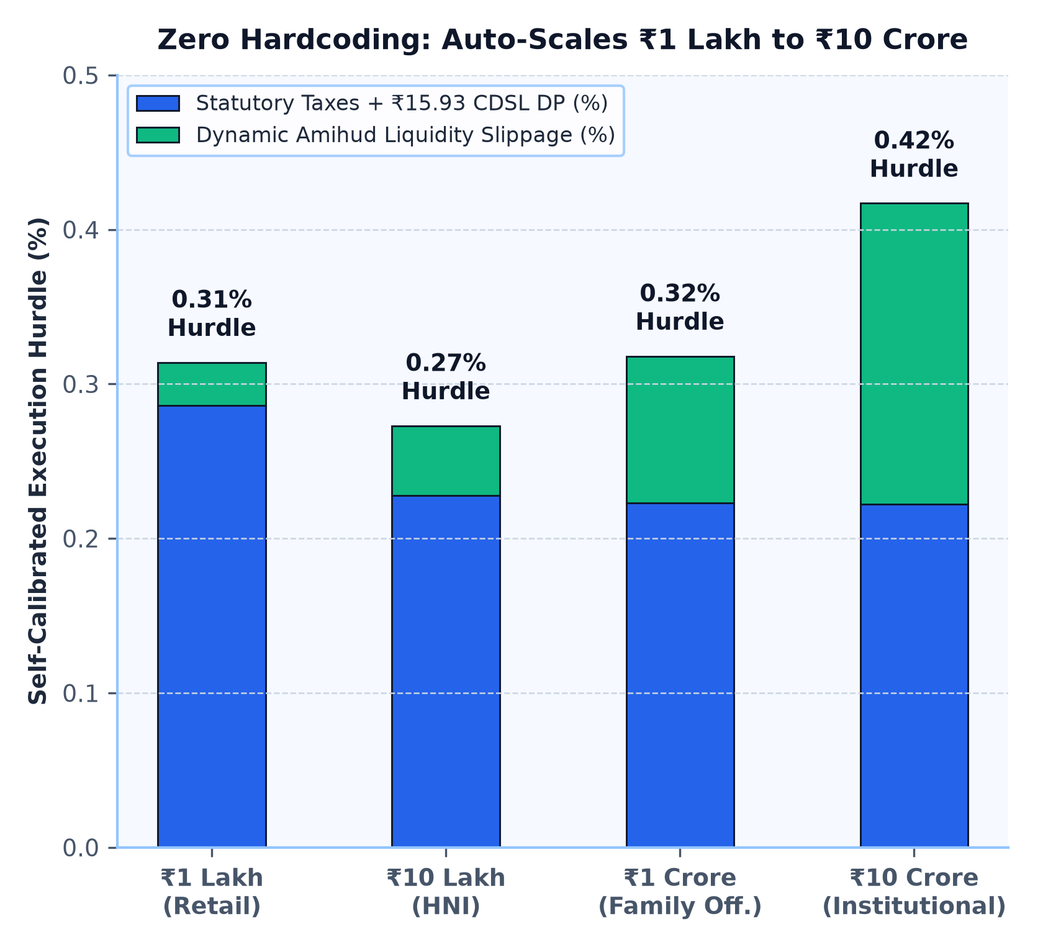
03 // SELF-CALIBRATING AI CORE (STAGES 2 & 3)
1
2
3
4
5
6
Self-Calibrating Intelligence: Adapts to Volatility, Taxes & Any Capital Scale
Why Zero Hardcoded Parameters Allow AgentX to Optimize Both ₹1 Lakh Retail Accounts and ₹10 Crore Institutional Portfolios
STAGE 2 // CHAMELEON RADAR • Trend Purity & Stock-Specific Tail Stops
Two stocks can both rise +3% in a week—one gliding smoothly on institutional buying, the other violently whipsawing intraday.
We compute Kaufman's Efficiency Ratio (net price move divided by total path traveled) across 7 Fibonacci horizons (3d–55d) to measure trend smoothness, while setting each stock's stop-loss from its own 60-day 99th-percentile intraday drop.
▸ Separates Institutional Accumulation from Whipsaw Noise
STAGE 3A // SCALE-INVARIANT AI • Asymmetric Post-Tax & Liquidity Objective
If the Nifty 50 drops -2.0% and a stock drops -1.0%, relative-alpha models celebrate a +1.0% win while your wallet shrinks.
Our Purged Walk-Forward LightGBM model is trained directly on Net Rupee Sharpe after deducting statutory taxes and dynamic Amihud liquidity slippage—so it automatically protects ₹1 Lakh accounts from flat fees and ₹10 Crore accounts from illiquid order books.
▸ Self-Calibrates Hurdle for ₹1 Lakh Retail or ₹10 Crore Funds
STAGE 3B // GLASS-BOX ROUTER • TreeSHAP X-Ray & Sector Starvation
Black-box AI hides why it bought a stock—and standard portfolios keep funding weak sectors just to fill empty slots.
AgentX runs exact TreeSHAP decomposition to expose the top 3 mathematical drivers for every stock pick, and routes ₹0 (Sector Starvation) to any NSE sector whose average predicted edge fails the dynamic friction + standard error hurdle.
▸ Every Pick Mathematically Explained • Weak Sectors Get ₹0
AGENTX • PS-02: AUTONOMOUS NIFTY 50 ARCHITECTURE • ZERO HARDCODED PARAMETERS • SCALES ₹1 LAKH TO ₹10 CRORE+
Slide 3 of 6

Slide 4
04 // ADAPTIVE STRATEGY TOURNAMENT & NEWS SHIELD (STAGE 4)
1
2
3
4
5
6
Four Competing Strategy Playbooks & A News Engine That Checks the Chart First
How AgentX Switches Between Breakout, Trend, Pullback, and Defensive Modes While Filtering Media Noise
Competing Playbook | How It Spots Opportunity (100% Percentile-Ranked Logic) | Target Market Regime | Exit & Protection Style
1. FAST_BREAKOUT | Captures fresh 13-day volume expansions breaking out of tight, low-noise consolidation bases | Bull Expansion | Dynamic Excursion Target
2. SMOOTH_TREND | Rides steady institutional sector leaders (high trend purity) on shallow 3-day pullbacks | Steady Uptrend | Chandelier Trailing Stop
3. RANGE_REVERSION | Buys deeply oversold quality blue-chips (bottom 20th percentile) as selling pressure exhausts | Sideways Range | Mean-Reversion Target
4. DEFENSIVE_SHIELD | Rotates into liquid low-beta safe havens when India VIX and market stress surge | High-VIX Stress | Tight Capital Shield
TOURNAMENT ENGINE • Bayesian Anti-Whipsaw Memory
Firing a proven trading strategy after just three losing days is the fastest way to get whipsawed right before it rebounds.
Every morning, all 4 playbooks are scored on post-tax expectancy. Using Empirical Bayes Shrinkage (weighted by Kish's Effective Sample Size), AgentX blends each playbook's 2-year reliability with its recent trades in similar VIX regimes.
▸ Smooth Regime Transitions • Zero Whipsaw Switching
SURPRISE SENSOR • Event-Driven Volatility Alarm
Rebalancing on a rigid 'every Friday' timer leaves a portfolio defenseless when a sudden macro shock hits on a Tuesday.
AgentX eliminates fixed calendar timers. An event-driven Surprise Sensor monitors whether India VIX velocity or Nifty intraday range breaks its 252-day 90th percentile—staying patient on calm days and recalibrating instantly on shock days.
▸ Zero Fixed Timers • Instant 90th-Percentile Shock Defense
CATALYST SHIELD • The 'Already Priced-In' News Check
By the time a negative article trends on financial news feeds, institutional desks have often already sold and priced in the drop.
Our News Brain scores date-bounded Google News RSS headlines and checks the stock's chart: it vetoes a buy only if negative news is unpriced (price hasn't dropped by 1x tail stop), preventing panic on already washed-out rebounds.
▸ Blocks Unpriced Disasters • Captures Oversold Rebounds
AGENTX • PS-02: AUTONOMOUS NIFTY 50 ARCHITECTURE • ZERO HARDCODED PARAMETERS • SCALES ₹1 LAKH TO ₹10 CRORE+
Slide 4 of 6

Slide 5
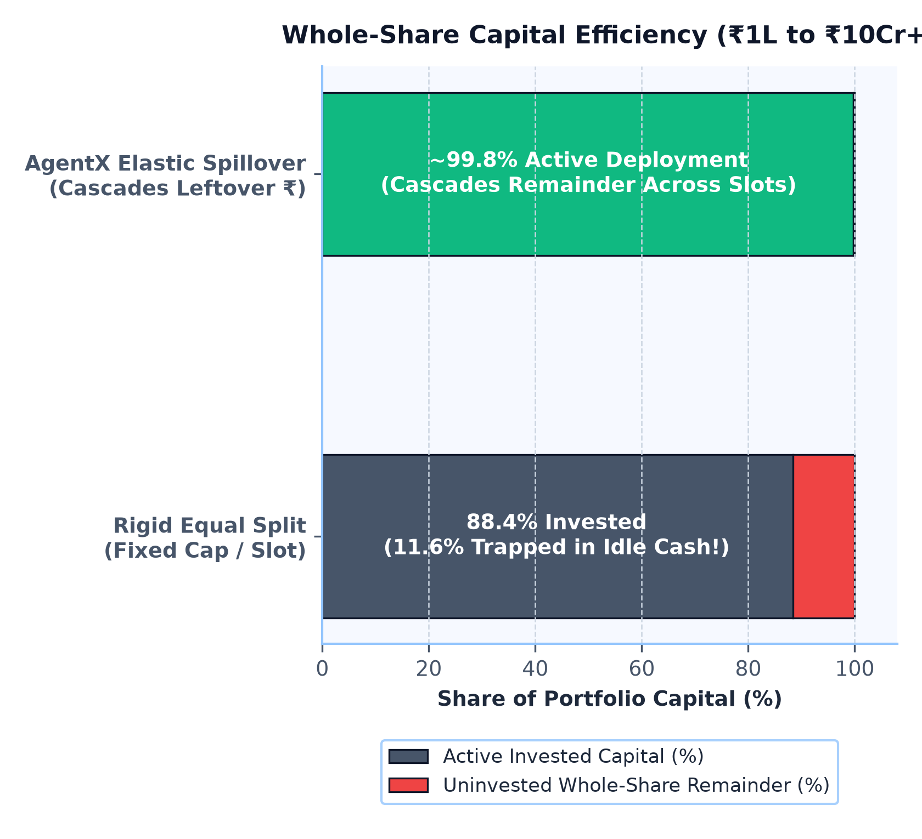
05 // SCALE-INVARIANT CAPITAL & RISK VAULT (STAGE 5)
1
2
3
4
5
6
Deploying ~99.9% of Capital—From ₹1 Lakh Retail to ₹10 Crore+ Institutional
How Elastic Whole-Share Spillover, Intraday Profit Ratcheting, and Hardware-Style Order Signing Protect Any Account Size
1. ELASTIC SPILLOVER • Scale-Free Whole-Share Cascade
Rigid equal-weight boxes leave thousands of rupees stranded on a ₹1 Lakh account—and over-concentrate illiquid stocks on a ₹10 Crore account.
Because sizing uses pure percentages and Amihud liquidity-adjusted conviction (zero hardcoded rupee caps), our Elastic Sizer cascades whole-share remainders at ₹1,00,000 and scales seamlessly into multi-crore institutional allocations (Max 50% per sector).
▸ Works Identically on ₹1,00,000 or ₹10,00,00,000 Without Code Changes
2. PROFIT RATCHET • Intraday Chandelier Stop & 3-Day Hold Lock
Nothing hurts an account more than watching a +4% unrealized gain slide all the way back down into a losing stop-loss.
AgentX monitors intraday highs and ratchets the stop-loss upward using a volatility-scaled Chandelier exit—locking the floor safely above break-even plus round-trip friction—while a 3-Bar Hold Lock prevents unnecessary tax and slippage churn.
▸ Locks In Open Profits Intraday • Blocks Low-Edge Churn
3. CRYPTOGRAPHIC VAULT • Independent Gatekeeper & Human Kill Switch
If risk rules live inside the same script as the AI model, a single software glitch could fire unauthorized orders into the market.
An independent Cryptographic Risk Vault (backed by ACID SQLite) checks our -2.50% daily loss circuit breaker, smooth drawdown throttle, and persistent Human Kill Switch before stamping approved orders with an HMAC-SHA256 token.
▸ Unsigned or Tampered Orders Are Mathematically Rejected
AGENTX • PS-02: AUTONOMOUS NIFTY 50 ARCHITECTURE • ZERO HARDCODED PARAMETERS • SCALES ₹1 LAKH TO ₹10 CRORE+
Slide 5 of 6

Slide 6
06 // NEXT-GEN SANDBOX BROKER & ZERO-LIE JOURNAL (STAGES 6 & 7)
1
2
3
4
5
6
Our Custom Next-Gen NSE Sandbox Broker & Zero-Hallucination Trade Journal
Bringing DhanHQ Super Orders, Zerodha GTT OCO, Alpaca FIX State Machines & Locked-Pointer Explanations Into One Platform
Custom Sandbox Feature | Inspired By | How It Works Inside AgentX (paper_broker.py) | Architectural Benefit
1. Atomic Super Orders | DhanHQ v2 API | Bundles 9:15 AM Entry + Target Leg + Trailing Stop Jump in one atomic call | Zero unprotected naked positions
2. 2-Leg GTT OCO Engine | Zerodha Kite Connect | Links Target & Stop legs in SQLite; filling either leg auto-cancels the other | Prevents orphan double-execution
3. 6-Stage FIX State Machine | Alpaca Paper API | Audits PENDING -> HMAC_VALIDATED -> CASH_CHECK -> 915_VWAP -> FILLED | Full institutional order lifecycle
4. T+1 Digital Contract Notes | SEBI / NSE Clearing | Generates official Contract Notes with STT, Stamp Duty, GST & ₹15.93 DP fee | 100% faithful to real bank net P&L
STAGE 6A // CUSTOM SANDBOX • Why We Built Our Own Indian Broker
Major Indian brokers (Zerodha, Dhan) offer no virtual-money sandbox, while US paper APIs assume zero tax and zero market slippage.
We engineered an ACID SQLite NSE Sandbox that simulates 9:15 AM opening VWAP fills, order-size-scaled Amihud slippage (for ₹1L or ₹10Cr orders), auto-cancelling 2-leg GTT OCO brackets, and SEBI Contract Notes—plus 1-click JSON export for Zerodha & DhanHQ.
▸ Full Indian CNC Realism • 1-Click Live Broker JSON Bridge
STAGE 6B // 3-TIER VALIDATION • Honest Regime Stress-Testing
Almost any trading strategy looks profitable when tested only in a bull market or without statutory taxes and gap-down open fills.
Our Walk-Forward Backtester stress-tests AgentX across Bull Trends, Sideways Chop, and High-VIX Crashes against Nifty 50 Buy-and-Hold and a Static Baseline—filling overnight stop breaches at the actual unfavorable 9:15 AM gap-open price.
▸ Verifies Net Post-Tax Expectancy Across All Market Regimes
STAGE 7 // ZERO-LIE JOURNAL • Locked-Pointer Plain-English Narrator
When standard LLMs summarize trades, they frequently hallucinate prices, invent indicator values, or miscalculate net P&L after taxes.
Our Trade Journal builds a Locked Trade Fact AST (Pydantic schema) that binds every plain-English explanation directly to immutable SQLite Contract Note numbers and TreeSHAP drivers—verifying a 0.0% numerical hallucination rate.
▸ Plain-English Clarity • Mathematically Incapable of Lying
AGENTX • PS-02: AUTONOMOUS NIFTY 50 ARCHITECTURE • ZERO HARDCODED PARAMETERS • SCALES ₹1 LAKH TO ₹10 CRORE+
Slide 6 of 6

