Slide 1

Optimizing Detection of Credit Card Fraud Using Machine Learning Techniques
Zeroth review
Presented By:
Sudharshanan S - 125003354
Krishaant SH - 125003153
Karthikeyan S - 125003137
Guided By:
Ms. Helen WR
Assistant Professor - III
CSE / SOC
SASTRA Deemed University

Slide 2
Outline
Base paper details
Abstract
Problem statement
Literature Review
Proposed Framework
Dataset description
Tentative Timeline
Thank you

Slide 3
Base Paper Details
Title: Credit Card Fraud Detection: An Improved Strategy for High Recall Using KNN, LDA, and Linear Regression
Authors: Jiwon Chung and KyunghoLee
Year of Publication: 2023
Journal name: Sensors
Index : SCIE
Link : https://www.mdpi.com/1424-8220/23/18/7788

Slide 4
Abstract
Fraud involves criminal deception and false representations to gain an unfair advantage, particularly amplified by the growth in online transactions and technologies. The widespread use of online transaction systems and IoT devices has increased transaction volumes, heightening the risk of fraudulent activities. Given the prevalence of fraud, there is an urgent call for effective fraud detection systems. In general, fraud detection can be categorized into two types: misuse detection and anomaly detection. Misuse detection involves the use of machine learning-based classification models to distinguish between fraudulent and legitimate transactions. On the other hand, anomaly detection establishes a baseline from sequential records to define the characteristics of a typical transaction and creates a distinctive profile for it. We proposed a strategy for misuse detection that utilizes a combination of K-nearest neighbor (KNN), linear discriminant analysis (LDA), and linear regression (LR) models. Then we enhance the results with few modifications. The features extracted using this strategy demonstrated recall scores higher values across four tested fraud datasets. As a result, this approach surpasses other methods that rely on single machine learning models, particularly in terms of recall.

Slide 5
Problem statement:
Surge in electronic commerce and widespread use of Internet of Things (IoT) devices have heightened concerns about fraudulent credit card transactions.
Existing detection methods often lack the sensitivity needed to accurately identify fraudulent activities, resulting in financial losses for businesses and individuals.
There is a pressing need for an improved algorithm leveraging advancements in machine learning to enhance credit card fraud detection.
The algorithm should be designed to achieve high sensitivity in detecting fraudulent transactions.
Additional logic should be incorporated into the algorithm to further enhance detection accuracy.
The solution aims to address the evolving landscape of credit card fraud in the digital era, ensuring better protection for consumers and businesses alike.

Slide 6
Solution Approach:
Proposed solution integrates three machine learning models: K-nearest neighbor, linear discriminant analysis, and linear regression.
Aims to leverage strengths of these models to extract relevant features from credit card transactions and enhance fraud detection accuracy.
Integration of conditional statements (e.g., "IF", "THEN") and operators (e.g., ">", "<") refines results, enhancing sensitivity of detection process.
Comprehensive evaluation across multiple fraud datasets demonstrates superior performance compared to single-model approaches.
Achieves high recall rates, contributing to improved detection of fraudulent transactions.
Contributes to mitigating risks associated with electronic commerce and IoT-based transactions.

Slide 7
Literature Survey
1.
Title: Transaction Fraud Detection Based on Total Order Relation and Behavior Diversity
Author: Lutao Zheng
Models used: Logical Graph of Behaviour Profile (LGBP)
Advantages: OM overcomes the shortcoming of Markov chain models since it characterizes the diversity of user behaviors
Disadvantages: For high stability group (HS) SM method is better than ours since SM is based on Markov chain, and thus is more suitable for the stable case
2.
Title: Improved competitive learning neural networks for network intrusion and fraud detection
Author: John Zhong Lei
Models used: improved competitive learning network (ICLN), supervised improved competitive learning network (SICLN)
Advantages: Achieves low misclassification rate in solving classification problems and is able to deal with both labeled and unlabeled data
Disadvantages: The current SICLN does not guarantee avoiding local optimization

Slide 8
Literature Survey
3.
Title: Teaching the Basics of KNN, LDA and Simple Perceptron Algorithms for Binary Classification Problems
Author: Lopez-Bernal
Models used: K-Nearest-Neighbor (KNN), Linear Discriminant Analysis (LDA), Simple Perceptron
Advantages: KNN: Easy to understand and Implement, Fast training
LDA: Low Computation cost and easy to implement
Perceptron: Easy to train and setup
Disadvantages: KNN: High computational cost and poor run time performance
LDA: Requires normal distribution and limited to 2 class
Perceptron: Only works on linearly separable data and limited to
binary data

Slide 9
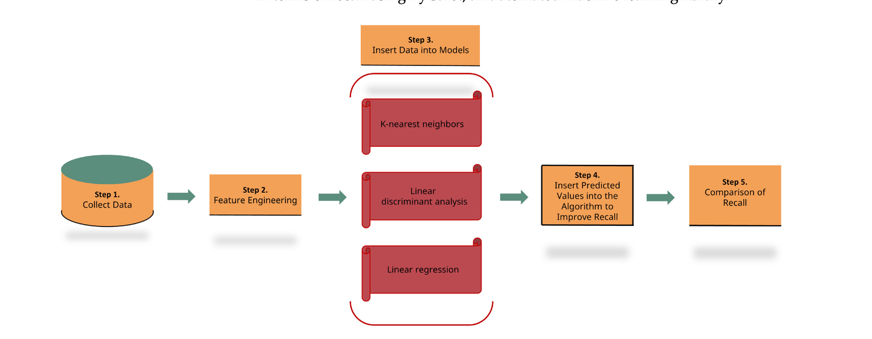
Proposed Framework

Slide 10
Dataset Description
Synthetic Financial Datasets for Fraud Detection:
Dataset contains 1,048,575 rows and 11 columns of data.
Categorical data identified in the dataset: - "type" column representing event time. - "nameOrig" column anonymizing the customer initiating the transaction. - "nameDest" column anonymizing the customer completing the transaction.
Link : https://www.kaggle.com/datasets/ealaxi/paysim1
Credit Card Transactions Fraud Detection Dataset:
Dataset comprises 1,852,394 rows and 23 columns of data, suitable for time series analysis.
Categorical variables converted into numerical data: - “merchant” , “category” ,“first” ,“last” ,“gender” ,“street” ,“job”, “trans_num”, “city”, “state”, and “dob
Link : https://www.kaggle.com/datasets/kartik2112/fraud-detection
Credit-card-Fraud Detection Imbalanced Dataset:
Dataset contains pertinent demographic variables: - Family size , Years employed , Age , Number of children
Label encoding performed on the following columns with categorical variables: - "gender", "car", "reality", "income_type", "education_type", "house_type", "family_type"
Link : https://www.kaggle.com/datasets/dark06thunder/credit-card-dataset
IEEE_CIS Fraud Detection:
contains a total of 590,540 rows and 394 columns.
Link : https://www.kaggle.com/competitions/ieee-fraud-detection

Slide 11
Tentative Timeline and Indiviual Contributions
Stage 1: [On/before 26/02/24]
Data Preprocessing and exploratory data analysis
Stage 2: [First 2 dataset: On/before 6/03/24 Remaining dataset: 21/03/24]
ML model construction and fitting
Stage 3: [ On/before 31/03/24]
Algorithm construction and recall value calculation
Stage 4: [On /before 7/04/24]
Comparing the recall values using graphs
Sudharshanan : Cleaning the 4 datasets
Krishaant: Fitting the models
Karthikeyan: Algorithm Construction and Recall comparision

Slide 12
Handling the imbalance dataset:
SMOTE (Synthetic Minority Over-sampling Technique)
Purpose:
Address class imbalance in datasets for better model performance.
Implemented in Python using imbalanced-learn library (imblearn).
Steps to Implement SMOTE:
Install imbalanced-learn:
Command: pip install imbalanced-learn
Import Necessary Libraries: -from imblearn.over_sampling import SMOTE
Initialize SMOTE object:
smote = SMOTE(sampling_strategy='minority')
Apply SMOTE: X_resampled, y_resampled = smote.fit_resample(X, y)

Slide 13
Dataset 1 : Synthetic Financial Datasets for Fraud Detection
Data cleaning and Data preprocessing:
No missing values were found .
Categorical columns ('type', 'nameOrig', and 'nameDest') were encoded numerically using LabelEncoder from scikit-learn.
Models used :
KNN (K-Nearest Neighbors),
LDA (Linear Discriminant Analysis)
LR (Linear Regression) predictive models .
Training set and Test set :
Partitioned all datasets into training data (80%) and test data (20%) before feeding them into the algorithm.
Employed Stratified K-Fold cross-validation with a fold value of 5 to enhance the robustness of our methodology and maintain consistent model performance.

Slide 14
Dataset 1 : Synthetic Financial Datasets for Fraud Detection
Here's a summary of the hyperparameters for each algorithm:
KNN (K-Nearest Neighbors):
algorithm: "auto"
leaf size: 30
metric: "minkowski"
metric_params: "None"
n_jobs: -1
n_neighbors: 5
p: 2
weights: "uniform"
LDA (Linear Discriminant Analysis):
covariance_estimator: "None"
n_components: "None"
priors: "None"
shrinkage: "None"
solver: "svd"
store_covariance: "False"
tolerance: 0.0001f
LR (Linear Regression):
Default settings retained

Slide 15
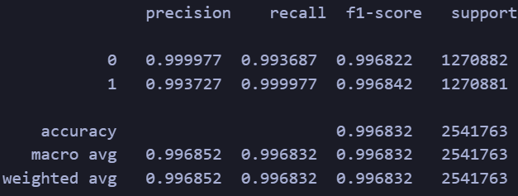
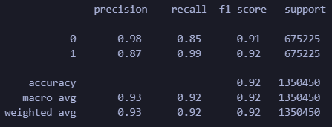
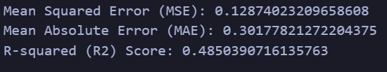
Dataset 1 : Synthetic Financial Datasets for Fraud Detection
Classification report:
KNN (K-Nearest Neighbors):
LDA (Linear Discriminant Analysis):
LR (Linear Regression):

Slide 16
Dataset 2: Credit Card Transaction fraud Detection Dataset
Data cleaning and Data preprocessing:
No missing values were found in the dataset .
Categorical columns ("merchant", "category", "first", "last", "gender", "street", "job", "trans_num", "city", "state", and "dob") were converted into numerical data.
Models used :
KNN (K-Nearest Neighbors), LDA (Linear Discriminant Analysis), and LR (Linear Regression) predictive models .
Training set and Test set :
Partitioned all datasets into training data (80%) and test data (20%) .
Employed Stratified K-Fold cross-validation with a fold value of 5 .

Slide 17
Dataset 2: Credit Card Transaction fraud Detection Dataset
Models used:
1.KNN ( K-Nearest Neighbors)
algorithm: "auto"
leaf size: 30
metric: "minkowski"
metric_params: "None"
n_jobs: -1
n_neighbors: 5
p: 2
weights: "uniform"
2.LDA (Linear Discriminant Analysis):
covariance_estimator: "None"
n_components: "None"
priors: "None"
shrinkage: "None"
solver: "svd"
store_covariance: "False"
tolerance: 0.0001f
3.LR (Linear Regression):
Default settings retained

Slide 18
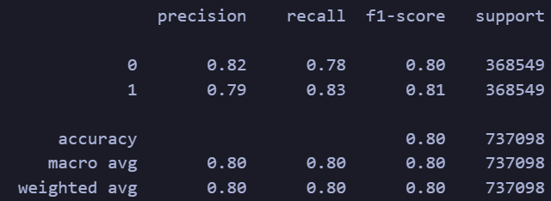
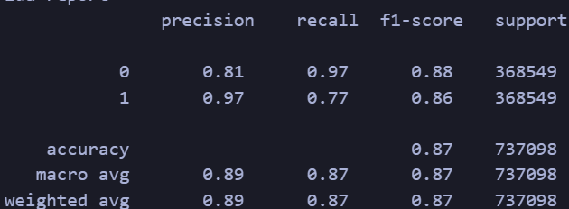

Dataset 2: Credit Card Transaction fraud Detection Dataset
Classification report:
KNN (K-Nearest Neighbors):
LDA (Linear Discriminant Analysis):
LR (Linear Regression):

Slide 19
REVIEW-02

Slide 20
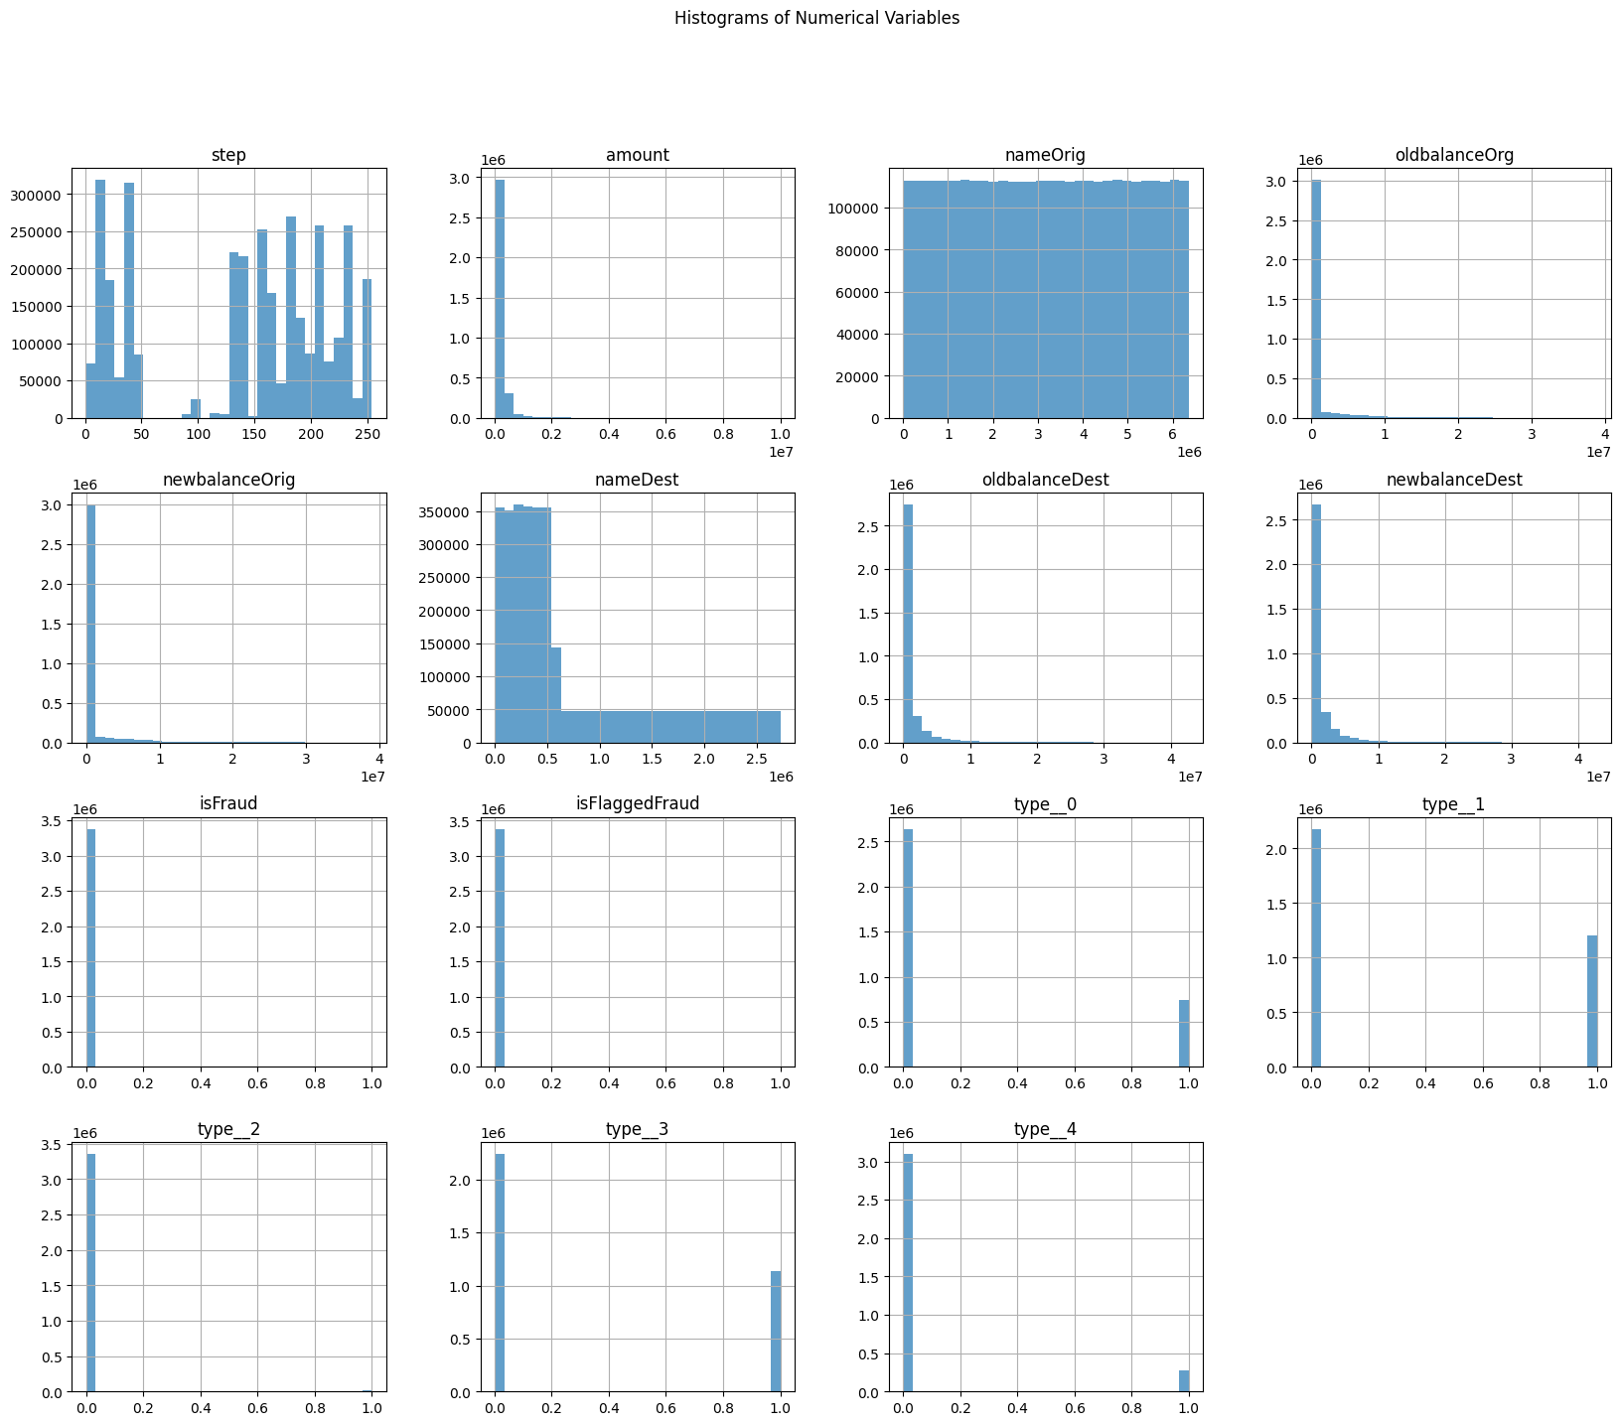
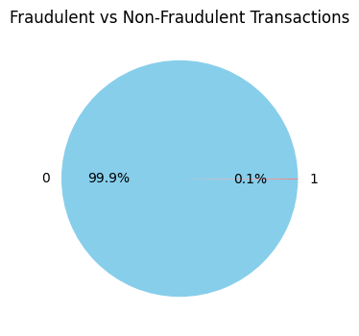
Dataset 1 : Synthetic Financial Datasets for Fraud Detection

Slide 21
Dataset 1 : Synthetic Financial Datasets for Fraud Detection

Slide 22
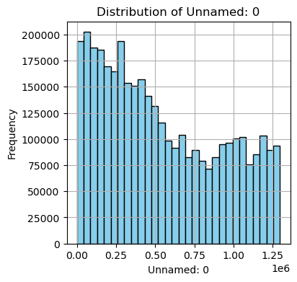
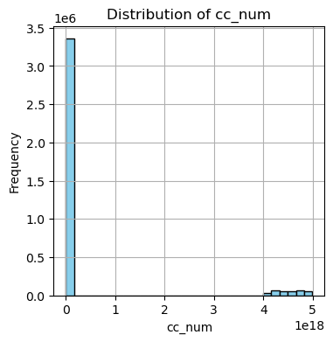
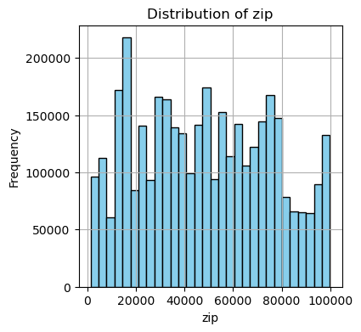
Dataset 2: Credit Card Transaction fraud Detection Dataset

Slide 23
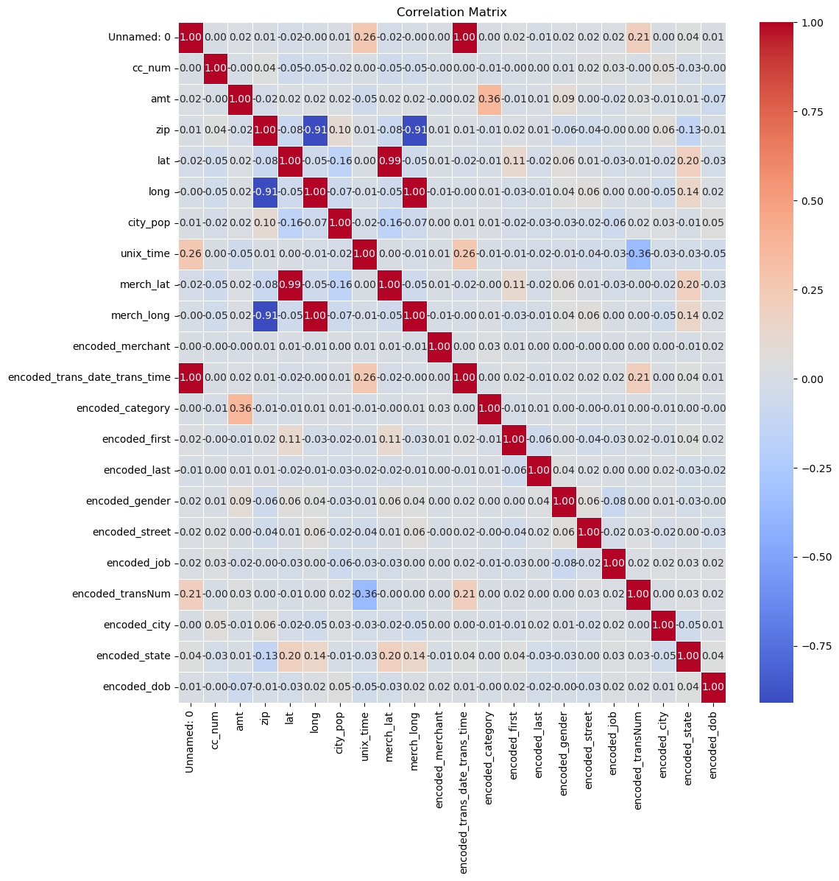
Dataset 2: Credit Card Transaction fraud Detection Dataset

Slide 24
Dataset 3: Credit Card Transaction fraud Detection Dataset
Data cleaning and Data preprocessing:
No missing values were found in the dataset .
Categorical columns gender”, “car”, “reality”, “income_type”, “education_type”, “house_type”, and “family_type were converted into numerical data.
Models used :
KNN (K-Nearest Neighbors), LDA (Linear Discriminant Analysis), and LR (Linear Regression) predictive models .
Training set and Test set :
Partitioned all datasets into training data (80%) and test data (20%) .
Employed Stratified K-Fold cross-validation with a fold value of 5 .

Slide 25
Dataset 3: Credit Card Transaction fraud Detection Dataset
Models used:
1.KNN ( K-Nearest Neighbors)
algorithm: "auto"
leaf size: 30
metric: "minkowski"
metric_params: "None"
n_jobs: -1
n_neighbors: 5
p: 2
weights: "uniform"
2.LDA (Linear Discriminant Analysis):
covariance_estimator: "None"
n_components: "None"
priors: "None"
shrinkage: "None"
solver: "svd"
store_covariance: "False"
tolerance: 0.0001f
3.LR (Linear Regression):
Default settings retained

Slide 26
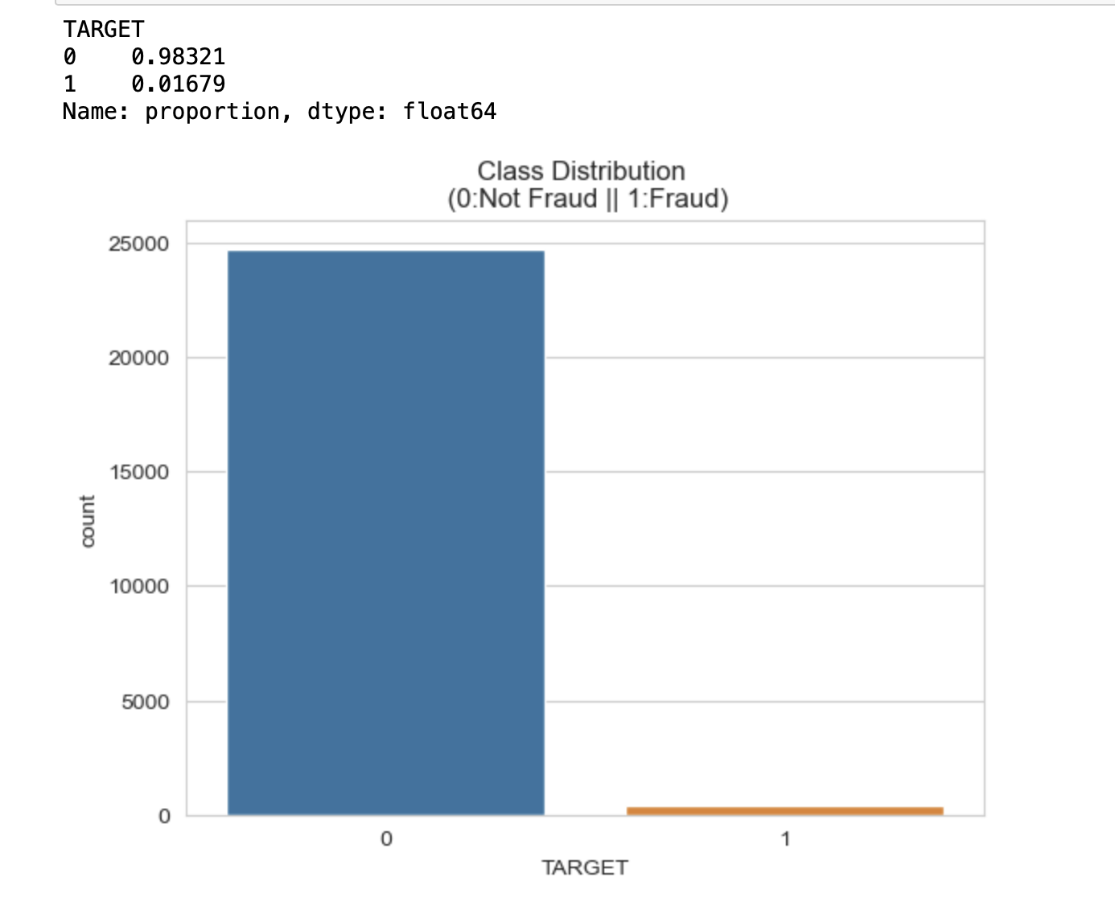
Dataset 3: Credit Card Transaction fraud Detection Dataset
Detailed Description about the dataset :
# | Column |  | Non-Null Count | Dtype
0 | Unnamed: |  | 25134 non-null | int64
1 | ID |  | 25134 non-null | int64
2 | GENDER |  | 25134 non-null | object
3 | CAR |  | 25134 non-null | object
4 | REALITY |  | 25134 non-null | object
5 | NO_OF_CHI |  | 25134 non-null | int64
6 | INCOME |  | 25134 non-null | float64
7 | INCOME_TY |  | 25134 non-null | object
8 | EDUCATION |  | 25134 non-null | object
9 | FAMILY_TY |  | 25134 non-null | object
10 | HOUSE_TYP |  | 25134 non-null | object
11 | FLAG_MOBI |  | 25134 non-null | int64
12 | WORK_PHON |  | 25134 non-null | int64
13 | PHONE |  | 25134 non-null | int64
14 | E_MAIL |  | 25134 non-null | int64
15 | FAMILY SI |  | 25134 non-null | float64
16 | BEGIN_MON |  | 25134 non-null | int64
17 | AGE |  | 25134 non-null | int64
18 | YEARS_EMP |  | 25134 non-null | int64
19 | TARGET |  | 25134 non-null | int64

Slide 27
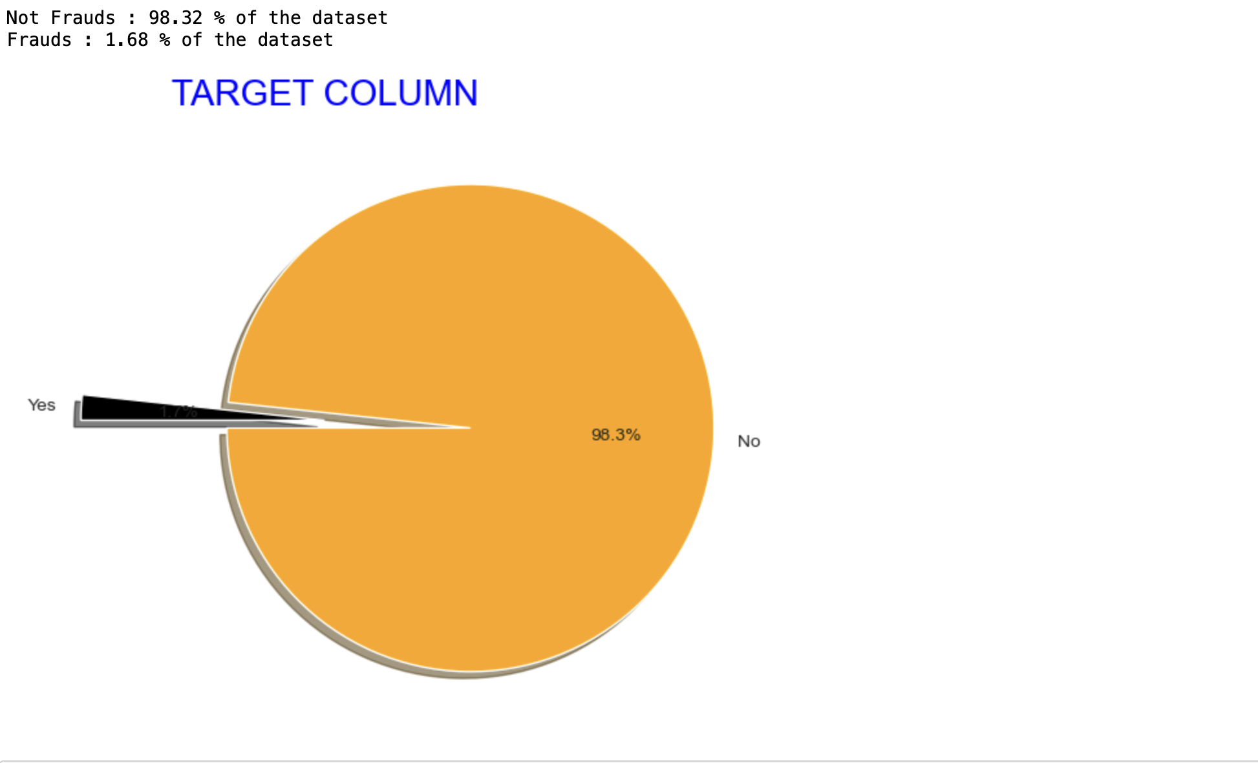
Dataset 3: Credit Card Transaction fraud Detection Dataset
Detailed Description about the dataset :
# | Column |  | Non-Null Count | Dtype
0 | Unnamed: |  | 25134 non-null | int64
1 | ID |  | 25134 non-null | int64
2 | GENDER |  | 25134 non-null | object
3 | CAR |  | 25134 non-null | object
4 | REALITY |  | 25134 non-null | object
5 | NO_OF_CHI |  | 25134 non-null | int64
6 | INCOME |  | 25134 non-null | float64
7 | INCOME_TY |  | 25134 non-null | object
8 | EDUCATION |  | 25134 non-null | object
9 | FAMILY_TY |  | 25134 non-null | object
10 | HOUSE_TYP |  | 25134 non-null | object
11 | FLAG_MOBI |  | 25134 non-null | int64
12 | WORK_PHON |  | 25134 non-null | int64
13 | PHONE |  | 25134 non-null | int64
14 | E_MAIL |  | 25134 non-null | int64
15 | FAMILY SI |  | 25134 non-null | float64
16 | BEGIN_MON |  | 25134 non-null | int64
17 | AGE |  | 25134 non-null | int64
18 | YEARS_EMP |  | 25134 non-null | int64
19 | TARGET |  | 25134 non-null | int64

Slide 28
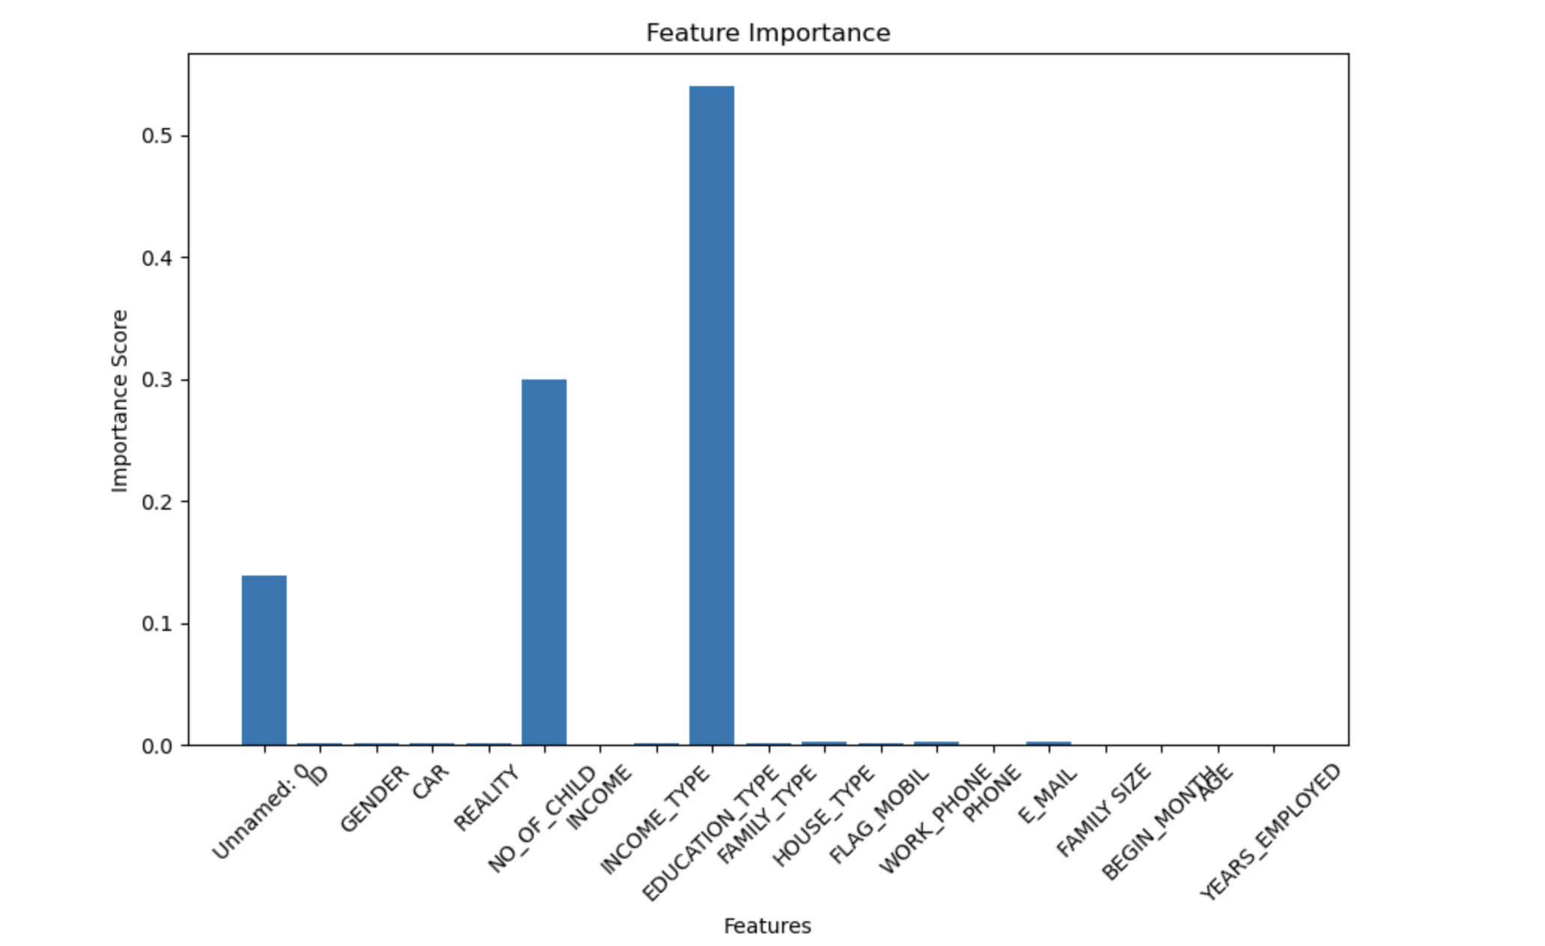
Dataset 3: Credit Card Transaction fraud Detection Dataset
Feature Importance :
EDUCATION_TYPE: 0.53974
NO_OF_CHILD: 0.30016
Unnamed: 0: 0.13839
E_MAIL: 0.0028
WORK_PHONE: 0.00224
HOUSE_TYPE: 0.0022
CAR: 0.00199
FAMILY_TYPE: 0.00191
GENDER: 0.00154
INCOME_TYPE: 0.00115
REALITY: 0.00109
ID: 0.00104
FLAG_MOBIL: 0.00102
FAMILY SIZE: 0.00092
YEARS_EMPLOYED: 0.00089
AGE: 0.00081
BEGIN_MONTH: 0.0008
PHONE: 0.00072
INCOME: 0.00058

Slide 29
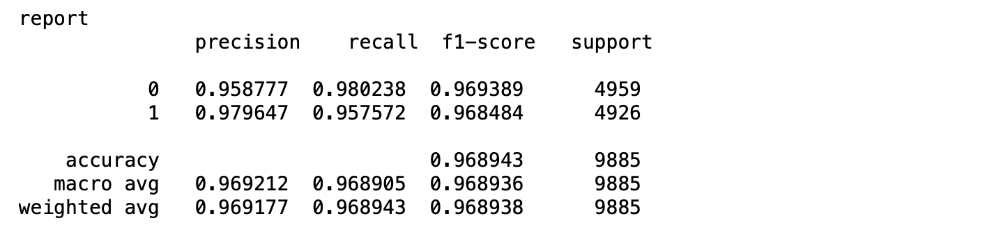
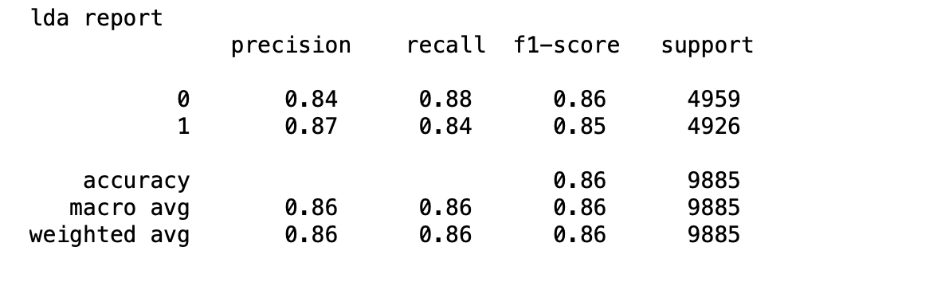

Dataset 3:Credit-card-Fraud Detection Imbalanced Dataset
Classification report:
KNN (K-Nearest Neighbors):
LDA (Linear Discriminant Analysis):
LR (Linear Regression):

Slide 30
Dataset 4: IEEE-CIS Fraud Detection
Data cleaning and Data preprocessing:
Exclude columns surpassing the median missing value.
Impute missing values for remaining columns using respective column medians.
Proportion of Fraud Cases:
Dataset's proportion of fraud cases stands at 3.5%.
Statistical analysis on missing values distribution:
Upper 25th percentile: 460,110 missing values
Median: 168,969 missing values
Lower 25th percentile: 1,269 missing values
Categorical Features - Transaction
ProductCD
card1 - card6
addr1, addr2
P_emaildomain
R_emaildomain
M1 - M9

Slide 31
Dataset 4: IEEE-CIS Fraud Detection
Models used :
KNN (K-Nearest Neighbors),
LDA (Linear Discriminant Analysis)
LR (Linear Regression) predictive models .
Training set and Test set :
Partitioned all datasets into training data (80%) and test data (20%) before feeding them into the algorithm.
Employed Stratified K-Fold cross-validation with a fold value of 5 to enhance the robustness of our methodology and maintain consistent model performance.

Slide 32
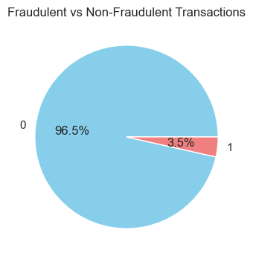
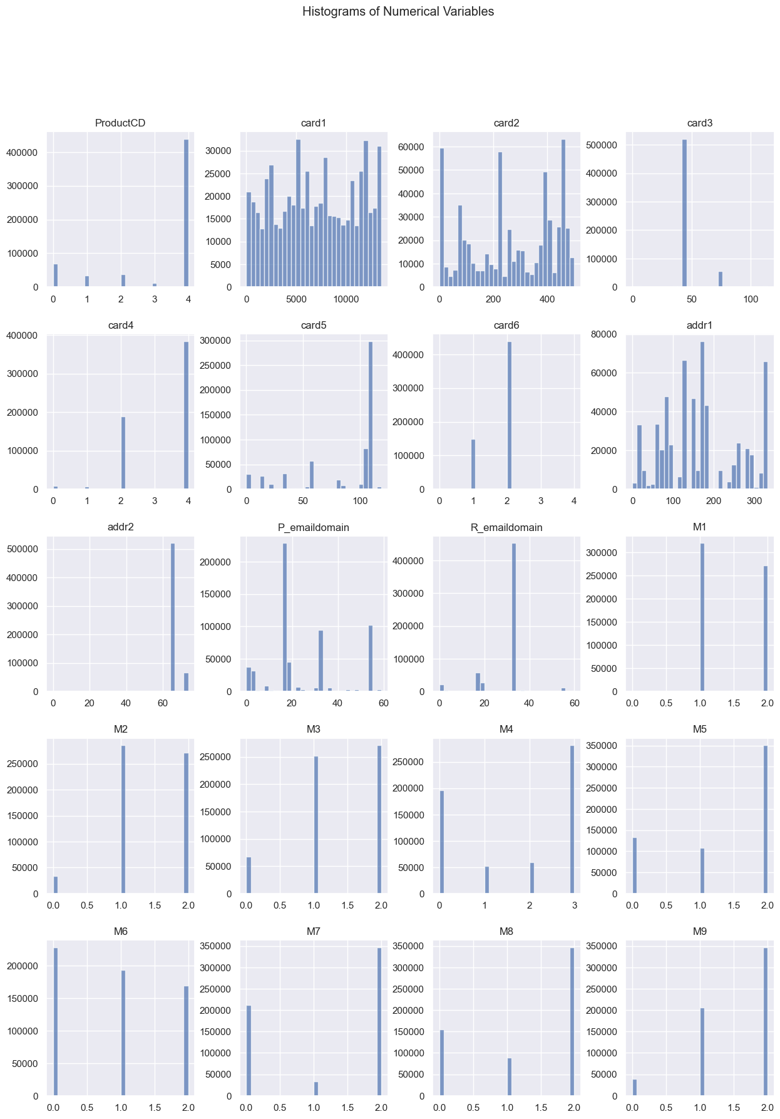
Dataset 4: IEEE-CIS Fraud Detection

Slide 33

Dataset 4: IEEE-CIS Fraud Detection

Slide 34
Dataset 4: IEEE-CIS Fraud Detection
Models used:
1.KNN ( K-Nearest Neighbors)
algorithm: "auto"
leaf size: 30
metric: "minkowski"
metric_params: "None"
n_jobs: -1
n_neighbors: 5
p: 2
weights: "uniform"
2.LDA (Linear Discriminant Analysis):
covariance_estimator: "None"
n_components: "None"
priors: "None"
shrinkage: "None"
solver: "svd"
store_covariance: "False"
tolerance: 0.0001f
3.LR (Linear Regression):
Default settings retained

Slide 35
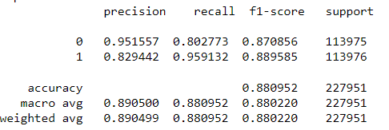
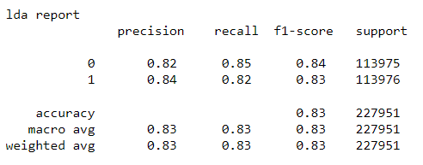

Dataset 4: IEEE_CISFraudDetection
Classification report:
KNN (K-Nearest Neighbors):
LDA (Linear Discriminant Analysis):
LR (Linear Regression):

Slide 36
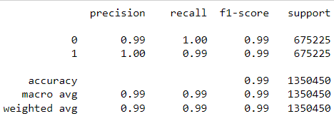

ALGORITHM CLASSIFICATION REPORT
DATASET-1

Slide 37
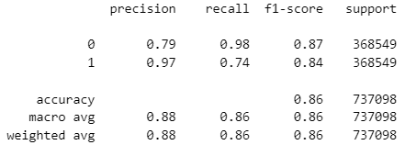

ALGORITHM CLASSIFICATION REPORT
DATASET-2

Slide 38
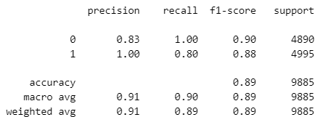

ALGORITHM CLASSIFICATION REPORT
DATASET-3

Slide 39
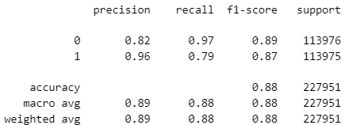

ALGORITHM CLASSIFICATION REPORT
DATASET-4

Slide 40
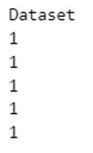
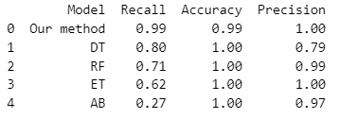

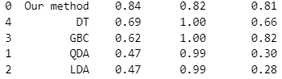
Comparison between models

Slide 41

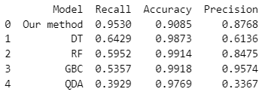

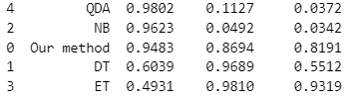
Comparison between models

Slide 42
NOVELTY
SMOTE (Synthetic Minority Over-sampling Technique)
To Address the Class Imbalance in datasets
New Algorithm
Input: PKNN = Predicted Value from KNN
PLDA = Predicted Value from LDA
PLR = Predicted Value from LR
Output: POR = Predicted Value from Algorithm
From i = 0 to length of Dataset
avg = (PKNN[i]+PLDA[i]+PLR[i])/3
if avg > threshold(0.43)
POR[i]=1
else POR[i] = 0

Slide 43
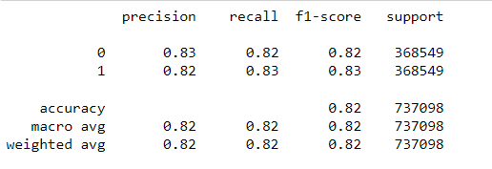

NOVELTY
RESULTS FROM THE NEW ALGORITHM:
DATASET-2

Slide 44
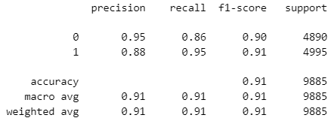

NOVELTY
RESULTS FROM THE NEW ALGORITHM:
DATASET-3

Slide 45
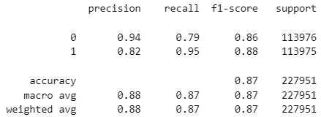

NOVELTY
RESULTS FROM THE NEW ALGORITHM:
DATASET-4

Slide 46
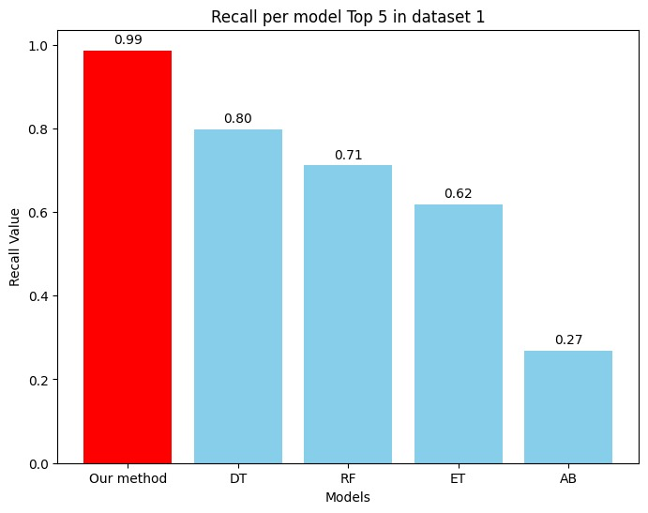
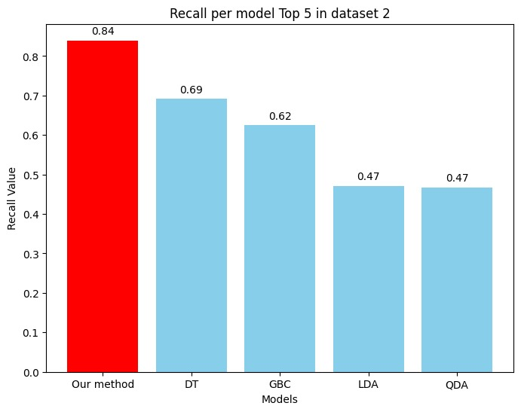
Comparison with other models

Slide 47
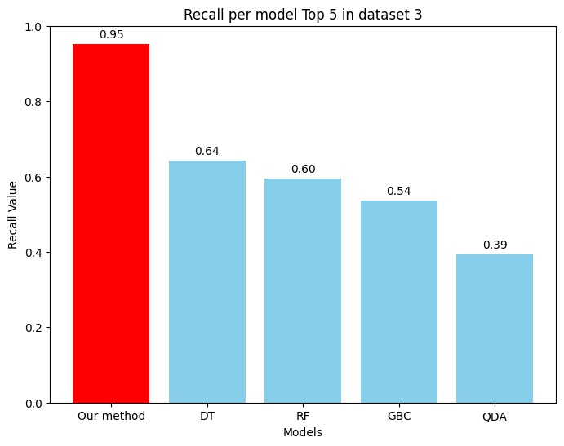
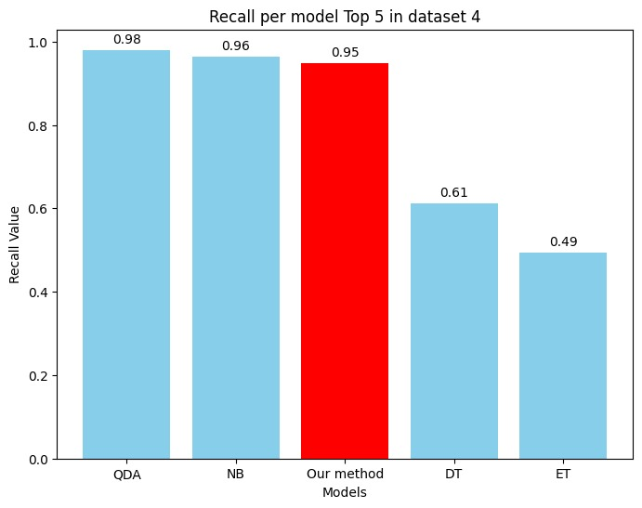
Comparison with other models

Slide 48
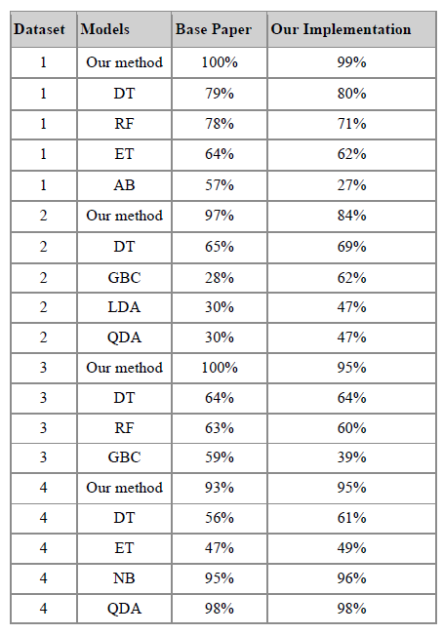
Our implementation and Base paper

Slide 49
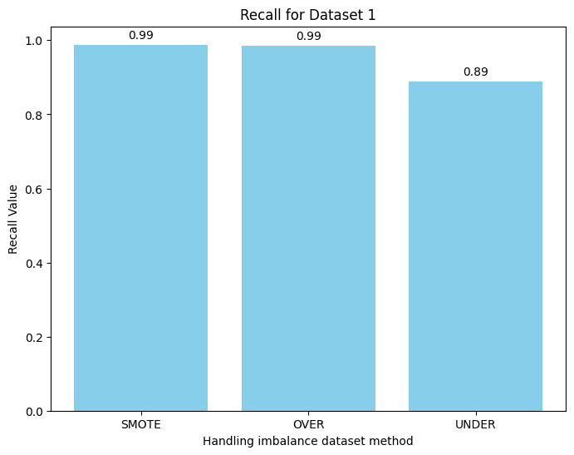
Why SMOTE

Slide 50
Hardware and Software Setup :
Central Processing Unit: Ryzen 5 4600h 3.0 GHz
Random Access Memory: DDR4 8.0 GB
JupyterNotebook
Pandas
Python 3.11
Scikit-learn

Slide 51
Thank You

