Slide 1
Contradictory Review Analysis for E-Commerce Feedback
38, Manas Mahajan
63, Rashmit Vartak
66, Ajay Nambiar

Slide 2
Table of Contents
Problem Statement
Project Workflow
Methodology
Proposed Solution
Result
Conclusion

Slide 3
Problem Statement
One of the significant challenges in Sentiment Analysis is the inconsistency often observed between textual reviews and numerical ratings. Users may express positive sentiments in their written reviews but assign lower star ratings, or vice versa. This discrepancy can arise due to subjective interpretation, cultural differences, contextual factors, or misuse of the rating system.
The impact of inconsistent reviews can be detrimental to businesses. Misguided product improvements, missed opportunities, and damaged reputation are some of the potential consequences. To address this challenge, it's essential to combine sentiment analysis with other factors, such as contextual analysis and user feedback mechanisms.

Slide 4
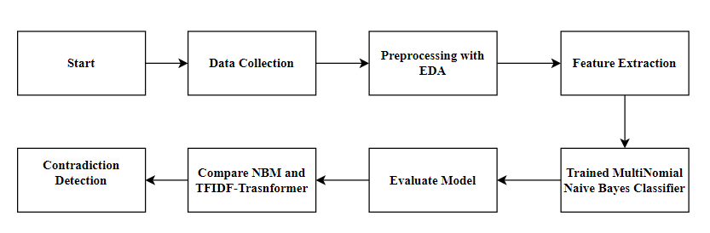
Workflow

Slide 5
Methodology:
TFIDF - Transformer Architecture:
Encoder-Decoder Structure: The Transformer architecture utilizes an encoder-decoder structure, where the encoder processes the input text and the decoder generates the output (sentiment label).
Attention Mechanism: The self-attention mechanism in Transformers allows the model to capture long-range dependencies and contextual information within the text.
Positional Encoding: To incorporate positional information, positional encoding is added to the input embeddings.

Slide 6
Naive Bayes Classifier:
Probabilistic Model: Naive Bayes is a probabilistic classifier that assumes independence between features.
Sentiment Classification: The model will be trained on a labeled dataset to learn the probabilities of words occurring in different sentiment classes.
Combination with Transformer: The output from the Transformer's decoder can be used as features for the Naive Bayes classifier, leveraging the Transformer's ability to capture contextual information.

Slide 7
Proposed Solution
This project aims to develop a sentiment analysis model capable of accurately classifying the sentiment of product reviews in multiple languages. The model will leverage the power of Transformer architectures, which have demonstrated exceptional performance in various NLP tasks, and combine them with the probabilistic approach of Naive Bayes for enhanced classification accuracy.

Slide 8
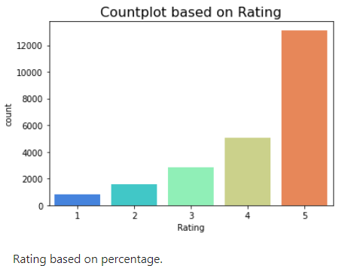
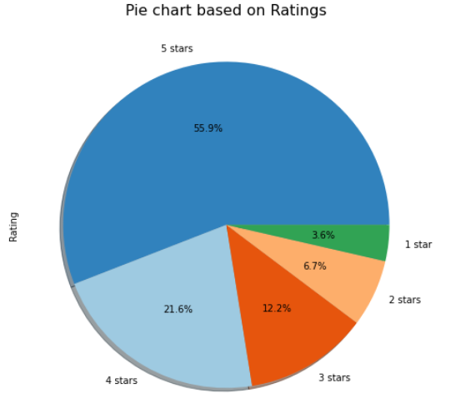
Dataset Link

Slide 9
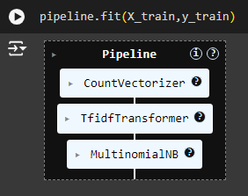
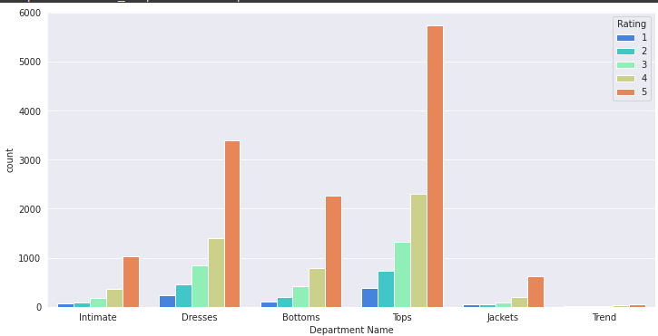

Slide 10
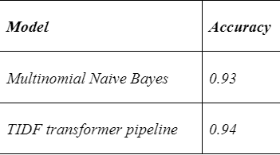
Results
•Contradictory Review Examples: Showcases instances where high sentiment scores contrast sharply with low star ratings, revealing inconsistencies.
•Impact on Consumer Behavior: Demonstrates how contradictory reviews influence consumer trust and buying decisions within the e-commerce context.

Slide 11
Conclusion
•Reinforcement of Key Insights: Contradictory review detection significantly shapes e-commerce strategies and enhances consumer trust through informed decision-making.
•Promoting Further Research: Exploration of advanced sentiment analysis methodologies will deepen understanding of nuance in customer reviews.
•Decision-Making Enhancement: Detecting sentiment discrepancies optimizes marketing and product strategies, ultimately influencing purchasing behavior positively.

