Slide 1


PYTHON MINIPROJECT
GROUP 9:
AUM KULKARNI -36
MANAS MAHAJAN-38
MRUNAL SHINDE-59

Slide 2

WORDLE GAME
Flex your word knowledge,
Description of Game
The game of wordle is a popular word guessing game.
Guessing a five-letter word initiates the game.
After each guess the game indicates whether the each letter is in the word, in the correct position or incorrect position.
This provides a clue as to the correct answer.
Six attempts are provided to the player to guess the right word.

Slide 3

IMPLEMENTATION
GAME LOGIC
1
Terminology:
The correct answer of the game is called 'secret word'
The term "secret word list" refers to a list of characters of the secret word.
The player's guess is known as the "guessed word."
The term "guessed word list" refers to a list of the characters of the guessed word.
A list containing the state of each letter is called 'state list'.
2
From a list of all 5 letter English words, a word will be randomly selected as the secret word.
.
3
The game's user interface will provide the guess word.

Slide 4
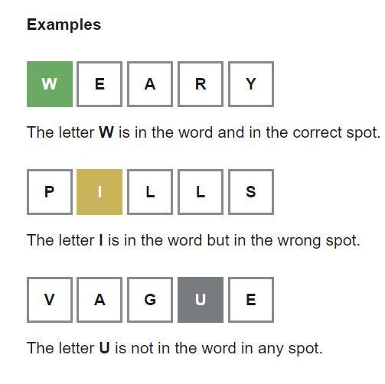
IMPLEMENTATION
4
If a letter from the guessed word:
is in the secret word and in the correct position, Then that position in the state list will receive a state of 2 (letter will be highlighted as green).
is in the word but in the incorrect position then that position in the state list will receive a state of 1 (letter will be indicated as yellow).
is not in the word , then that position in the state list will receive a state of 0 (letter will be indicated as grey).

Slide 5
IMPLEMENTATION
5
PYGAME:
It is a module which is used to create video games. It consists of computer graphics and sound libraries.
COLORAMA:
The colorama is one of the built in modules to display the text in different colours. The background or the foreground colours of the text and the style of the text can be changed by the module.

Slide 6

THANK YOU

