Slide 1
Project: “Feel Right @ Home”
Capstone Project
Mavi N. Polatoglu

Slide 2
Intro / Problem Definition Data Methodology Results Discussion Conclusion
Contents

Slide 3
Introduction
Target audience are graduate-level students and young professionals who are more likely to move.
Application uses venue information to compare neighborhoods seen from Foursquare.
The algorithm developed answers the question:
“Which neighborhood in Toronto is the most similar to the one I am living in right now (NYC, Fordham)?”.

Slide 4
Data
Data sources are Wikipedia and Foursquare.

Slide 5
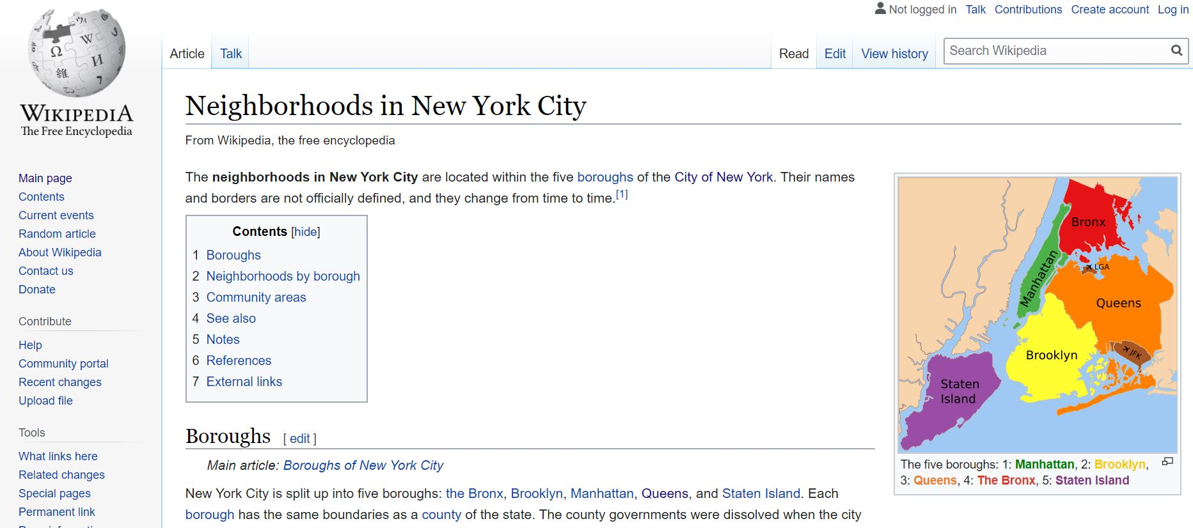
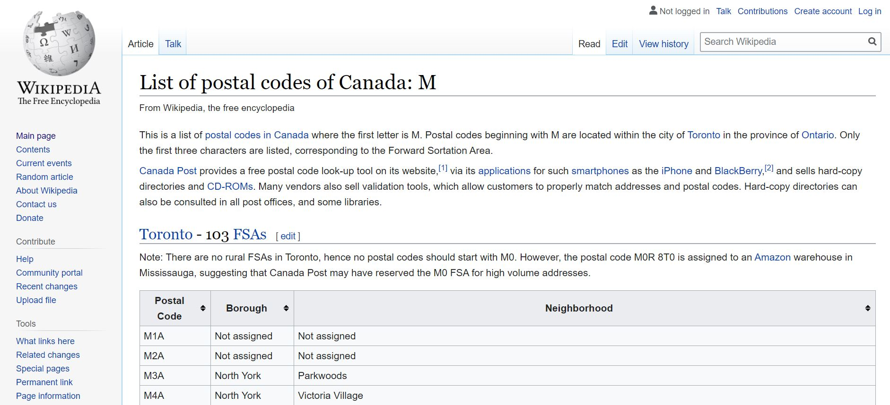
Data
The names of neighborhoods were scraped from Wikipedia pages. These names were used as geocodes for location information.
195 neighborhoods in Toronto were considered.

Slide 6
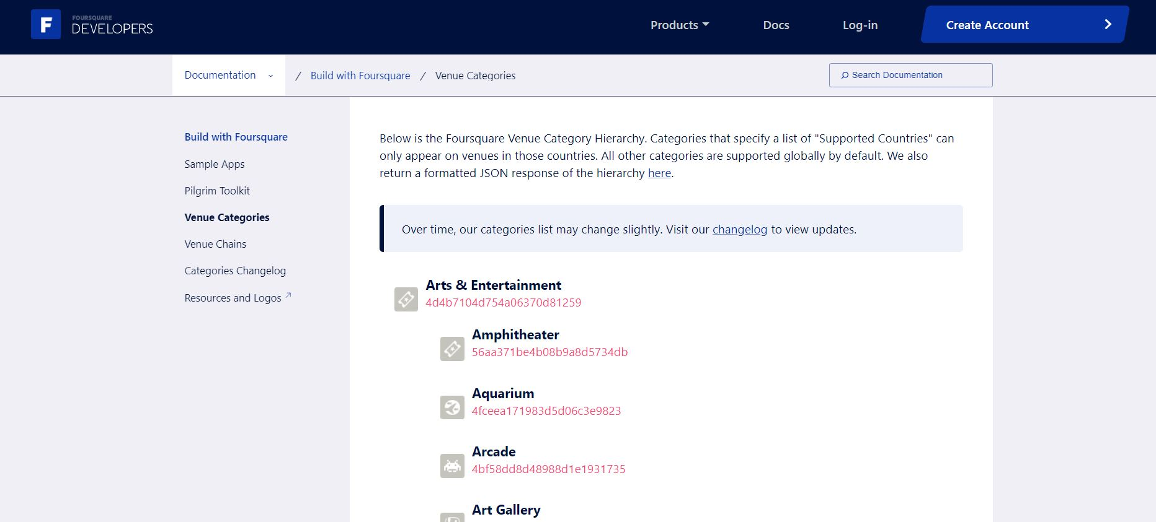
Data
Foursquare’s category endpoint was used to get different levels of category hierarchy.
The comparisons were done based on main-categories such as Arts&Entertainment instead of detailed venue categories such as Aquarium.

Slide 7
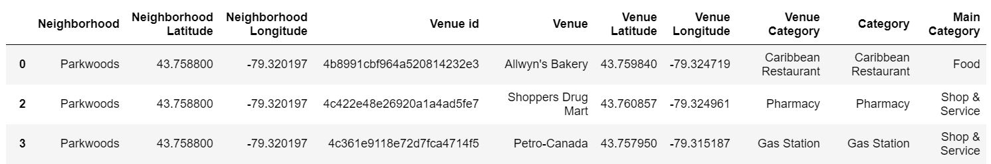
Data
After location data was added and main categories were matched, the dataframe looks like the below.
Figure 2: First three rows from a dataframe showing the collected data. This information exists for all neighborhoods of Toronto(city) and NYC, here seen is for 3 venues in Parkwoods, Toronto. Apart from the neighborhood name, each venue’s exact location and main category are listed.

Slide 8
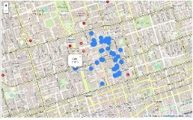
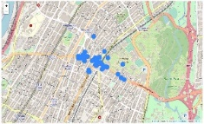
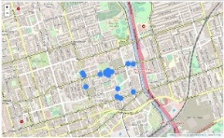
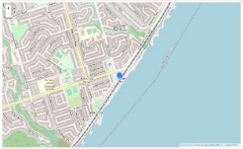
Methodology
Error{Fordham, Central Bay Street}
Error{Fordham, Regent Park}
Central Bay Street, Toronto
What needed developing was a type of numerical guide to “how similar” each pair is.
Fordham, NYC
Increasing Error
Less similarity
Error{Fordham, Others}
Regent Park, Toronto
Other neighborhoods in Toronto
Error{Fordham, Rogue Hill}
Rogue Hill, Toronto
Figure 3: Schematic explaining pairwise comparison. Each pair has an error value that calculates the dissimilarity between 2 neighborhoods depending on the venues extracted using Foursquare. Blue dots in small icons are the venues Foursquare returned.

Slide 9



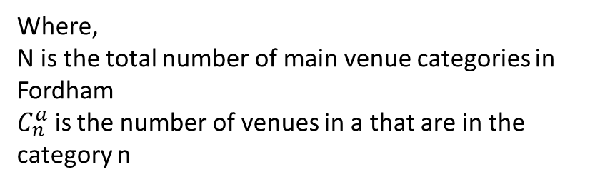
Methodology
The error is essentially a root-mean-squared error in multidimensions where each dimension is the venues’ main categories.
If category n, exists in both neighborhoods, the error contribution is the Euclidean distance between two points.
If category n, exists only in Fordham, the power of 3 applies a harsh penalty
If category n, exists only in neighborhood X, there is no contribution.
Final error is the summed contributions.
z
Where,
N is the total number of main venue categories in Fordham
$C_{n}^{a}$ is the number of venues in a that are in the category n

Slide 10
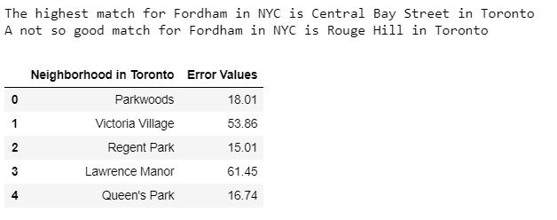
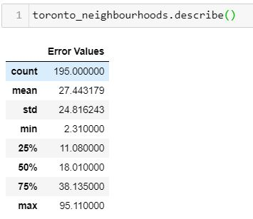
Results
There are as many error values as many candidate neighborhoods in Toronto.
(a)
(b)
Figure 4: (a) Printed output of the best and worst candidate neighborhood as well as head of the erro dataframe. (b) The errors described using the “describe” method.
Error for Central Bay Street is the lowest @ 2.31 : Best candidate!
Error for Rouge Hill Street is the highest @ 95.11

Slide 11
Discussion
Assumptions that could be shortcomings if the project expanded:
Venues are assumed to be distributed around the center of the neighborhood in a circular area.
50 venue per neighborhood was set as a limit.

Slide 12
Discussion
Future suggestions
Including police crime data in order to have safety as a dimension in neighborhood comparison.
Including housing prices in case the user would like to use it as a filter.
Customizing algorithm for people who have special needs e.g., closeness to dialysis center.

Slide 13
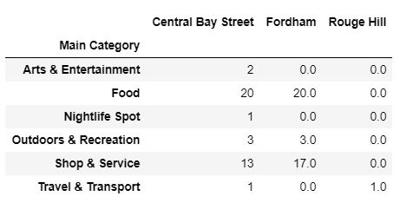
Conclusion
The algorithm successfully rated neighborhoods according to the venue similarities.
Figure 5: Central Bay Street, Fordham, and Rouge Hill compared according to venues.

