Slide 1
Journal Scribe – A Web Application
Mini Project Report by Shivam Gupta
Roll No.: 2324000398
GLA University, Mathura

Slide 2
Introduction
Motivation:
Modern users struggle to organize and access personal memories efficiently.
Privacy concerns and lack of customization in existing platforms inspired the creation of 'Journal Scribe'.
Overview:
A web application to create, manage, and revisit memories easily.
Features include uploading images, adding descriptions, editing, and deleting memories.

Slide 3
Project Objectives
Simplify memory management.
Ensure seamless CRUD operations.
Design for scalability with future features like authentication.
Prioritize user privacy and data control.

Slide 4
Software Requirements
Problem Definition:
Difficulty in managing and organizing personal memories.
Lack of privacy in social media platforms.
Tools and Technologies:
Backend: Java and Spring Boot
Frontend: HTML and CSS
Database: MySQL
Build Tool: Maven

Slide 5
Software Design
Key Components:
Data Flow Diagrams (Level 0 & Level 1)
UML Diagrams (Class Diagram, Use Case Diagram)
Database Design: MySQL with efficient schema for memory management.

Slide 6
Implementation Highlights
Robust backend with Spring Boot.
Responsive frontend using HTML and CSS.
Image upload and storage with secure handling.
REST APIs for seamless CRUD operations.

Slide 7
Testing
Black Box Testing:
Validate functionality for creating, editing, viewing, and deleting memories.
White Box Testing:
Ensure data validation and error handling.
Test database queries for efficiency and accuracy.

Slide 8
Conclusion
'Journal Scribe' offers a user-friendly platform for personal memory management.
Addresses privacy concerns and ensures efficient CRUD operations.
Future scope includes user authentication, multi-user collaboration, and cloud integration.

Slide 9
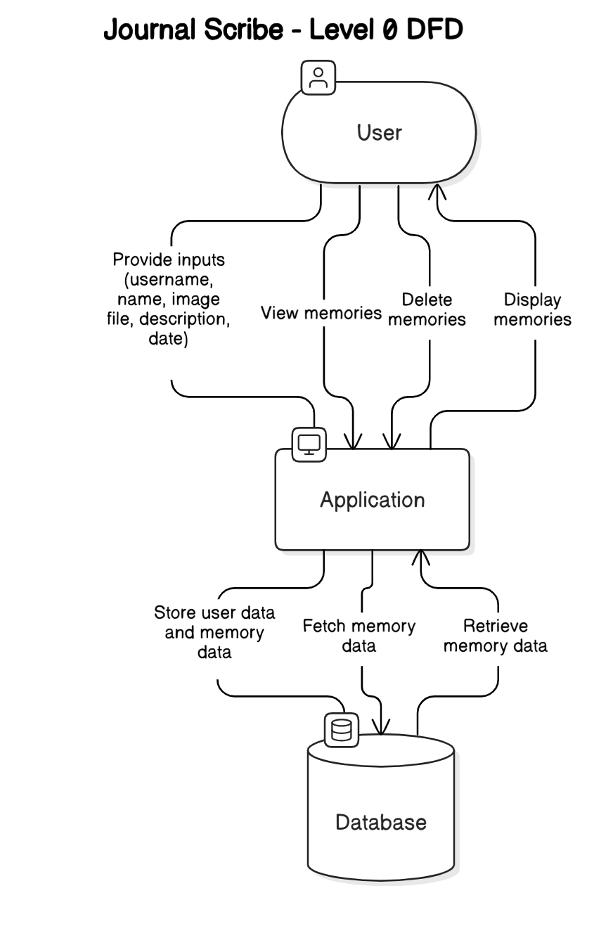
Data Flow Diagrams (Level 0)
Represents user interaction with the
application and database.
Simplifies high-level processes of memory
management.

Slide 10
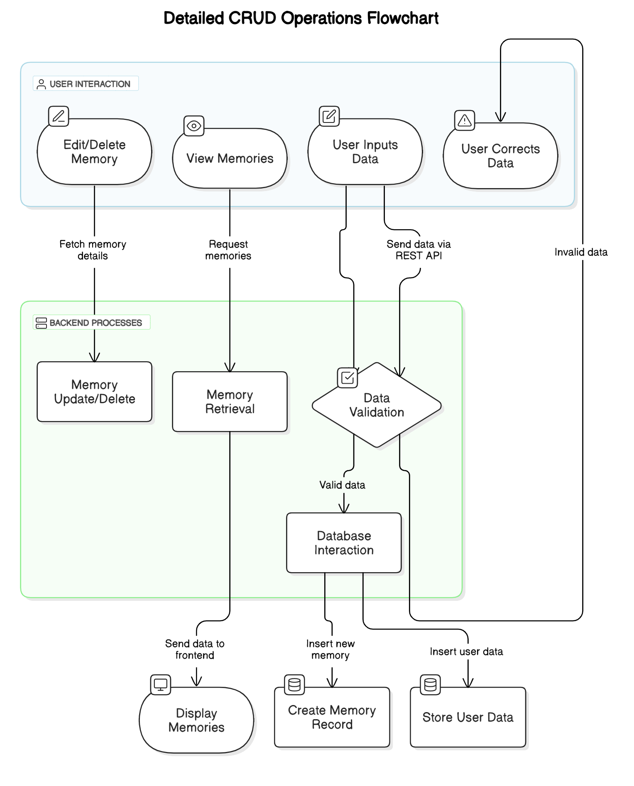
Data Flow Diagrams (Level 1)
Details CRUD operations:
Create, Read, Update, and Delete.

Slide 11
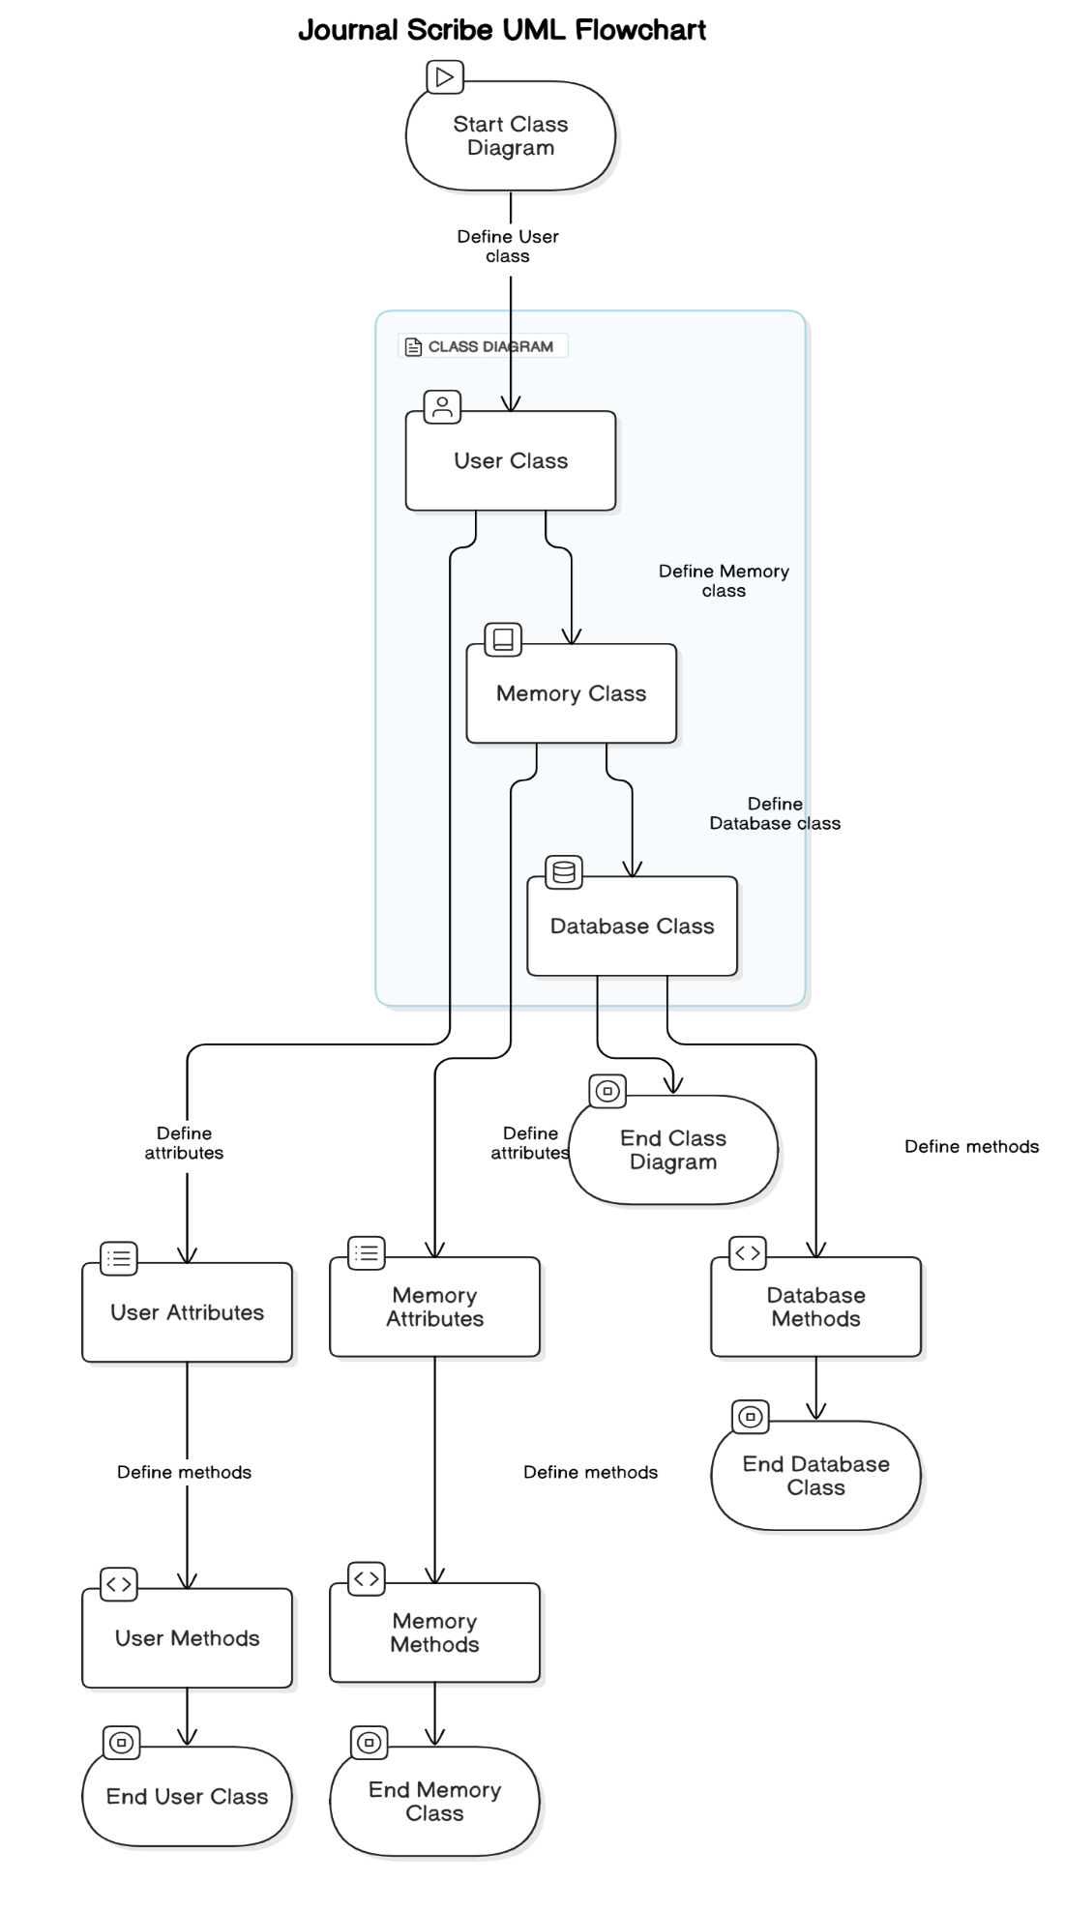
UML Design
Class Diagram:
Depicts relationships between
User, Memory, and Database.

Slide 12
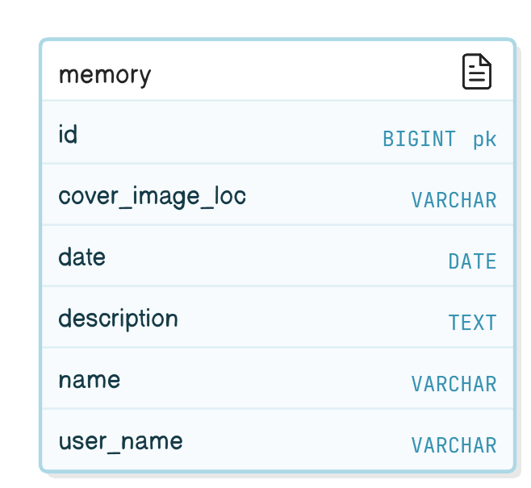
Database Design
Central table: Memory table
Attributes: ID, Image Path,
Date, Description, Name, Username.
Optimized for efficient memory
retrieval and management.

Slide 13
User Interface Highlights
Key Features:
Add Memory Form
Memory Gallery with view, edit and delete options.
Responsive design for various devices.

Slide 14
Implementation Challenges
Ensuring secure image upload and storage.
Validating user inputs effectively.
Optimizing database queries for large datasets.

Slide 15
Future Scope
Implementing user authentication.
Adding multi-user collaboration.
Integrating cloud storage for scalability.

Slide 16
Acknowledgements
Special Thanks:
Project Guide: Prof. Aditya Tiwari
Faculty Members of GLA University
Friends and peers for their support.

