Slide 1
Convolutional Neural Network

Slide 2
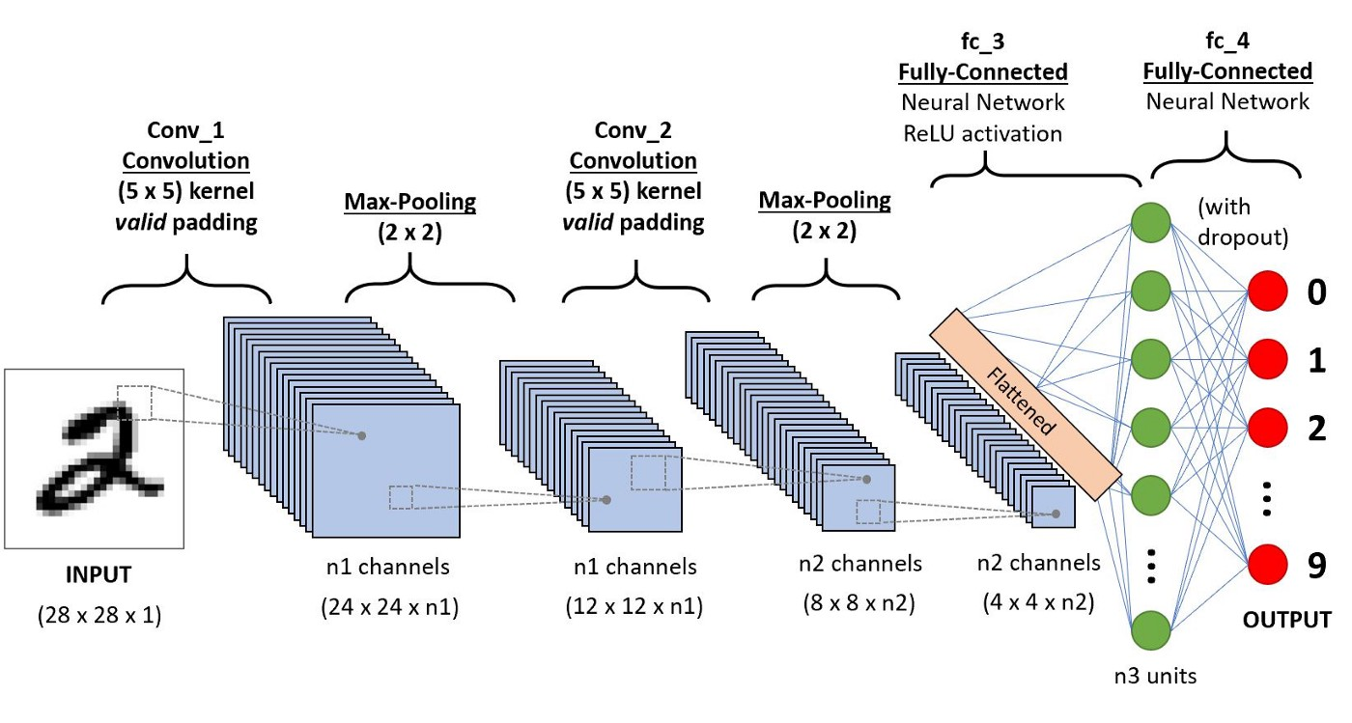
Introduction
Convolutional Neural Network (CNN) is a type of deep learning algorithm.
It is designed to process and analyze visual data, such as images and videos.
CNNs have revolutionized computer vision tasks, achieving state-of-the-art performance.

Slide 3
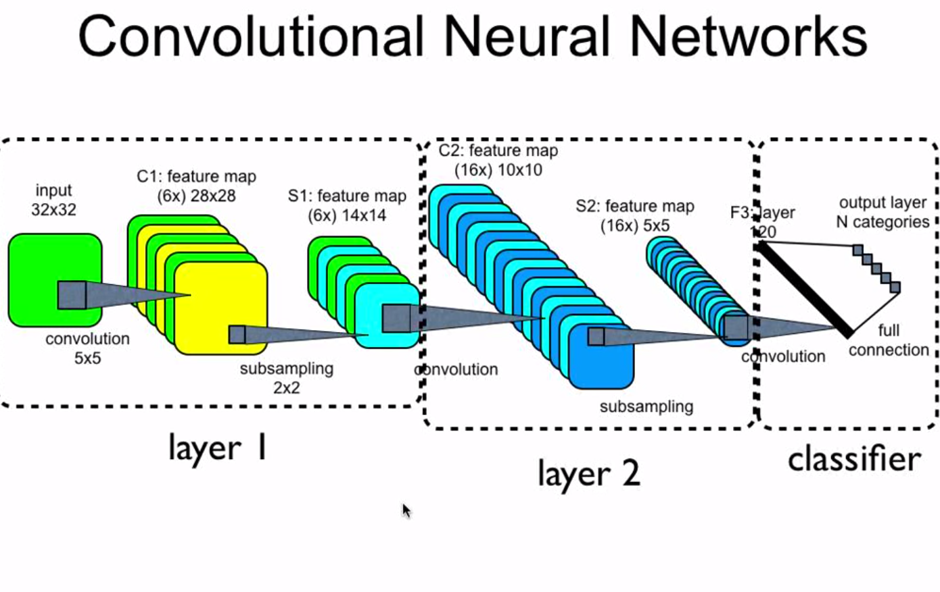
Basic Structure
A CNN consists of three main types of layers: convolutional, pooling, and fully connected layers.
Convolutional layers perform feature extraction by convolving filters over the input data.
Pooling layers reduce the spatial dimensions of the feature maps, helping to capture important information.

Slide 4
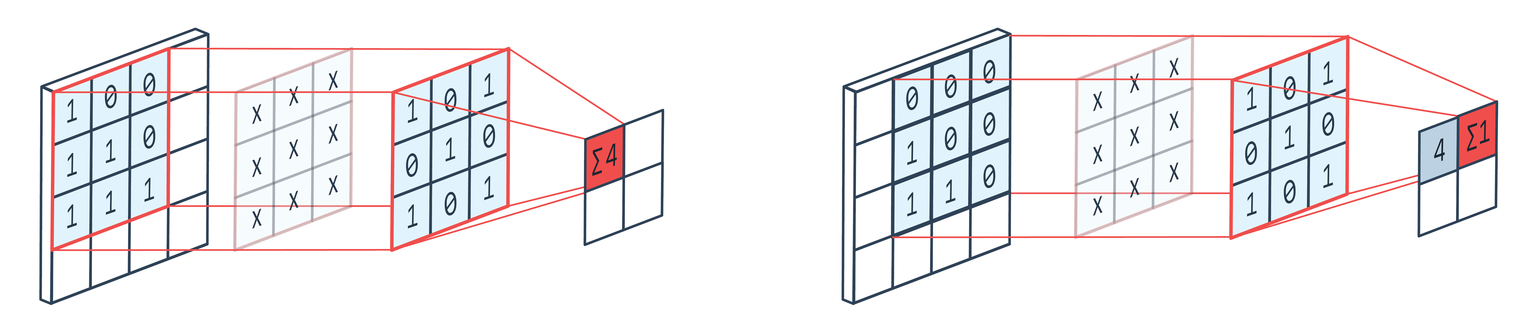
Convolutional Layer
Convolutional layers apply filters to input data, extracting relevant features.
Each filter detects a specific pattern or feature in the data.
Multiple filters are used to capture different features simultaneously.

Slide 5
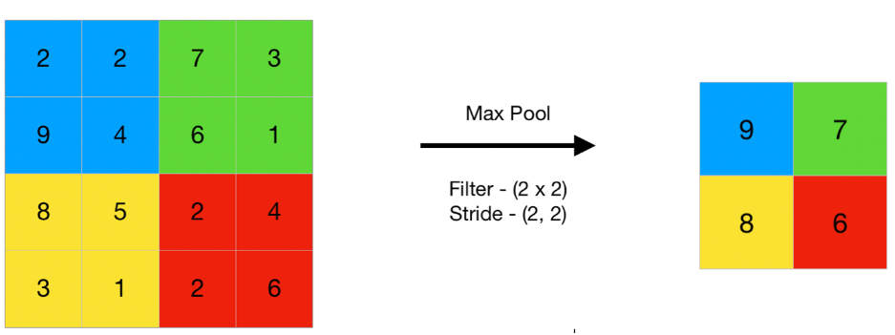
Pooling Layer
Pooling layers reduce the spatial size of the feature maps.
Common pooling operations include max pooling and average pooling.
Pooling helps to make the network more robust to image translations and reduces computational complexity.

Slide 6
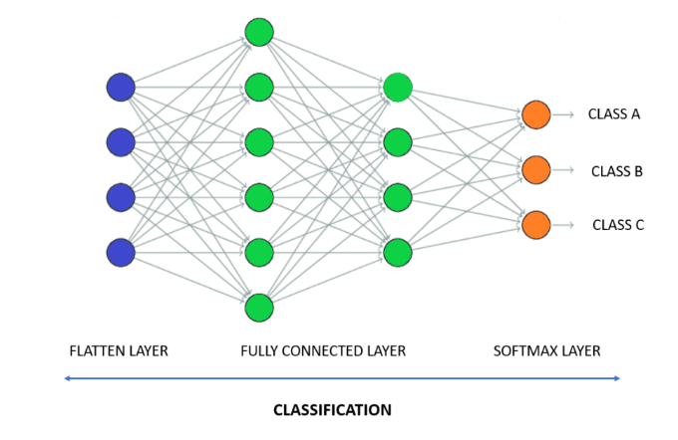
Fully Connected Layer
Fully connected layers are traditional neural network layers.
They take the output of the previous layers and perform classification or regression tasks.
These layers enable the network to make predictions based on learned features.

Slide 7
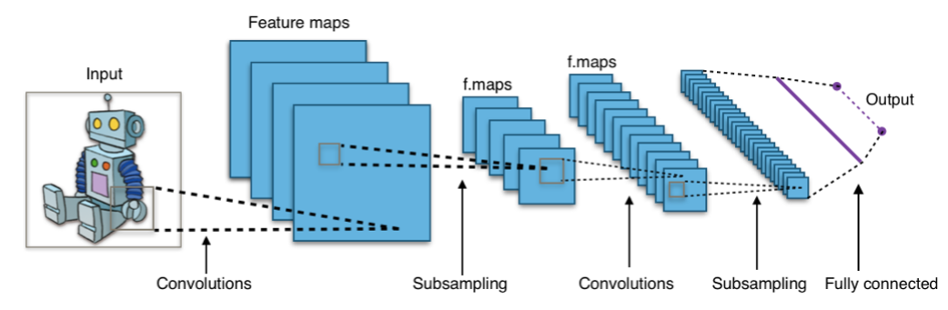
Training a CNN
CNNs are trained using a large labeled dataset.
The network learns the optimal weights and biases through backpropagation and gradient descent.
The loss function measures the difference between predicted and actual values, guiding the learning process.

Slide 8
Applications of CNNs
CNNs have broad applications in computer vision tasks.
They are used for image classification, object detection, and segmentation.
CNNs also excel in facial recognition, medical image analysis, and self-driving cars.

Slide 9
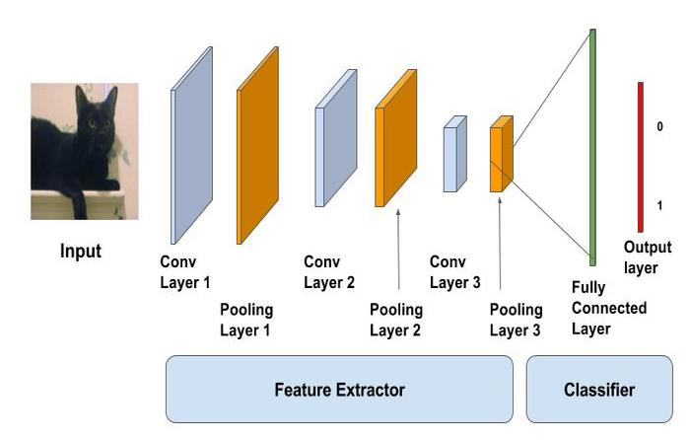
Image Classification
CNNs can classify images into different categories.
They learn to recognize patterns and features, making them suitable for image classification tasks.
ImageNet, a large-scale dataset, has been widely used to evaluate CNN models.

Slide 10
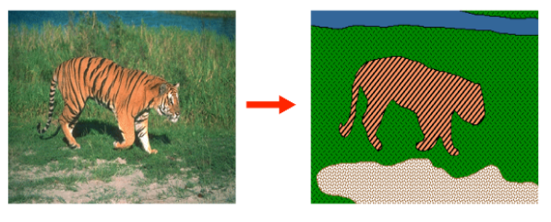
Image Segmentation
CNNs can perform pixel-level segmentation, separating different objects within an image.
They assign a class label to each pixel, enabling precise object localization.
Image segmentation is vital in medical imaging and autonomous navigation.

Slide 11
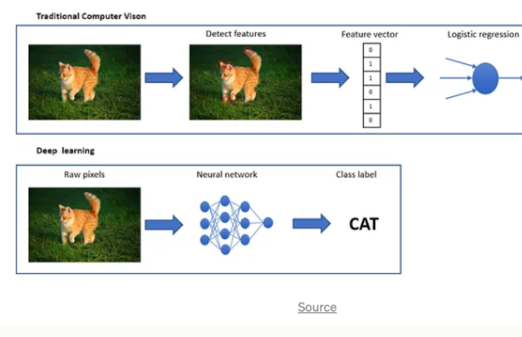
Facial Recognition
CNNs excel in facial recognition tasks.
They can learn facial features and identify individuals from images or videos.
Facial recognition has applications in security systems, access control, and social media.

Slide 12
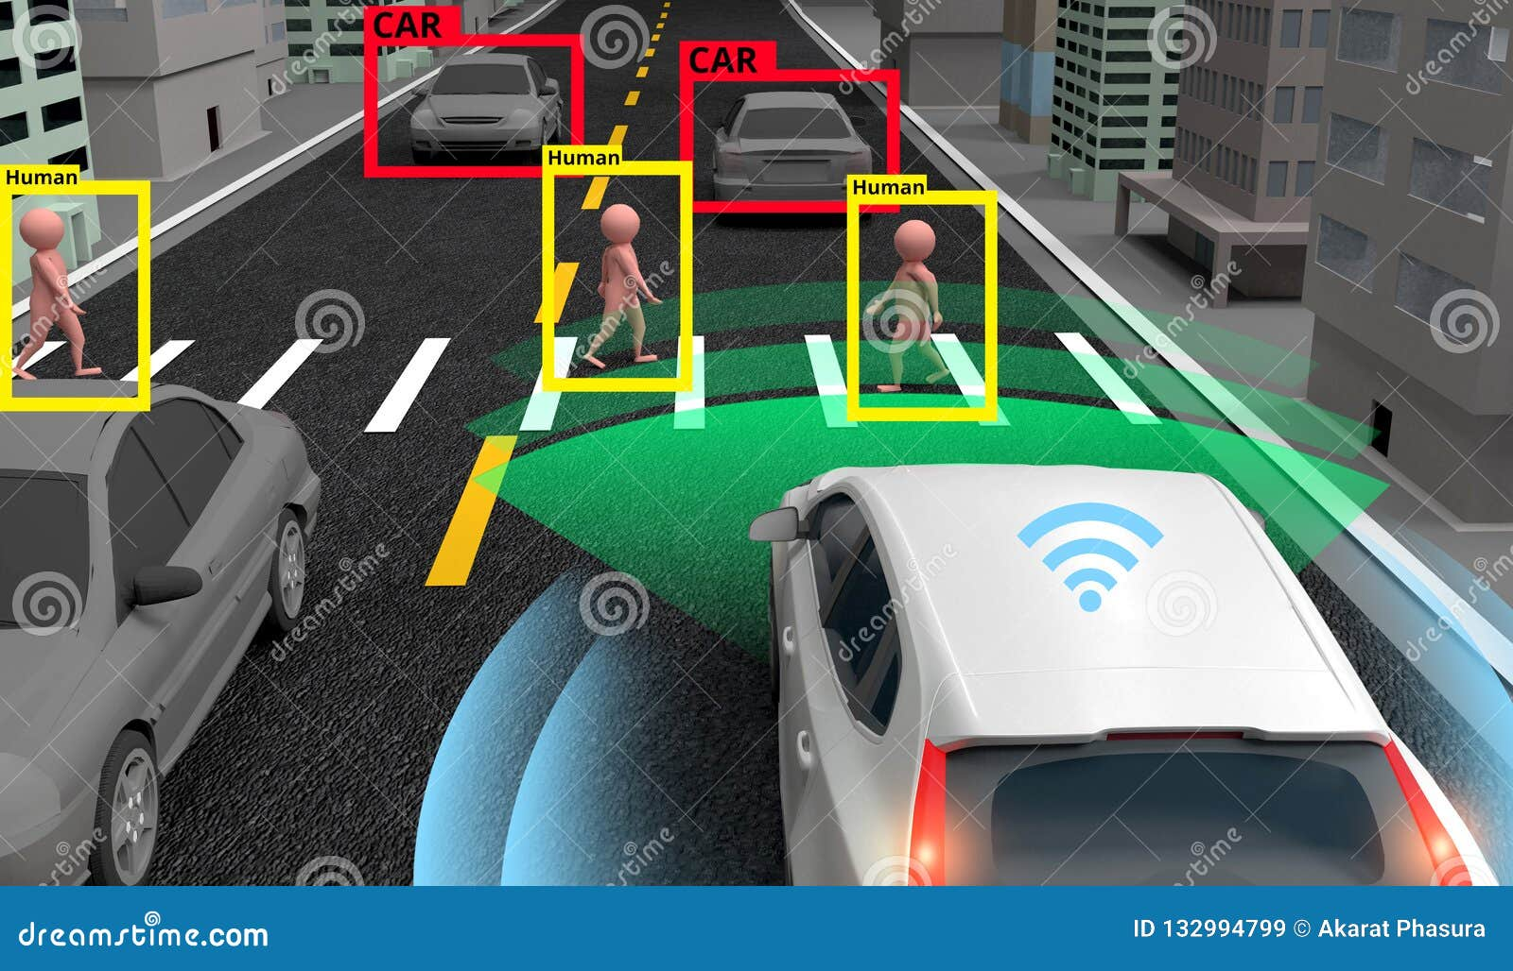
Self-Driving Cars
CNNs play a crucial role in enabling autonomous vehicles.
They can identify objects, pedestrians, and road signs for safe navigation.
CNNs help self-driving cars perceive the environment and make real-time decisions.

Slide 13
Advantages of CNNs
Good at detecting patterns and features in images, videos, and audio signals
Robust to translation, rotation, and scaling invariance
End-to-end training, no need for manual feature extraction.
Can handle large amounts of data and achieve high accuracy

Slide 14
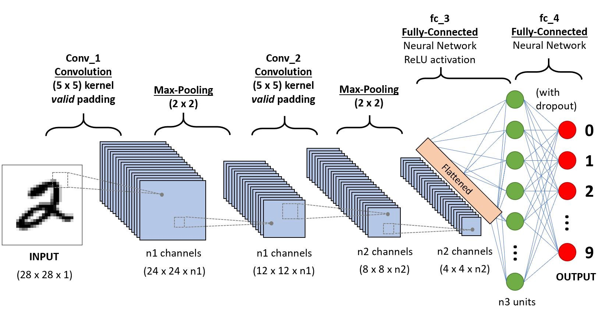
Conclusion
Convolutional Neural Networks have revolutionized computer vision tasks.
They excel in image classification, object detection, and segmentation.
CNNs will continue to drive advancements in various industries, from healthcare to autonomous vehicles.

Slide 15


