Slide 1
STOCK PRICE
PREDICTION
BY:
Aryaman Tyagi (2029049)
Himanshu Maski (2029057)
Ayush Das (2029051)
Prakhar Bhardwaj (2029063)

Slide 2
Basic Concepts
Importance of Predicting Stock Prices:
Informed Decision-Making:
Accurate stock price predictions enable investors and traders to make well-informed decisions.
Risk Management:
Understanding the future direction of stock prices helps in assessing and managing risks effectively.
Market Trends Analysis:
By forecasting stock prices, analysts gain insights into broader market trends. This information is valuable for anticipating shifts in investor sentiment and market dynamics.
Investor Confidence:
Reliable predictions enhance investor confidence in financial markets. Confidence, in turn, fosters a healthy and robust investment environment.

Slide 3
Progress of Stock Price Prediction
Traditional Methods:
Historically, stock price prediction relied on traditional financial models such as moving averages, trend analysis, and technical indicators. While these methods provided insights, they often struggled to capture the complexity of market dynamics.
Introduction of Machine Learning:
The advent of machine learning (ML) revolutionized stock price prediction. Algorithms, particularly regression models, were employed to analyze historical data and identify patterns. This shift allowed for more sophisticated analysis and improved prediction accuracy.
Time Series Analysis:
Time series analysis gained prominence in stock price prediction, acknowledging the temporal nature of financial data. Models like ARIMA (AutoRegressive Integrated Moving Average) and more advanced variations helped capture trends and seasonality in stock prices.

Slide 4
Time Series Model
Wide-Sense Stationary Time Series (WSS):
Definition:
A time series is said to be wide-sense stationary if its mean, variance, and autocorrelation are constant over time, but not necessarily higher-order moments.
Note:
Wide-sense stationary allows for some flexibility in the distribution of the data, accommodating situations where higher-order moments may change.
Strictly Stationary Time Series:
Definition:
A time series is strictly stationary (or simply stationary) if the joint distribution of any set of k random variables from the series is the same as the joint distribution of the same set of k random variables at any other point in time. In other words, the entire distribution of the process is time-invariant.
Implication:
Strict stationarity is a more restrictive condition than wide-sense stationarity, requiring the entire distribution of the process to be invariant over time.

Slide 5
Transforming Data
For transforming data we have used log transformation.
Transformation of data helps stabilize the variance over time, making the data more stationary.
Log-transformed returns tend to be more normally distributed, which simplifies the application of statistical techniques that assume normality.
Logarithmic transformation can make the data more amenable to various statistical techniques and tests.
Log-transforming can help smooth out extreme values or outliers in the data.

Slide 6
Autocorrelation Function
AutoCorrelation Function are tools used in time series analysis to understand and identify patterns and relationships in the data.
The ACF measures the correlation between a time series and its lagged values.
ACF is calculated for multiple lag values and the resulting values are plotted to form the ACF plot.
If the ACF at lag k is high, it indicates a strong autocorrelation between the data points k time units apart.
If the ACF at lag k is close to zero, it suggests a weak or no autocorrelation at that lag.

Slide 7
Partial AutoCorrelation Function
Partial AutoCorrelation Function are tools used in time series analysis to examine the autocorrelation structure of a time series.
PACF measures the correlation between a data point and its lagged values, excluding the contributions of the intermediate lags.
PACF helps identify the direct relationship between a data point and its earlier observations.
PACF is also calculated for multiple lag values, and the results are plotted to form the PACF plot.
A non-zero PACF at lag k suggests a direct correlation between the data point and its value k time units ago.
A PACF close to zero at lag k indicates that there is no direct correlation between the data point and its value k time units ago.

Slide 8
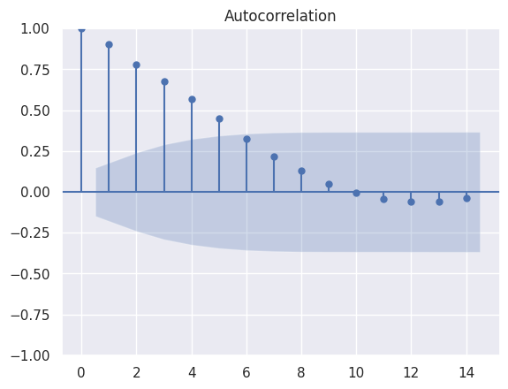
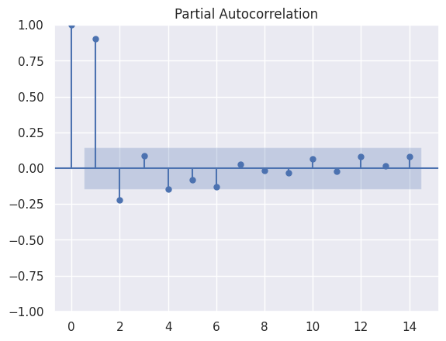

Slide 9
Model Performance
Sample Splitting
We divided the dataset into two subsets - a training set used to train the model and a testing set for assessing its performance.
We ensured randomization in the sample splitting process to avoid introducing bias and maintain the representativeness of both sets.
We considered an appropriate split ratio, such as 80% for training and 20% for testing, to strike a balance between model learning and evaluation.
Forecast Accuracy
We have MSE for models accuracy
Mean Squared Error (MSE): Measures the average of the squared differences between predicted and actual values. Penalizes larger errors more heavily.

Slide 10
Model Performance
Confidence Interval:
We calculated the confidence interval to measure the uncertainty of the model's predictions.
We computed prediction intervals around the model's point predictions to quantify the range of potential outcomes.
Combining sample splitting, forecast accuracy metrics, and confidence intervals provides a holistic evaluation of the model's performance.

Slide 11
Akaike Information Criterion &
Bayesian Information Criterion
AIC (Akaike Information Criterion) and BIC (Bayesian Information Criterion) are statistical measures used in model selection, particularly in the context of linear regression and other statistical models.
AIC is an information-theoretic criterion that measures the goodness of fit of a statistical model while penalizing for its complexity.
AIC=−2⋅ln(L’)+2⋅k
Lower AIC values indicate a better trade-off between fit and complexity.
BIC is another information criterion for model selection. It adds a stronger penalty for model complexity than AIC.
BIC=−2⋅ln(L')+k⋅ln(n)
BIC is particularly useful when the sample size is relatively large.

Slide 12
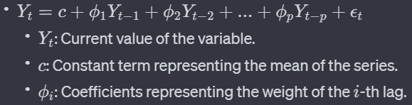
AR Model
The Autoregressive (AR) model is a time series analysis model that expresses a variable in terms of its own past values.
The order p determines how many past values influence the current value.
Higher-order models (p>1) capture more complex patterns but may also introduce more parameters.

Slide 13
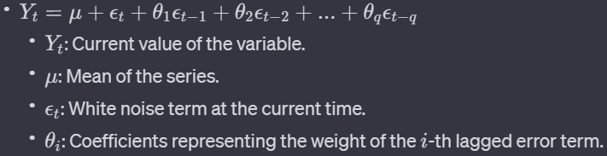
MA Model
The Moving Average (MA) model is a time series analysis model that explains a variable by a linear combination of past white noise terms (error terms).
The order q determines how many past error terms influence the current value.
The model is very sensitive to the order of the model i.e the value of q.

Slide 14
AR V/S MA Model
AR Model
Uses past values of the variable itself to make predictions.
Expresses the current value as a linear combination of its own past values.
Captures patterns and dependencies based on historical observations.
Effective for forecasting when historical patterns and dependencies are crucial.
MA Model
Utilizes past white noise terms (errors) for predictions.
Represents the current value as a linear combination of past error terms.
Focuses on capturing short-term fluctuations and unexpected shocks.
Suitable for capturing sudden shocks or irregular fluctuations in data.

Slide 15

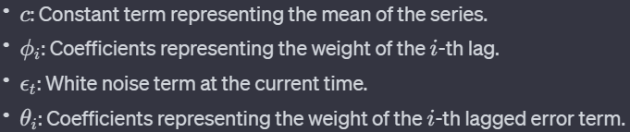
ARMA Model
The Autoregressive Moving Average (ARMA) model combines elements of both AR and MA models to provide a more comprehensive framework for time series analysis.
AR Component : Captures patterns and dependencies based on past values of the variable.Captures patterns and dependencies based on past values of the variable.
MA Component : Accounts for short-term fluctuations and unexpected shocks.Utilizes q lagged error terms

Slide 16
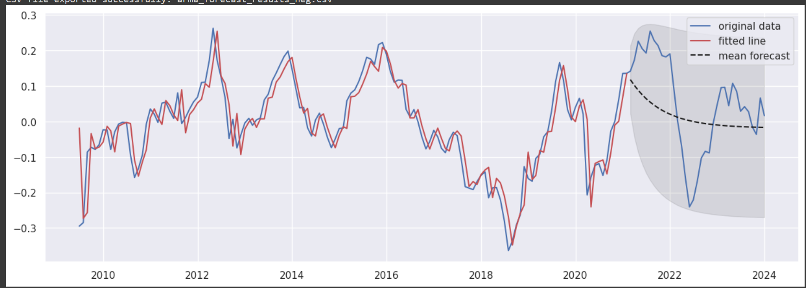
Output ARMA Forecasted Mean

Slide 17
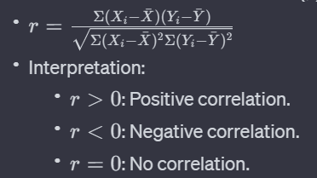
Correlation Analysis
To assess the relationship between the stock prices of Company A and Company B using correlation analysis.

Slide 18
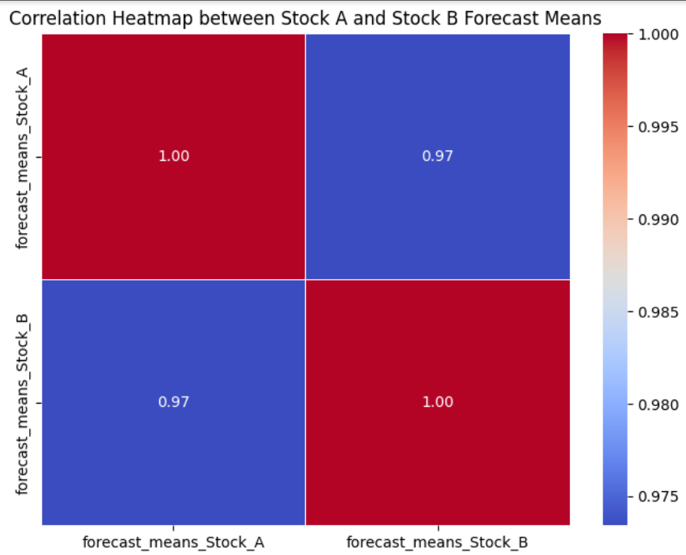

Slide 19
CONCLUSION
In concluding the project on "Stock Price Prediction using Machine Learning," we have successfully navigated the intricate landscape of financial data by leveraging advanced technologies, with a specific focus on time series analysis and ARIMA models. Our journey involved meticulous data preprocessing, thoughtful feature engineering, and the deployment of machine learning algorithms to decode hidden patterns within historical stock prices. The project's success is underscored by its ability to deliver accurate predictions and its broader implications for the intersection of finance and technology. By embracing time series analysis and ARIMA models, we've contributed to the evolving dialogue on predictive analytics in financial markets. The project not only stands as a testament to the efficacy of our chosen methodologies but also symbolizes the transformative potential of data science in reshaping the financial industry. As we conclude, this project is more than a report; it is a milestone in the synergy between financial acumen and technological innovation. The lessons learned provide a foundation for ongoing exploration, innovation, and transformative contributions to the fascinating intersection of finance and artificial intelligence.

