Slide 1

Capstone (DATA 2204) Final Project– Cancer Detection
Name: Maviya Shaikh
Student Number: 100766785
Guided By: Professor Sam Plati

Slide 2
Project Overview
The purpose of this project is to develop the solution for Princess Margret Hospital to identify whether the patient has stage 1 cancer or not.
The objective of this project is to alert the patient at potential cancer risk so that they can start recovering at early stage of the cancer.
Purpose
Objective
Notes:
This slide represents the project purpose and objective “How it is going to help Princess Margret Hospital in detecting the cancer patient”. The solution develop will identify the patients who has cancer so that the lives of the people can be saved.

Slide 3
Key Questions
1) To identify patient who has stage 1 cancer: The solution developed should detect all the patient with cancer as misclassification of this patient is not tolerated at any cost because the patient might lose their life.
2) To identify patient who do not have cancer: It is also very important to detect these patients because they should not get wrong treatment which is not required.
3) To understand the key factors that affect the cancer: It helps to know the characteristics of the features that led cancer in the patient. So, it is necessary to understand the dataset thoroughly.
Notes:
This slide represents three key questions that solution developed will be answerable to.

Slide 4
Assumptions and Constraints
Assumptions:
The dataset is valid and come from the reliable source
The dataset provided is legible and comprehensible
All independent variables in the dataset are useful to predict the outcome variable
Constraints:
The additional data cannot be added in the dataset
The additional feature or attribute cannot be added in the dataset
All the independent variables are cell structures which is highly corelated because it is coming from the same body
Notes:
Before going into analysis, its very important to know the underlying assumptions and constraints.

Slide 5
Exploratory Data Analysis
From the calculation of the basic statistics, it was found that distribution of the variables are right skewed or left skewed.
There are only 0.6% of the missing value in the dataset which is removed.
Correlation of the features is analysed with the graphs and it is found that most of the variables have more than 90% correlation.
From the target variable class, it is analysed that the ratio of patient who have cancer and not have cancer is 2:1.
There are 120 outliers detected in the dataset, but as it is the original data of the patient, the outliers are not removed in this project.
Notes:
This slide provides the results of the analysis of the data. From pandas profiling report, the basis statistics is calculated and distribution of the variables are found which is not normal. There are 10 rows (i.e. 0.6%) missing in the dataset which is removed. The correlation is analysed using heatmap and it is found that features are highly correlated. For heatmap, you can check the appendix. Also, the classes are identified as not balanced. The outliers are also detected using Tukey method to know the dataset, but it is not removed.

Slide 6
Insights from Exploratory Data Analysis
Dataset is not balanced.
Dataset is not normally distributed.
The features of the dataset are highly correlated with each other.
Notes:
The three main insights from the EDA is represented here to get the clearer idea about dataset.

Slide 7
Model Building
1
The training and test size of the model is decided as 80% to train the model and 20% to test the model.
2
The trained data is balanced using synthetic minority oversampling technique by creating a synthetic data for minority class to eliminate the bias in prediction.
3
The data is scaled to normalized the values of the independent continuous variable within the specific range.
Final datapoints for training the data is 896 and testing the data is 336 in which 112 data points are predicted for no cancer and 224 data points are predicted for cancer patients.
Notes:
This slide represents the steps taken in order to build the model. First it is divided into 80% to train the model and 20% to test the model. After that, dataset is balanced using SMOTE technique that creates synthetic data for minority class. Finally, the data is scaled to normalize it. Thus, final number of data points are shown in the slide.

Slide 8
Model Analysis
Model Name | No Cancer | Cancer | Overall Model Evaluation
KNN | It correctly identified 108 patients and misclassify 4 patients. | It correctly identified 220 patients and misclassify 4 patients. | The model got 98% predictions correct.
Random Forest | It correctly identified 105 patients and misclassify 7 patients. | It correctly identified all the 224 patients. | The model got 98% predictions correct.
Neural Network | It correctly identified 101 patients and misclassify 11 patients. | It correctly identified all the 224 patients. | The model got 96% predictions correct.
Amongst all the model, Random Forest model is selected as the best model because it correctly identifies all the patients who have cancer and misclassify less patient who do not have cancer in comparison to Neural Network.
Notes:
This slide represents 3 models I ran to achieve the objective of this project. The table demonstrates how each model classify the patient. All the models are performing well but the random forest stood out because of less misclassification of the patient. For more information about the math behind this numbers, check appendix.

Slide 9
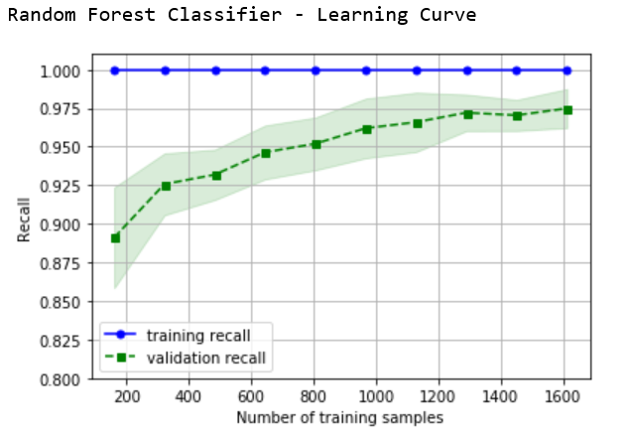
Learning Curve
The learning curve for Random forest algorithm is created to evaluate the performance of the model on training and validation(or test) data.
From the figure, it is analysed that model correctly predicts on training data as the model is trained on it.
The main purpose of this learning curve is to see the prediction on validation or test data, as the instances of dataset increases the model tries to fit perfectly. So, this model seems a right fit for this dataset.
Notes:
Learning curve is the powerful tool to let us know how the model performs at various number of instances and this model seems a right fit for this dataset therefore recall of testing data is exponentially increasing.

Slide 10
Optimized model
The model correctly identified 103 patients and misclassify 9 patients who do not have cancer
The model correctly identified all the 224 patients who have cancer.
The optimized model is created using cross validation and Grid Search Optimization technique.
The optimized model misclassify more patient than standard model. Also, the optimized model give 1% less accurate model than standard model.
Note:
Cross-Validation: It measure the performance of the model on new test data by dividing the dataset into training set and testing set.
Grid Search: It trains the algorithm for all combinations by using learning rate and number of layers. It calculates the best parameters of the model using cross validation technique.
Notes:
The optimized model is run with grid search technique but the model does not make any benefit to the dataset. So, standard model is better than optimized model.

Slide 11
Insights from Analysis
All the models give better prediction for patient who has cancer (Class 1) compare to patient who do not have cancer (Class 0).
The standard model outperformed the optimized model. Also, the computational cost of standard model is less as it eliminates computational time of optimization techniques.
From the learning curve, it is derived that as the data points are added the validation recall will improve. So, if more data is collected the performance of the model is improved.
Random Forest algorithm suits the dataset of this project better than other algorithms because it is more accurate and fit the dataset perfectly.
Notes:
These are the key insights found out in this project. First is model predicts better for patient who has cancer as it has more data. Second, if more data points added, there is a chances that model can still improve and give better result. Third, the standard model is good enough for this dataset as we are getting 98% accuracy for it. Finally, random forest is the right fit for this dataset as it is not more complex like neural network and not as simple like K-NN.

Slide 12
Conclusion
1) The Random Forest Classifier is successful in detecting all the cancer patients.
2) The Random Forest Classifier is 94% accurate in detecting patient who do not have cancer.
3) The features do not have normal distribution of the data and are highly co-related with each other that depicts, the more co-related the independent variables are, it results into better prediction of the cancer because intuitively the cell structures of an individual’s patient body are similar.
Notes:
This slide represents the answers to the three key question that we addressed before starting the project.

Slide 13
Further Questions
Would the model give better prediction if more data of the patient is collected?
Does there any machine learning model that gives 100% accuracy?
Does not removing the outliers in this project is considered as an advantage, but would the model performs better if similar kind of data is collected?
Does the model helping the Princess Margret Hospital to make the informed decisions in detecting the cancer?
Notes:
The objective of the project is achieved but there might be some further question arises which are demonstrated in this slide.

Slide 14
APPENDIX

Slide 15
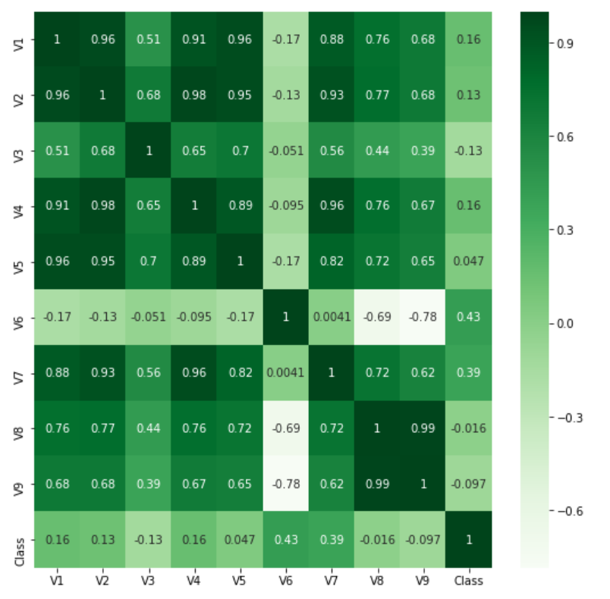
Correlation Heat Map
It shows the correlation between all the features of the dataset. From the figure, it can be said that the variable are highly correlated with each other.

Slide 16
Classification Report
It demonstrates the results of key metrics for the model. The explanation of classification report metrices are as follows:
Precision: It tells us how often the model is correct when it makes the prediction
Recall: It is the ratio of correctly classified the positive instances from the total number of positive instances or correctly classified negative instances from the total number of negative instances i.e. It identifies all the relevant instances from retrieved instances
F1-Score: It is the harmonic mean of precision and recall
Accuracy: It is the ratio of the number of correct predictions to the total number of predictions made i.e. It represents the percentage of predictions that model got right

Slide 17
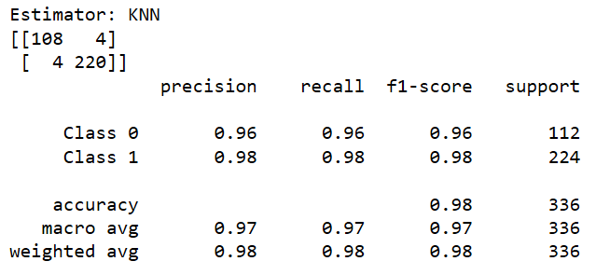
K-NN model
The reason for choosing this model is that it is a simple machine learning model and it does not make any assumption about distribution of the data. It classifies the data points analysing nearest neighbour from the training set.
Figure: Confusion matrix and classification report of K-NN

Slide 18
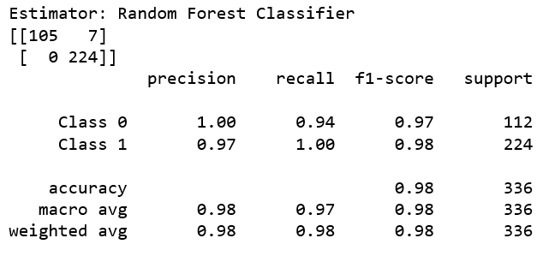
Random Forest model
It is a classification algorithm consist of multiple decision trees. The reason for choosing this model is that it operates as ensemble i.e. class with the most votes is selected for prediction.
Figure: Confusion matrix and classification report of Random Forest

Slide 19
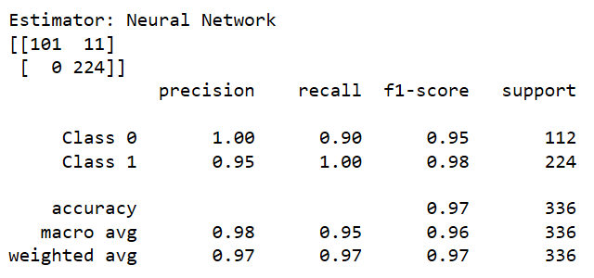
Neural Network model
The reason for choosing this model is that it has the ability to perform complex problems and is good at handling large amount of data. It tries to mimic the brain by running the data points through various hidden layers and provides the final output in terms of prediction.
Figure: Confusion matrix and classification report of Neural Network

Slide 20
THANK YOU

